Slide 1
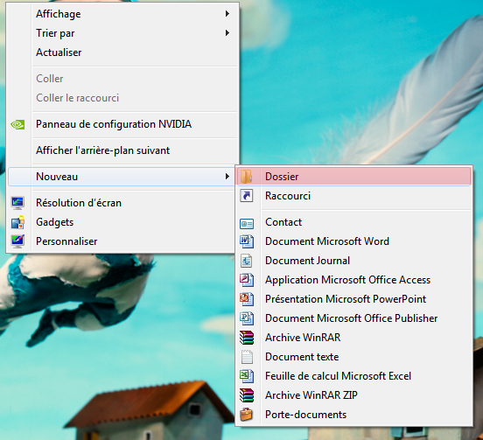
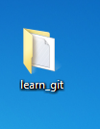
Creating a folder called learn_git

Slide 2
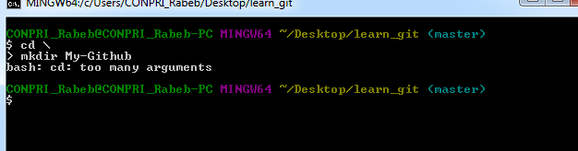
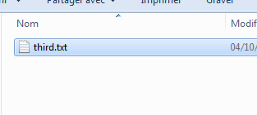
Cd (change directory) into the learn_git folder
Create a file called third.txt

Slide 3


Initialisation an empty git repository

Slide 4


Add third.txt to the staging area
Commit with the message "adding third.txt".

Slide 5

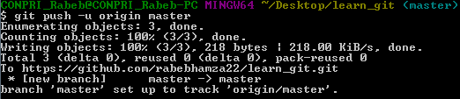
Check out your commit with git log

Slide 6

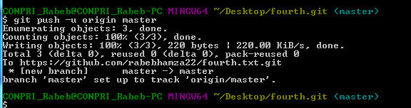
Create another file called fourth.txt

