Slide 1
NOTETECH SYSTEM Drive Student Success
TEAM :
Abdelrahman Mahmoud Rabea Adel
Ahmed Mansour Ashraf Gamal

Slide 2
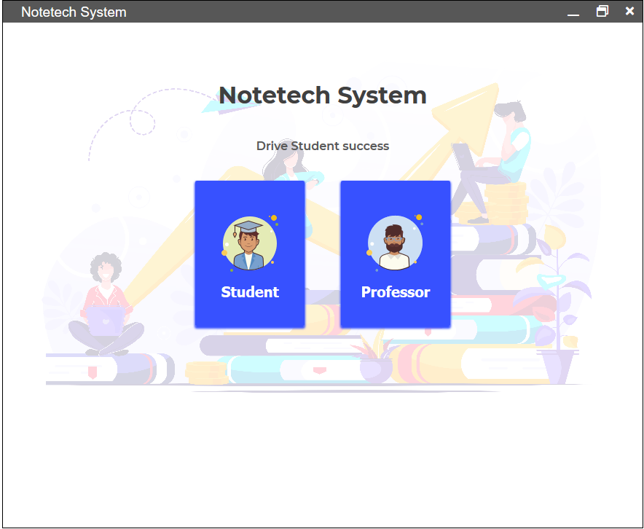
NOTETECH SYSTEM

Slide 3
NOTETECH SYSTEM
NOTETECH is an application that acts as an assistant to every professor and student at any place , it offers a lot of functions that help every body to accomplish his / her tasks easily & effectively.

Slide 4
Our Home Page

Slide 5
OVERVIEW
OUR APP HAS TWO USERS
Professor
Student
Lets start by Professor User Interfaces…

Slide 6
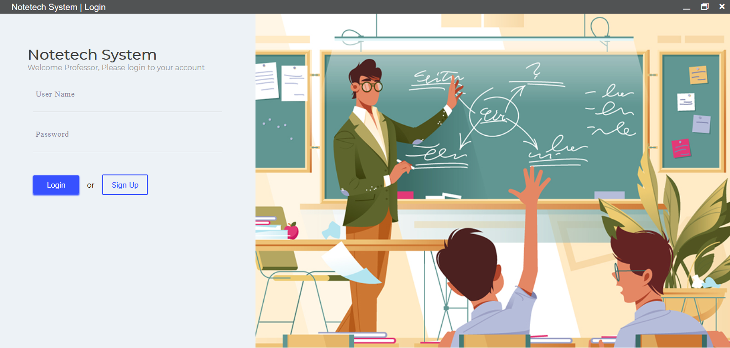
Login

Slide 7
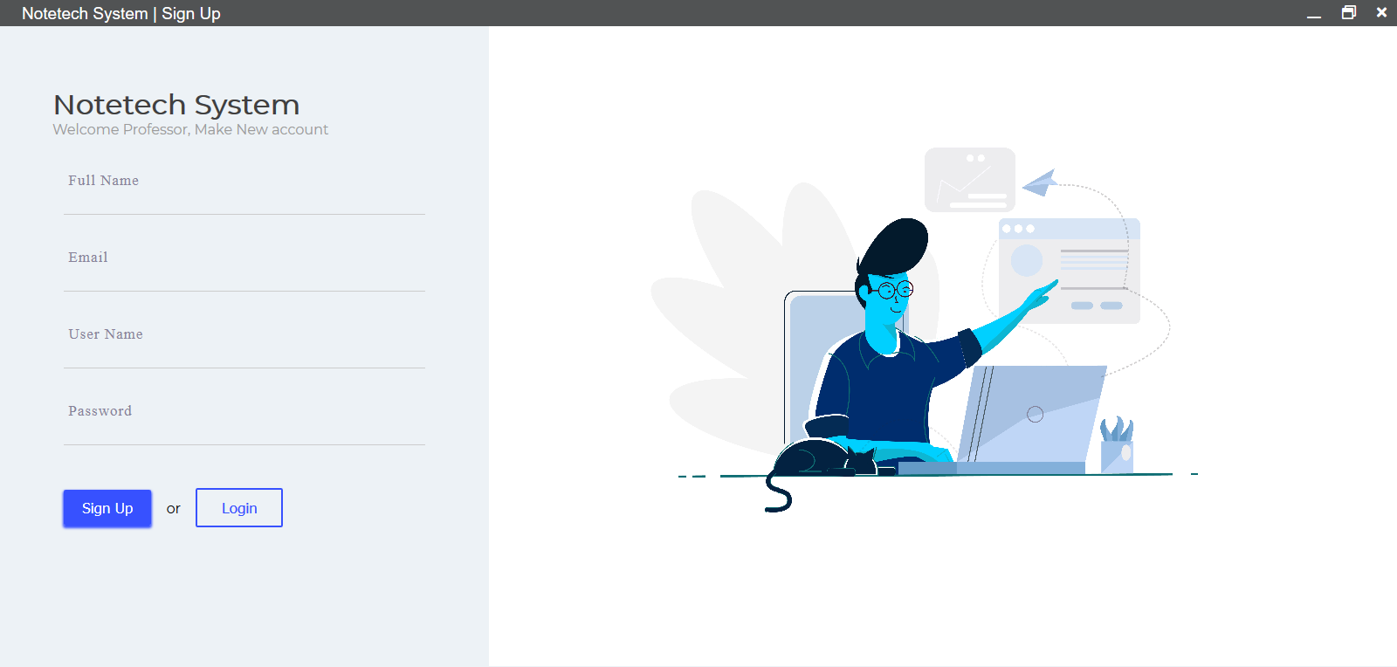
SIGN UP

Slide 8
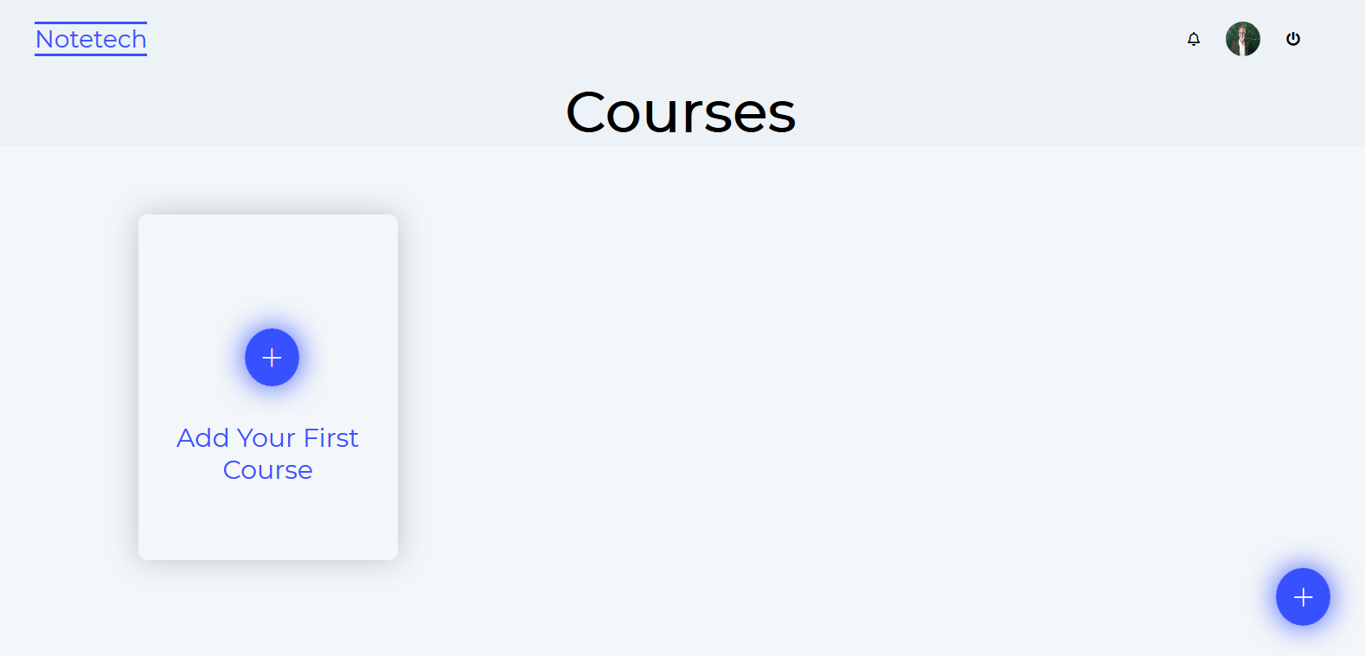
First time professor create account

Slide 9
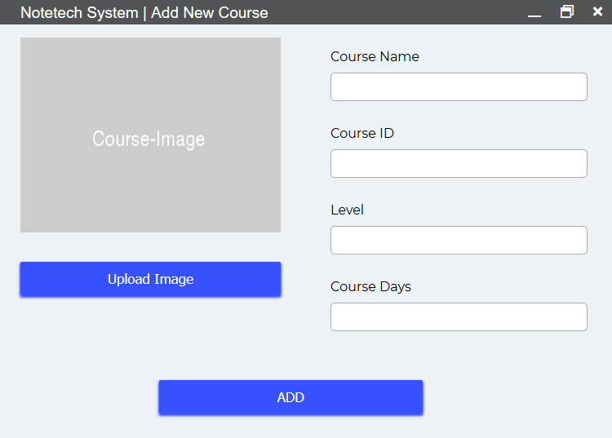
Add or remove Courses

Slide 10
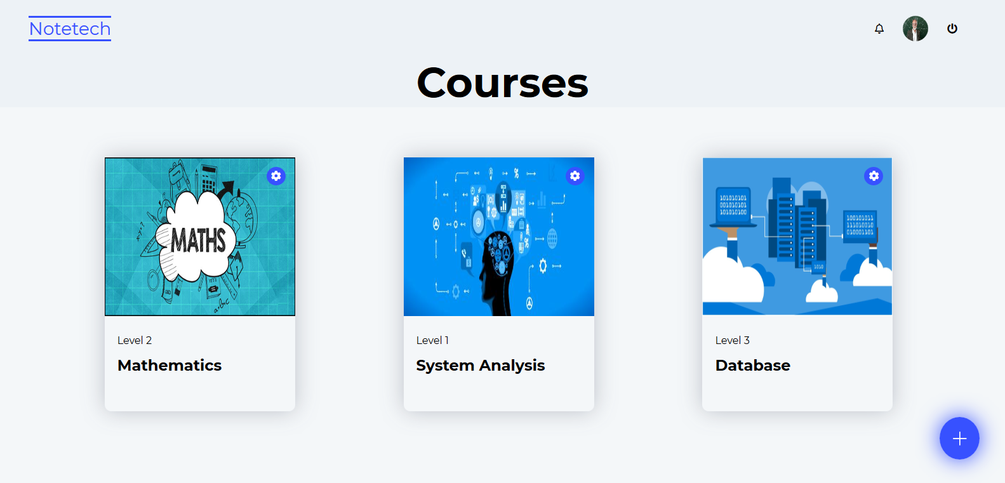
View Courses

Slide 11
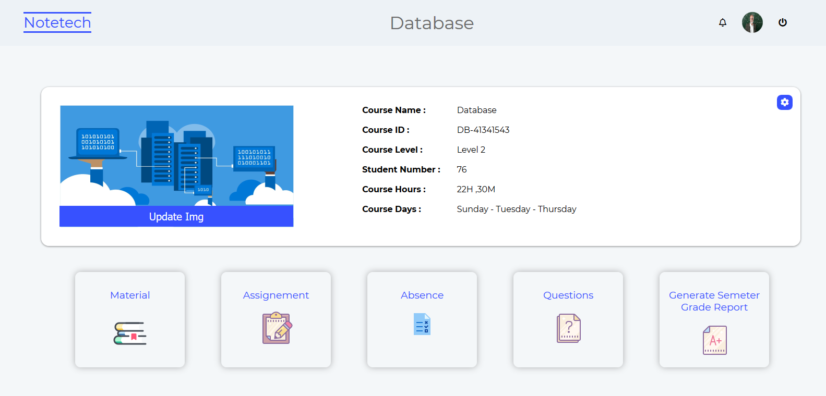
View Courses Statics

Slide 12
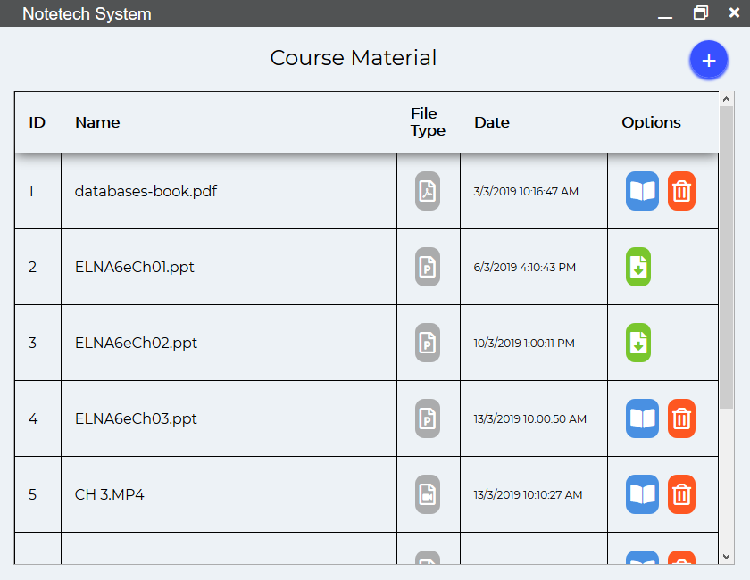
UPLOAD MATERIAL

Slide 13
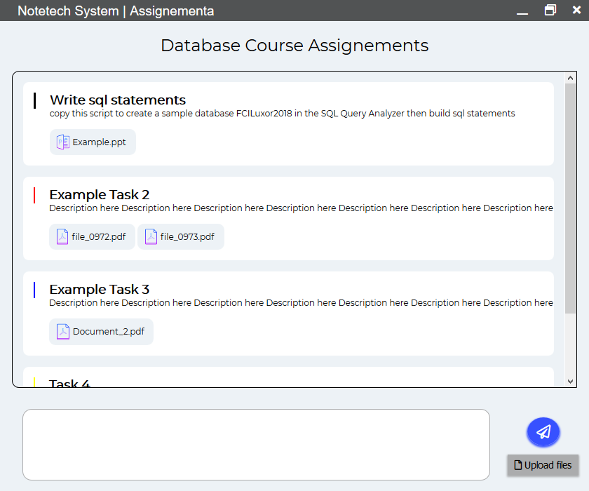
Add Assignments

Slide 14
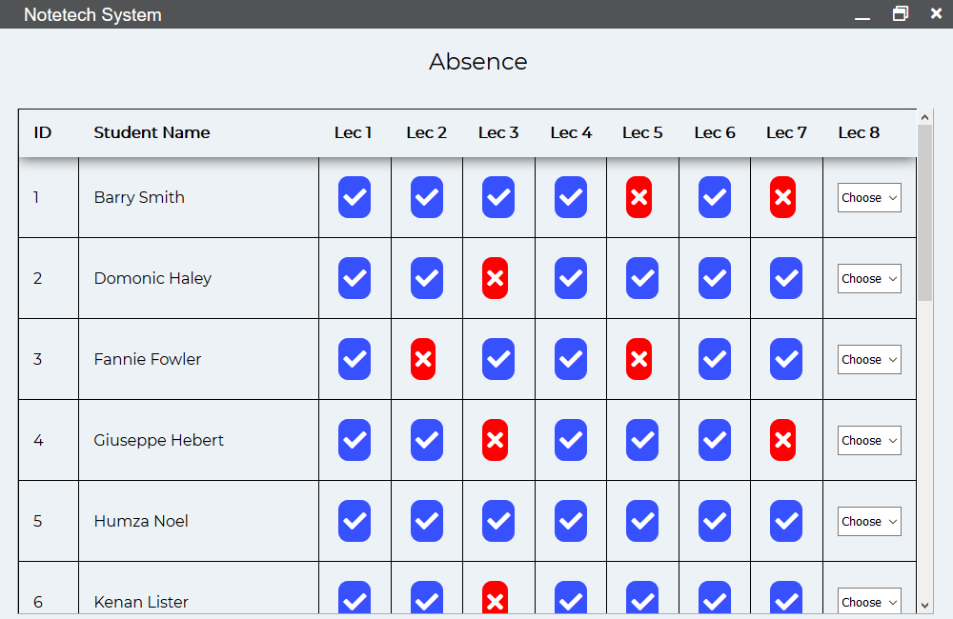
View Absence

Slide 15
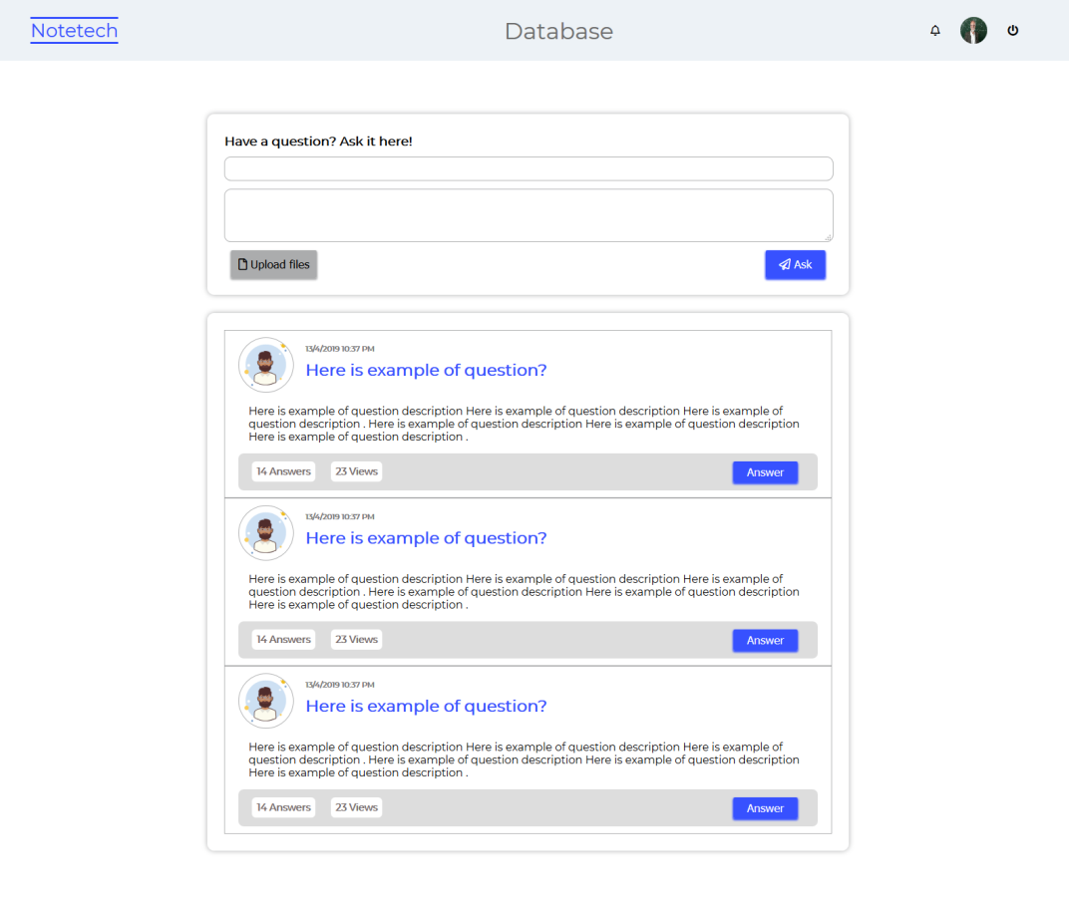
VIEW & ANSWER QUESTIONS

Slide 16
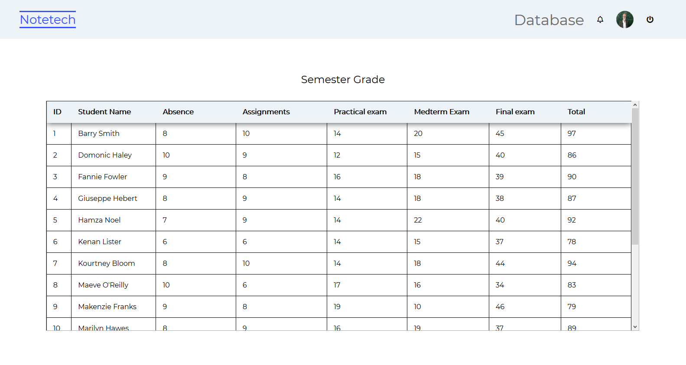
Semester Grade

Slide 17
LETS
GO
TO
Student
FRAMES

Slide 18

Login

Slide 19

Sign up

Slide 20
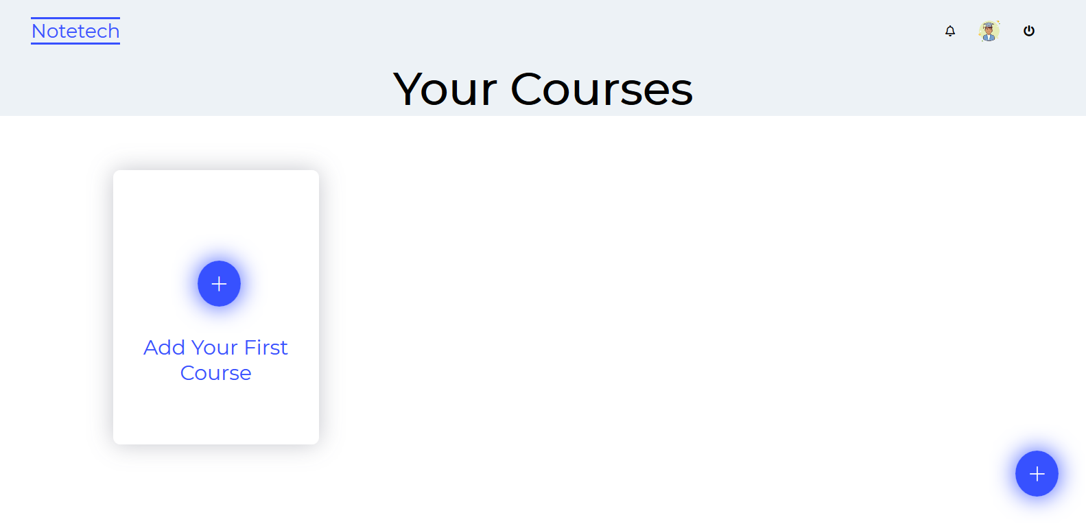
First time student create account

Slide 21
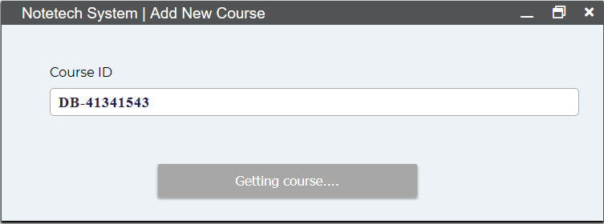
Join Courses

Slide 22
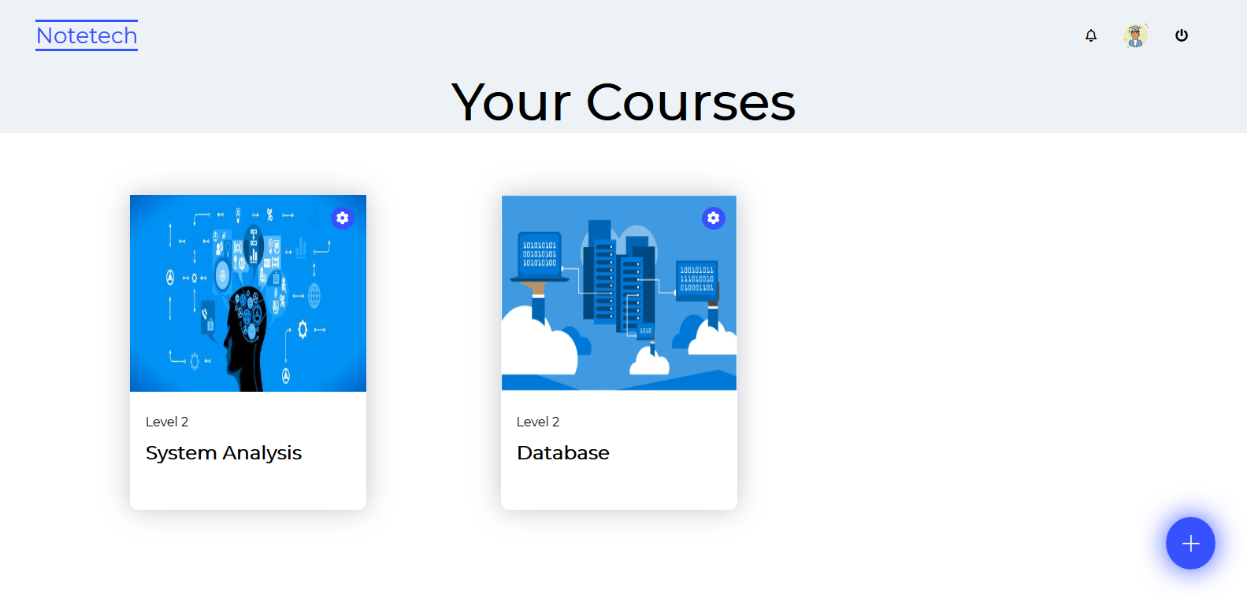
View Courses

Slide 23
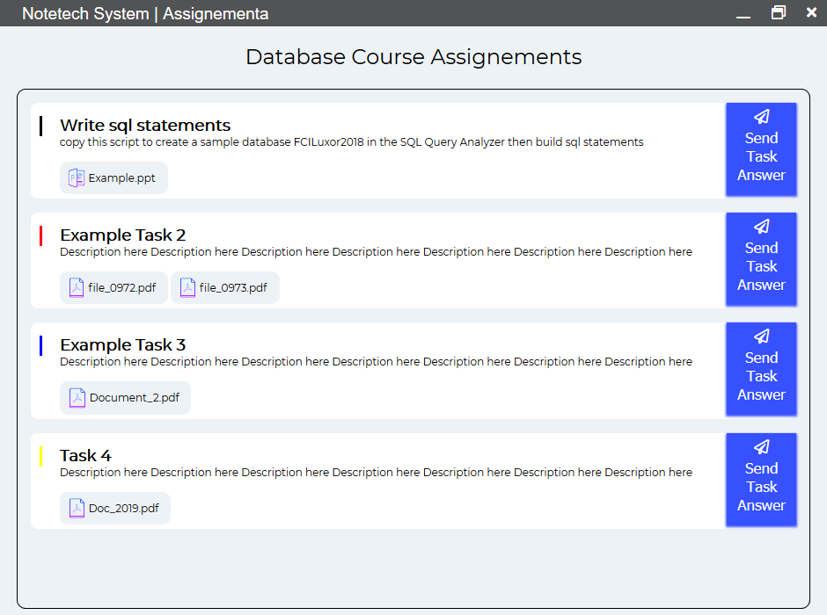
View & Upload Solution

Slide 24
View & download Material

Slide 25
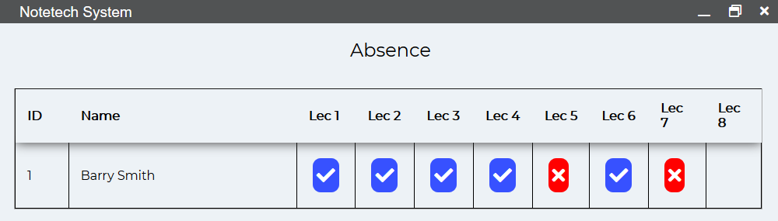
View His / Her absence

Slide 26
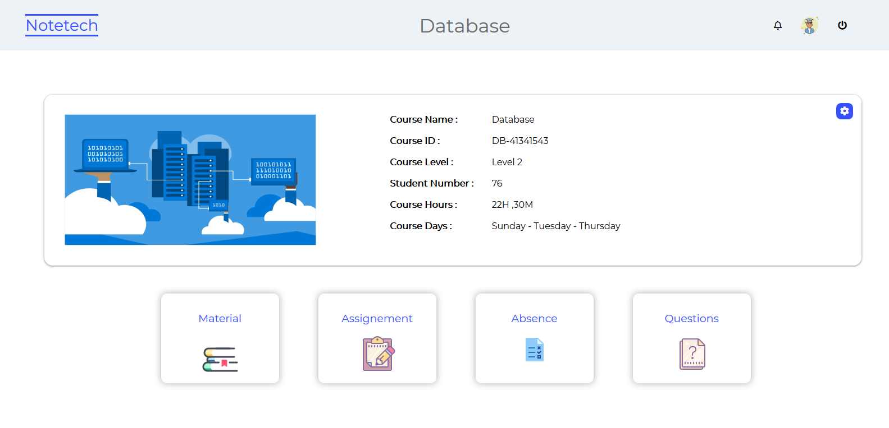
View His / Her Statics in a course

Slide 27
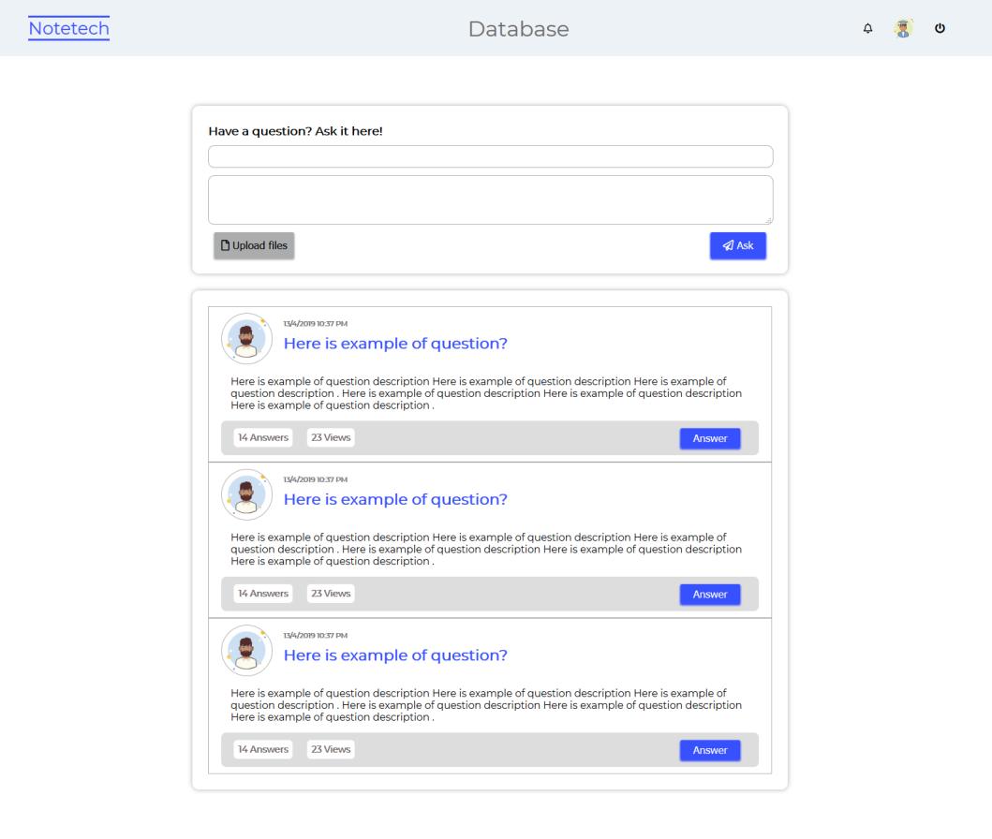
ASK & ANSWER Questions

Slide 28


