Slide 1
network programing
chat server with RSA encryption
rabe Adel

Slide 2
Chat server is chat room between two or more client the Messages they sanded it encrypted with raps algorithm no can see the Messages only clients use the same two primes number

Slide 3
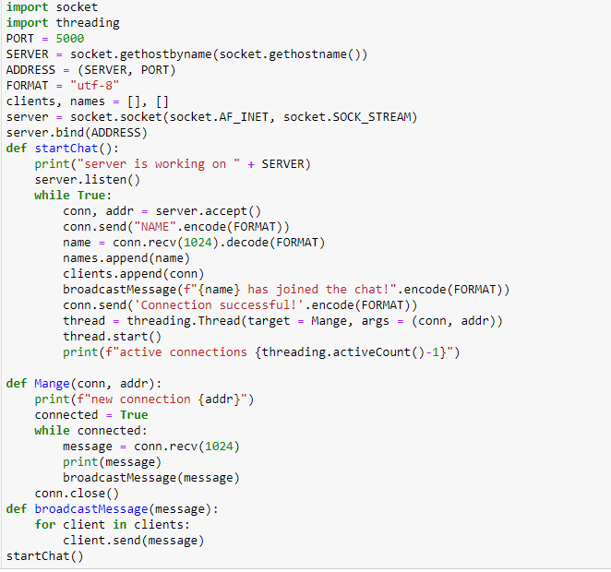
SERVER

Slide 4
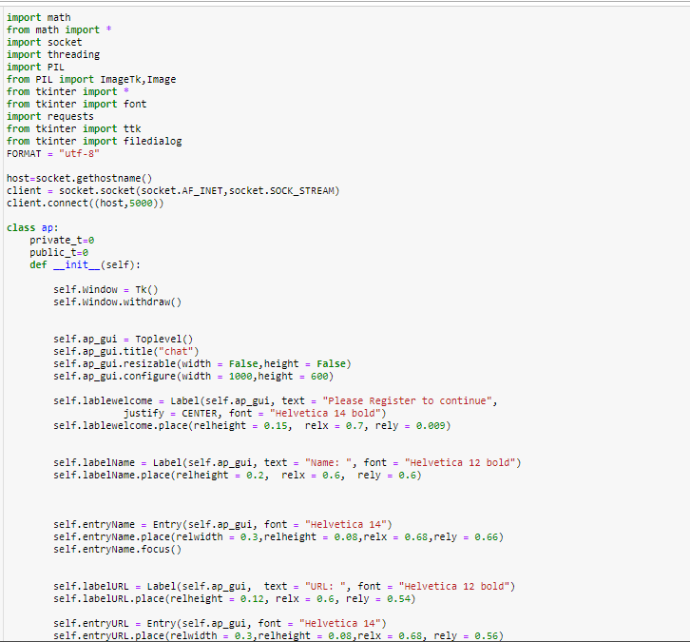
client

Slide 5
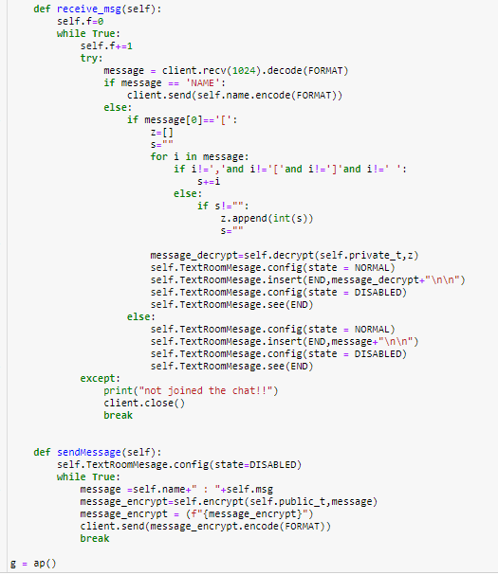
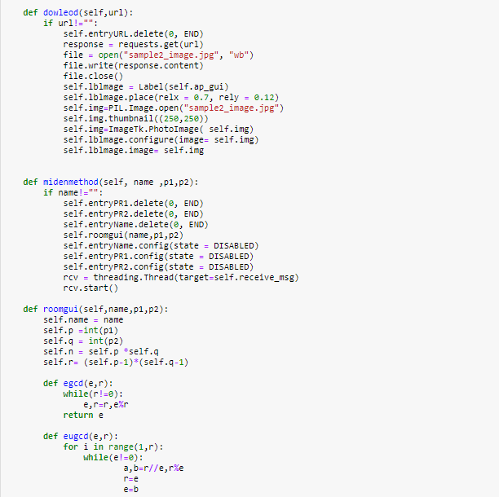
client

Slide 6
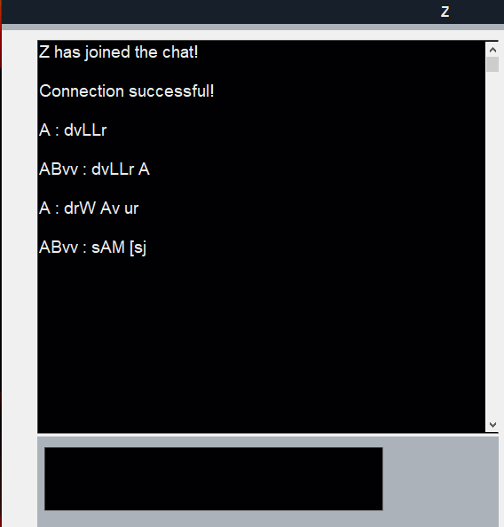
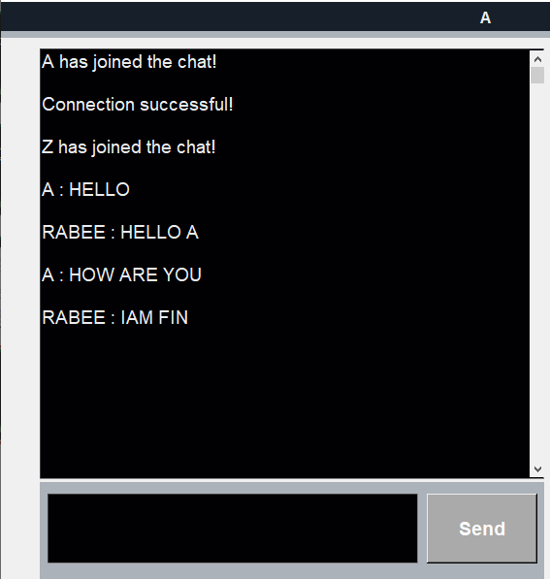
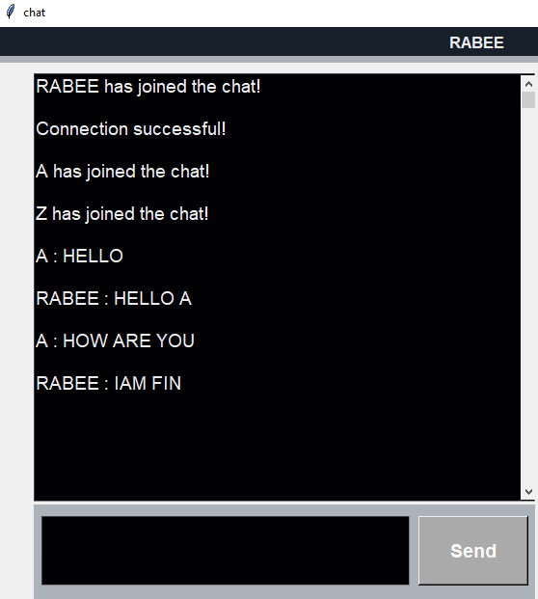


Slide 7

THANKS
YOU
FOR LISTENING

