Slide 1
CUSTOMER SHOPPING BEHAVIOR
Customer shopping behavior,
in one view
A concise Data Driven Presentation on revenue, loyalty, subscriptions, demand signals, and the next operating moves.

Slide 2
THE DATASET
A $233K dataset reveals a repeat-buyer business
3,900
$59.7
3.75
purchases
average purchase
average review rating

Slide 3
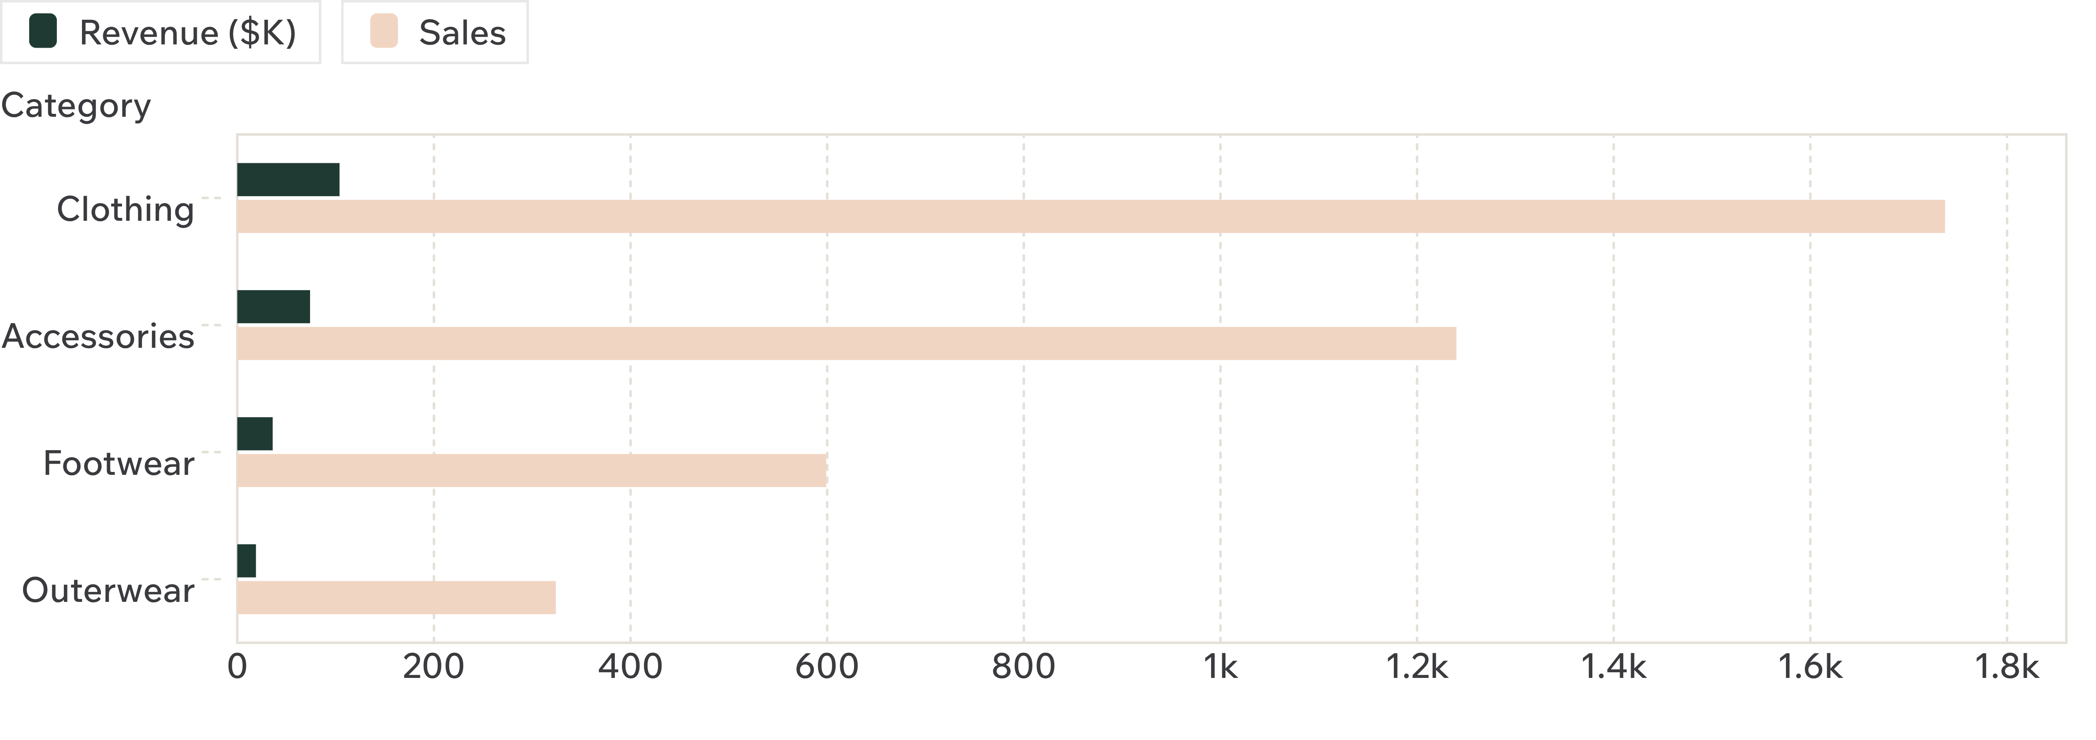
CATEGORY MIX
Clothing drives the business, with accessories close behind
Clothing is the clear scale engine; accessories is the strongest secondary category.

Slide 4
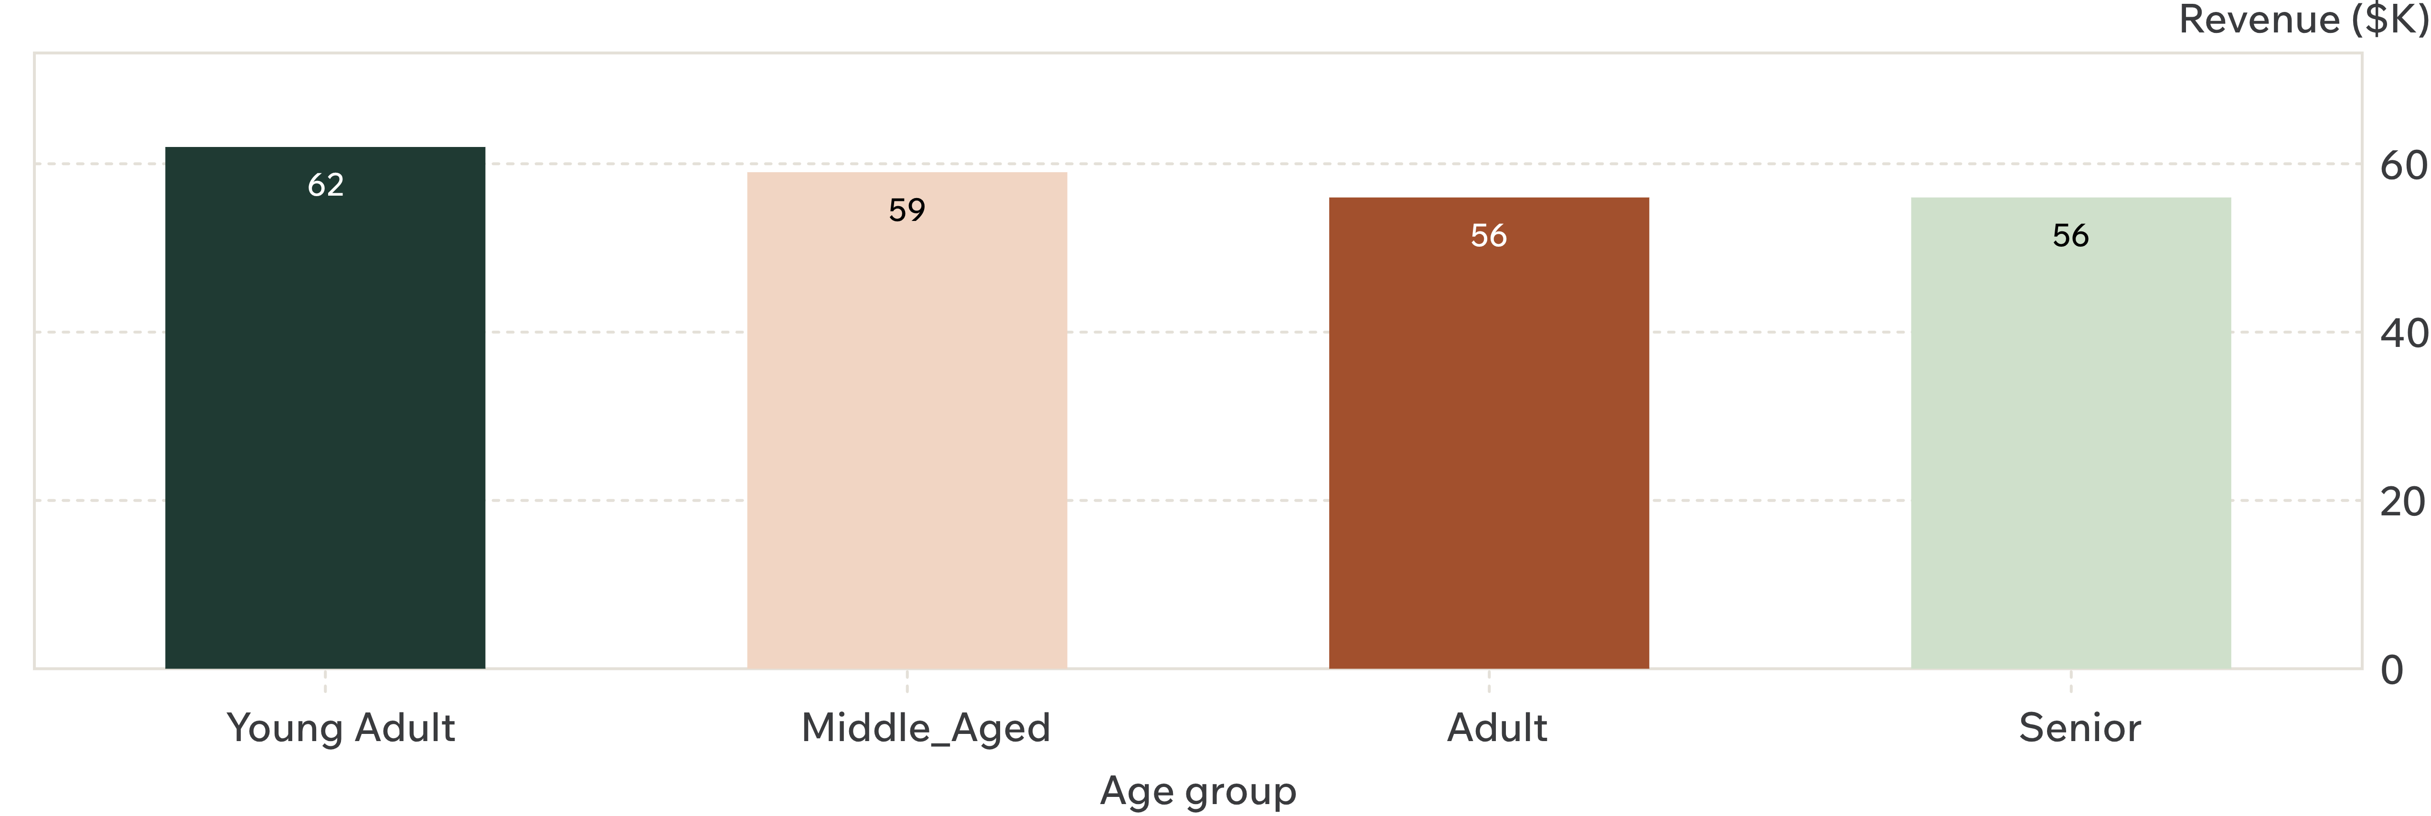
AGE MIX
Young adults lead revenue, but the age mix is balanced
Young adults contribute the most, but no single age group dominates the business.

Slide 5
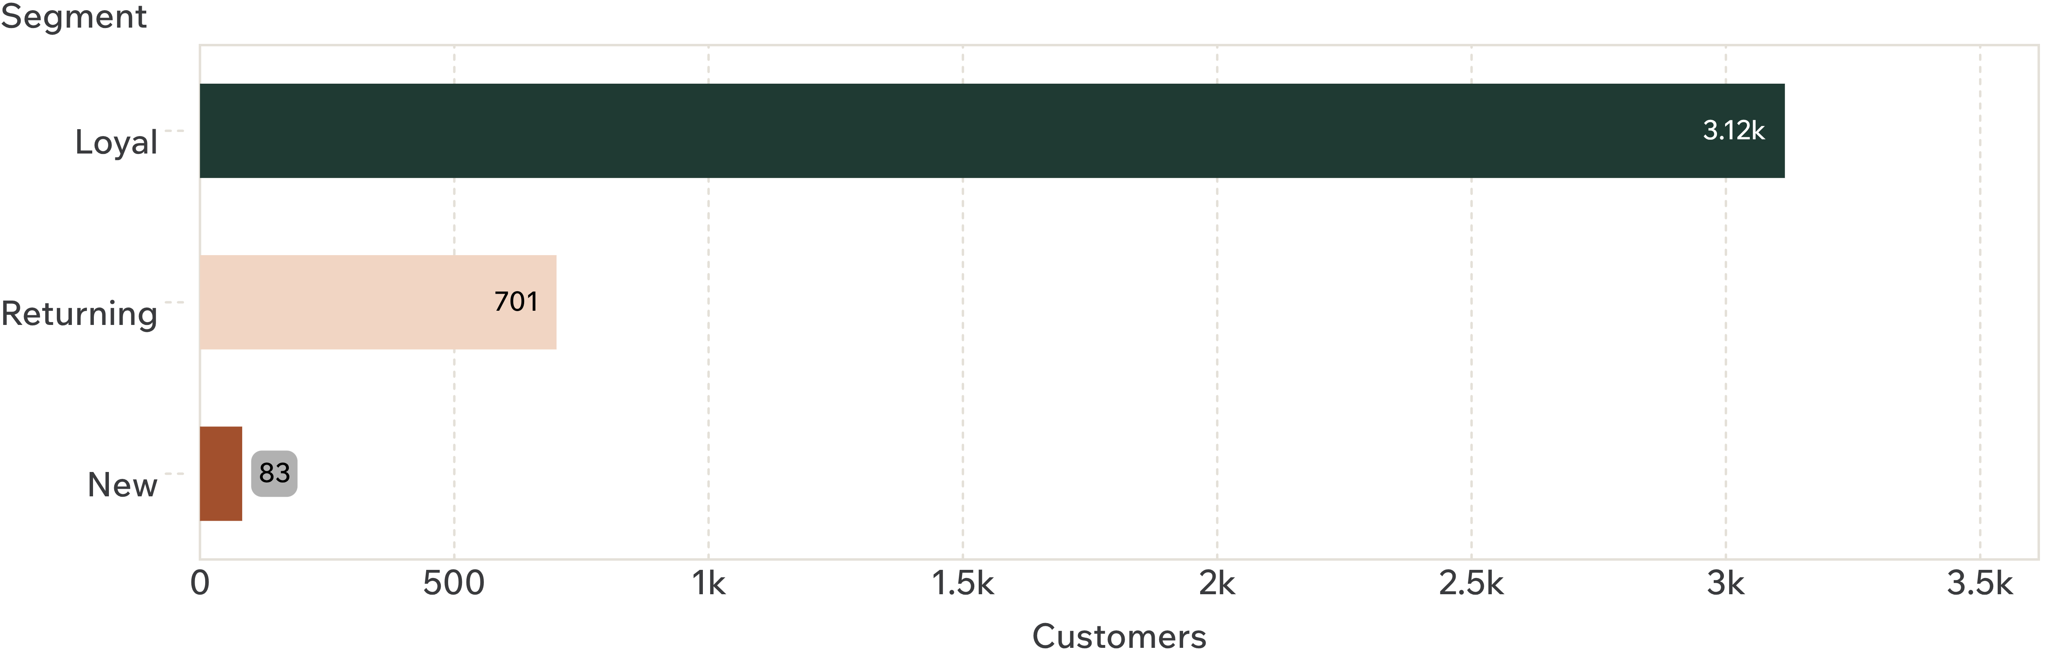
CUSTOMER SEGMENTS
Loyalty is the biggest asset — and the biggest unlock
Move returning buyers into loyal behavior while keeping the top of funnel healthy.

Slide 6
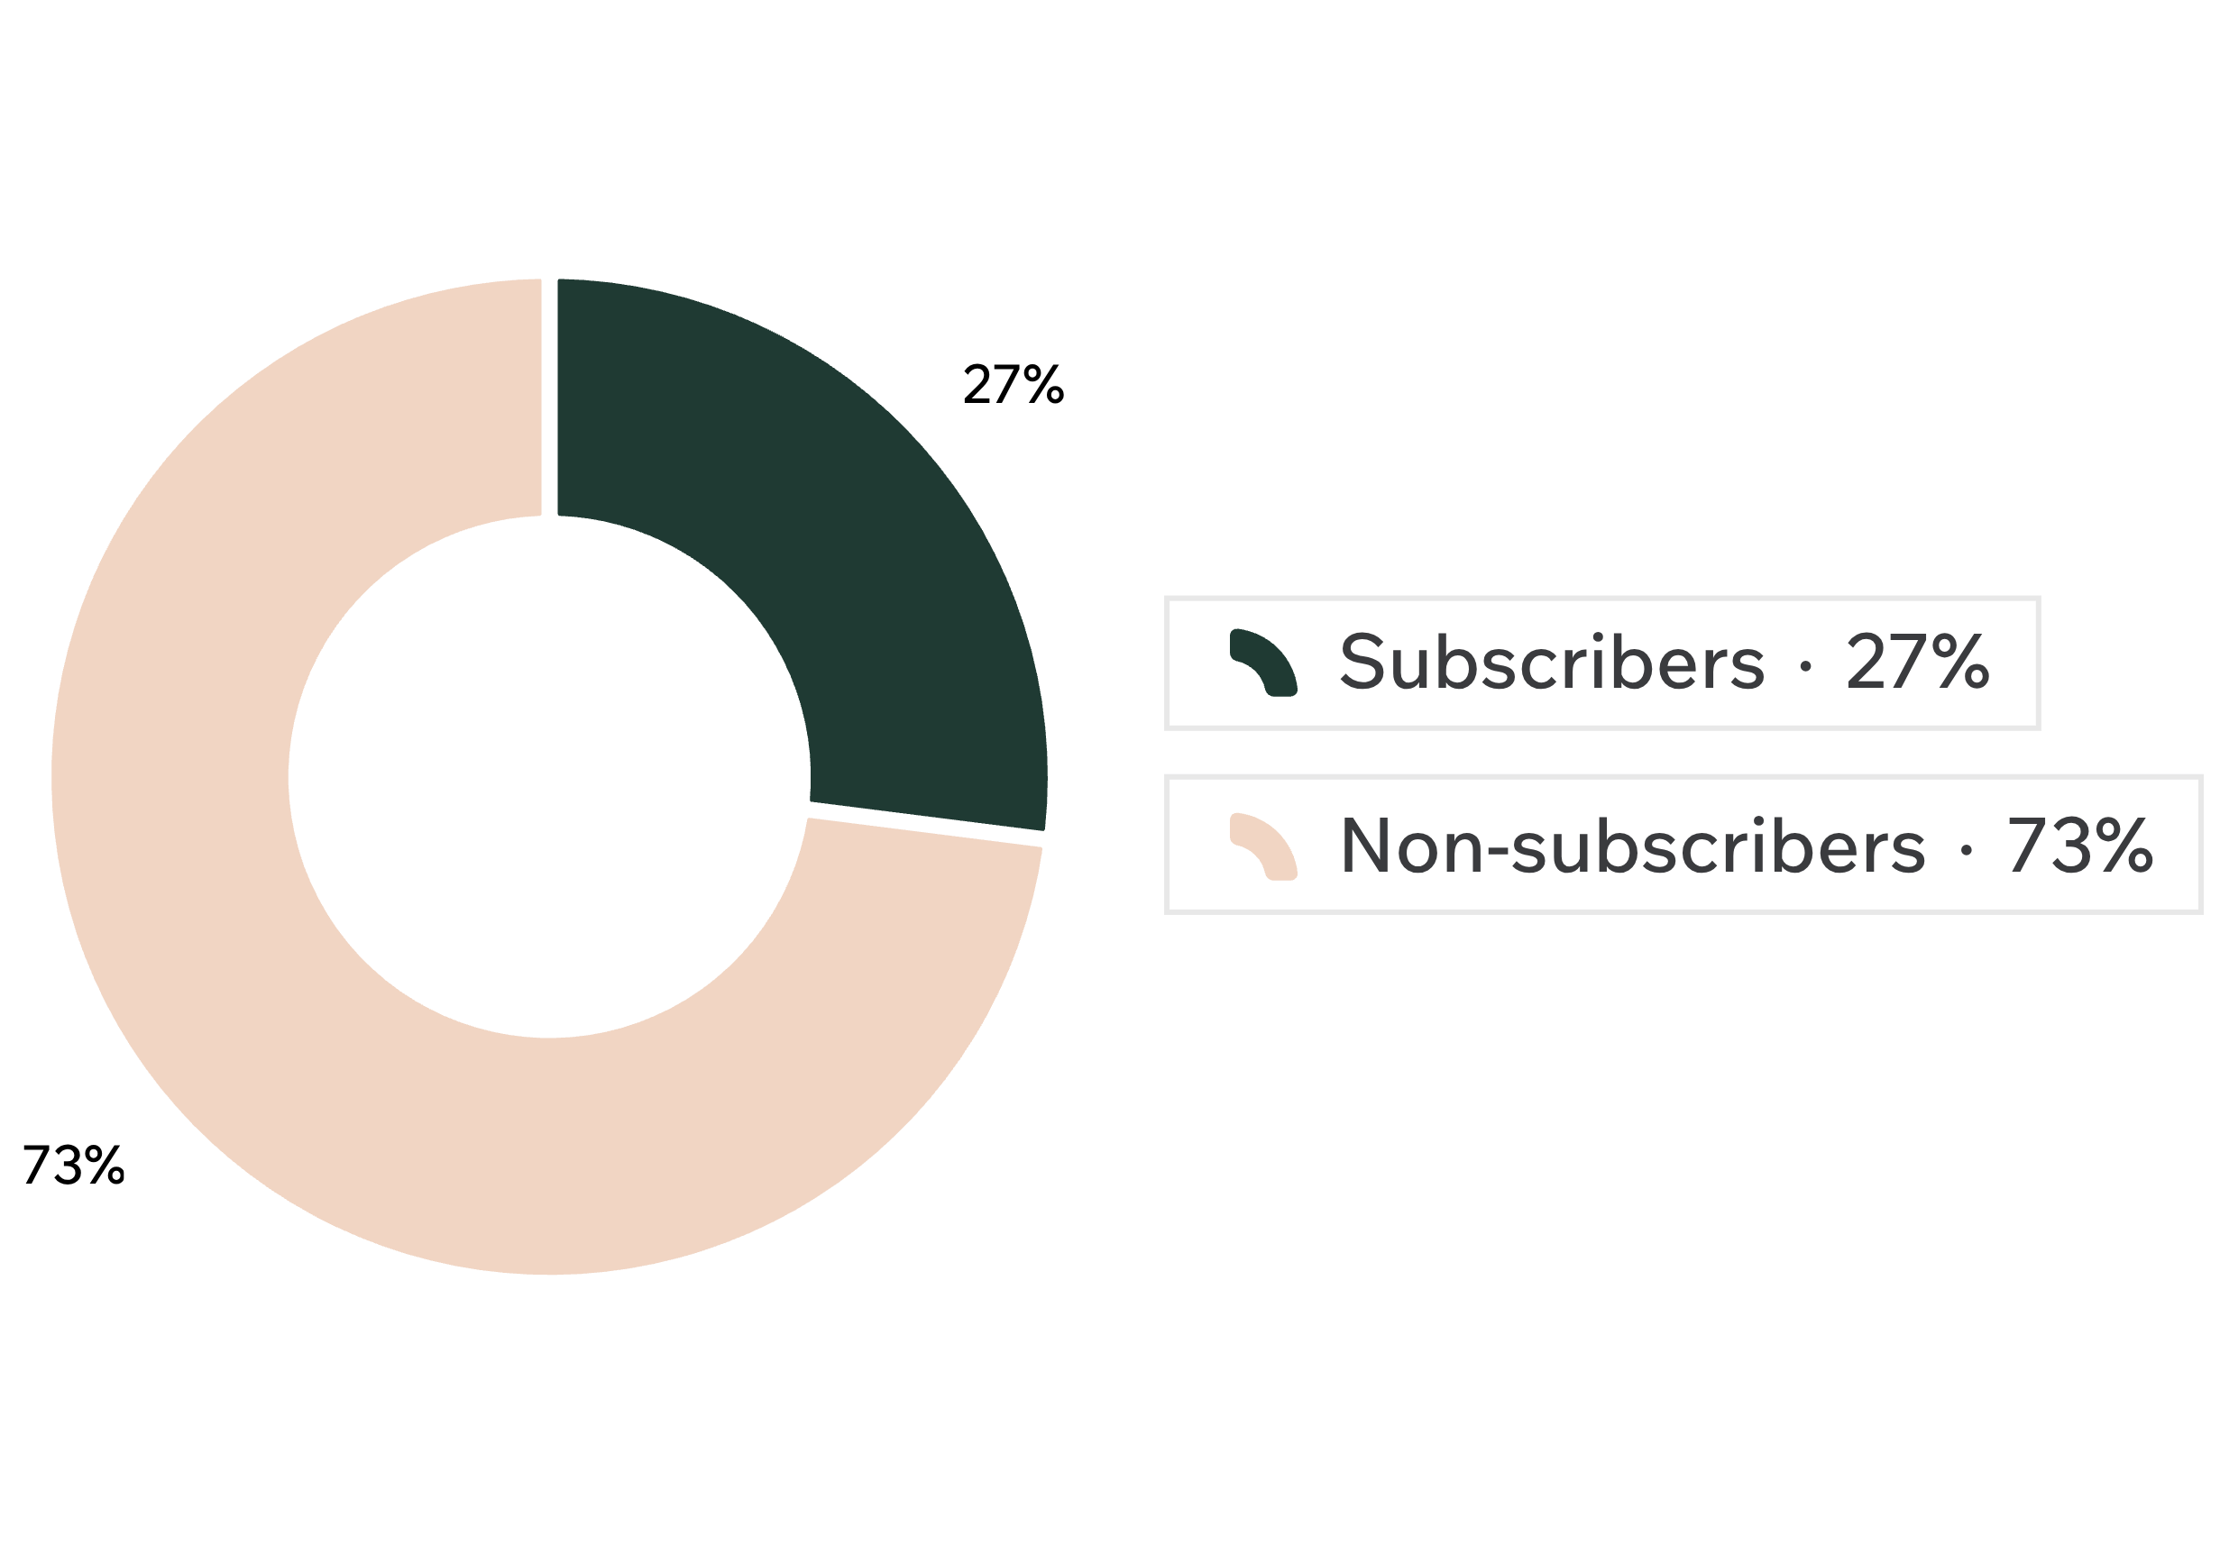
SUBSCRIPTION MIX
Subscriptions are underpenetrated, not under-relevant
27%
of customers are subscribers: 1,053 total, $62.6K revenue.
Non-subscribers represent 73% of customers: 2,847 total, $170.4K revenue.
Average purchase is nearly flat: $59.49 subscribed vs. $59.87 not subscribed.
The opportunity is conversion and retention value, not simply a higher basket size.

Slide 7
DEMAND SIGNALS
Discounts influence demand, but they are not the whole value story
50.00%
11
$60.48
Highest discount rate
High-spending discount users
Express average purchase
Hat 50.00%, Sneakers 49.66%, Coat 49.07%, Sweater 48.17%
Express buyers average $60.48 vs. $58.46 for Standard
Identified customers above the average purchase amount
Test targeted incentives and premium fulfillment instead of broad discounting.

Slide 8
PRODUCT SIGNALS
Top products combine volume and satisfaction
Top-rated
Category leaders
3.86
4
Gloves 3.86, Sandals 3.84, Boots 3.82, Hat 3.80, Skirt 3.78
Jewelry, Blouse, Sandals, and Jacket top their categories by orders
Use products that already win on rating or orders as campaign anchors and cross-sell hubs.

Slide 9
THE OPERATING SYSTEM
The growth path is a focused operating system
01
02
03
04
Convert
Reward
Refine
Target
Convert loyal and returning buyers into subscribers with exclusive benefits
Reward repeat behavior to grow the loyal segment
Refine discounting around high-response products and margin thresholds
Target age groups and express-shipping users with relevant offers

Slide 10
NEXT DASHBOARD
What to measure next
Measure | Track
Subscription conversion | Track by customer segment and category
Retention | Monitor returning-to-loyal movement
Promotion efficiency | Compare incremental revenue with discount cost
Product momentum | Pair rating, orders, and repeat purchase behavior
Turn the report into a recurring decision dashboard.

