Slide 1
Let us try Something

Slide 2
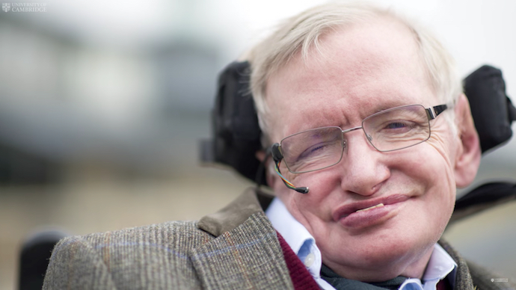
ALS
Amyotrophic lateral sclerosis (ALS), also known as motor neuron disease (MND) or Lou Gehrig’s disease, is a specific disease that causes the death of neurons controlling voluntary muscles.

Slide 3
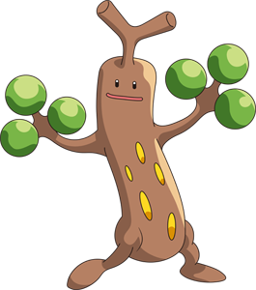
Appname
By sudowoodo

Slide 4
Demo
sudowoodo

Slide 5






sudowoodo

Slide 6
The Future
Learn the behaviour of the patient using Machine Learning and implement a system which suggests different ideas to improve the quality of life.
Add a Medicine Tracking System which keeps track of all the medicine doses and reminds the caretaker to give the medicine at the right interval.
Implement a heart pulse graph and a sleeping tracker to UI.
sudowoodo

Slide 7

Thank You!
/rabeehrz
sudowoodo
/AbhishekS-2099
/zeref134
/alanaby01

