Slide 1
Intro
An ideal voting system must come with its sets of criteria and principles on which an individual having a certain data that matches the criteria falls in the category of Eligibility.
Which includes the following:
Name
Citizen ship
Age
Gender
CNIC (proof of his nationality)
His Status (in country/or/abroad/or/visiting)
Employment
Type of Employment
With the most important being:
Citizen ship (person voting must be of this country)
Name (person uses his real name or not to fake it)
CNIC (person has proof of his nationality)
Age (person must be at least 18)

Slide 2
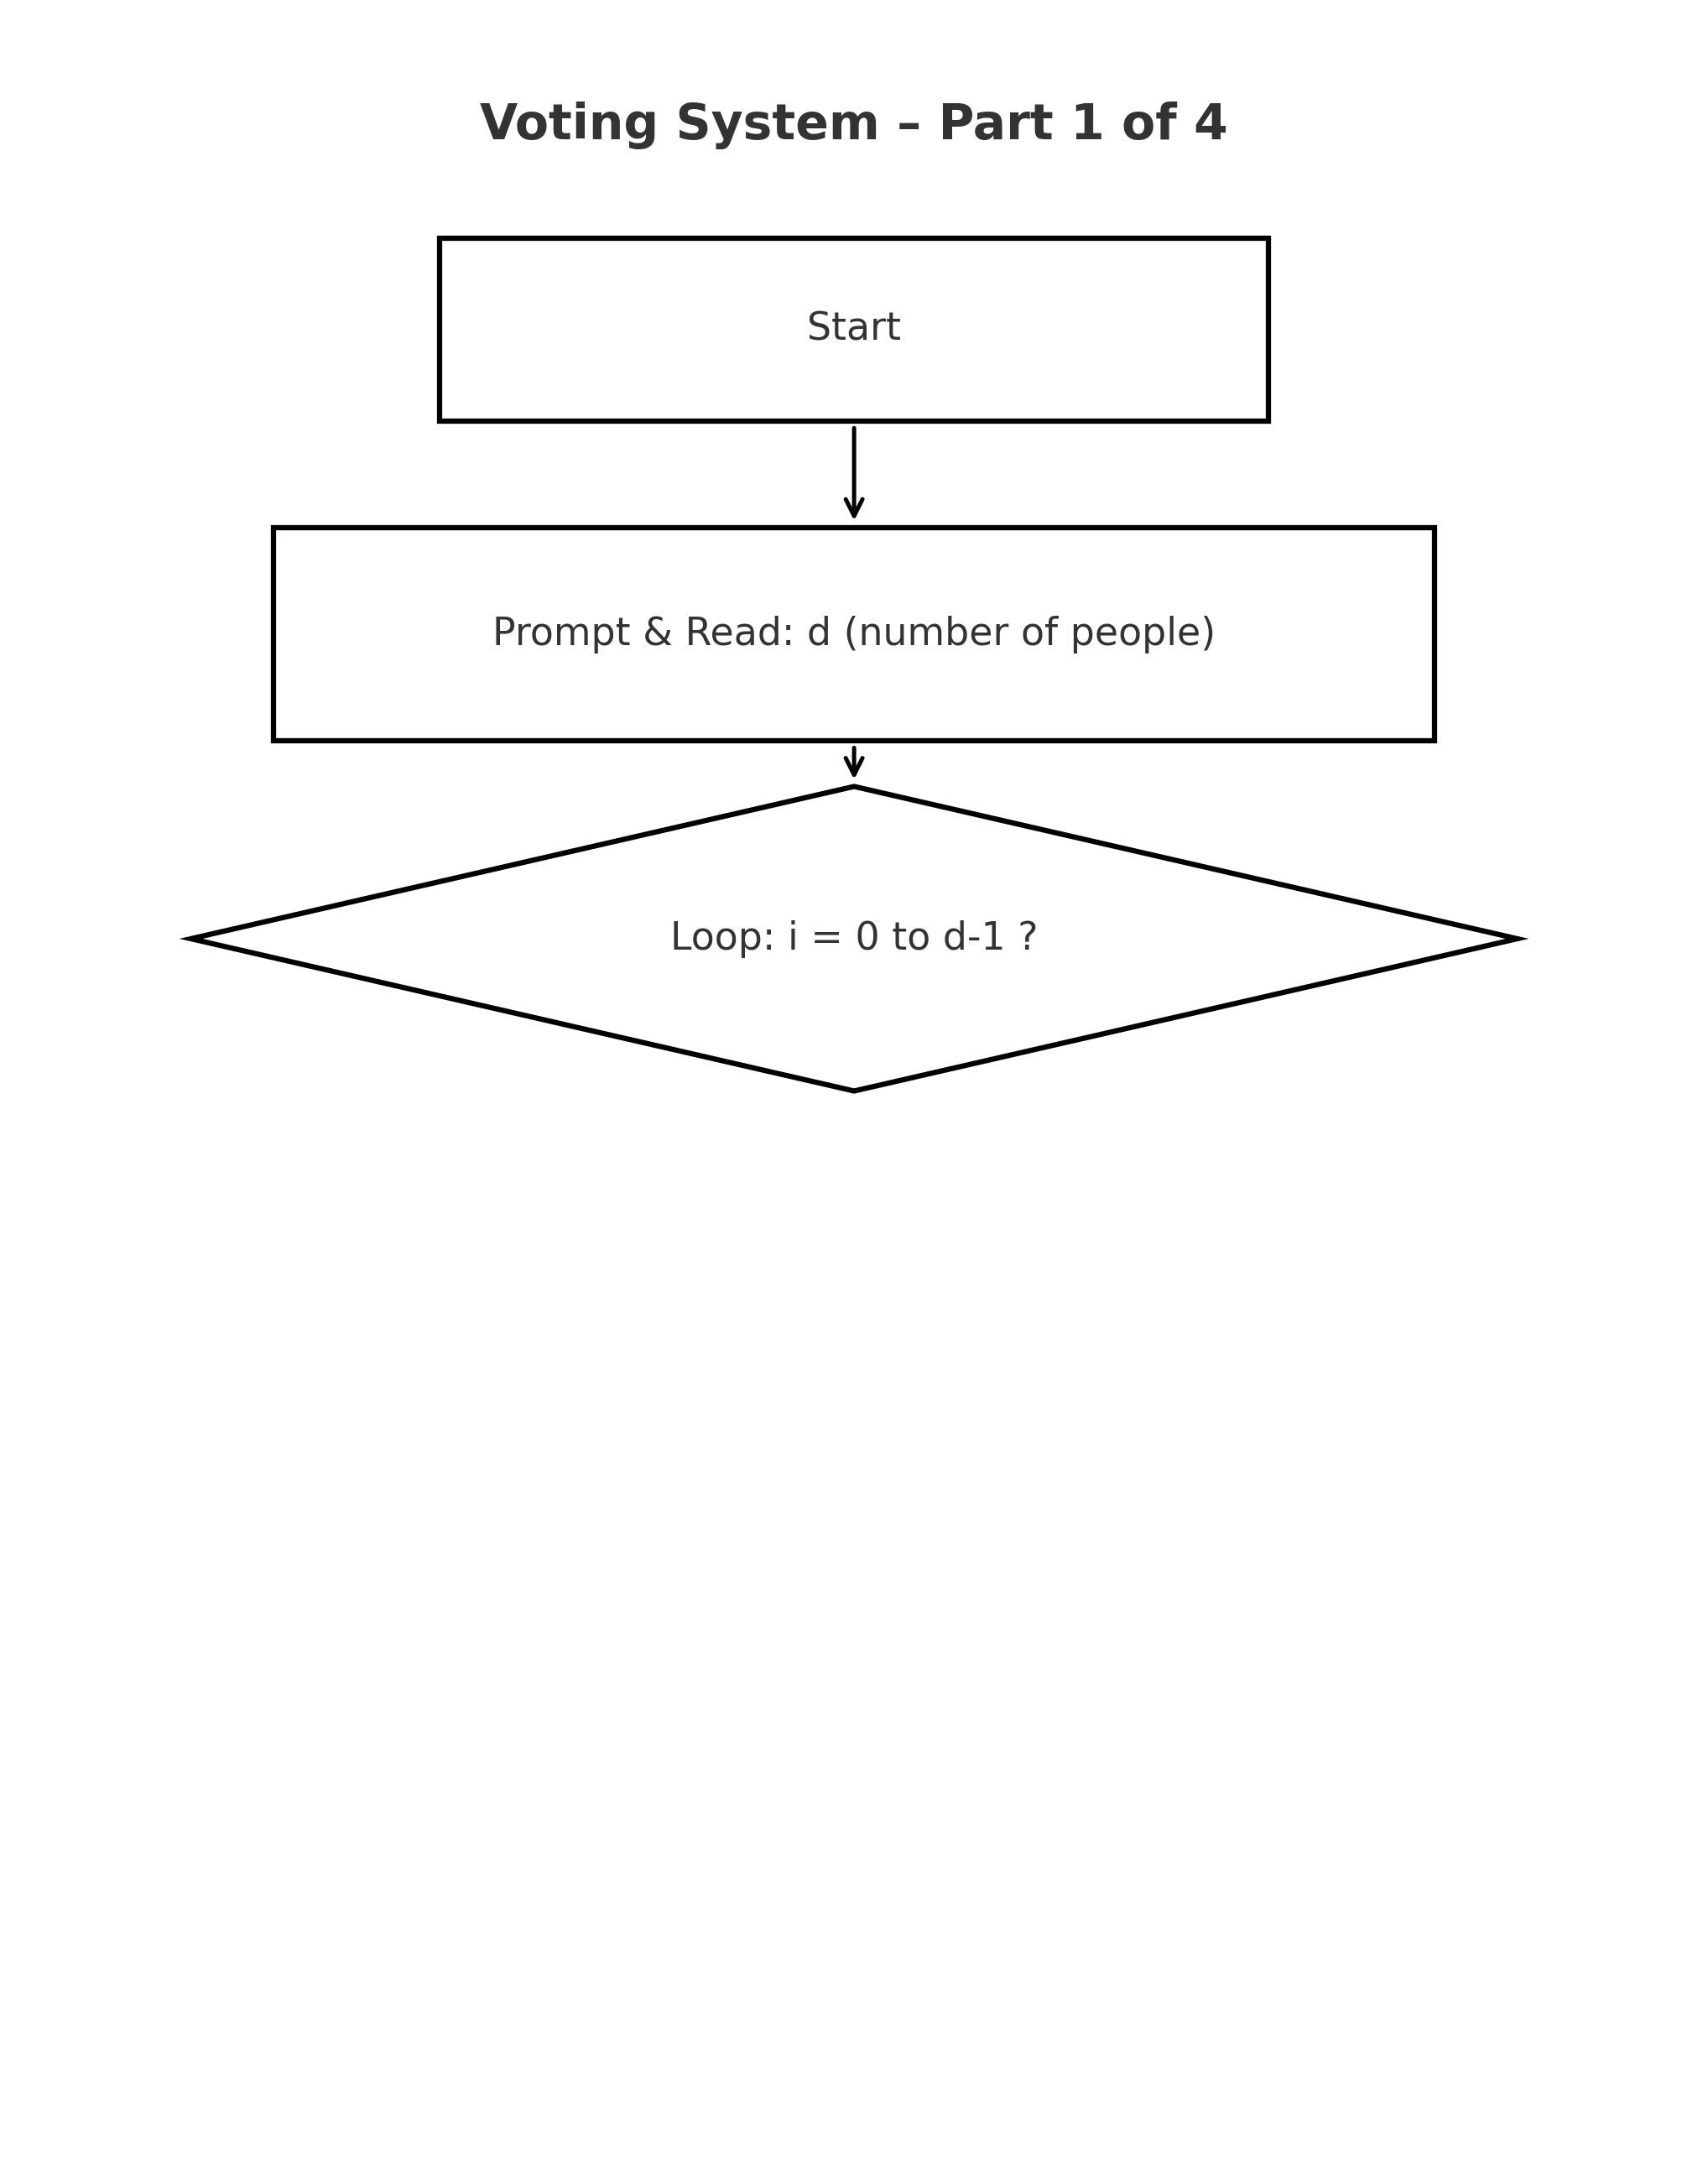
Flowchart

Slide 3
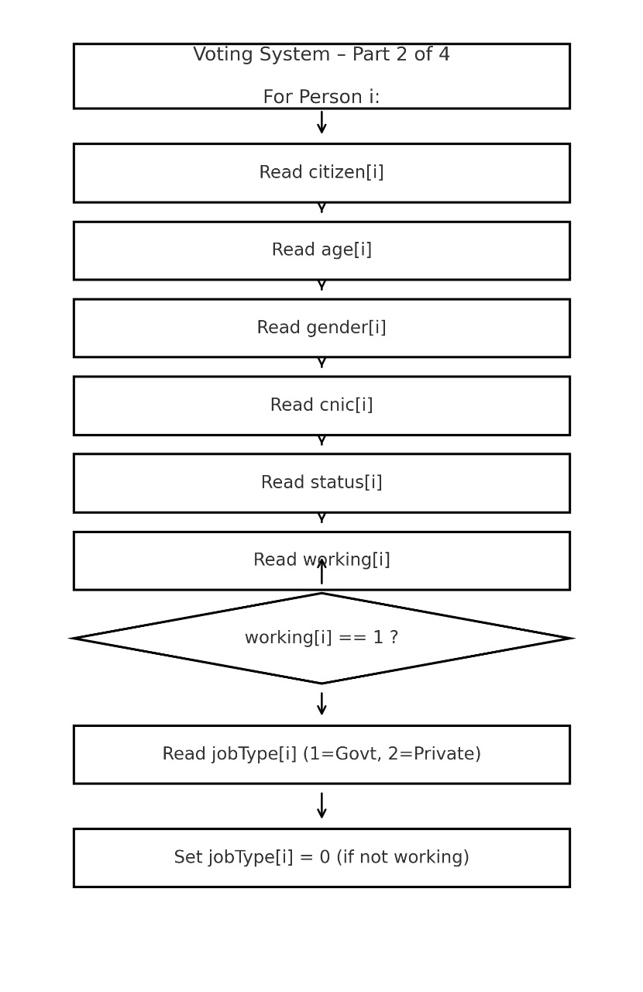

Slide 4
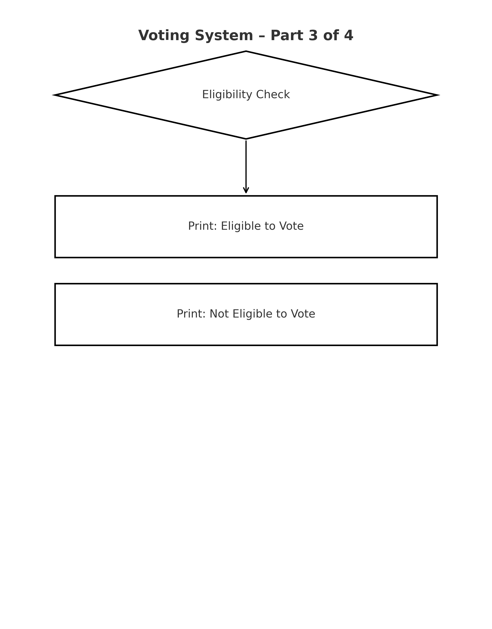

Slide 5
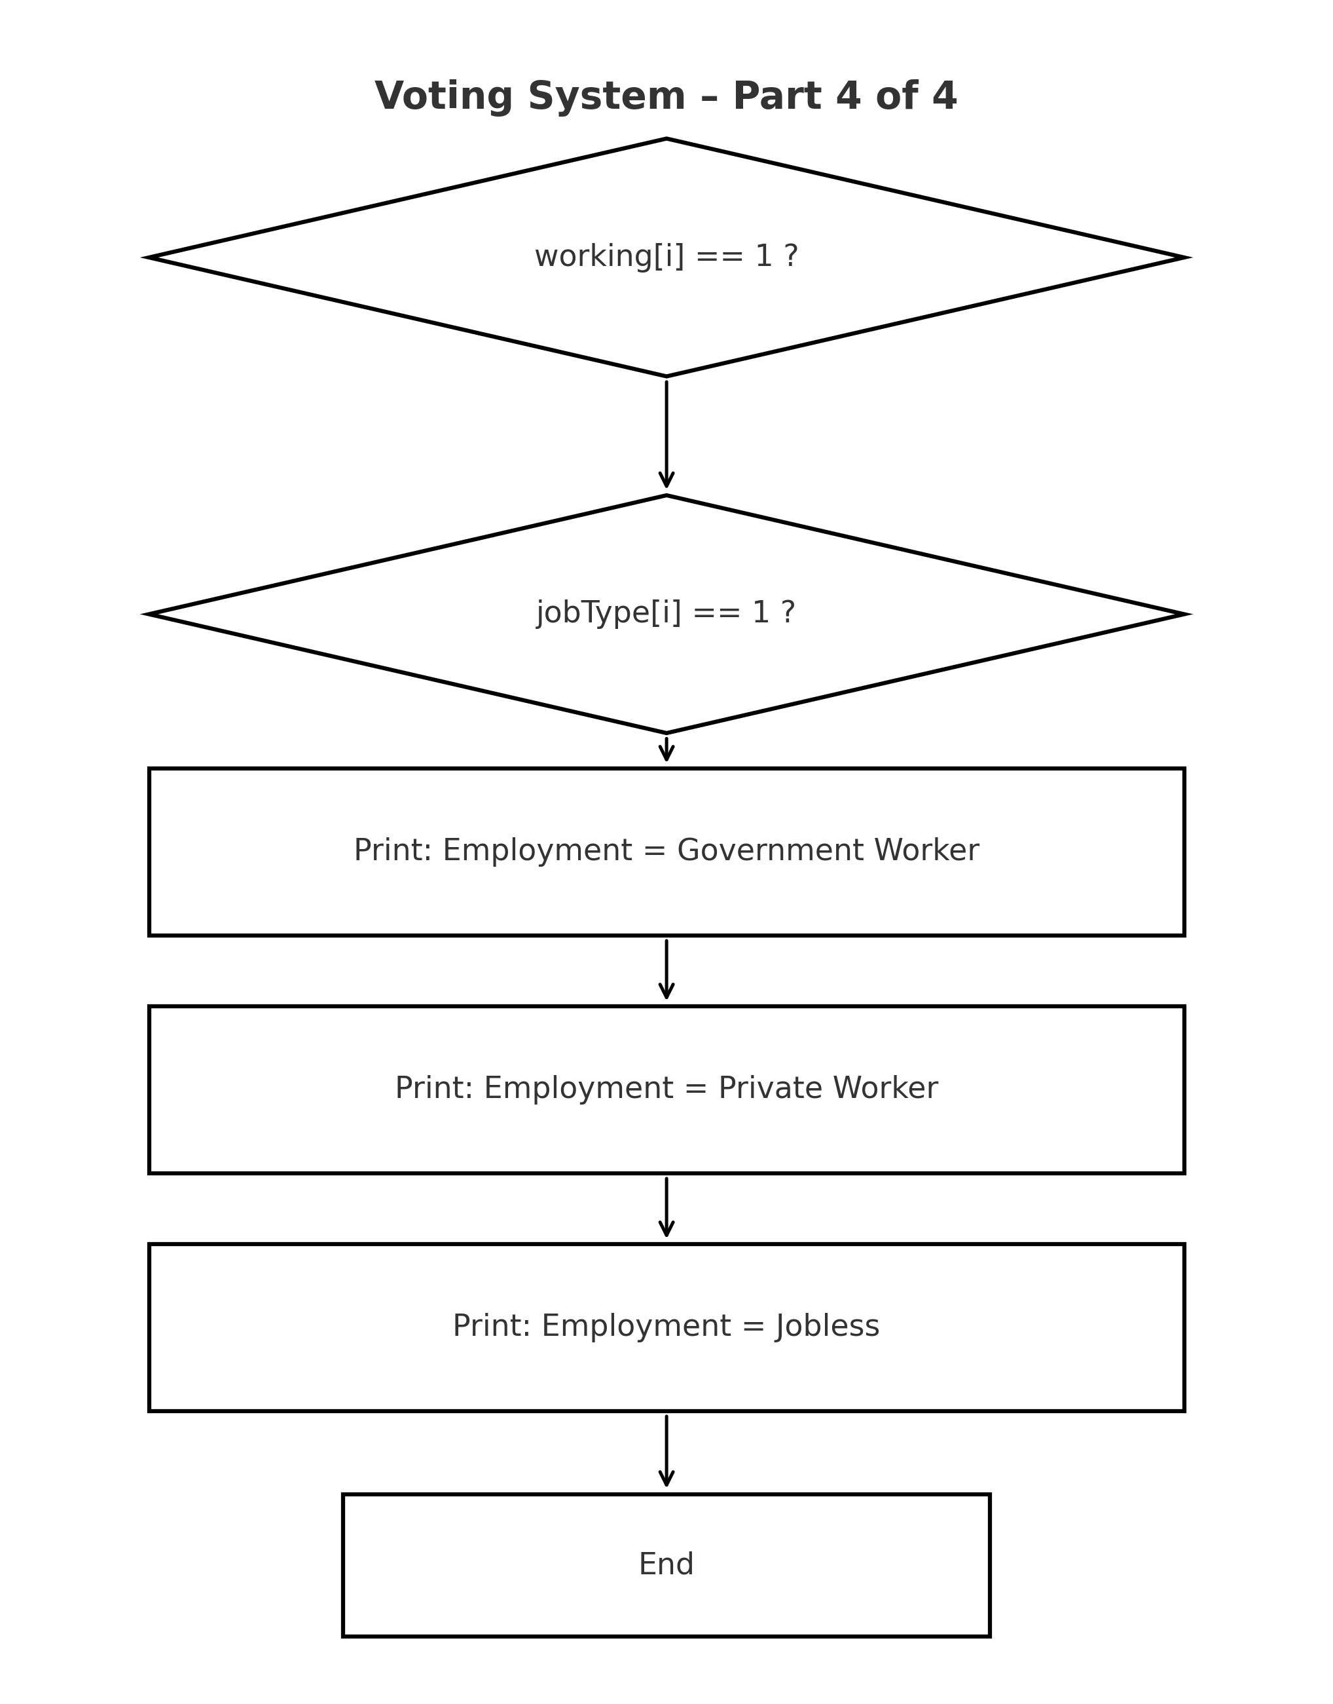

Slide 6
The Code
#include <stdio.h>
#include <string.h>
int main(){
int d, i;
printf("Enter number of people: ");
scanf("%d", &d);
// Arrays to store data for each person ................... present int he dry run table
char citizen[d][20];
int age[d], gender[d], cnic[d], status[d], working[d], jobType[d];
for (i = 0; i < d; i++){
printf("\n--- Person %d ---\n", i + 1);
printf("Do you possess Citizenship of which country? ");
scanf("%s", citizen[i]);
printf("Enter Age: ");
scanf("%d", &age[i]);
printf("Enter your Gender (1=Male, 2=Female): ");
scanf("%d", &gender[i]);
printf("Do you have a CNIC? (1=Yes, 2=No): ");
scanf("%d", &cnic[i]);
printf("Enter Status (1=Abroad, 2=In Country): ");
scanf("%d", &status[i]);
printf("Are you Working? (1=Yes, 2=No): ");
scanf("%d", &working[i]);
if (working[i] == 1){
printf("If working, enter job type (1=Government, 2=Private): ");
scanf("%d", &jobType[i]);
}else{
jobType[i] = 0; // Not applicable
}
}

Slide 7
printf("\n===== Voting Eligibility Results =====\n");
for (i = 0; i < d; i++)
{
printf("\nPerson %d:\n", i + 1);
printf("Citizen: %s | Age: %d | CNIC: %s | Status: %s\n",
citizen[i],
age[i],
cnic[i] == 1 ? "Yes" : "No",
status[i] == 1 ? "Abroad" : "In Country");
// Voting eligibility check
if (strcmp(citizen[i], "Pakistan") == 0 && age[i] >= 18 && age[i] < 110 && cnic[i] == 1)
{
printf(" Eligible to Vote\n");
}
else
{
printf(" Not Eligible to Vote\n");
}
// Work details
if (working[i] == 1)
{
if (jobType[i] == 1)
printf("Employment: Government Worker\n");
else if (jobType[i] == 2)
printf("Employment: Private Worker\n");
}
else
{
printf("Employment: Jobless\n");
}
}
return 0;
}

Slide 8
The Output of Code

Slide 9
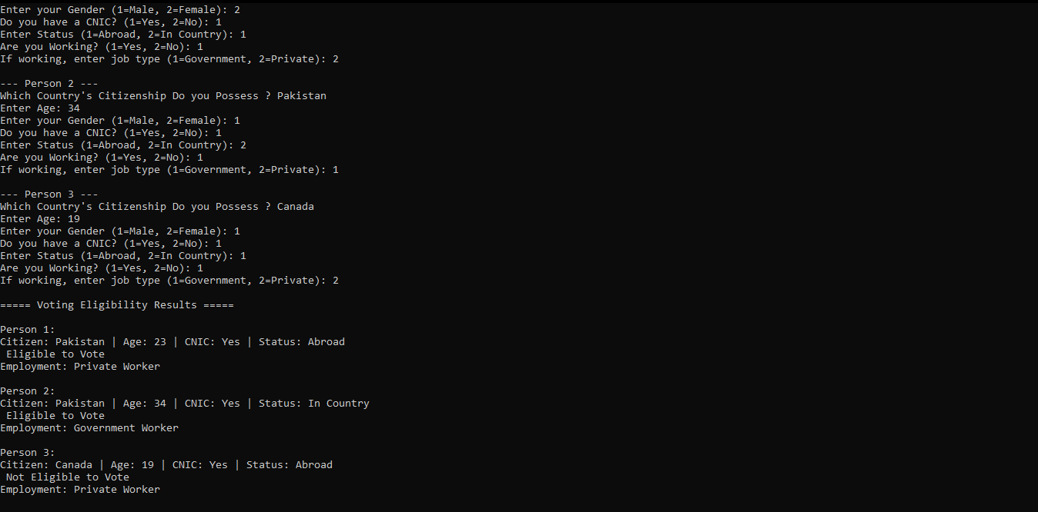
The Code Output

Slide 10
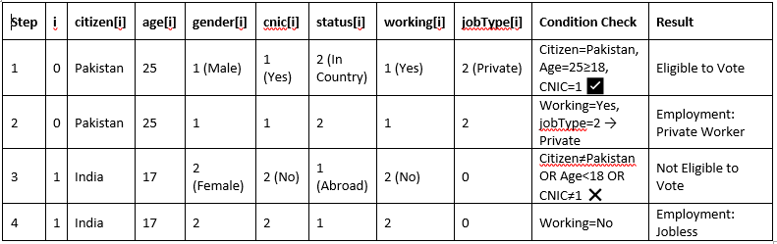
Dry Run Table

Slide 11
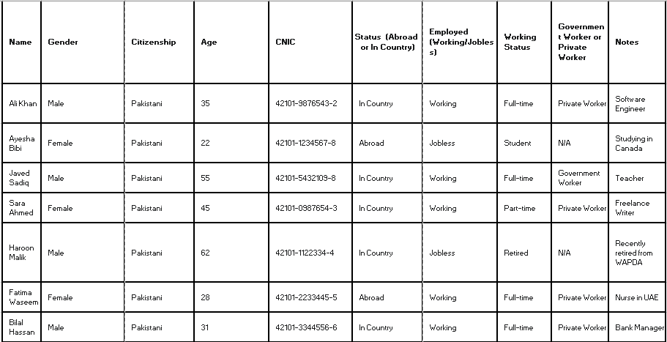
CCP Data

Slide 12
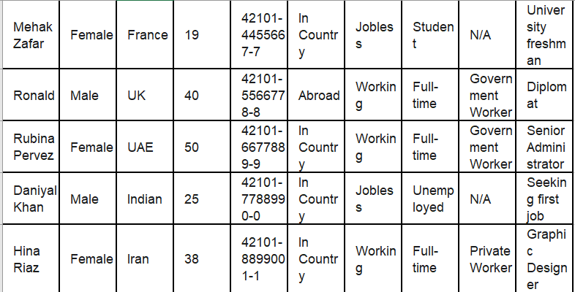
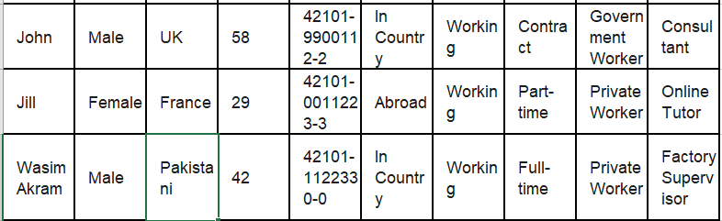

Slide 13
The Pseudo Code
  Start
  d, i
  Arrays: citizen[d][20], age[d], gender[d], cnic[d], status[d], working[d], job Type[d]
  citizen[i]
  age[i]
  gender[i]
  cnic[i]
  status[i]
  working[i]
  c. If working[i] == 1, then input job Type[i], else set job Type[i] = 0.
  "===== Voting Eligibility Results =====".
  If citizen[i] == "Pakistan" AND age[i] >= 18 AND age[i] < 110 AND cnic[i] == 1,
  → Print & Write "Eligible to Vote".
Else → Print & Write "Not Eligible to Vote".
  If working[i] == 1:
  If job Type[i] == 1 → Write "Government Worker".
  If job Type[i] == 2 → Write "Private Worker".
Else → Write "Jobless
End.

Slide 14
Conclusion
This C program implements a voting eligibility system that collects and processes personal information of multiple individuals using arrays. For each individual, the program records their citizenship, age, CNIC possession, current status (abroad or in-country), and employment details (jobless, government, or private worker). The program then evaluates whether each individual is eligible to vote based on the criteria: being a citizen of Pakistan, aged between 18 and 109 years, and possessing a valid CNIC. The results, including voting eligibility and employment details, are displayed for each individual. This program demonstrates the use of arrays for storing multiple entries, conditional statements for eligibility checks, and string comparison functions to verify citizenship.

