Slide 1
Will the price of a real estate property will be reduced based on its characteristics and market data?

Slide 2
What are we analyzing?
What factors influenced the price cuts?
What’s the accuracy rate that my property price will get reduced?
Which of the 5 cities (LA, NYC, Chandler, Miami, and Chicago) have a good enough dataset to have better price cut prediction accuracy rating?
Notes:
So, What are the driving forces behind the trimming of property prices?
How can we gauge the likelihood of a price reduction of the property we’re selling?
Between Los Angeles, New York City, Miami, Chandler Arizona, and Chicago, which cities dataset can help us predict the accuracy of the price drop elements?

Slide 3
Supervised ML Models Suited for Non-Linear Datasets
Decision Tree
Decision Tree using OneHotEncoder
Random Forest
Notes:
"In analyzing the Zillow For Sale Dataset, we recognized the non-linear dynamics affecting property value price reductions. To address this, we initially deployed Decision Tree and Random Forest models to predict if a property's price would drop from its original list price.
Despite their robustness, both models exhibited limitations. We attributed this to the small dataset size, which typically results in overfitting—a scenario where models fail to generalize due to limited data.
To mitigate overfitting and enhance model efficacy, we implemented feature engineering strategies within a pipeline framework. A significant enhancement was the application of OneHotEncoder to our Decision Tree model. This step was crucial for transcending the categorical data constraints, particularly with variables like 'Property Type', 'City', and 'Zip Code’.
Post-implementation of OneHotEncoder, we observed a marked improvement in the model's predictive capabilities. Our approach underscores the importance of preprocessing in machine learning, especially when dealing with categorical data in small datasets."

Slide 4
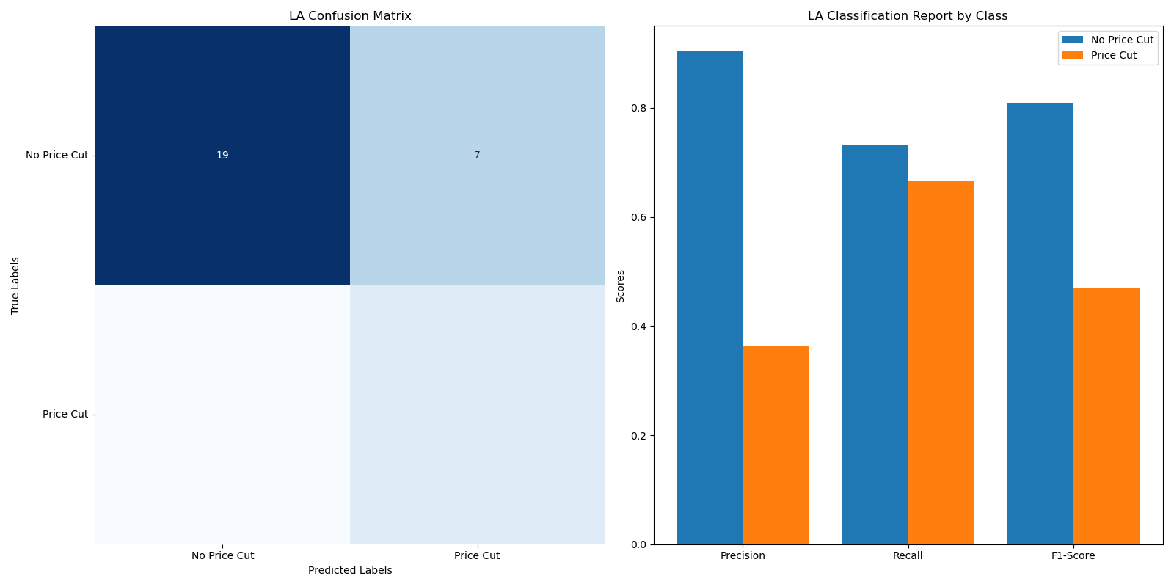
Los Angeles (158 For Sale Properties)
Notes:
The Los Angeles model for predicting home price reductions has an accuracy of 72%, showing moderate effectiveness.
It performs well in identifying properties that won't have a price cut (90% precision for no price cuts) but struggles more with accurately predicting actual price cuts, as indicated by a lower precision (36%) and recall (67%) for price-cut predictions.
The results suggest the model is cautious, leading to a high rate of correctly predicting no price cuts but missing some actual price cuts.
Overall, while the model captures some patterns in the data, there's room for improvement in predicting price reductions more accurately.

Slide 5
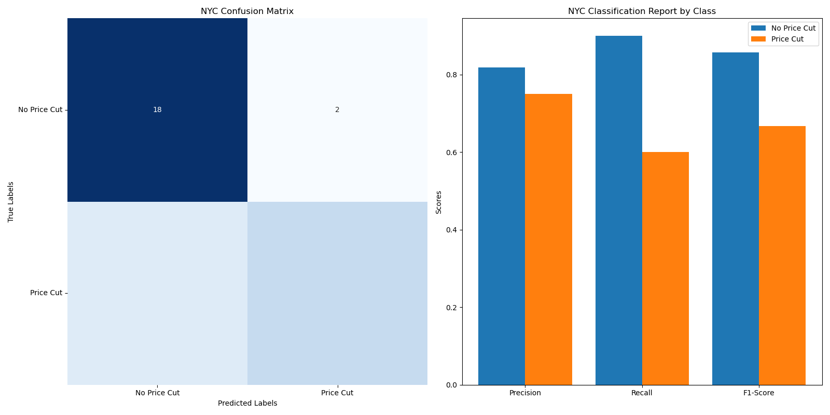
New York City (149 For Sale Properties)
Notes:
The New York City model for predicting home price reductions demonstrates an accuracy of 80%, indicating a strong performance.
It is more effective at predicting properties without price cuts, with an 82% precision, and shows a respectable ability to identify actual price cuts, with a 75% precision.
The model balances accuracy across both predicting price cuts and identifying no price cuts, reflected in its overall precision, recall, and F1-scores.
This suggests the model is reliable and has a balanced approach to predicting price reductions in the New York City real estate market.

Slide 6
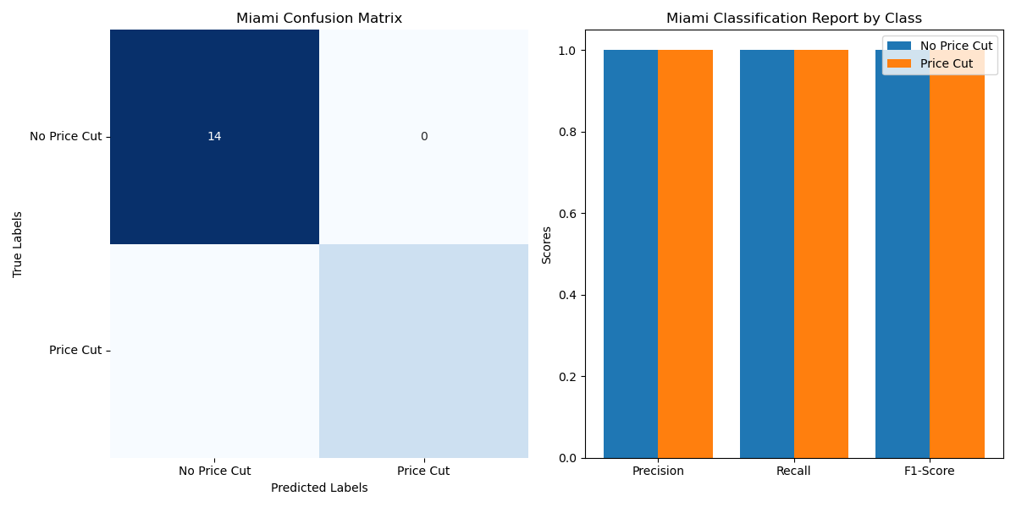
The Perfect Prediction Score: Miami (81 For Sale Properties)
Notes:
The Miami model achieved a perfect accuracy score of 100%, successfully predicting all instances of price cuts and no price cuts in the test set. While this indicates exceptional performance, it's essential to approach this result with caution.
A perfect score could suggest overfitting, especially if the test dataset is small or not representative of the broader market.
It's crucial to validate these results further before drawing definitive conclusions about the model's effectiveness in predicting price reductions in the Miami real estate market.

Slide 7
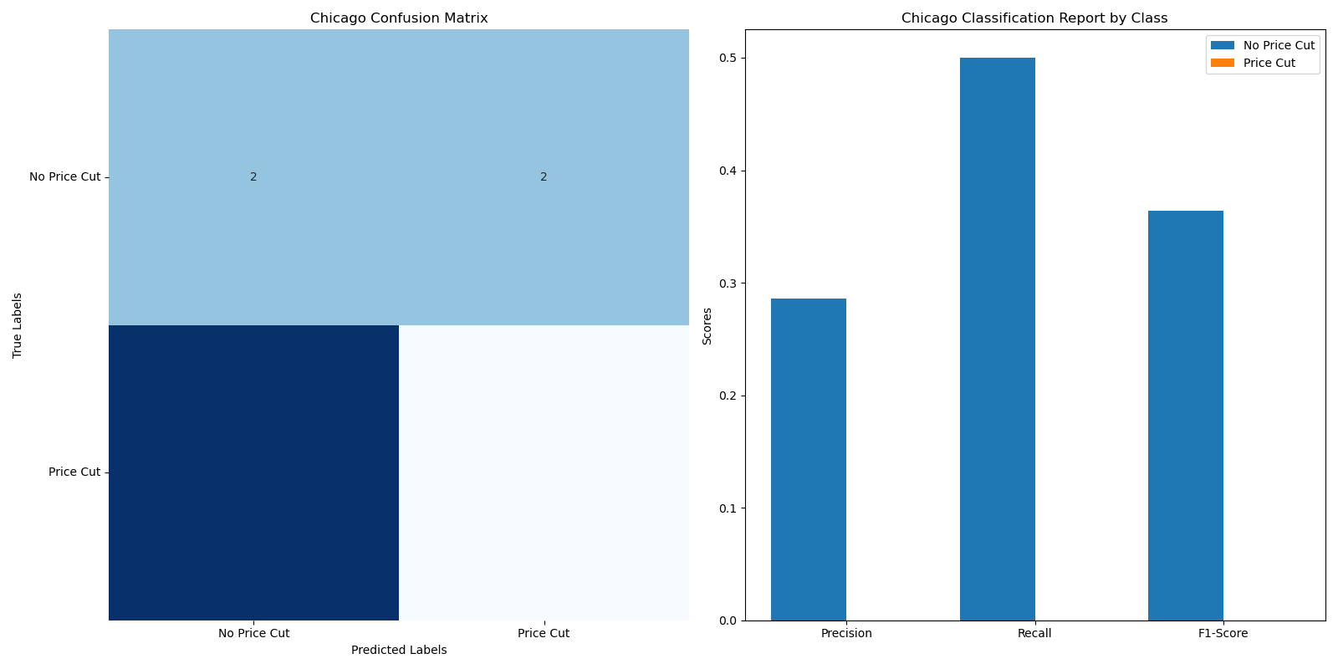
The outlier: Chicago(41 For Sale Properties)
Notes:
This performance is significantly lower than what was observed for the Los Angeles and New York City datasets. Chandler, Arizona had 438 properties for sale!
The Chicago model displayed a notably low accuracy of 22.2%, indicating substantial challenges in predicting home price reductions accurately.
This poor performance is underscored by a low precision and recall across both categories, particularly in failing to predict any price cuts correctly (0% precision and recall for price cuts). Such results could stem from a variety of factors, including a small or unrepresentative test dataset, inadequate model training, or the possibility that the features used are not sufficiently predictive for the Chicago market.

Slide 8
Room for improvement (41 For Sale Properties)
More GOOD QUALITY data (with a caveat)
Chicago’s prediction underperformed because we were working with such limited data (44 for sale properties)
Chandler, AZ had 438 properties for sale when we pulled this data, but the price cut prediction was lower than LA or NYC at 76.1%
Feature Engineering is necessary
Patience is necessary
Notes:
More good quality data isn’t about the size. It’s about the type of features fed into the models.
Feature Engineering is essential. We saw a dramatic increase in prediction accuracy once we encoded the data, especially categorical data.
Patience is key. A lot of trial and error was done to get more accurate prediction results.

