Slide 1

DYNAMIC, FASTER
Dynamic data transformation for third-party systems using Apache Spark

Slide 2







WHAT WE ARE DOING
NETSOL
IIB
INFINITE

Slide 3
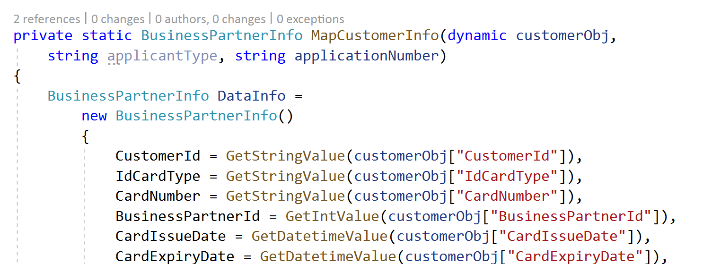
PROBLEM
NO FLEXIBILITY
COSTLY

Slide 4


SOLUTION
NOT YOU
BUT YOU !

Slide 5
WHY APACHE SPARK
LARGE-SCALE DATA PROCESSING
MACHINE LEARNING
AD-HOC QUERY

Slide 6

HOW ARE WE GOING TO DO IT
PIKACHU
CUSTOM RULESETS
ENGINE
INFINITE

Slide 7
HOW ARE WE GOING TO DO IT
PIKACHU
CUSTOM RULESETS
CUSTOM RULESETS
SYSTEM X
SYSTEM X
CUSTOM RULESETS
CUSTOM RULESETS
ENGINE
SYSTEM X
SYSTEM X

Slide 8
DEMO
Dynamic data transformation for third-party systems using Apache Spark

