Slide 4
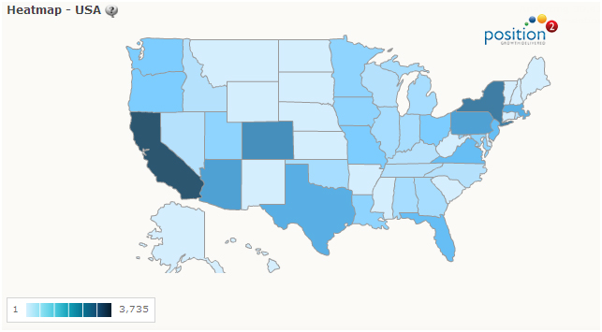
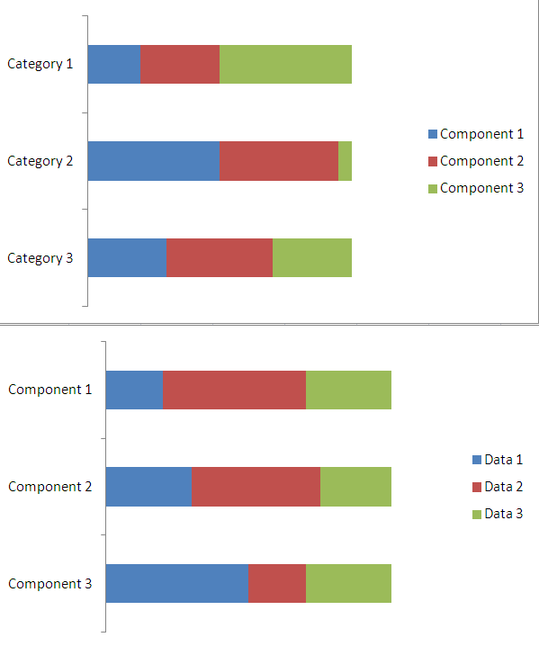
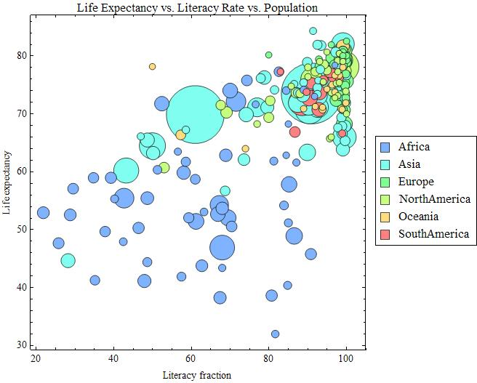
Income Level
Avg Age
Age of Purchase
Background Checks
Time of year
Gun Ownership
Ammo Sales
3 Day Weight
Sliders or Drop Downs
(may change)

