Slide 1
Farm Nerds
“Prosperous farmers mean more employment, more prosperity for the workers and the business men of every industrial area in the whole country.”
- Franklin D. Roosevelt

Slide 2
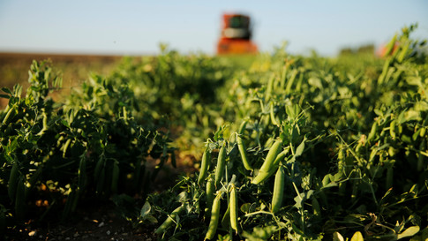
Agriculture and Pandemic
Fails to meet consumer demand
Erroneous production prediction
Low sales despite high production
GDP Loss
Mobility of the country due to Pandemic
Agricultural and Economic sectors hampered

Slide 3
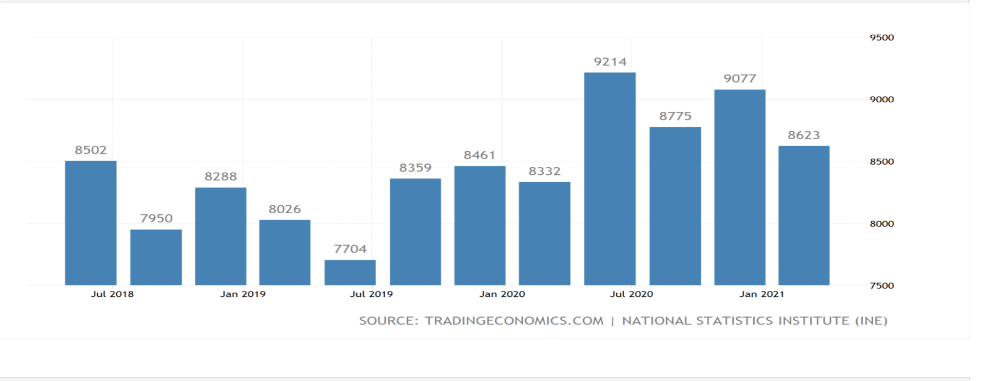
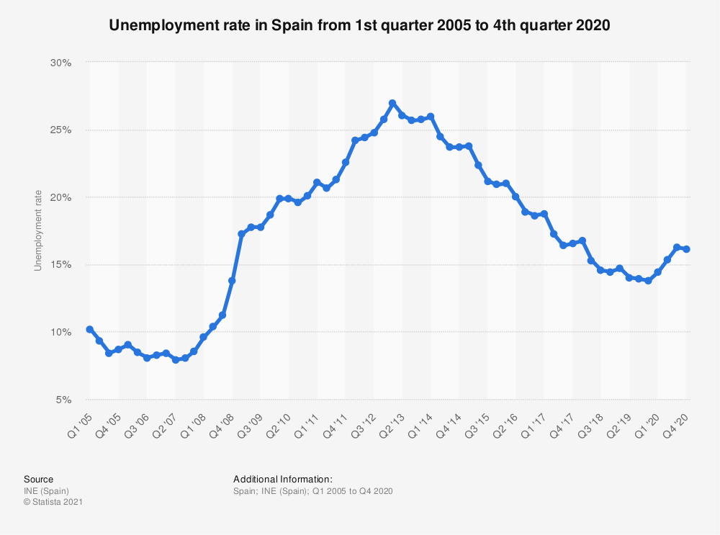
Covid-19 impact on Agriculture led to loss in GDP and increase in unemployment in Spain in mid 2020

Slide 4
Our Proposed Model
Predicts future weather and natural factors
Predicted weather condition provides future harvest number
Predicted result involves mobility of the country due to pandemic condition
Ultimately it alerts the farmers, investors, government and guides in managing such situation

Slide 5
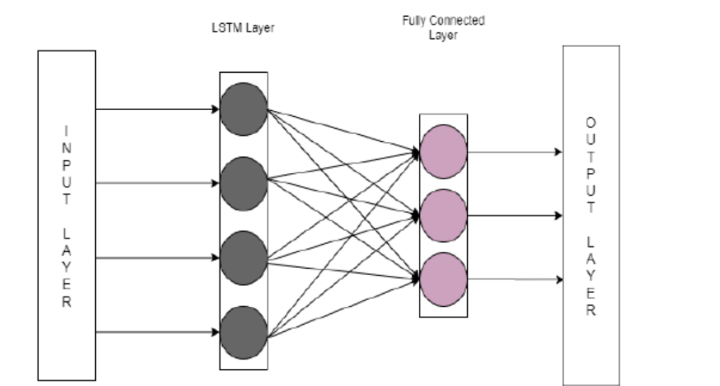
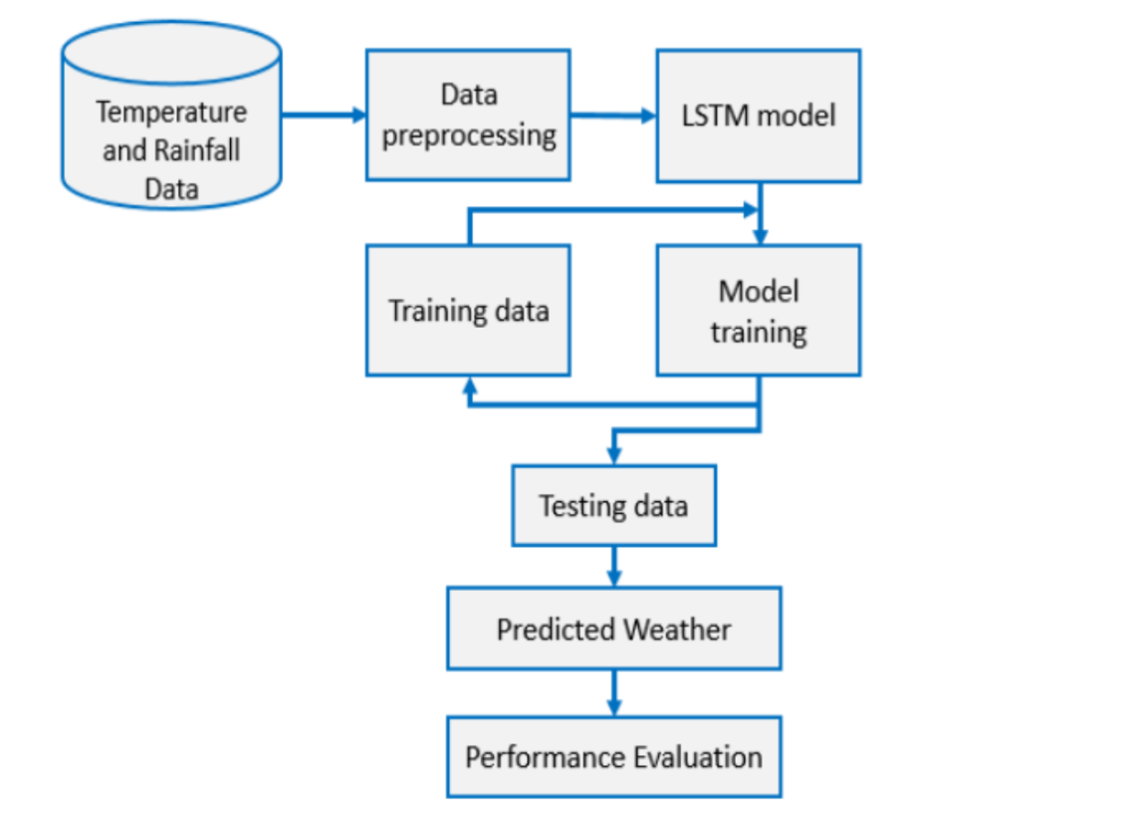
Basic LSTM block architecture
Algorithm for temperature and rainfall prediction

Slide 6

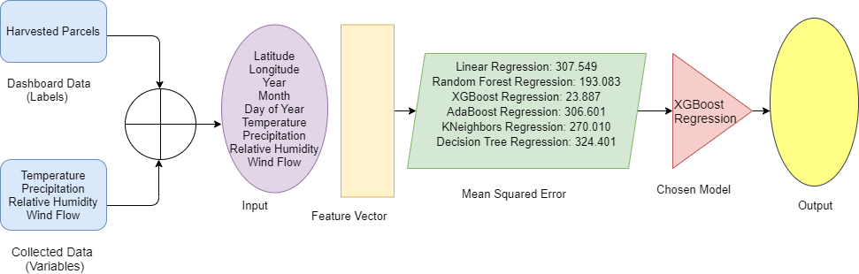
Indicator Algorithm

Slide 7
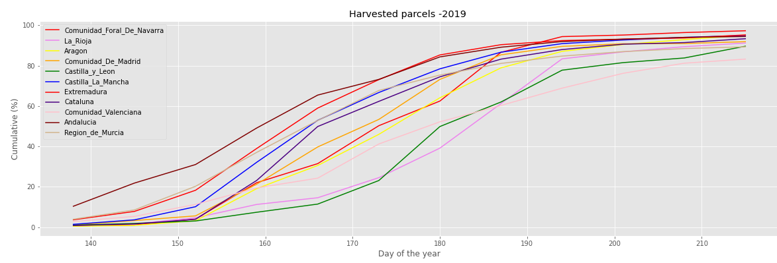
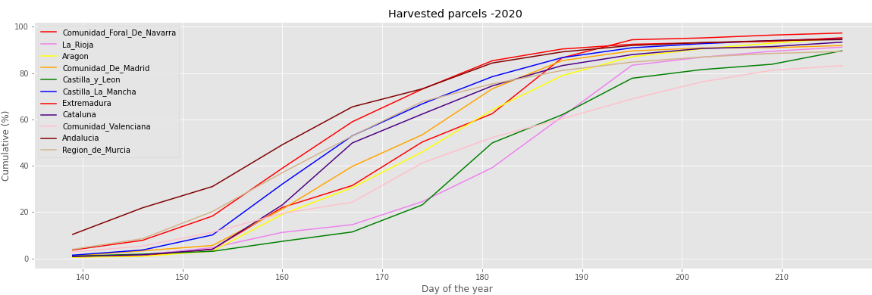
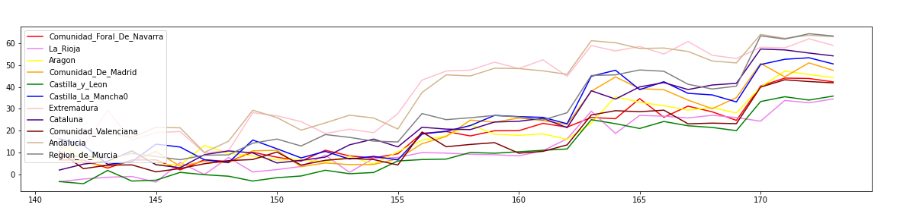
Prediction for Cereal Production Based on our Demo Model for 2021

