Slide 1
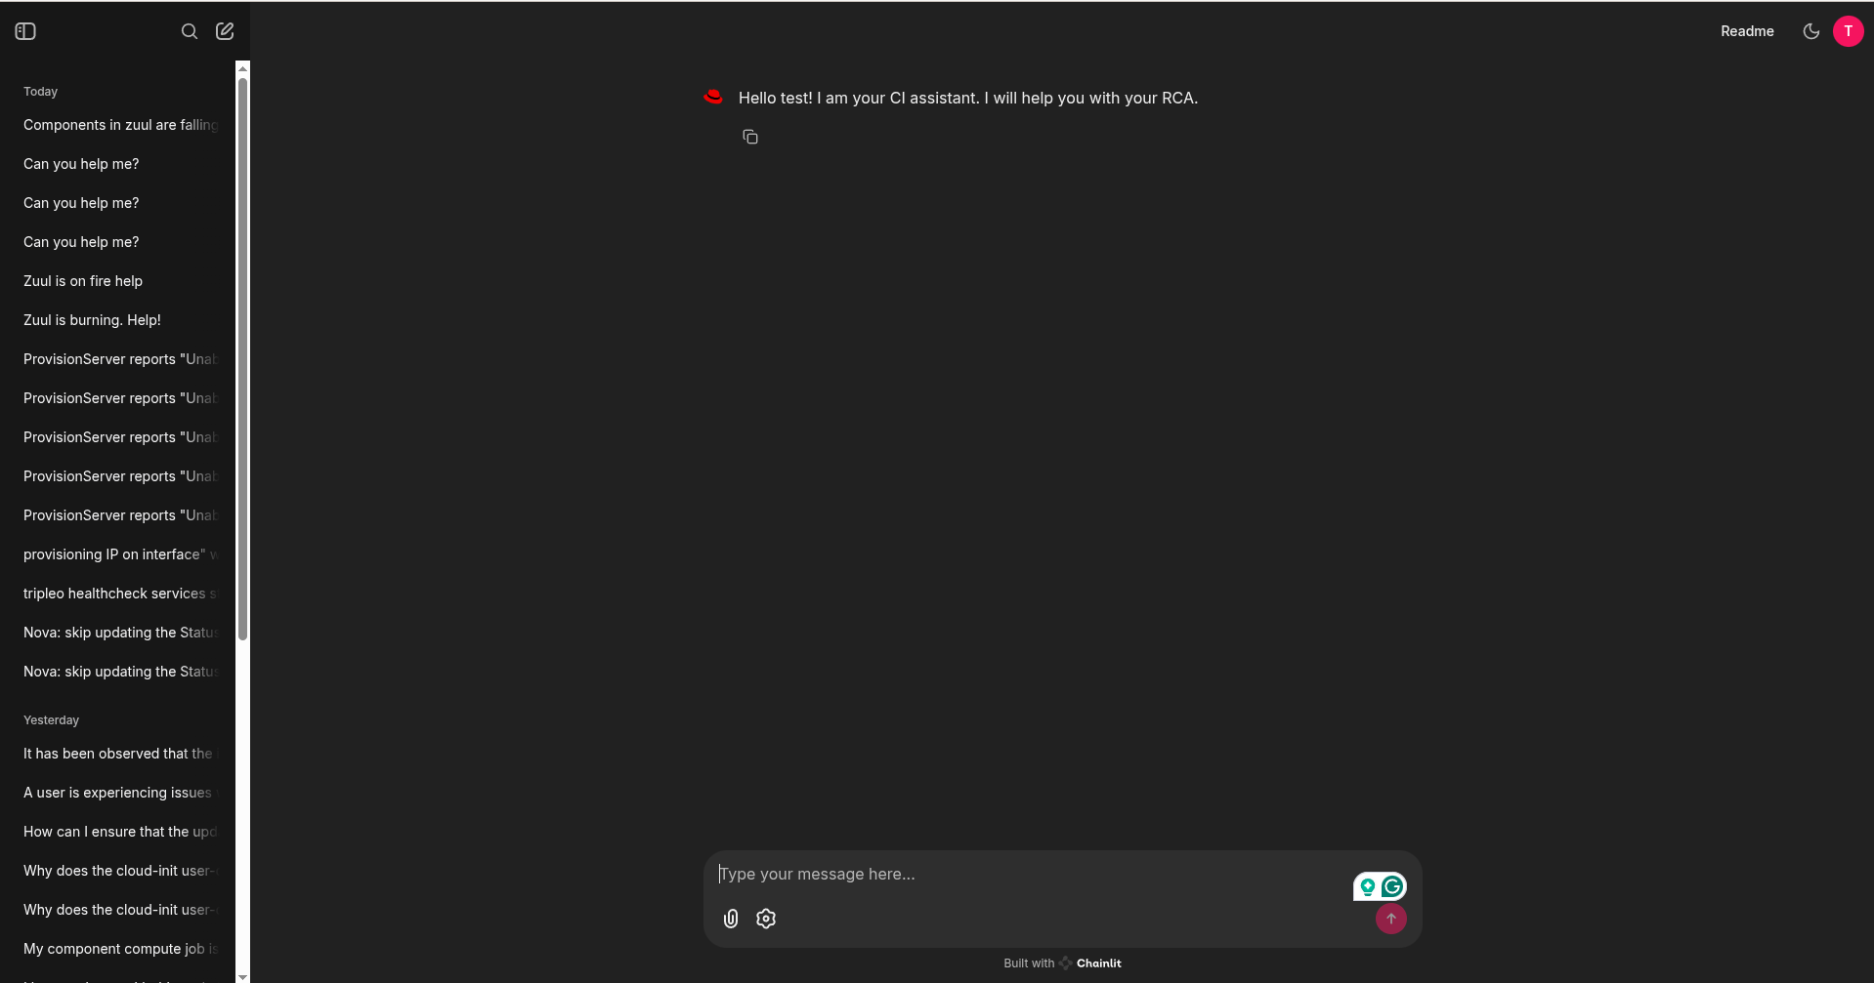
Thread History
Attachments
Settings
New Thread

