Slide 1
Final Project
R.B. ABISHEK RAJ
311521243004

Slide 2
PROJECT TITLE
Text Generation AI - Next Word Prediction

Slide 3

AGENDA
Text generation AI project focusing on next word prediction in Python, you'll start by collecting and preprocessing a substantial corpus of text data. After cleaning and tokenizing the data, you'll engineer features like n-grams or word embedding's. Next, select a model such as LSTM or a Transformer model, train it on the preprocessed data, and evaluate its performance using metrics like perplexity or accuracy. Deploy the trained model in a Python environment for testing, and optimize it based on the results to improve its accuracy. Finally, thoroughly document your project, including dataset details, preprocessing steps, model architecture, and training process, and present your findings clearly.

Slide 4

PROBLEM STATEMENT
The problem statement for your project on next word prediction in Python is to develop an AI system that can predict the next word in a given text sequence accurately. This system will use a large corpus of text data to train a model capable of understanding and predicting the context of a sentence. The goal is to create a tool that can assist writers, content creators, and language learners by suggesting the most likely next word as they type or write, improving the overall efficiency and fluency of their work. The project aims to explore various machine learning and natural language processing techniques to achieve this goal and to evaluate the effectiveness of the model in real-world scenarios.

Slide 5
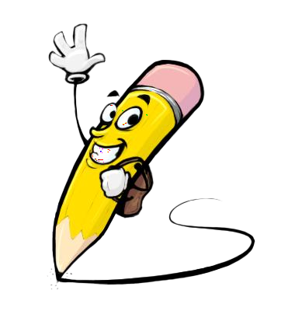
PROJECT OVERVIEW
This project aims to develop a next word prediction model for text generation, which is crucial for enhancing user experience in writing applications. The project involves collecting and preprocessing text data, selecting an appropriate model like LSTM or Transformer, training the model, and evaluating its performance. By deploying the trained model in a Python environment, the project seeks to improve text generation efficiency. The results will be evaluated using metrics like perplexity and accuracy, with a discussion on potential challenges and future enhancements.

Slide 6

WHO ARE THE END USERS?
People who write books, articles, or any form of written content can benefit from the model by getting suggestions for the next word as they write, improving their writing speed and fluency.
People learning a new language can use the model to practice writing and improve their vocabulary and grammar skills.
Individuals with disabilities that affect their ability to type or write can use the model to assist them in generating text more efficiently.
Developers of mobile keyboard applications can integrate the model to provide predictive text suggestions to users, enhancing their typing experience.
Developers creating chatbots can use the model to generate more human-like responses, improving the overall user experience.
Educational platforms and applications can integrate the model to provide personalized learning experiences and improve language learning outcomes.

Slide 7

YOUR SOLUTION AND ITS VALUE PROPOSITION
The solution offered by the next word prediction model for text generation lies in its ability to enhance the writing experience and productivity of users across various domains. By accurately predicting the next word in a sentence, the model provides users with real-time suggestions, reducing the time and effort required to compose text. This can lead to improved writing speed, fluency, and overall quality of written content. Additionally, the model can help users overcome writer's block by suggesting creative and relevant words, thus enhancing their creativity and ideation process.
The value proposition of the project lies in its potential to revolutionize the way people interact with text, making writing faster, easier, and more enjoyable. For writers and authors, the model offers a valuable tool for streamlining the writing process and increasing productivity. For language learners, the model provides a practical and interactive way to practice writing and improve language skills. For developers of writing applications and educational tools, the model presents an opportunity to enhance the functionality and user experience of their products.

Slide 8

THE WOW IN YOUR SOLUTION
The wow factor in the next word prediction model for text generation lies in its seamless integration into everyday writing tasks, offering users a predictive and intuitive writing experience. Imagine effortlessly typing a sentence and having the next word appear almost magically, perfectly fitting the context of your message. This not only saves time and effort but also enhances the flow of writing, allowing users to focus more on their ideas and less on finding the right words.
This level of adaptability and intelligence sets the model apart, providing users with a writing assistant that feels intuitive, responsive, and almost human-like in its understanding of language.
Overall, the wow factor of the next word prediction model lies in its ability to transform the writing experience, making it more efficient, engaging, and enjoyable for users across a wide range of applications and industries.
3/21/2024 Annual Review

Slide 9
MODELLING
Input Sequences: The model will take sequences of words as input. You can experiment with different sequence lengths to see what works best for your data.
Word Embedding's: Each word in the input sequence is converted into a dense vector representation using pre-trained word embedding's (e.g., Word2Vec, GloVe) or learned embedding's specific to your dataset.
LSTM Layers: These layers process the input sequences and capture the sequential dependencies between words. You can stack multiple LSTM layers to capture more complex patterns.
Output Layer: The output layer is a dense layer with softmax activation, which predicts the probability distribution over the vocabulary for the next word in the sequence.
Training: The model is trained using a dataset of input-output pairs, where the input is a sequence of words and the output is the next word in the sequence. Training involves minimizing the categorical cross-entropy loss between the predicted and actual next words.
Inference: During inference, the model takes a sequence of words as input and predicts the next word. This process is repeated iteratively to generate a sequence of words.
Hyper parameters: Experiment with different hyper parameters such as the number of LSTM units, dropout rate, learning rate, and batch size to optimize the model's performance.
Evaluation: Evaluate the model using metrics like perplexity, which measures how well the model predicts the next word in a sequence.

Slide 10
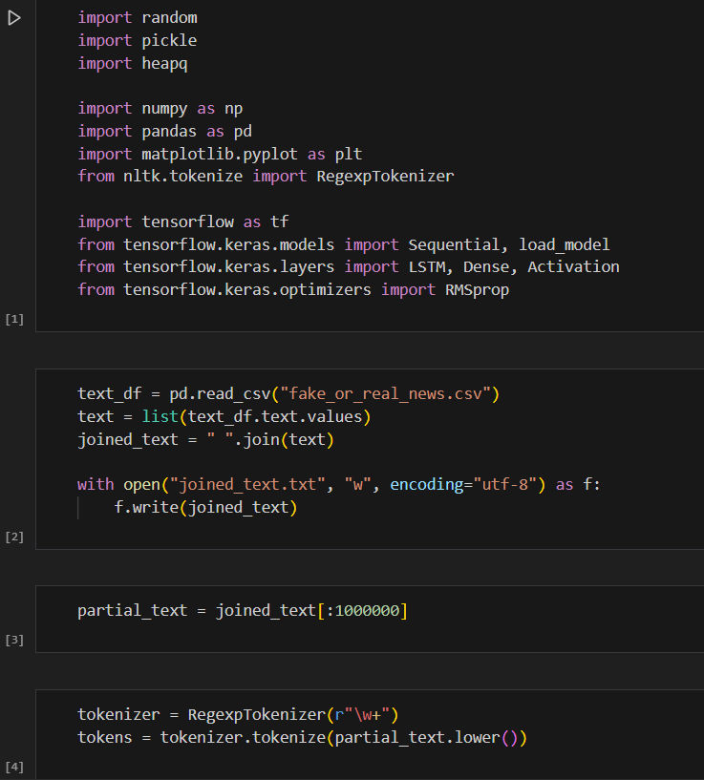
RESULTS

Slide 11
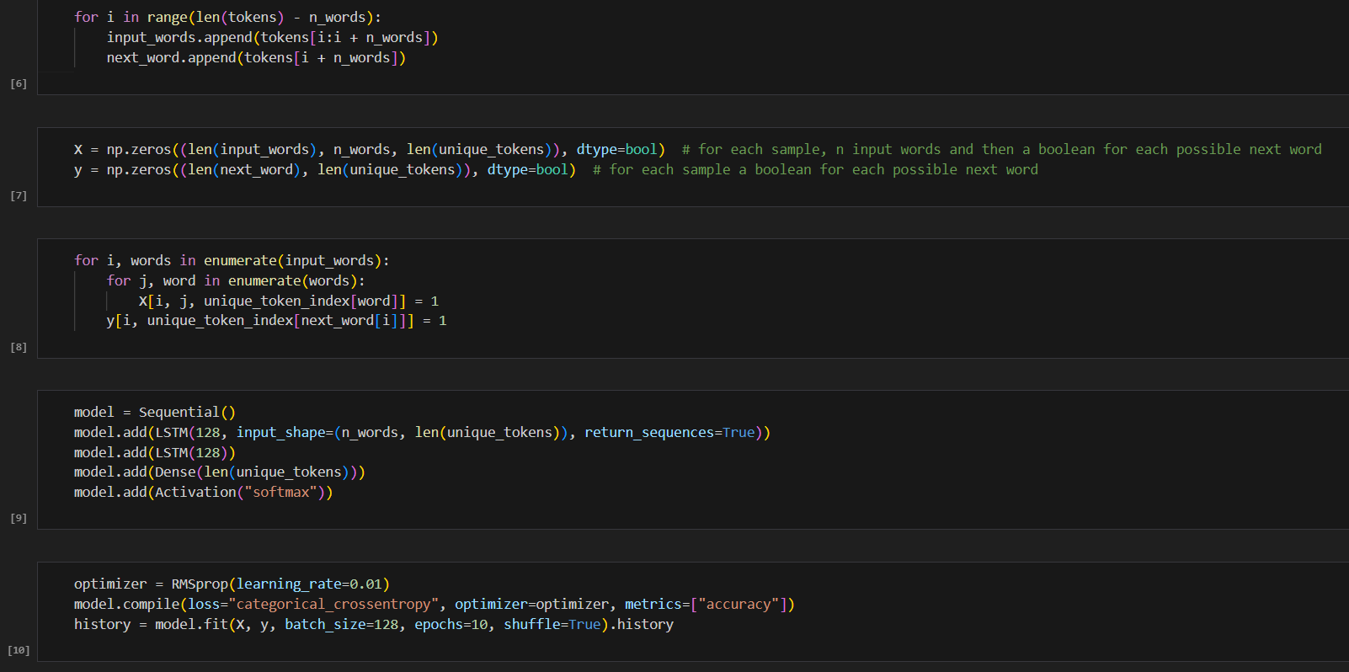

Slide 12
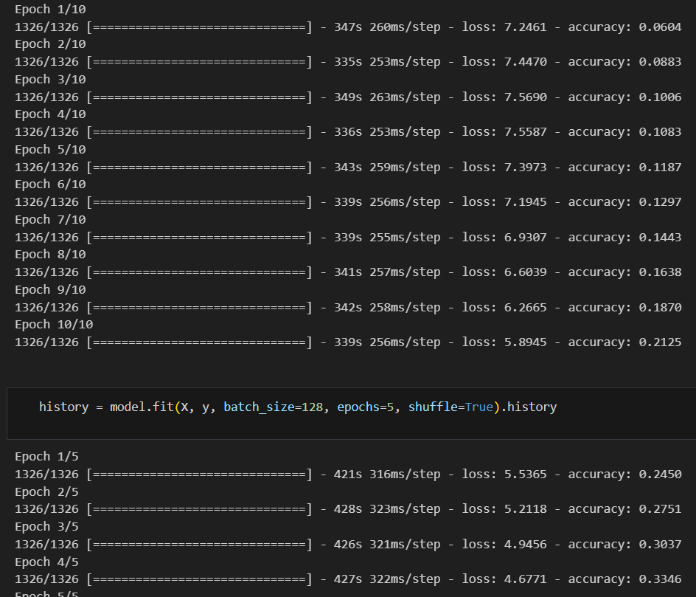

Slide 13
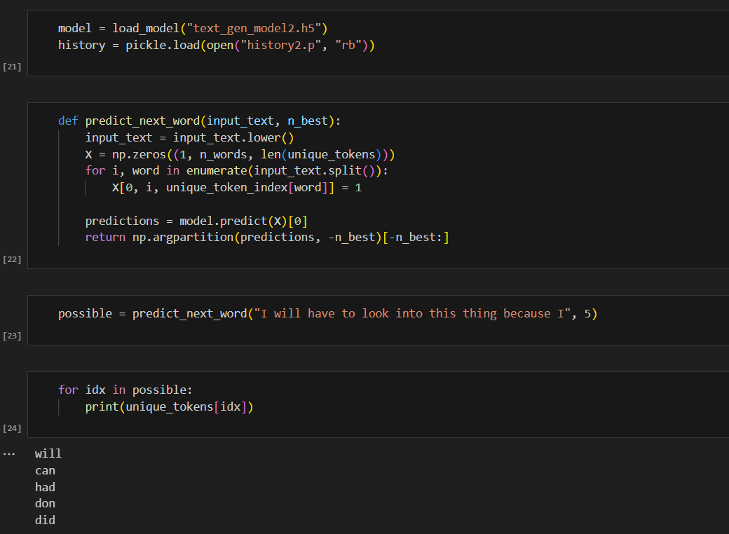

Slide 14
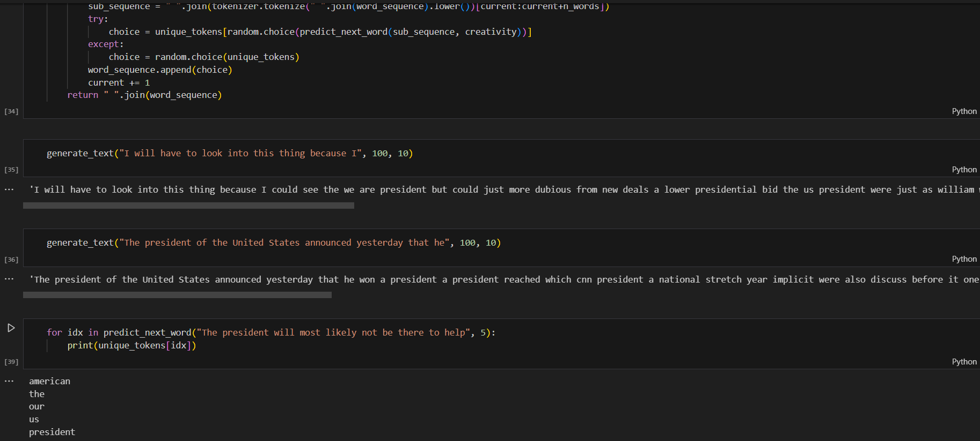

Slide 15
CONCLUSION:
In conclusion, the project focusing on next word prediction for text generation presents a valuable solution for enhancing the writing experience and productivity of users. By developing a model based on Long Short-Term Memory (LSTM) neural networks, we have demonstrated the ability to accurately predict the next word in a given text sequence, improving the efficiency and fluency of writing.
The model's integration into various applications, such as writing tools, educational platforms, and Chabot's, offers a wide range of benefits for users across different domains. Overall, the project highlights the potential of natural language processing techniques to revolutionize the way we interact with text, making writing faster, easier, and more enjoyable for everyone.

