Slide 1
Rabia Syed
BSCS-24103
Stock Market Matching Engine

Slide 2
Main Features
Users (Create Users)
Place Orders
View Portfolio
Automatic Trade
Full Order Book
View Trade History
Cancel Order

Slide 3
Data Structures I am Using And Why
Hash Map – For Quick Lookup
  OrderID – Orders
  UserID – Users
  Symbol- OrderBook
BTree – To maintiain Order Book
  Sell Tree
  Buy Tree
OrderQueue – If there are multiple orders of same prices

Slide 4
Completed
All the functionalities
Create user, portfolio , automatic trade
Slight Issue in Cancel order.
What is Left to Implement
Socket Programming To connect Backend and Frontend
Frontend

Slide 5
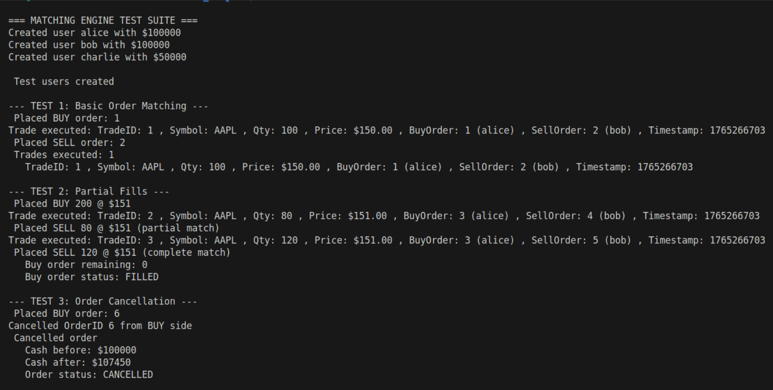
Demo

Slide 6
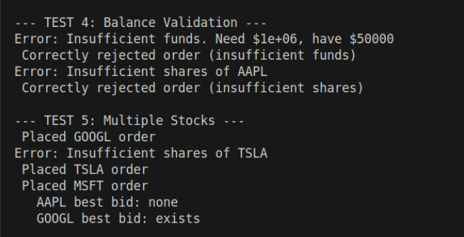
Demo

Slide 7
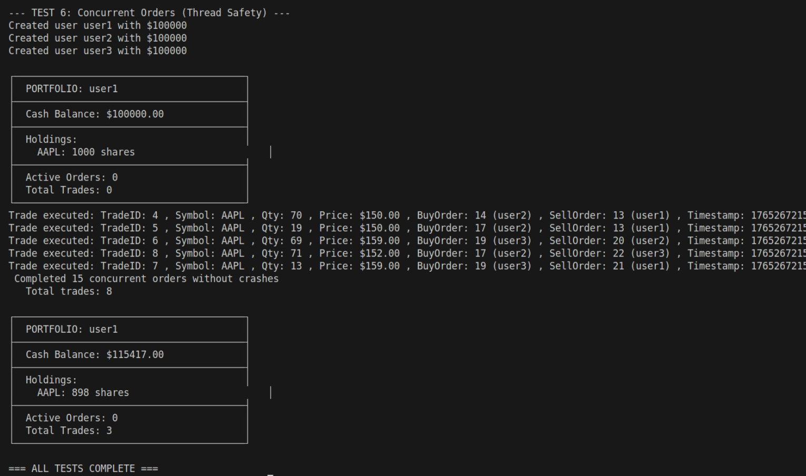
Demo

