Slide 1
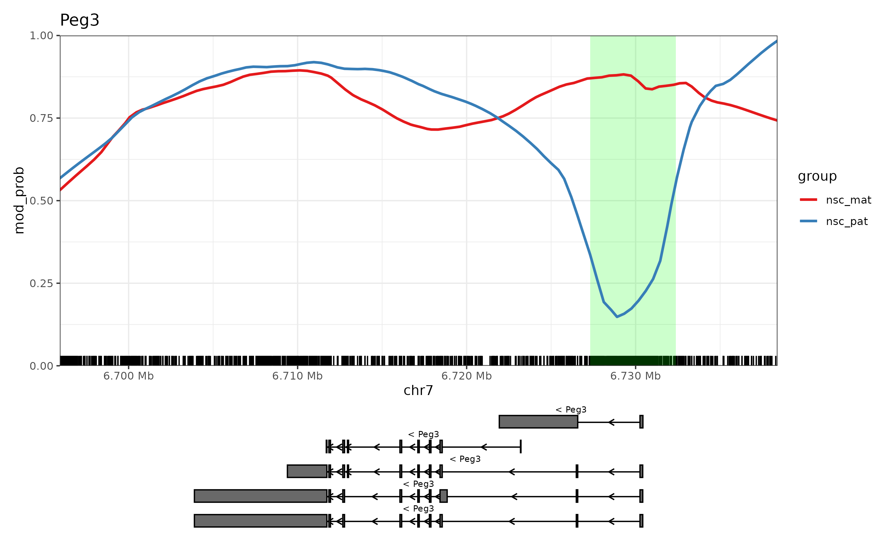
Methylation: Peg3

Slide 2
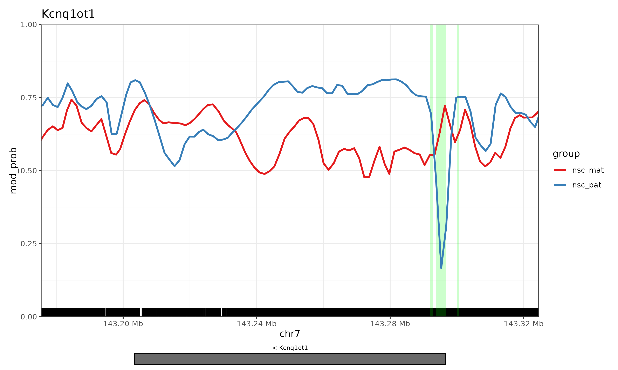
Methylation: Kcnq1ot1

Slide 3
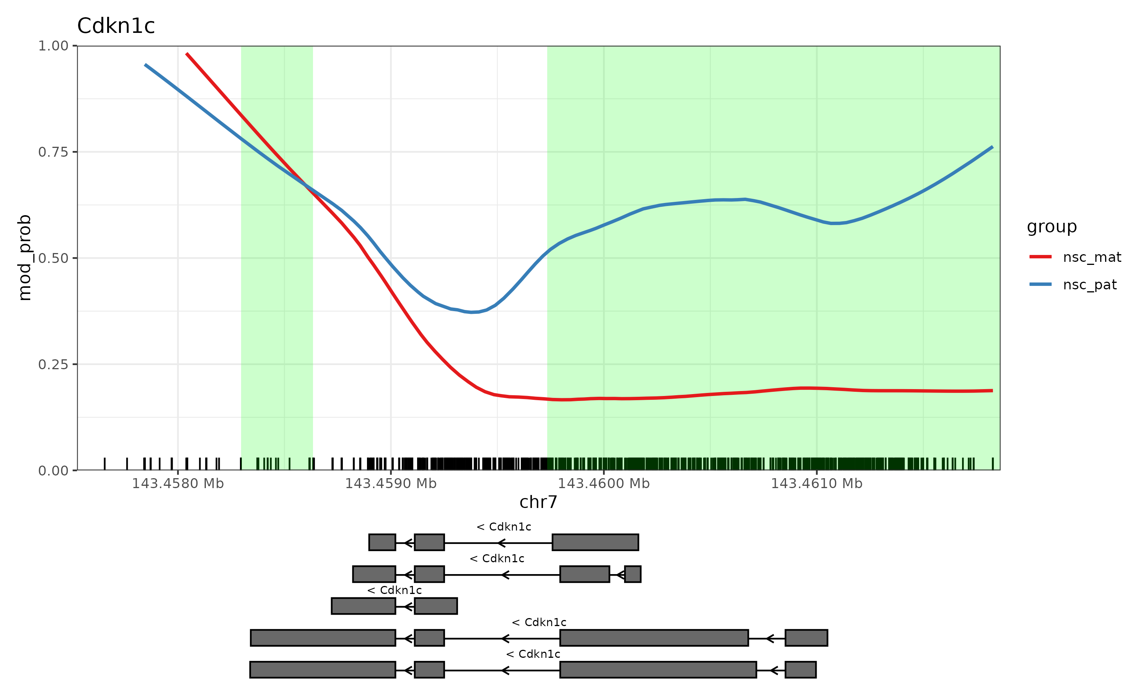
Methylation: Cdkn1c

