Slide 1
A PROJECT ON
SHIFT ALLOCATION SYSTEM
Presented By:
Bishwa Kandel (SEC078BCT009)
Rabi Chandra Aryal (SEC078BCT023)
Shashank Katuwal (SEC078BCT032)
Sumesh Dhonju (SEC078BCT034)
Project Supervisor:
Er . Nabin Dhakal

Slide 2
INTRODUCTION
The project outlines the design, development, and implementation of a system that automates employee shift allocation, reducing human errors and ensuring efficient utilization of available manpower.

Slide 3
PROBLEM STATEMENT AND SOLUTION
Problem Statement :
Manual Allocation of Shifts
Offices and Company use manual shift assignment of their employees which is not completely feasible and is time consuming.
Constraint Satisfaction Problem
Solution :
Shift Allocation System
This system solves the problem by assigning the shifts desired by the company in just one click.

Slide 4
OBJECTIVE
To develop a system that facilitates the allocation of shifts to the employees using certain predefined parameters

Slide 5
CONSTRAINT SATISFACTION PROBLEM
Variable : Shift
Domain : set of employees available to work those shifts
Constraint : Max working hours , Max shifts per day, Designation match ,Fair distribution
Constraint Solving Strategy
Ensuring an Optimal and Feasible Assignment

Slide 6







IMPLEMENTATION ELEMENTS :
LANGUAGES/
STACK:
TOOLS:

Slide 7
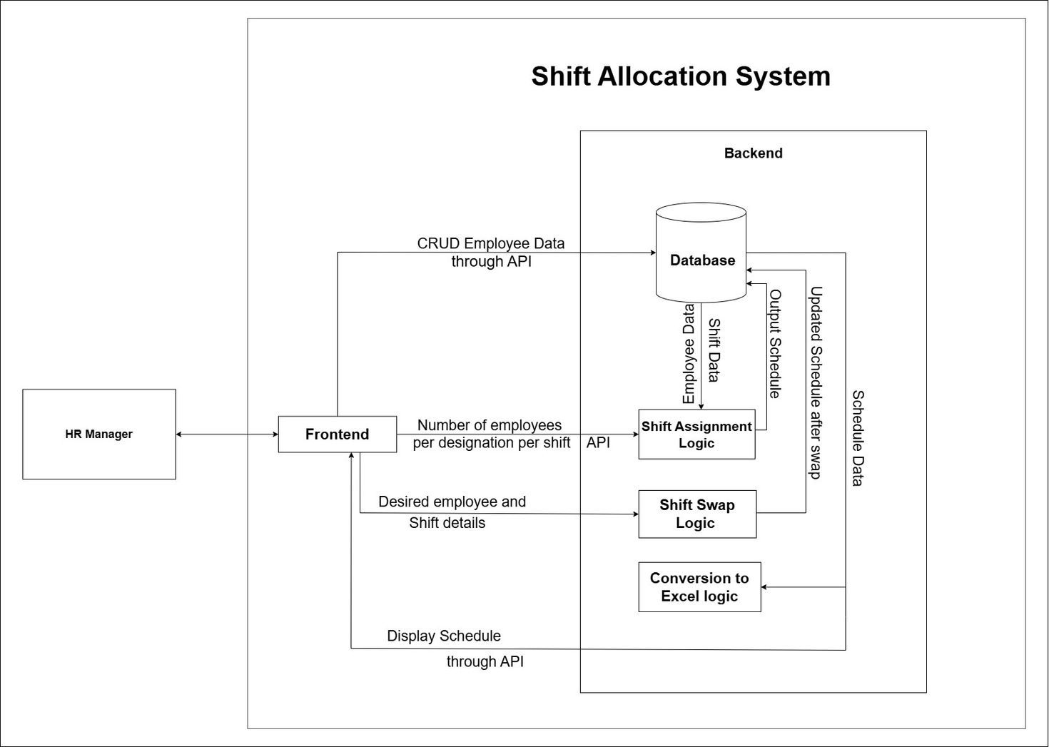
SYSTEM BLOCK DIAGRAM
Figure: System Block Diagram

Slide 8
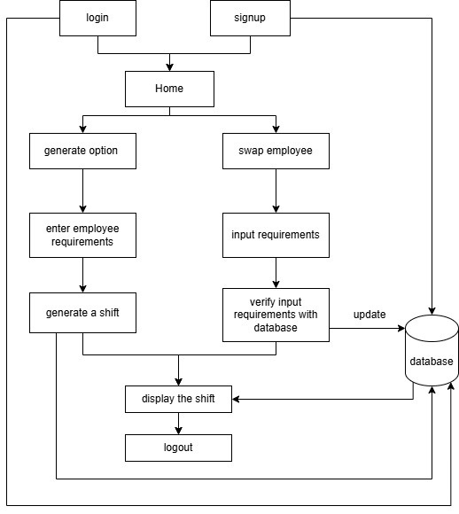
SYSTEM WORKFLOW DIAGRAM
Figure: System Workflow Diagram

Slide 9
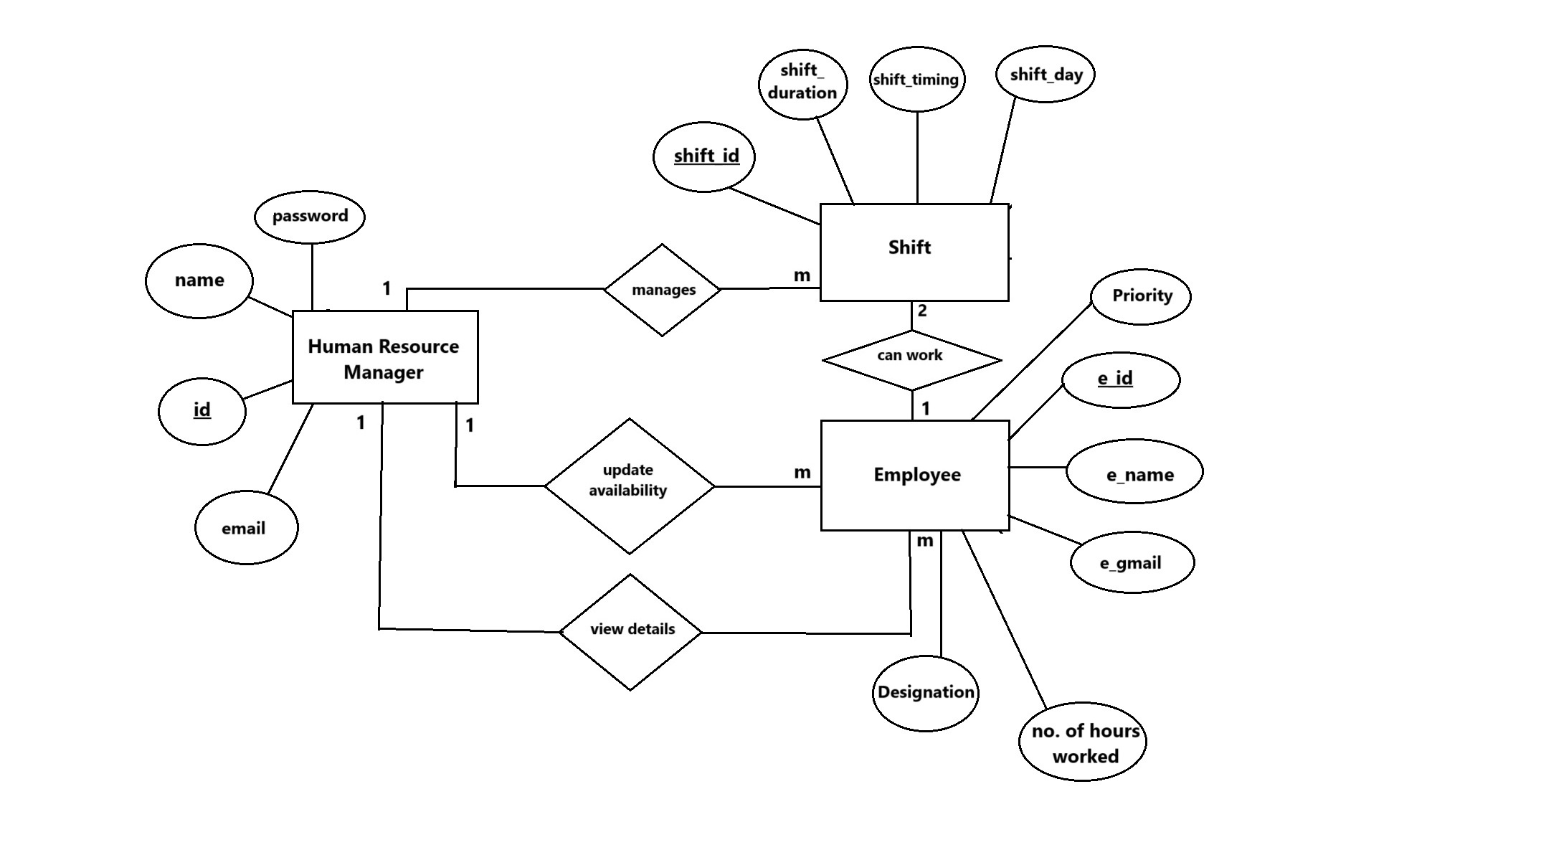
ENTITY-RELATIONSHIP DIAGRAM
Figure: Entity-Relationship Diagram

Slide 10
PARAMETERS
TIMEFRAME
Number of employees to assign for that time-instance.
WORKLOAD
Number of working hours per week for an employee
MAX SHIFTS PER DAY
The maximum number of shifts an employee can work per day
CRITICALITY
Importance of a certain position of employee for smooth operation

Slide 11
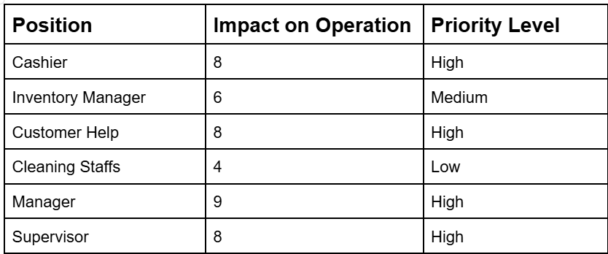
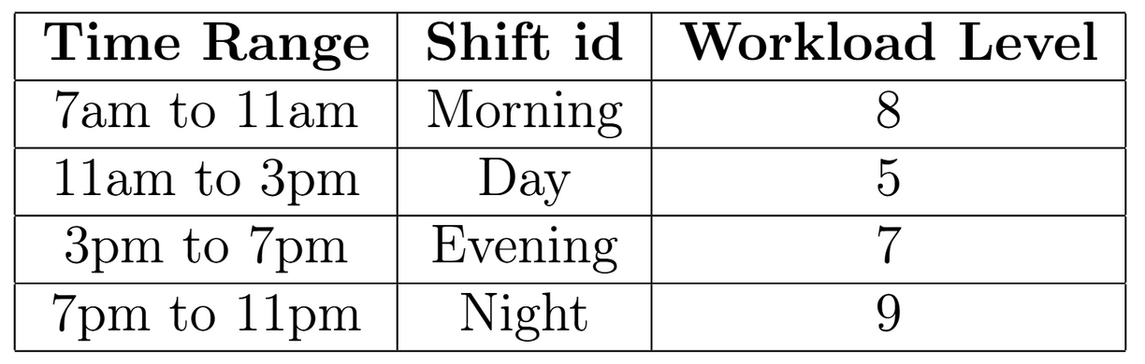
ASSUMPTIONS
Workload is defined manually by surveying the number of customers visiting
the department store during specific time frames.
Table: Shift and Workload Level
Table: Position and Priority Level

Slide 12
{ “Cashier” : 46 ,
“Inventory Manager” : 38 ,
“Supervisor” : 56 ,
“Cleaning Staff” : 48 ,
“Customer Help” : 42 ,
“Manager”: 58 }
MAX WORKING HOURS
Represented in form of dictionary
MAX SHIFTS PER DAY
An employee can work a maximum of 2 shifts per day
If working on multiple shifts , the shifts must not be consecutive i.e
(Morning , Day ) is not possible

Slide 13
METHODOLOGY

Slide 14
HOW ARE THE SHIFTS ASSIGNED ?

Slide 15
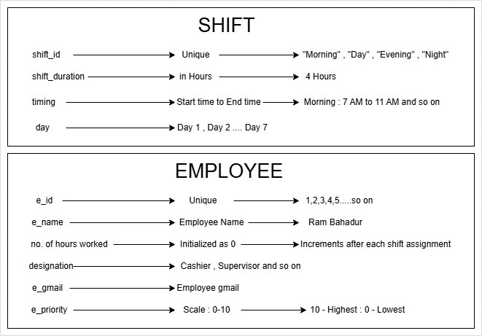
DATABASE SCHEMA STRUCTURE
Figure: Database Schema Structure of Shift and Employee

Slide 16
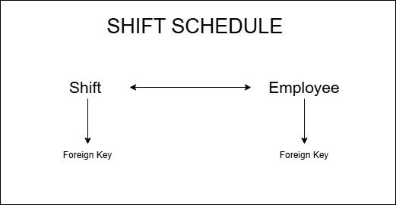
Figure: Link between Shift and Employee

Slide 17
ASSIGNMENT FUNCTION
Parameters
shifts - dictionary of shifts for each day
employees_by_designation - dictionary of employees grouped by designation
designation_counts
MAX_WORKING_HOURS
MAX_SHIFTS_PER_DAY

Slide 18
STEP 1 :
Initialize Empty Schedule List
Schedule = [ ]
list = [ 1 , ‘abc’ , 7.29 ]
mutable
allows duplicates
indexing

Slide 19
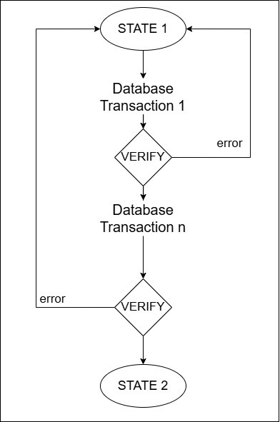
STEP 2 :
Ensure Atomic Transaction
Figure: Visual Representation of Atomic Transaction

Slide 20
STEP 3 :
Iterate through each day in shifts
Initialize assigned_today { }
dictionary
assigned_today =
{
1 : 1,
2 : 1,
3 : 2,
}
Employee with e_id = 1 is assigned 1 shift today
Employee with e_id = 2 is assigned 1 shift today
Employee with e_id = 3 is assigned 2 shifts today
assigned_today { } is reset at the beginning of each day

Slide 21
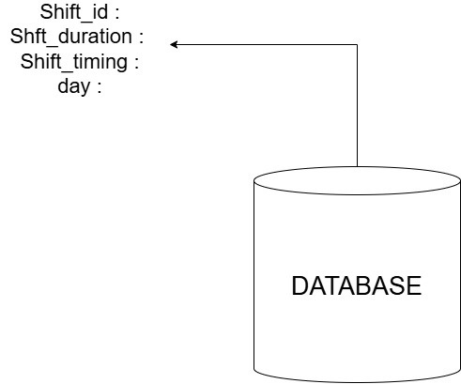
STEP 4 :
Extract Shift Details from database
Shift_id :
Shift_duration :
Shift_timing :
day :
Figure: Extraction of shift details from database

Slide 22
STEP 5 :
Fetch required number of employees per designation per shift
designation_count = {
Cashier : {Morning :6 , Day :8 , Evening :9 , Night : 5},
Supervisor : {Morning :8 , Day :6 , Evening :5 , Night : 4},
Manager : {Morning :6 , Day :8 , Evening :9 , Night : 5},
and so on }
Frontend

Slide 23
STEP 6 :
Filter available employees
Based On
whether they’ve reached Max_shifts_per_day
whether they’ll exceed maximum working hours

Slide 24
STEP 7 :
Prioritize Employee with Least Working Hours
ASSIGN
Employee 1 Employee 2
Working_Hours : 10 Working_hours: 12
Designation : Cashier Designation : Cashier

Slide 25
STEP 8 :
Assign Employees to Shift
assigned_today { chosen_emp }
chosen_emp[Working_Hours] = chosen_emp[Working_Hours] + Shift_duration

Slide 26
STEP 9 :
Store Employee Assignment in Database
i . Fetch Employee from database
ii . Create a ShiftSchedule record to link employee to shift
Figure: Fetching Employee from database

Slide 27
STEP 10 :
Store Assignment in Output Schedule
Schedule = [ Assignment_details ]

Slide 28
HOW OUTPUT IS STORED IN THE LIST
Schedule = [
{ “Day” : “Day1”,
“Shift_id” : “Morning” ,
“Shift_timing” : “7am to 11am”,
“Designation” : chosen_emp [ ‘designation’],
“e_id” : chosen_emp [ ‘e_id’ ],
“name” : chosen_emp [ ‘e_name’ ],
“email” : chosen_emp [ ‘e_gmail’ ],
“Hours_assigned” : chosen_emp [ ‘shift_duration’ ]
“Total Hours After Assignment” : 12 } ,
{ “Day” : “Day2” ,
.................... and so on } ,
]

Slide 29
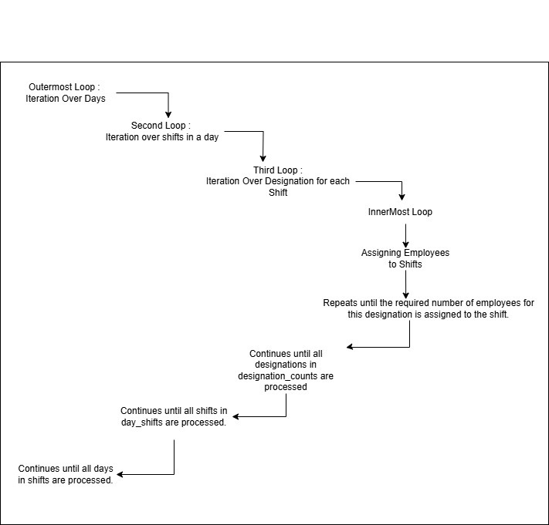
NESTED FOR LOOP
Figure: Nested For Loop of assignment function

Slide 30
OTHER FUNCTIONALITIES

Slide 31
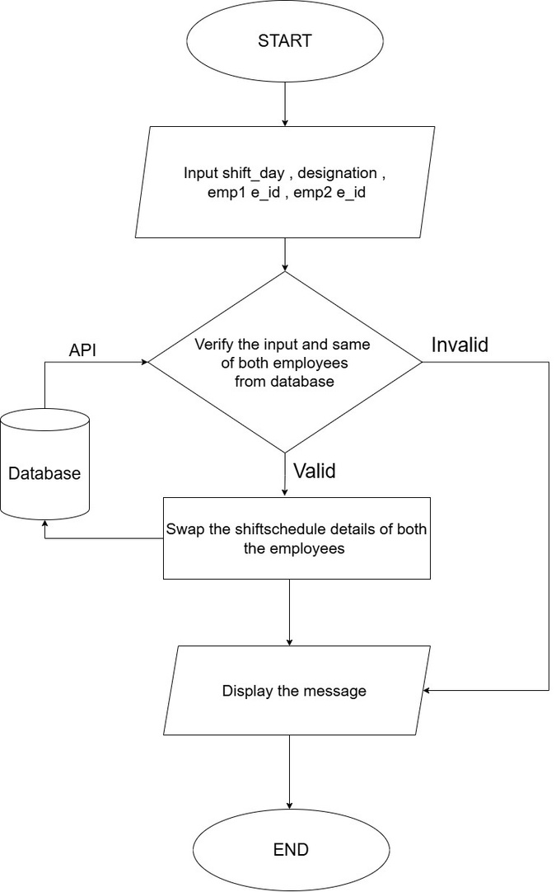
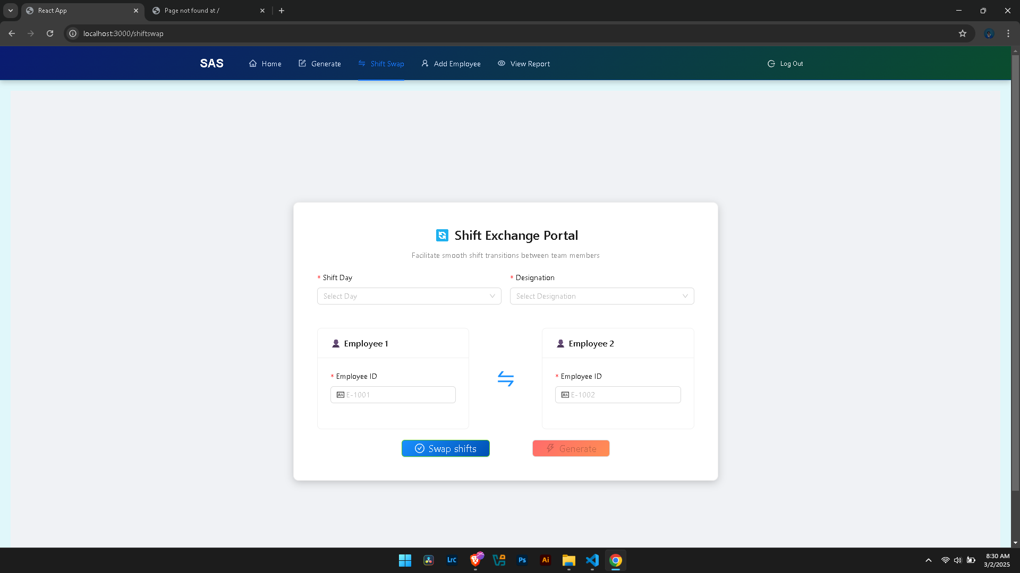
Swap
Figure: Flowchart for Swap Shift functionality

Slide 32
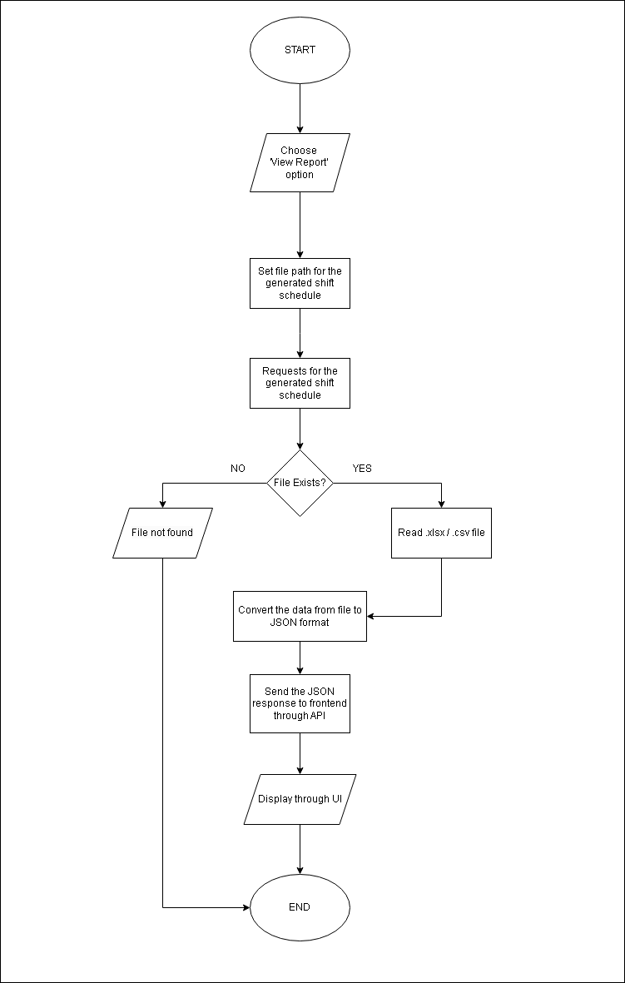
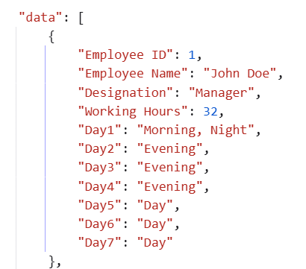
View Report
Figure: Flowchart for View Report functionality

Slide 33
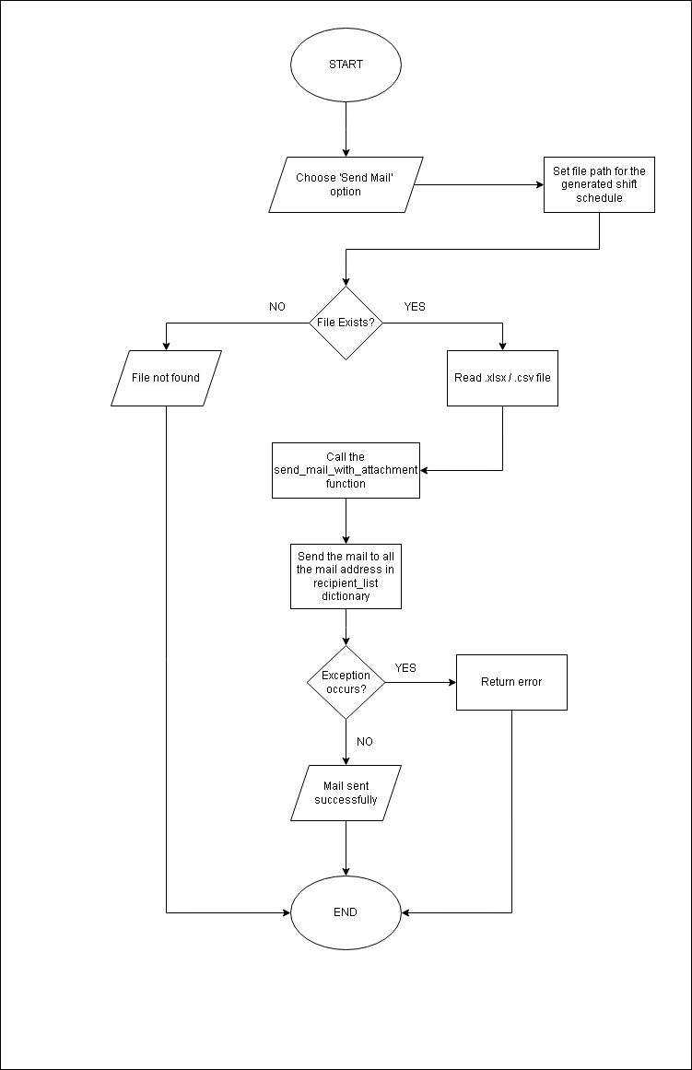
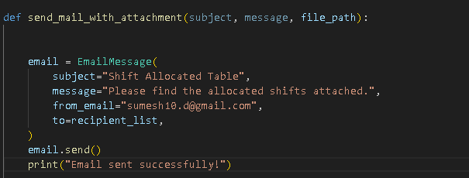
Send Email
Figure: Flowchart for Send Email functionality

Slide 34
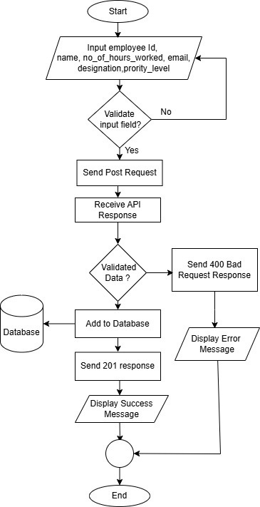
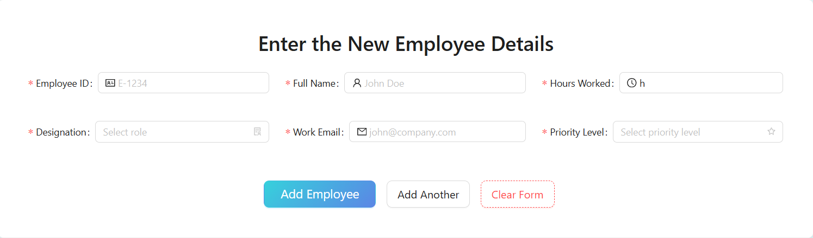
C
ADD EMPLOYEE
reate
Figure: Flowchart for Add Employee functionality

Slide 35
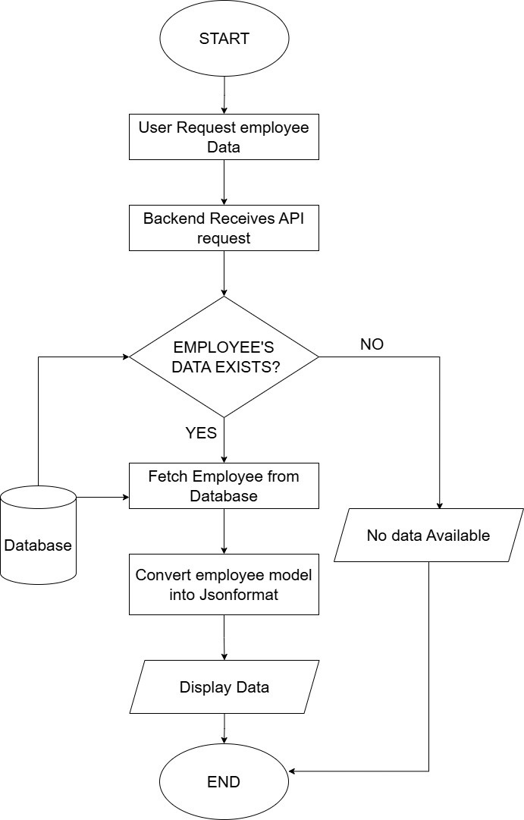
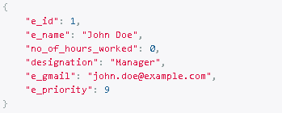
R
VIEW EMPLOYEE
etrieve
Figure: Flowchart for View Employee functionality

Slide 36
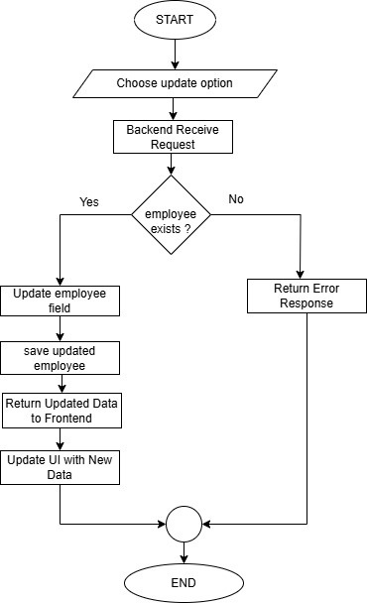
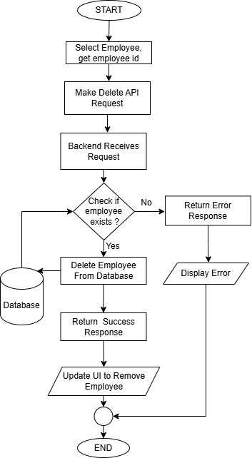
U
D
pdate
elete
Figure: Flowchart for Update Employee functionality
Figure: Flowchart for Delete Employee functionality

Slide 37
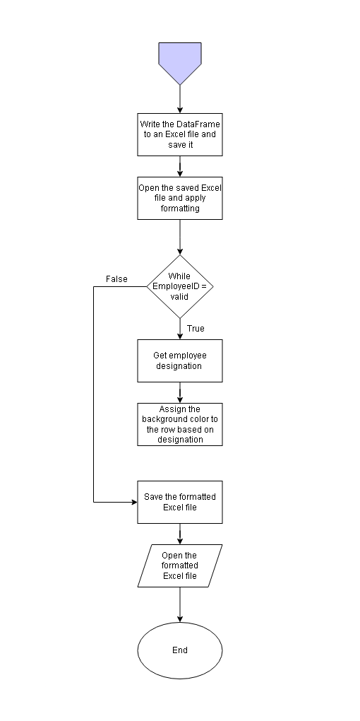
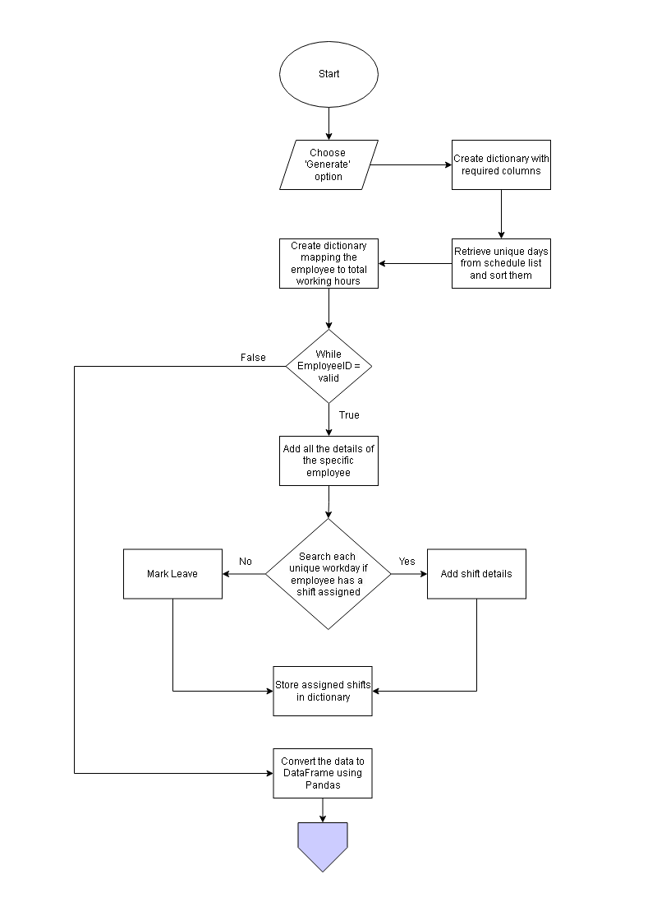
Conversion of Schedule list to Excel
Figure: Flowchart for conversion of schedule list to Excel

Slide 38
RESULTS

Slide 39
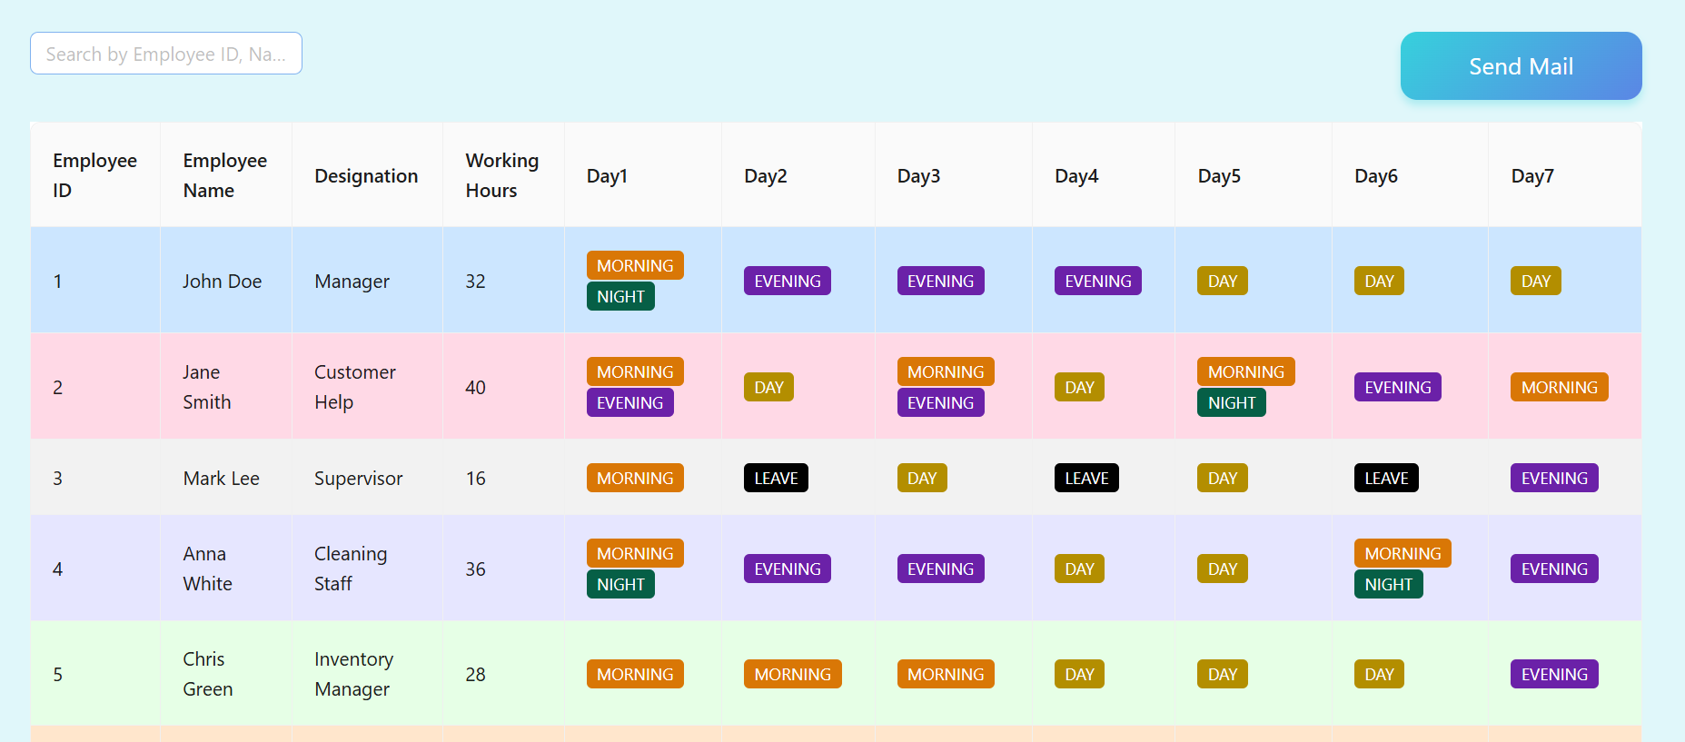
OUTPUT SCHEDULE
UI snippet : Output Schedule Overview

Slide 40
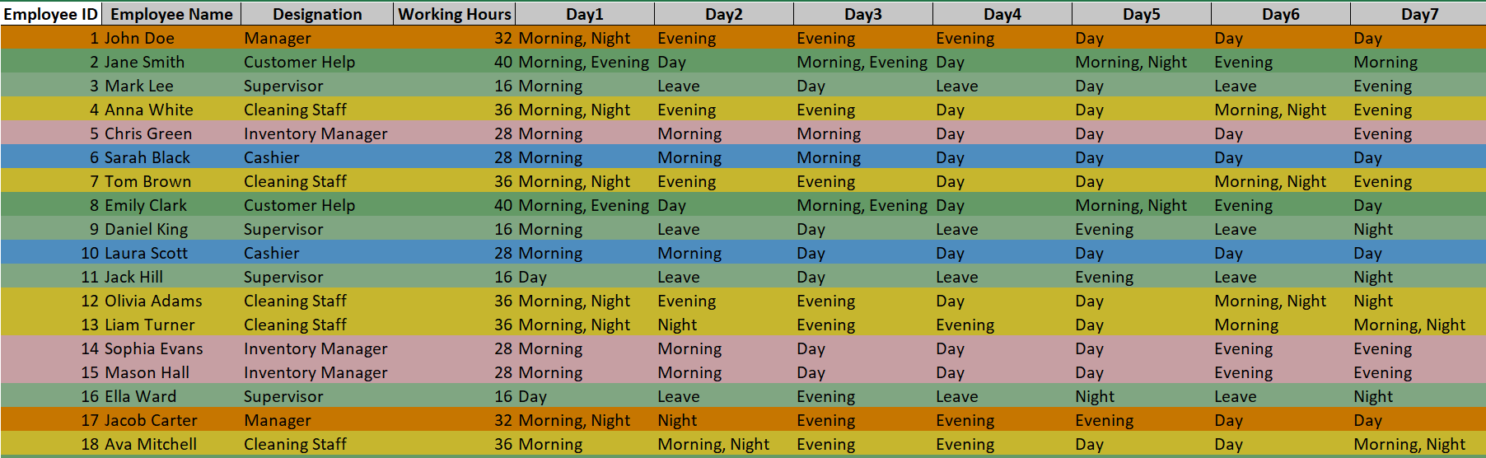
OUTPUT SCHEDULE IN EXCEL FORMAT

Slide 41
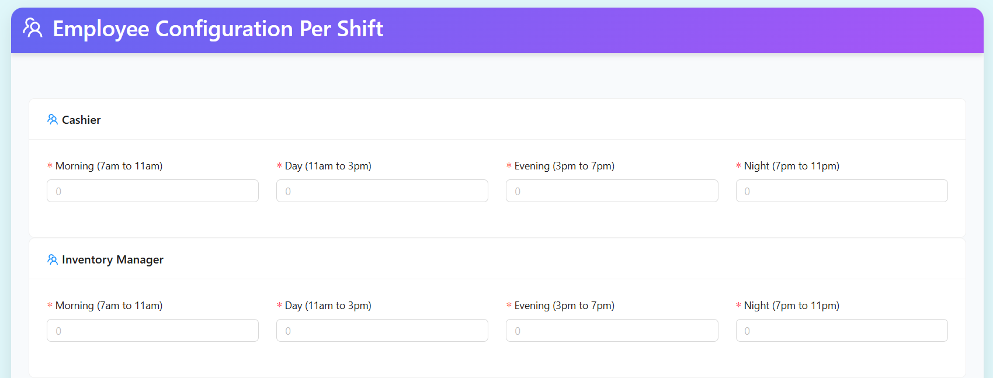
EMPLOYEE INPUT PORTAL
UI snippet: Employee Input overview

Slide 42
SHIFT SWAP PORTAL
UI snippet: Shift Swap overview

Slide 43
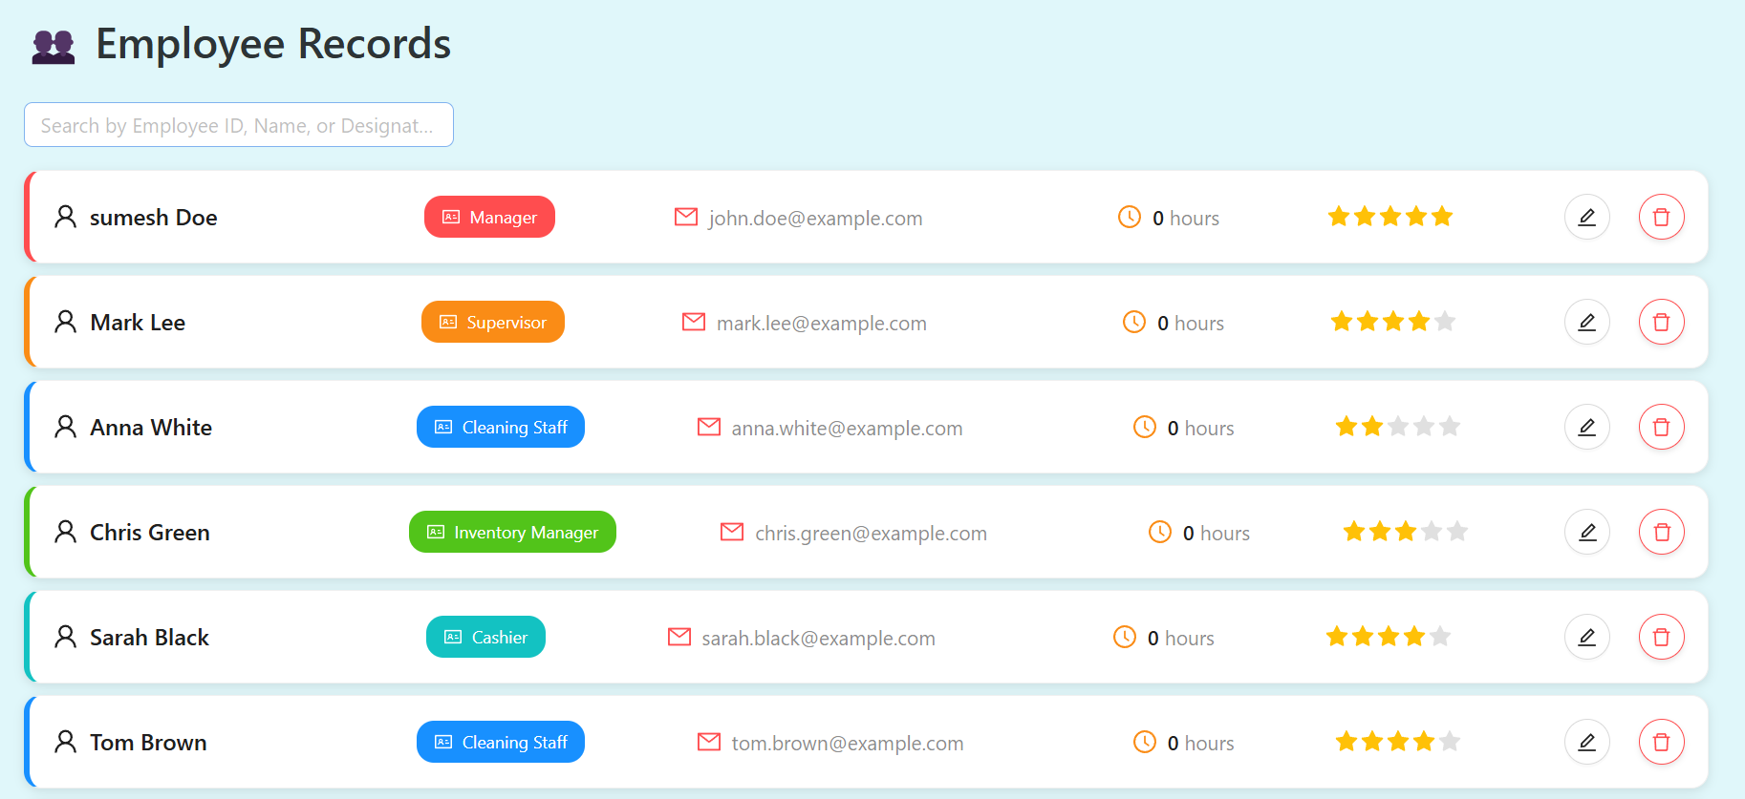
EMPLOYEE RECORDS DISPLAY PORTAL
UI snippet: Employee Records overview

Slide 44
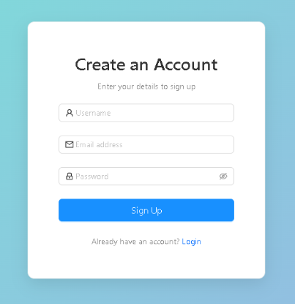
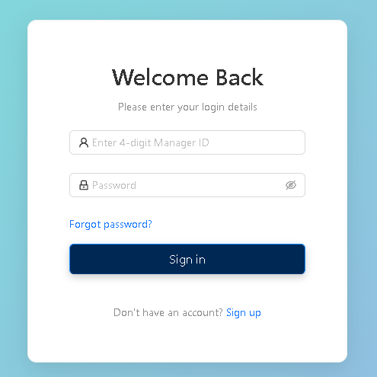
SIGNUP PAGE
LOGIN PAGE
UI snippet: Signup overview
UI snippet: Login overview

Slide 45
EMPLOYEE ADD PORTAL
UI snippet: Employee Add overview

Slide 46
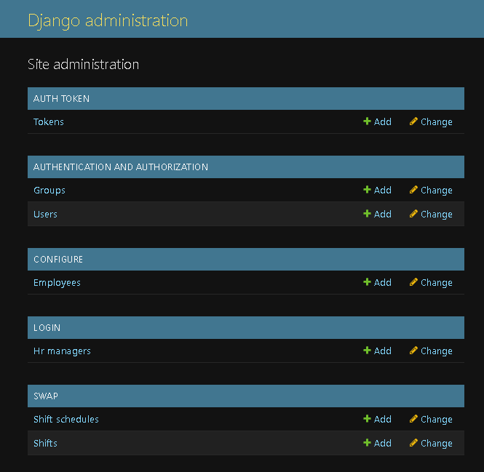
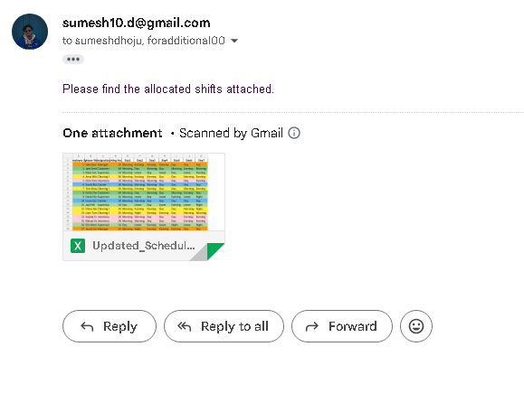
ADMIN DASHBOARD
SEND MAIL
Backend Snippet: Admin Dashboard
overview
Backend Snippet: Send Mail
overview

Slide 47
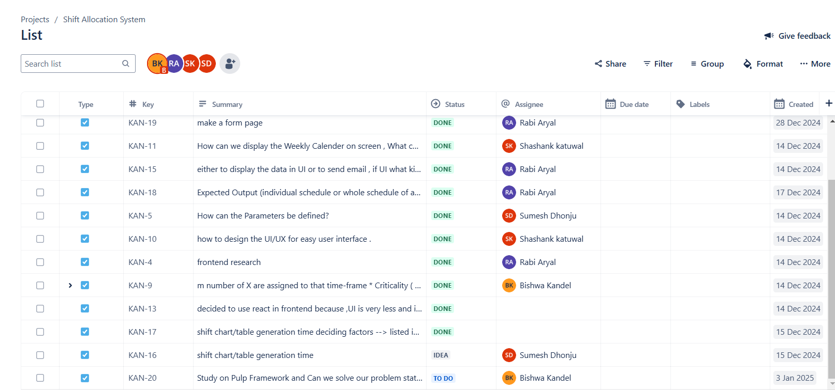
PROGESS TRACKING USING JIRA
Snippet: Progress Tracking overview

Slide 48
CONCLUSION
The Shift Allocation System has proven to be an effective workforce management tool by automating shift assignments and enhancing operational productivity. By minimizing manual workload and ensuring fair shift distribution, the system significantly improves workforce efficiency and scheduling accuracy.

Slide 49
THANK YOU !

Slide 50
DEMONSTRATION

