Slide 1
DATA VISUALIZATION TECHNIQUES FOR ECONOMISTS (ECO346)
Annual Earnings Distribution & Career Lifecycle in Urban KP
Empirical Analysis of the PSLM 2019–20 Microdata: Distribution, Makeover & Cross-Language Reproduction
STUDENT PROFILE
Student Name: Rabia Tahir
Registration No: FA24-BED-093
Email Address: rabii.okiee@gmail.com
Programme / Batch: BS Economics with Data Science (FA24-BEDS)
Semester & Section: Semester 5 (Section A)
Instructor: Dr. Rafi Amir-ud-Din
ASSIGNED VARIANT
Rule: Last 2 digits mod 8 (93 % 8 = 5)
Variant Number: Variant 5
Region / Sector: KP Urban (Khyber Pakhtunkhwa)
Filter Codes: prov_code == 1, urban_rural == 2
Sample Restriction: Aged 15–64, earn_annual > 0
Total Earners: N = 678 individuals
DELIVERABLES SUMMARY
Q1: Public GitHub Repo (6 clean commits)
Q2: Weighted Log Density Distribution (R)
Q3: Age-Earnings Relationship Redesign (R)
Q4: Visual Makeover (Default vs Redesign)
Q5: Exact Reproduction in Python (Matplotlib)
Q6: Executive Briefing Deck (4 Slides)

Slide 2
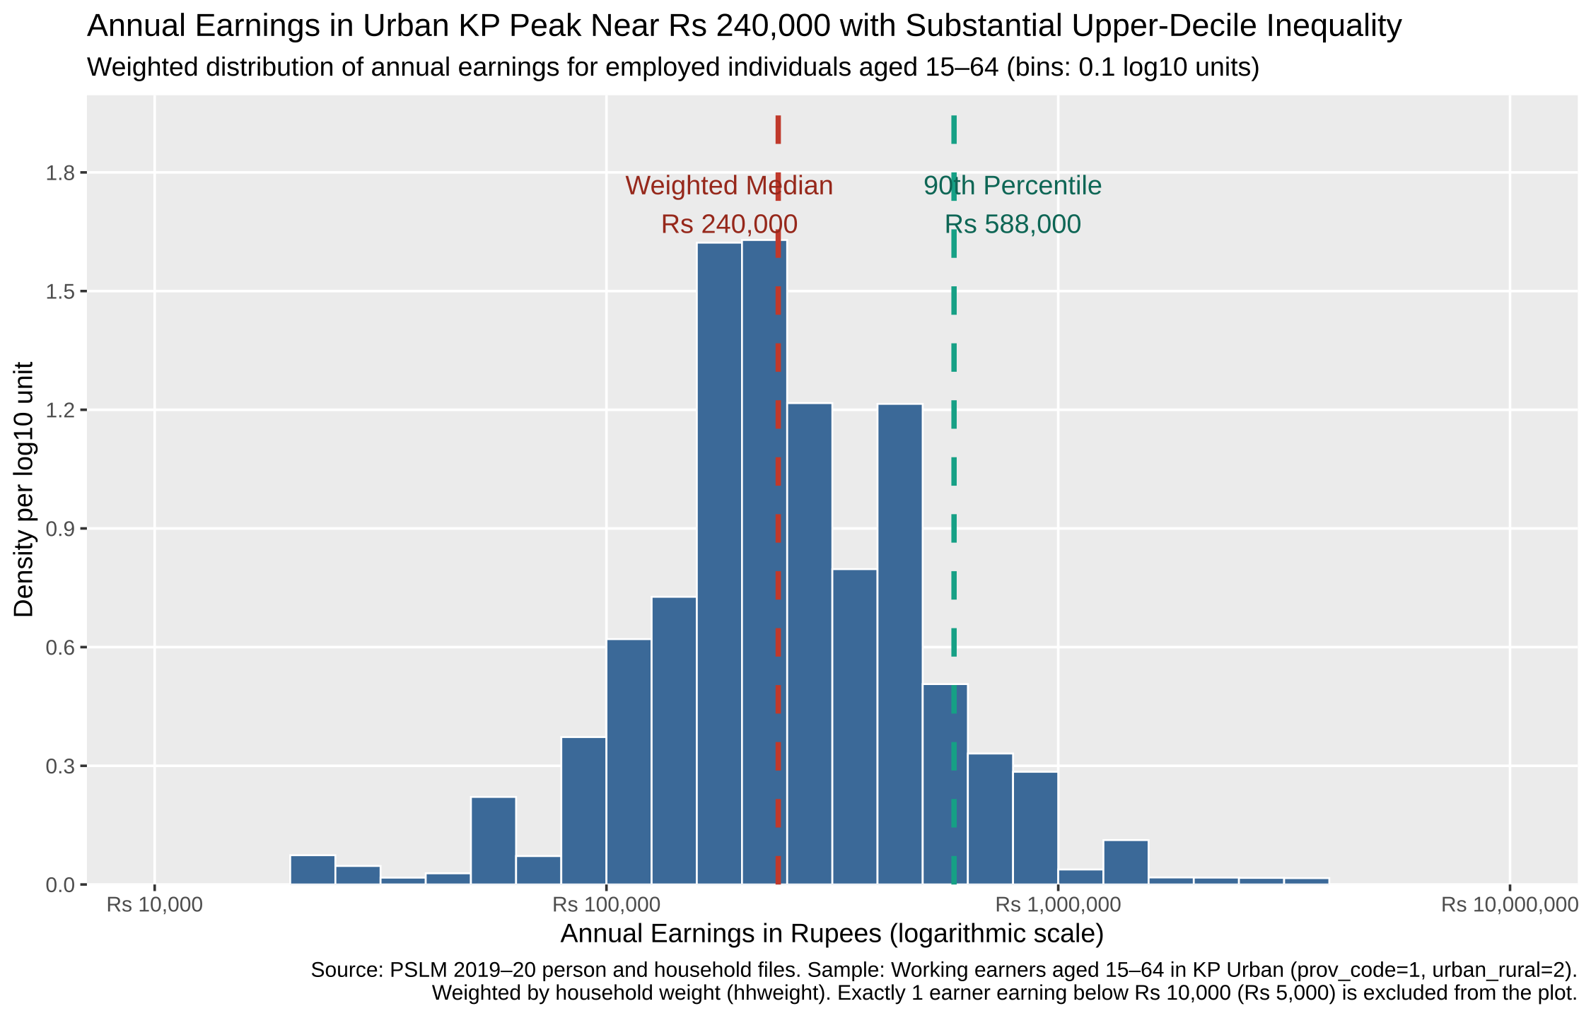
ECO346 · DATA VISUALIZATION TECHNIQUES FOR ECONOMISTS
Question 2: Annual Earnings Distribution in Urban KP
SUMMARY OF FORM METRICS
• Total Earners Sample: 678 working individuals
• Excluded Outliers (<Rs 10k): 1 earner (Rs 5,000 at age 56)
• Weighted Median: Rs 240,000
• Unweighted Median: Rs 240,000 (Exact match)
• Weighted 10th Percentile (P10): Rs 108,000
• Weighted 90th Percentile (P90): Rs 588,000
• Decile Ratio (P90 / P10): 5.44 (Top decile earns 5.4x)
ECONOMIC INTERPRETATION (F4)
The distribution is unimodal and roughly log-normal, peaking between Rs 200,000 and Rs 300,000 with upper-tail skewness. The weighted and unweighted medians are identical at Rs 240,000 because household sampling weights are distributed symmetrically near the center of the earnings distribution, placing cumulative 50% mass at the same discrete wage mode.

Slide 3
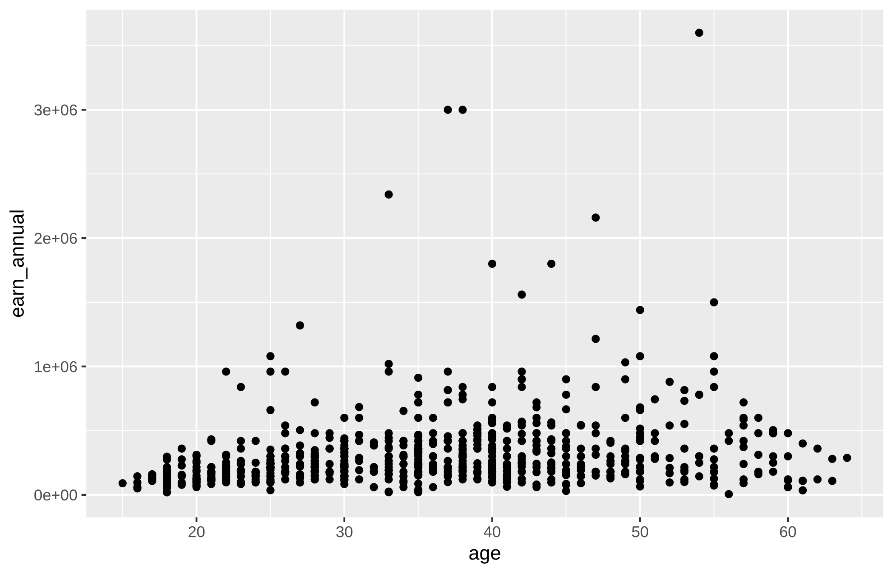
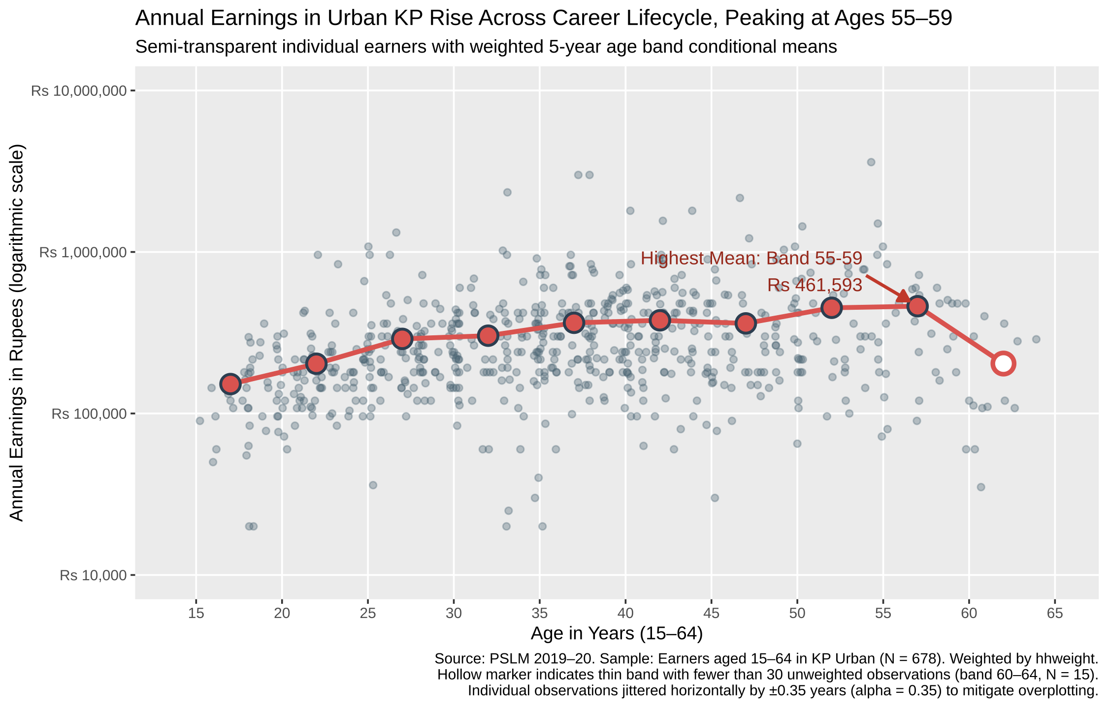
ECO346 · DATA VISUALIZATION TECHNIQUES FOR ECONOMISTS
Question 4: The Makeover — Default vs. Redesign
R DEFAULT (ggplot2 untouched)
REDESIGN (Principled Data Visualization)
CORE DESIGN PRINCIPLES & VISUAL TRADE-OFF
1. Logarithmic Vertical Scale (Perceptual Channel Resolution): The default linear scale crushes 95% of earners against the baseline due to positive skewness. Logarithmic scaling normalizes proportional earnings variance across income brackets.
2. Jittering (±0.35) & Alpha (0.35) (Overplotting & Data–Ink): Integer ages produce artificial vertical stripes; horizontal jitter and transparency reveal true bivariate density while preserving accurate age measurements.
3. Weighted Conditional Means & Thin Markers: Extracts the lifecycle signal from noise; hollow marker distinguishes small-sample variance (age 60-64).
• What the default shows that redesign hides: Default linear coordinates display absolute rupee distances (raw wealth gap), which log compression visually attenuates.

Slide 4
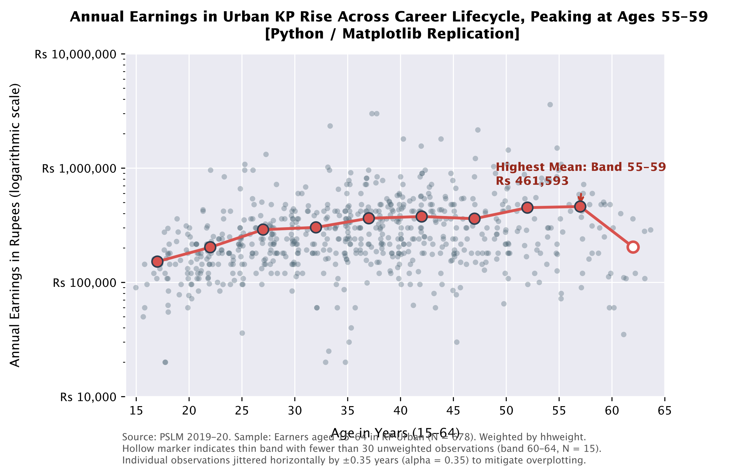
ECO346 · DATA VISUALIZATION TECHNIQUES FOR ECONOMISTS
Questions 3 & 5: The Lifecycle Curve & Cross-Language Reproduction
THE ONE MOST IMPORTANT FINDING
• Late-Career Peak: Earnings climb monotonically from labor entry (Rs 152k at 15–19) to peak at ages 55–59 (Rs 461,593), reflecting cumulative experience and seniority premiums in urban KP.
• Retirement Precipice: Post-60 earnings drop precipitously by 56% to Rs 203,724 in band 60–64 (hollow marker, N=15 thin band), driven by physical health attrition, transition to lower-hour self-employment, and lack of universal pension coverage.
• Cross-Sectional Limitation: The figure cannot distinguish genuine individual lifecycle aging from generational cohort effects (e.g., younger cohorts having higher urban educational attainment) or survivor bias.
PYTHON REPLICATION VERIFICATION (Q5)
• Band 25–29 Mean: Rs 289,679 (R) == Rs 289,679 (Python) — 100% Exact to the Rupee!
• Peak Band 55–59: Rs 461,593 (R) == Rs 461,593 (Python)
• Default Differences: Matplotlib defaults to no jittering, linear scale, and opaque markers. Explicitly configured horizontal uniform jitter (±0.35), log10 y-scale with rupee tick formatters, and imported dvte.mplstyle to match R's visual grammar.

