Slide 1
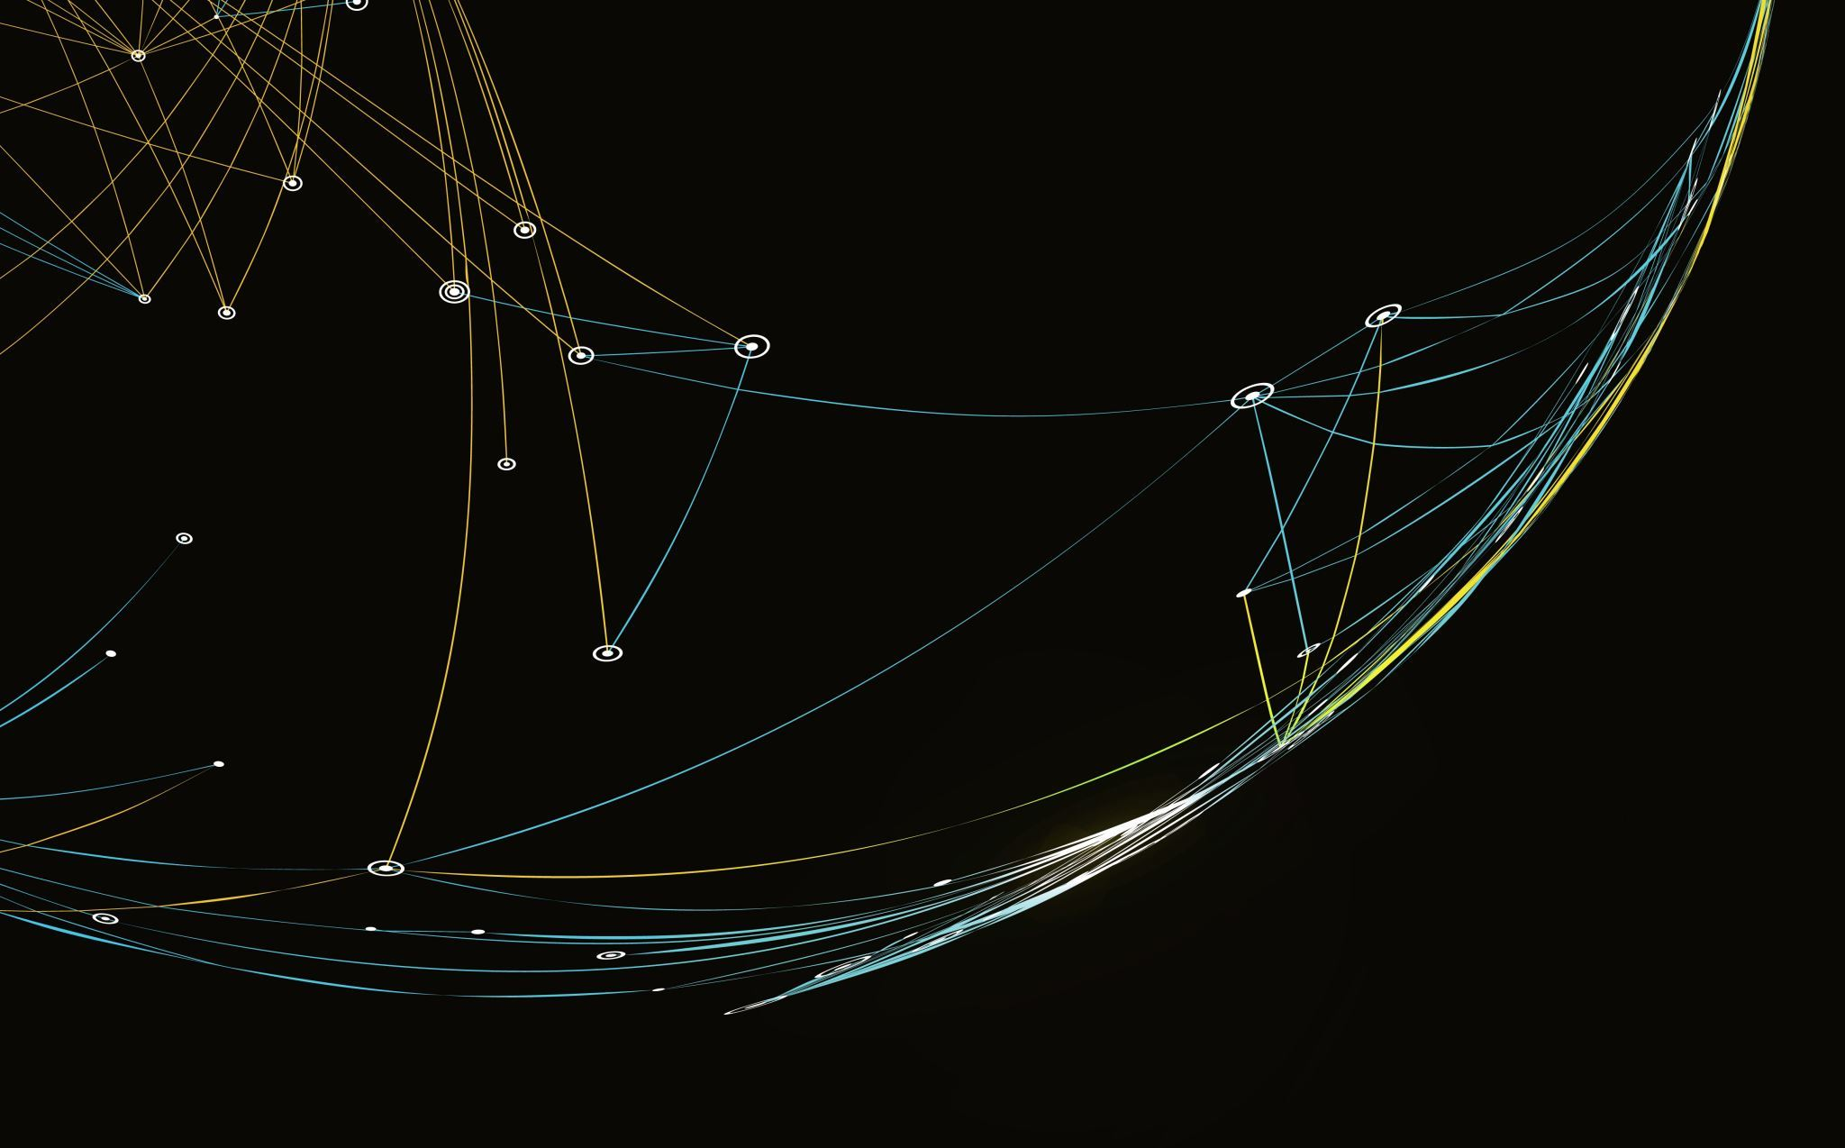
Malware Detection
Presented by: Heidi Raber and Brandon Walker

Slide 2
Problem
Malware is downloaded accidently
Theft caused by malware can cost money and computers' capabilities
Malware can look just like good-ware, but it is misleading

Slide 3
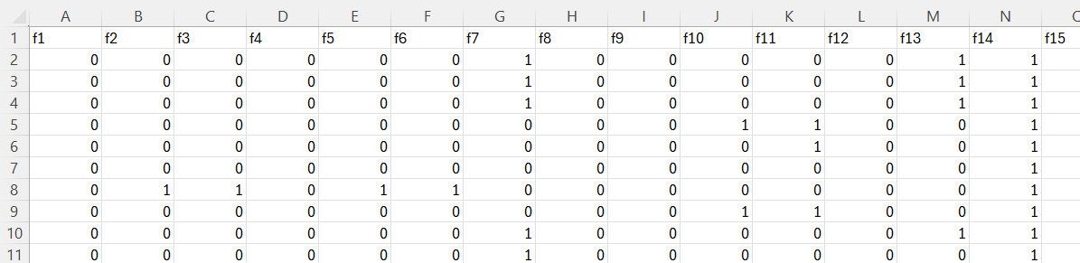
Data Set
Samples of Android applications (~15000 samples)
Features: 215 API calls

Slide 4
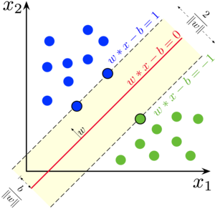
Models
New
Support Vector Machine
Stacking Model
Naïve Bayes
Support Vector Machine

Slide 5
Models (cont.)
Learned in the semester
Linear Regression (SGD with Adam)
Decision Tree
Logistic Regression
K-Nearest Neighbor
AdaBoost
Random Forest
Gradient Boosting
Ensemble (Majority Vote and Weighted)

Slide 6
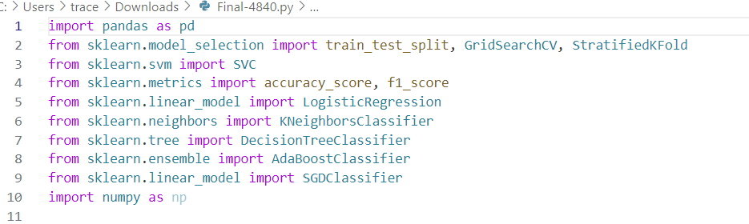
Experiment
Data split 80% for training and 20% for testing
VSCode and Scikit-Learn

Slide 7
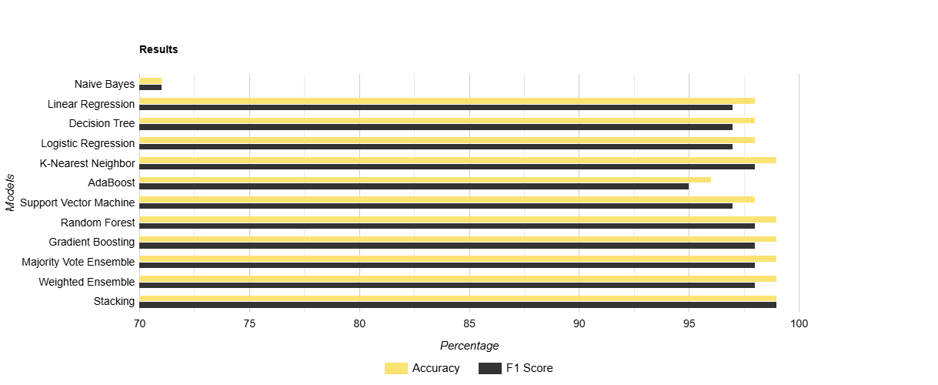
Results
Evaluation Table

Slide 8
Analysis
F1 scores are most important since noticing the malware is more important than having too many false positives
Recommendation: Stacking Model
K-Nearest Neighbor Model also did very well

Slide 9
Conclusion & Future Work
Great results and promise for the future
Finding a large dataset and hardware that can handle it is important
For ensemble learning, novelty of models is important

