Slide 1

OmniMediaTrak

Slide 2

Executive Summary:
OmniMediaTrak is a global media tracking platform covering books, manga, anime, games, podcasts, live events, and more.
The platform starts with a single-region, managed-first stack and evolves into multi-region compute with a single logical database that scales via partitioning, indexing, and replicas.

Slide 3
Primary Goals:
Low operational burden (managed services)
Fast catalog browsing and personal list tracking
Clear path to scale and add features without redesign

Slide 4
Scope by Phase:
Phase 0 (MVP): catalog browsing, auth, personal lists, local/manual ingestion
Phase 1: multi-region compute failover
Phase 2-3: EU/APAC compute for latency
Phase 4: database scaling hardening (partitions, indexes, replicas)
Phase 5: social features via derived read models

Slide 5
Front End:
Next.js App Router + TypeScript
Catalog browsing and personal lists
Table-first UI with filters, columns, and list actions
Parity checklist for the original UI layout

Slide 6
Back End:
Fastify + TypeScript (OpenAPI-first target)
REST API for media, lists, relationships, and auth
OpenAPI-first contract with shared schemas (planned)
Admin token for privileged media CRUD

Slide 7
Database:
single PostgreSQL DB with schema isolation
Single Postgres database with schema isolation (`media`, `users`, `interaction`, `auth`)
`media.media` holds canonical metadata; type-specific fields in JSONB
`interaction.user_media` hash-partitioned by `user_id`
Relationships modeled as explicit graph edges

Slide 8
Backlog:
API: OpenAPI-first contract + generated typed client
UI: TanStack Query/Table + Tailwind adoption
Data: Postgres FTS/pg_trgm for search
Observability: Sentry + structured logging
Mobile: Expo app start
Specific media pages
Profile page
Auth: OIDC providers (Google/Apple), account linking, 2FA
Reviews: API + UI
Ads/consent system, social features, subscriptions

Slide 9
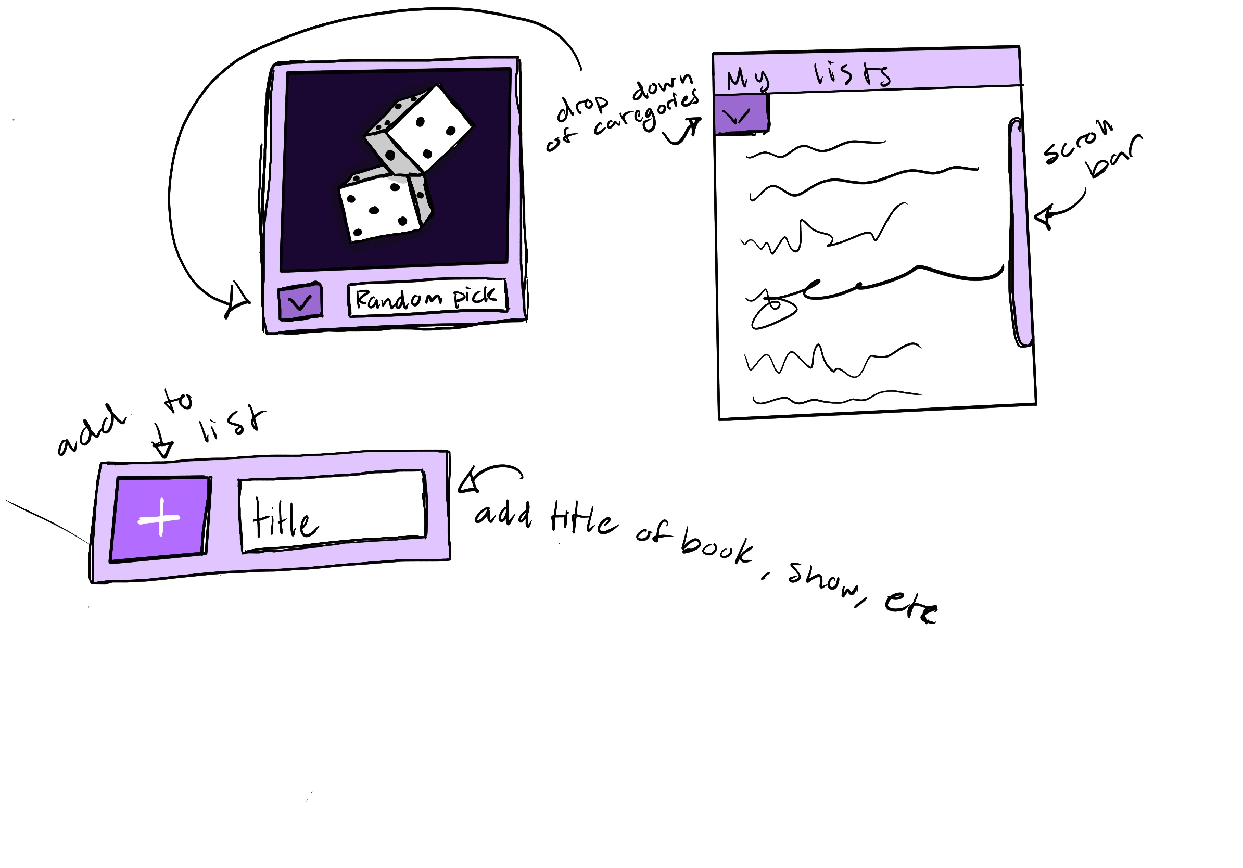
Widget Mockups
Small widget to add titles to existing list
Medium widget to pick random show/movie/etc with optional genre selector
Large widget to view lists with optional category/genre selection

