Slide 1
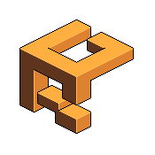
Preserve your 2D game’s aspect ratio with no effort Works with any orthographic camera Works on mobile devices Works with Unity UI Canvas Includes “Shooting Gallery” mini-game example
LetterBoxer

Slide 2
Preserves your game’s aspect ratio
On 5:4 screen without LetterBoxer
sides of game play area are lost
Game designed for 16:9 aspect ratio
On 5:4 screen with LetterBoxer
sides of game play area are made visible by adding mattes to the top and bottom of the screen

Slide 3
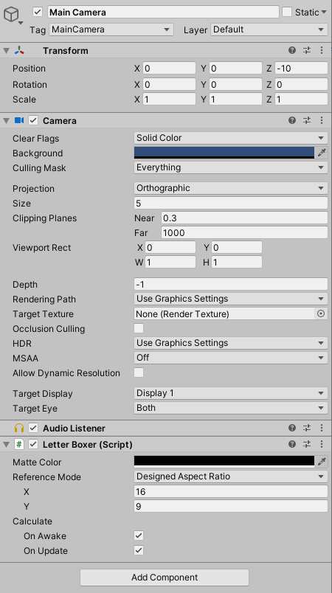
Setup the Component
1
On your Main Camera game object
Add the Letter Boxer script by clicking on the Add Component button
Specify the X and Y of your target aspect ratio
Set Matte Color to the color that you want your letterbox or pillarbox bars to be
!
!
This asset ONLY works for cameras with Projection set to Orthographic
2
4
3

Slide 4
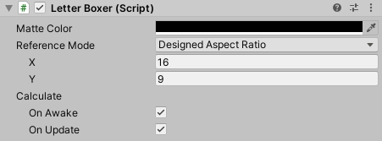
Advanced Configuration
Matte Color – The color for the letter/pillar matte bars
Reference Mode – Used to toggle how the target aspect ratio is calculated.
Designed Aspect Ratio – Lets you specify an aspect ratio using X and Y values. For example 16 by 9
Original Resolution – Lets you specify an aspect ration by specifying the width and height, in pixels, of the screen your game as originally designed to fit
Calculate On Awake – The component will calculate the aspect ratio and letterbox the screen during OnAwake() of the main camera
Calculate On Update – The component will calculate the aspect ratio and letterbox the screen during OnUpdate() of the main camera. This means every frame so will have some performance impact.
1
2
3
4

Slide 5
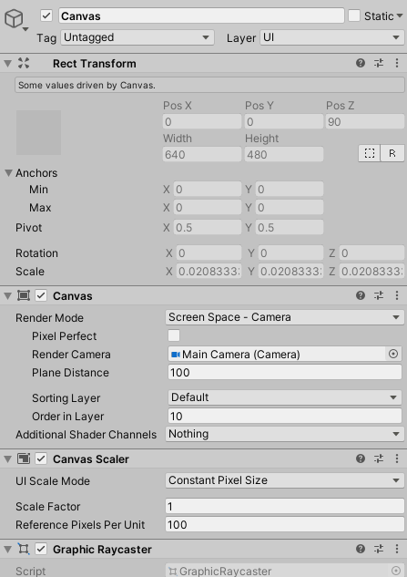
Unity UI
To have your UI scale with the letterboxed screen:
Set Render Mode to Screen Space - Camera
Set Render Camera to your camera that has the Letter Boxer script attached to it
Set Order in Layer to a high number so that your UI appears on top of any other sprites
1
2
3

