Slide 1
MSCS 634 | FINAL PROJECT
Wine Quality Data Mining
From chemical measurements to practical, responsible decision support
Rabi Gurung
University of the Cumberlands
MSCS634 - B01 Advanced Big Data and Data Mining
Dr. Satish Penmatsa
Aug 21, 2026
EDA | Regression | Classification | Clustering | Pattern Mining
UCI Red Wine Quality Dataset
Notes:
Hello everyone. This presentation summarizes my final MSCS 634 project on wine quality data mining. I used the UCI Red Wine Quality dataset to move from exploration into prediction and practical insights. I will cover the data, the main findings, the models, and the limits of using these results in real decisions.

Slide 2
Dataset and preparation
02
Starting with a usable, consistent foundation
1,599
- Chemical measurements plus a quality score
- Removed duplicates and reviewed noisy outliers
- Used the cleaned dataset consistently across deliverables
- Kept the workflow reproducible from preparation to modeling
raw red-wine records
Why it matters
Careful preparation reduces noise before the models learn from the data.
MSCS 634 | Wine Quality Data Mining
Notes:
The raw dataset contains 1,599 records of red wine. Each record includes chemical measurements, such as alcohol and acidity, plus a quality score. I removed duplicates and reviewed noisy outliers before modeling. This matters because clean and consistent data gives every later analysis a more reliable starting point.

Slide 3
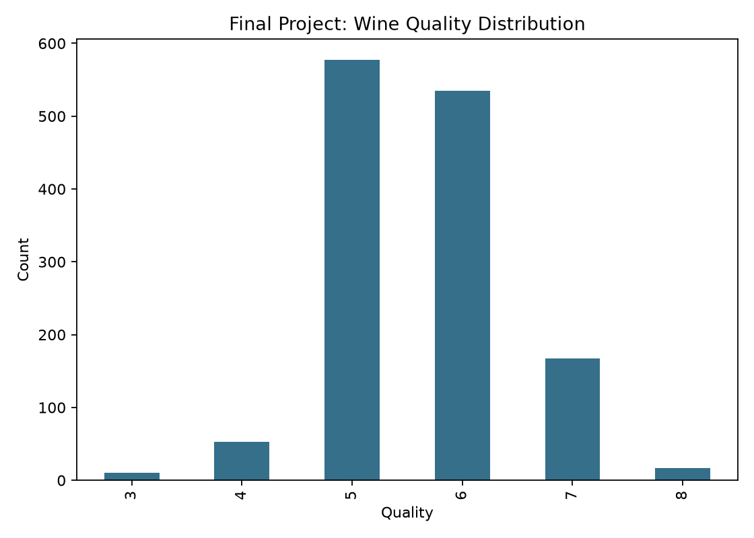
Exploratory insights
03
The data already points to the strongest quality signals
- Most quality scores are concentrated around 5 and 6
- Alcohol has a positive relationship with quality
- Volatile acidity has a negative relationship with quality
- Outliers are important in several chemistry variables
Quality distribution from the project dataset
MSCS 634 | Wine Quality Data Mining
Notes:
This chart shows that most wines in the dataset received quality scores of five or six. The exploratory analysis also revealed two clear patterns. Higher alcohol tends to be associated with higher quality, while higher volatile acidity tends to be associated with lower quality. These early patterns helped guide the later modeling choices.

Slide 4
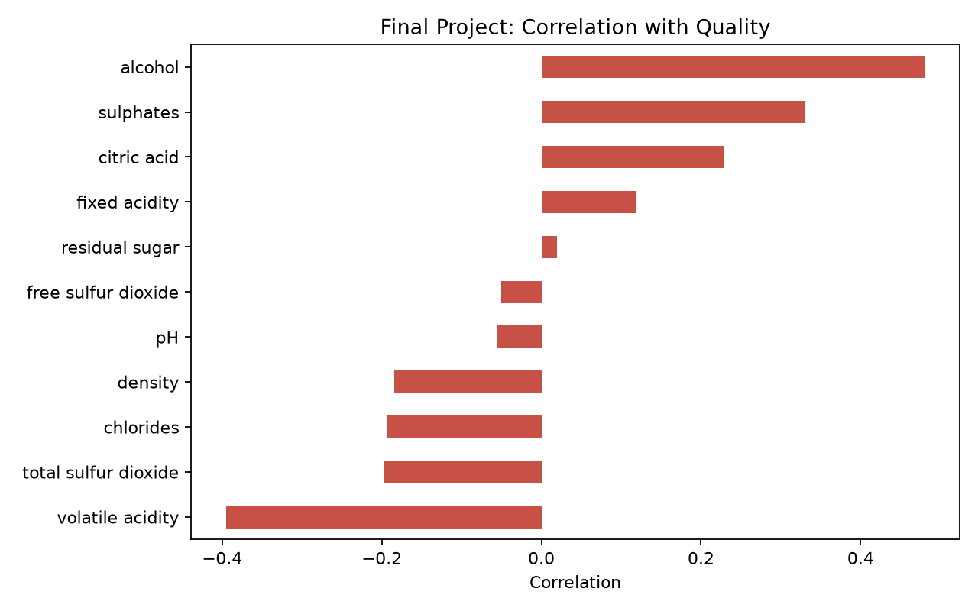
Regression findings
04
Predicting the numeric quality score
- Tested Multiple Linear Regression and Ridge Regression
- Evaluated R-squared, MSE, RMSE, and cross-validation
- Prediction was useful but modest
- Ridge offered a more stable option for this dataset
Feature relationships supporting model interpretation
MSCS 634 | Wine Quality Data Mining
Notes:
For regression, I predicted the numeric quality score using Multiple Linear Regression and Ridge Regression. I assessed the models with R-squared, mean squared error, root mean squared error, and cross-validation. The results showed modest predictive power. Ridge regression was preferred because it was more stable. The key message is that chemistry explains part of quality, but not all of it.

Slide 5
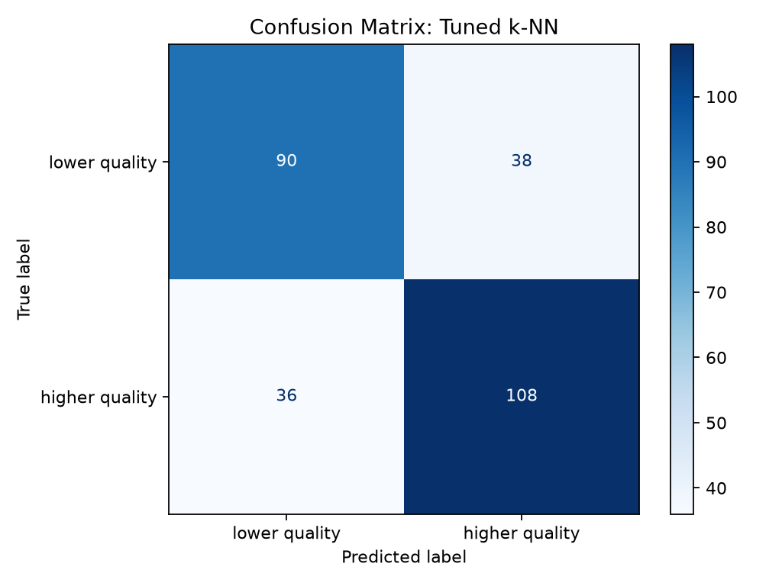
Classification findings
05
Turning quality into a practical screening decision
- Converted quality into a higher-versus-lower class
- Compared Decision Tree and k-Nearest Neighbors
- Tuned k-NN with GridSearchCV
- Accuracy and F1 show potential for early screening
Classification performance summary
MSCS 634 | Wine Quality Data Mining
Notes:
For classification, I changed the quality score into a higher or lower quality category. I compared a Decision Tree with k-Nearest Neighbors, and I tuned k-NN using GridSearchCV. Accuracy and F1 score show that classification can help with an early screening decision. It should support a human review, not replace it.

Slide 6
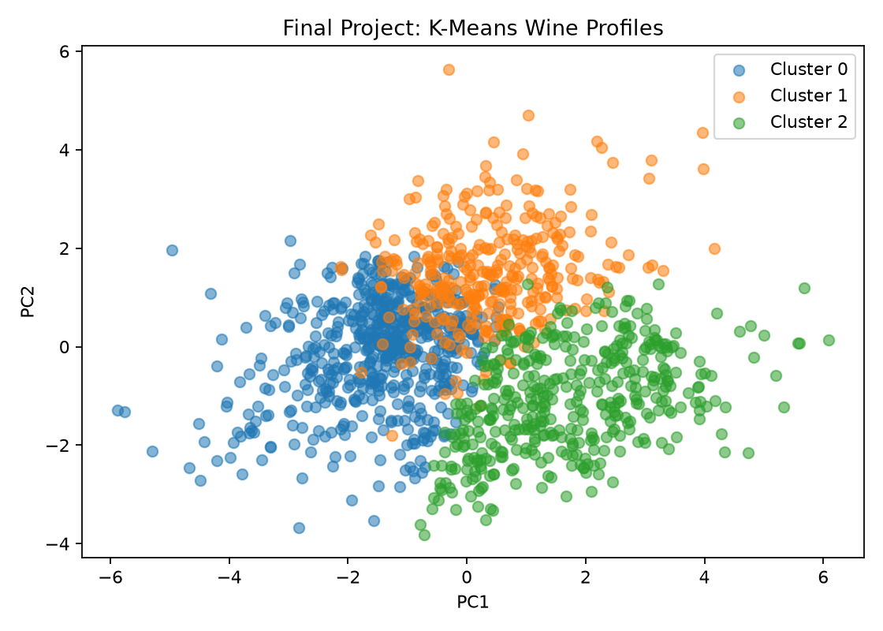
Clustering and pattern mining
06
Finding distinct wine profiles and interpretable relationships
- K-Means identified three chemical profiles
- PCA made the cluster separation easier to see
- Association rules translated patterns into plain language
- Higher alcohol and lower volatile acidity aligned with quality
Three K-Means profiles visualized with PCA
MSCS 634 | Wine Quality Data Mining
Notes:
This part of the project looks beyond prediction. K-Means clustering found three groups of wines with different chemical profiles. The PCA chart makes those groups easier to see. Association rule mining then helped translate the patterns into understandable relationships. One repeated pattern was that higher alcohol and lower volatile acidity were aligned with higher quality.

Slide 7
Ethics and limitations
07
Useful models still need careful boundaries
Use the results as decision support, not as the final decision.
- The dataset represents one wine type and region
- Quality ratings include human and subjective judgment
- Models may not transfer to other wines or consumers
- External validation is required before broad use
MSCS 634 | Wine Quality Data Mining
Notes:
There are important limits to these results. The dataset represents one type of red wine from one region, so the findings should not be treated as universal. Quality scores also include human judgment. For those reasons, the models should be used as decision support. They need external validation before they are used for pricing, marketing, or production decisions.

Slide 8
Recommendations
08
What to carry forward from the analysis
1
Keep the strongest chemical indicators
Alcohol, volatile acidity, sulphates, and density remain useful features.
2
Use models for targeted screening
Use classification for initial screening and clustering for profile-based decisions.
3
Add richer data before expanding use
Future work should include sensory, production, region, and consumer preference data.
MSCS 634 | Wine Quality Data Mining
Notes:
The recommendations are straightforward. First, keep the strongest chemical indicators, especially alcohol, volatile acidity, sulphates, and density. Second, use classification for early screening and clustering for profile-based decisions. Third, improve future models with sensory, production, region, and consumer preference information. That extra context should improve both accuracy and usefulness.

Slide 9
References
Cortez, P., Cerdeira, A., Almeida, F., Matos, T., & Reis, J. (2009). Modeling wine preferences by data mining from physicochemical properties. Decision Support Systems, 47(4), 547-553. https://doi.org/10.1016/j.dss.2009.05.016
UCI Machine Learning Repository. (2009). Wine quality dataset. https://archive.ics.uci.edu/dataset/186/wine+quality
Thank you
Notes:
These are the two primary sources for the project. The Cortez and colleagues study describes the original wine quality data mining work, and the UCI repository provides the dataset. Thank you for listening. I am ready for any questions.

