Slide 1
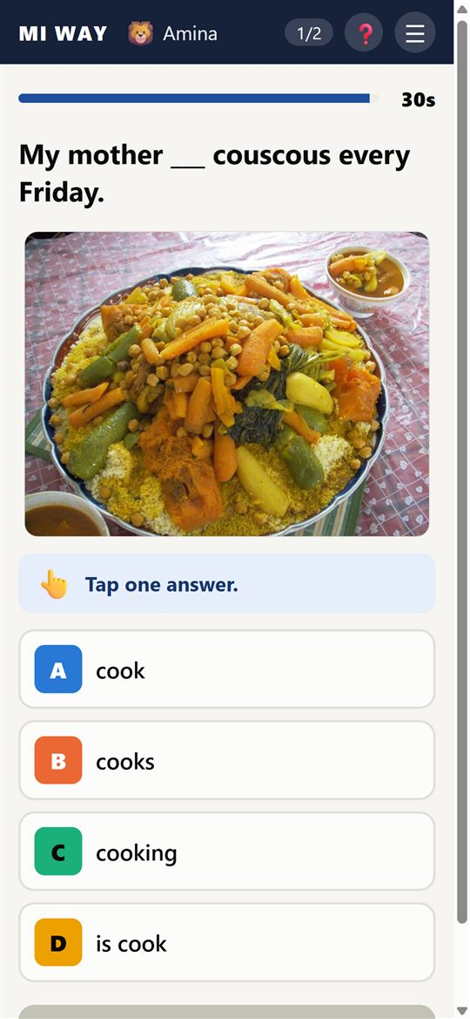
Live English quizzes, no internet
MI WAY Classroom
A demo for teacher training days
Rabii Hajoui · high school English teacher, Morocco
Notes:
Introduce the app in one sentence: every student answers on their phone, with no internet, and the teacher sees at once who understood. It is free and made by a Moroccan teacher.

Slide 2
Three problems in our classes
📶
💰
⏱
No Wi-Fi
No budget
No time
Most quiz tools need the internet.
Free plans are limited or full of ads.
Making a quiz for every lesson takes hours.
And the real question: who understood, and who did not?
Notes:
Ask participants: how many of you have reliable Wi-Fi in class? The three problems are network, budget and preparation time.

Slide 3
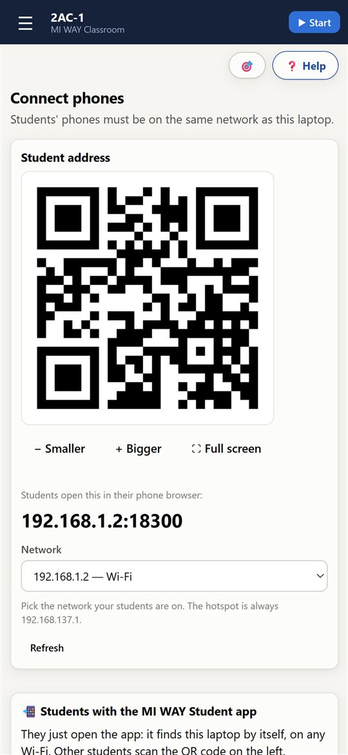
Ready in one minute
1
Hotspot
The teacher's phone or laptop makes the network. No internet needed.
2
One QR code
Students scan and tap their name. Nothing to install, no accounts.
3
Quiz
Answers arrive live on the screen or projector.
Notes:
Show the real connection: turn on your phone hotspot, open MI WAY, and project the QR code. Participants can join now.

Slide 4
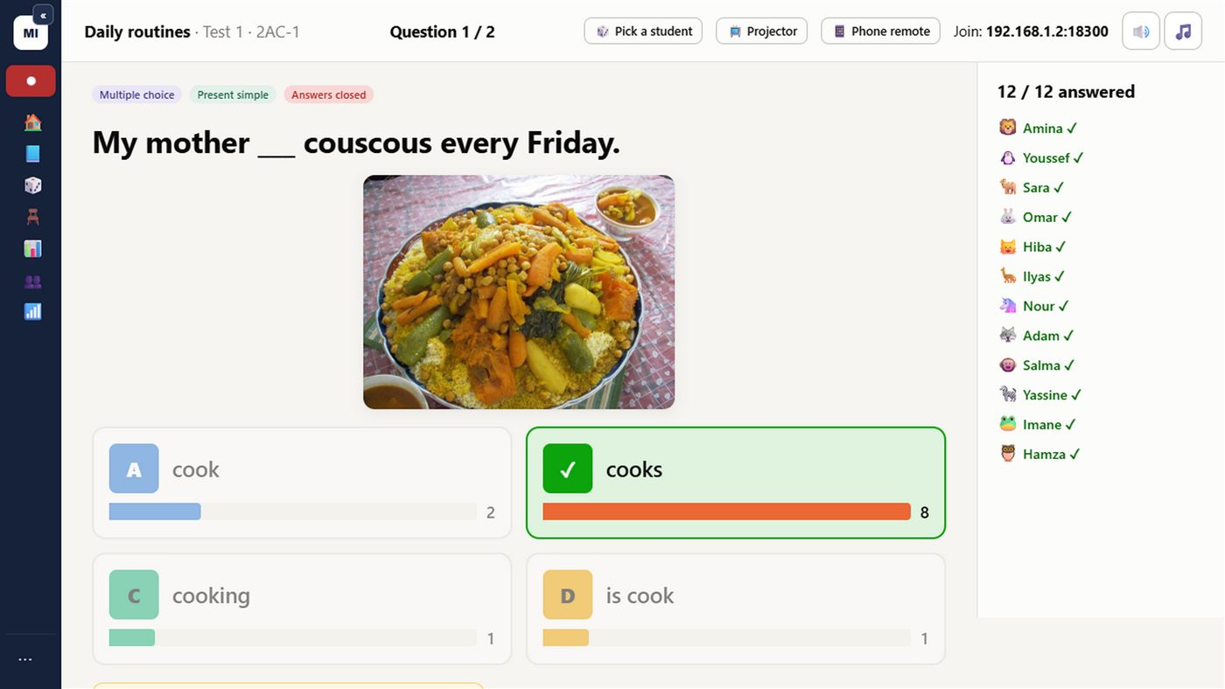
Test · Teach · Test
Test 1
Teach
Test 2
➜
➜
Diagnostic test: what the class already knows
Targeted remediation: only the missed points
Measured progress, student by student
Every question has 4 versions, so neighbours cannot copy.
Notes:
The link with assessment: Test 1 = diagnostic, Teach = targeted remediation, Test 2 = measured progress. The app shows the missed points so you reteach only those.

Slide 5
What we measured
91
students
42% → 58%
24
sessions
One Common Core class, same skill, in 3 weeks
5,495
answers
3 Common Core classes, 29 Sep – 15 Oct 2026. Anonymous data from the author's classes.
Notes:
Real results from one class and one skill. Not a scientific study, but an encouraging sign.

Slide 6
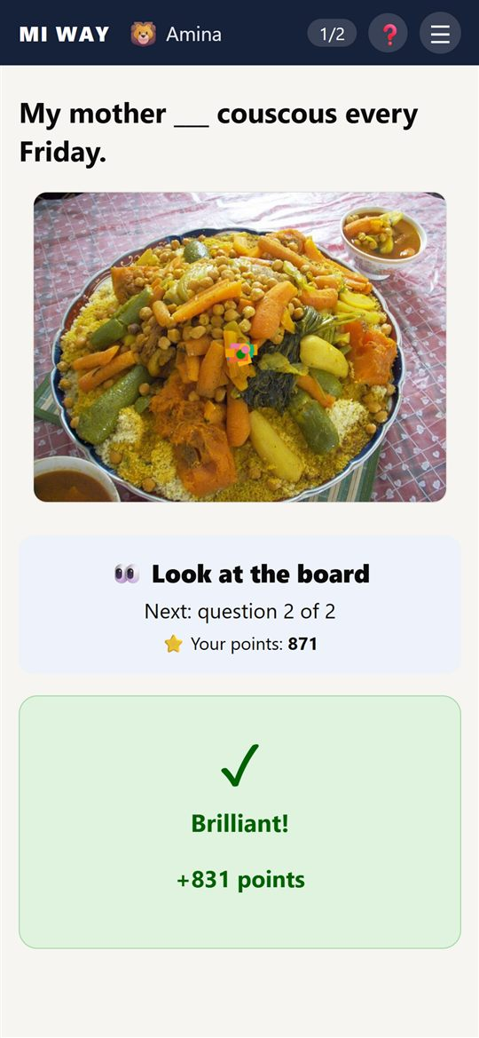
Ready for Moroccan textbooks
Ready lessons
All skills
Spotlight 1AC, 2AC, 3AC
Outlook
Ticket to English
Gateway
Insights
Listening for every lesson and unit
Speaking, writing and picture vocabulary
3 help levels 🌱🌿🌳 for every student
Record book, marks /20, Excel export
Notes:
Lessons are ready for middle and high school textbooks. Teachers can also make their own lessons for any book.

Slide 7
Demo: 20 minutes
0–3 min
Turn on the hotspot, open a ready lesson
3–8 min
Participants scan the QR and play the students
8–15 min
5-question quiz: live answers, podium
15–20 min
Test 2, each "student's" progress, discussion
You need: an Android phone or a Windows laptop, and a projector if possible.
Notes:
During the demo, participants play the students on their own phones. Keep 5 minutes for questions.

Slide 8
Common questions
Is it really free?
Does every student need a phone?
Yes, no student limit and no ads. Only the optional AI quiz writer needs the teacher's own paid key.
No. Students can play in pairs or groups, one phone per group.
What about student data?
Which devices?
Everything stays on the teacher's device. No cloud, no accounts.
Teacher: Android or Windows. Students: any phone with a browser.
Notes:
Be honest about AI: it is optional and needs a paid key. Everything else is free.

Slide 9
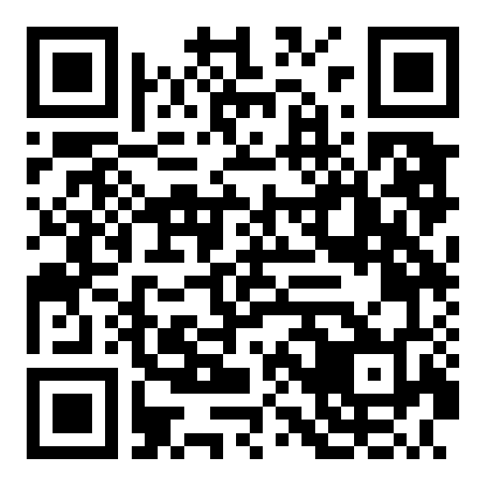
Try it with your teachers
miwayclassroom.com/kit
Download, handout, videos and slides
Training and questions: miwayclassroom@gmail.com
Notes:
Share the link or the QR code. The full kit is at miwayclassroom.com/kit.

