Slide 1
KubeCon 2026 • GKE Cloud TPU & GAIE
Defeating the Prefix-Cache Penalty:
KV-Aware Routing & Disaggregated Serving
for Agent Fleets on GKE
Gateway API Inference Extension (v1) • llm-d DisaggregatedSet • vllm-torchtpu • Cloud TPU v6e
Notes:
[00:00 - 00:35]
Kubernetes services were built around a simple assumption: HTTP requests are independent, pods are interchangeable, and round-robin spreads load evenly.
When you run an autonomous SWE or SRE agent fleet behind a stateless Service, you spend most of your accelerator cycles recomputing identical prompt prefixes across replicas. And if you switch to naive longest-prefix sticky routing, parallel agent fan-out herds onto a single pod and makes P95 tail latency worse than round-robin.
In this session, we will walk through why both failures happen and how we fix them using Gateway API Inference Extension and disaggregated TorchTPU serving on GKE.

Slide 2

Rabimba
Karanjai
Google Developer Expert — AI & ML
ML Scientist — PayPal
Notes:
[00:35 - 01:00]
I'm Rabimba Karanjai, a Google Developer Expert for AI/ML and ML Scientist at PayPal.
Everything we cover today—the Go 1.23 Envoy ext_proc router, the GKE Cloud TPU v6e and GAIE manifests, and the trace-calibrated local digital twin—is open-source under Apache-2.0 in our companion repository.

Slide 3



Scan to Grab the Companion Artifact & Slides
Every GKE manifest, Go ext_proc router package, and automated test gate (make gate-all) is in the repo.
KubeCon 2026 Repo
Interactive Web Deck
GAIE Upstream Docs
github.com/rabimba/GDE-ML-Artifacts/tree/main/KubeCon26
rabimba.github.io/.../KubeCon26/slides
gateway-api-inference-extension.sigs.k8s.io
Go 1.23 FleetKV EPP router, TPU v6e DisaggregatedSet YAML & Digital Twin.
Follow along with live speaker notes (press S) and copyable YAML/Go snippets.
Kubernetes SIG Networking Gateway API Inference Extension v1 specification.
Notes:
[01:00 - 01:20]
If you want to run the benchmark on your laptop or deploy the manifests on GKE, scan the left QR code for the companion repo, or the middle QR code for this interactive slide deck.

Slide 4


Chatbots Are Lines. Agent Fleets Are Trees.
Linear Chatbot Traffic
SWE / SRE Agent Fleet (Fork-Storm)
• Single user typing one turn every 15 to 30 seconds
• Short system prompt (~1,024 tokens)
• Predictable, incremental KV cache growth per session
• Independent sessions rarely share 20K-token prefixes at millisecond zero
• 20,480-Token Trunk: 120 MCP tool schemas + repo AST + alert state (80 x 256-tok blocks)
• 8-Way Parallel Fork: Orchestrator spawns 8 specialist sub-agents at t = 0 ms
• Log Bursts: Each sub-agent appends +8,192 tokens of kubectl logs / diffs on Turn 2
• Synthesis Join: Orchestrator merges all 8 sub-agent findings (85.6% prefix overlap)
t = 0 ms
8-Way Fork
20,480-Tok
Shared Trunk
Notes:
[01:20 - 02:30]
Why do agent fleets break standard serving pools? Because a chatbot is a line, whereas an agent workflow is a tree.
When an incident orchestrator triggers on an alert, it assembles a 20,480-token shared trunk—80 blocks of 256 tokens holding MCP tool schemas, repository structure, and alert state—and at millisecond zero spawns 8 parallel sub-agents. Each sub-agent pulls 8,192 tokens of pod logs and diffs before converging on a synthesis turn. Over the episode, 85.6% of tokens across those branches are shared prefix blocks.

Slide 5
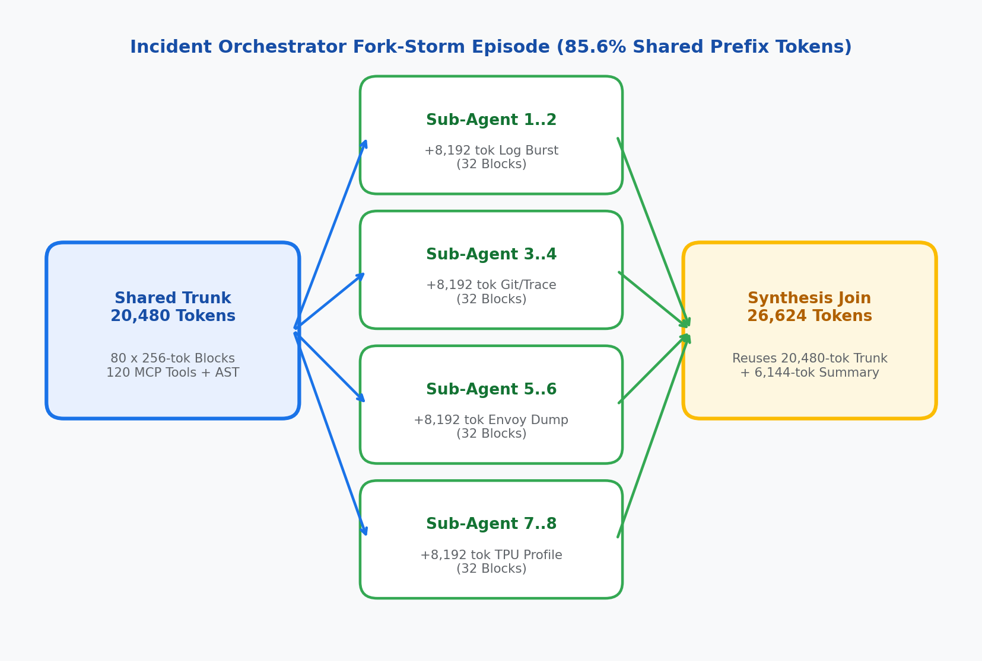
Anatomy of an 8-Way Incident Orchestrator Fork-Storm
20,480-Token Shared Parent Trunk -> 8 Concurrent Sub-Agent Branches -> Join
Every 256-token block hash in the 80-block parent trunk is identical across all 8 child sub-agents:
• Blocks 0..1 (512 tok): Global MCP tool bootstrap shared across all cluster orchestrators.
• Blocks 2..79 (19,968 tok): Incident repository AST + active alert context (80 blocks total trunk).
• Turn 1..4 Branch Deltas: 8 parallel specialists append +512 tok role, +8,192 tok log burst, +1,024 tok config/patch.
• Synthesis Join (26,624 tok): Orchestrator re-attaches the 80-block trunk plus a 24-block branch synthesis.
Notes:
[02:30 - 03:20]
Look at the token budget across a single orchestrator episode. Blocks 0 through 79 form the 20,480-token parent trunk. When the orchestrator forks 8 sub-agents simultaneously, all 8 child requests carry those exact 80 block hashes, followed by a 2-block role delta and a 32-block (8,192-token) log burst on Turn 2. Finally, the join turn reuses the original 80-block trunk.

Slide 6
Failure Mode 1: Stateless K8s Round-Robin
Failure Mode 2: The Prefix-Herd Trap
Standard ClusterIP Service (1/N Scatter Misses)
Naive Longest-Prefix Sticky Routing (argmax MatchedBlocks)
• 1/N Cache Scatter: Pods 0..3 each recompute the same 20,480-token parent trunk on their MXUs (~30.8% hit rate).
• Duplicate HBM Residency: Identical 20,480-token FP8 KV blocks occupy N x High-Bandwidth Memory across the pool.
• Prefill-Decode Interference: Co-located 8,192-token log-burst prefills stall active decode streams past 133 ms P99 ITL.
• Single-Pod Stampede: All 8 forked sub-agents match 80/80 trunk blocks on Pod 0; naive routing herds 8/8 branches onto Pod 0.
• Serial MXU Queueing: Pod 0 queues all 8 bursts serially while Pods 1..3 sit idle, spiking P95 TTFT to 33.4s (worse than Round-Robin!).
• HBM Self-Eviction: 8 diverging branches exceed Pod 0's 360-block HBM budget and LRU-evict their own parent trunk before Join.
🎯 Pop Quiz: Why does Naive KV-Sticky routing make P95 Fork-Burst TTFT worse than Stateless Round-Robin?
Because all 8 parallel sub-agents share the exact 80-block parent trunk on Pod 0—serializing 8 prefill bursts on one MXU and overflowing Pod 0's HBM!
Notes:
[03:20 - 05:00]
Behind a standard Kubernetes Service, round-robin scatters those 8 child branches across all replicas. Every replica misses on the parent trunk, recomputes 20,480 tokens of prefill, and stalls co-located decode streams past 133 milliseconds P99 ITL.
The natural next step is enabling longest-prefix sticky routing. That triggers a second failure mode during parallel agent fan-out: the Prefix-Herd Trap. At fork time, all 8 sub-agents match 80 out of 80 parent blocks on Pod 0. A router that maximizes prefix match sends all 8 concurrent branches to Pod 0 while Pods 1 through 3 sit idle. Worse, as those 8 branches append 8,192-token log bursts on Pod 0, they exceed Pod 0's 360-block HBM capacity and LRU-evict the shared parent trunk right before the synthesis join turn.

Slide 7
Why KV-Aware Routing & Disaggregation Need Each Other
Solving both 1/N scatter misses and fork-storm herding requires coordinating the GAIE control plane with a disaggregated Prefill/Decode data plane:
• 1. Compute the Shared Trunk Once on Prefill TPUs: Prefill pods compute the 20,480-token trunk once and back their 360-block HBM cache with 48 GiB of Tier-2 Host DRAM (/dev/shm via TPUConnectorHMA).
• 2. Gate Admission on HBM Block Fit: Before routing a forked branch, FleetKV checks whether the branch horizon + 24-block safety reserve fits in free HBM; overflow branches spill cleanly to peer pods.
• 3. Isolate Log-Burst Prefills from Decode ITL: 8,192-token Turn 2 log bursts execute on dedicated Prefill MXUs so Decode TPUs stream tokens uninterrupted at 27–33 ms P99 ITL (< 40 ms SLO).
• 4. Stream KV Blocks Over MTU-8896 gVNIC: TPUConnectorHMA transfers delta KV blocks asynchronously over jumbo-frame gVNIC from Prefill TPUs to whichever Decode pod has HBM headroom.
Notes:
[05:00 - 06:15]
This is why routing and disaggregation have to work together. KV-aware routing on an aggregated pool ties compute affinity to memory residency, herding forked branches onto whichever pod holds the parent trunk. Disaggregation without KV-aware fit routing still recomputes shared prefixes.
When we combine them, Prefill pods compute the shared trunk once, pin evicted blocks in 48 GiB of host DRAM, compute only the branch delta, and stream KV blocks over gVNIC to whichever Decode pod has HBM headroom.

Slide 8
Control Plane: Fit-Aware Tree Routing in GAIE ext_proc
router/pkg/scorer/policies.go — Hard HBM Fit Gate + Staged Prefill Leases
go (router/pkg/scorer/policies.go)
The three control surfaces:
func ScoreEndpoint(pod *PodState, req *RouteInput) float64 {
// 1. Hard HBM Fit Gate: spill to peer if branch horizon overflows HBM
effectiveFree := pod.FreeHBMBlocks - pod.ReservedBlocks
if effectiveFree < req.EstimatedBranchBlocks + SafetyReserveBlocks {
return RejectOverflowSpillToPeer
}
// 2. Trade off ZMQ-indexed block hits against in-flight prefill queue
savedMs := float64(pod.MatchedHBMBlocks)*HBMBlockMs +
float64(pod.MatchedDRAMBlocks)*DRAMBlockMs
queueWait := float64(pod.InFlightPrefillTokens) / PodTokPerMs
return savedMs - queueWait
}
• ZeroMQ KV Indexer (:5557): Subscribes to vllm-torchtpu BlockStored & BlockRemoved events across HBM and Tier-2 Host DRAM.
• Hard HBM Fit Gate: Rejects pods where admitting the branch horizon (+24 safety blocks) would evict warm parent trunks.
• Staged Lease Accounting: AcquireStagedLease releases InFlightPrefillTokens on ResponseHeaders (TTFT) while holding ReservedBlocks until stream EOF.
Notes:
[06:15 - 07:30]
Here is the scoring function inside fleetkv-epp. Every vllm-torchtpu prefill pod publishes BlockStored and BlockRemoved events over ZeroMQ on port 5557 as 256-token blocks enter HBM or spill to host DRAM.
When Envoy forwards a request over ext_proc, the router first checks the HBM Fit Gate: if admitting another branch plus our 24-block safety reserve would overflow the pod's free HBM blocks, it spills that branch to a peer pod instead of evicting the shared trunk. Second, notice our staged lease accounting: we release InFlightPrefillTokens as soon as ResponseHeaders arrive at TTFT, while holding the HBM block reservation until the SSE decode stream completes.

Slide 9
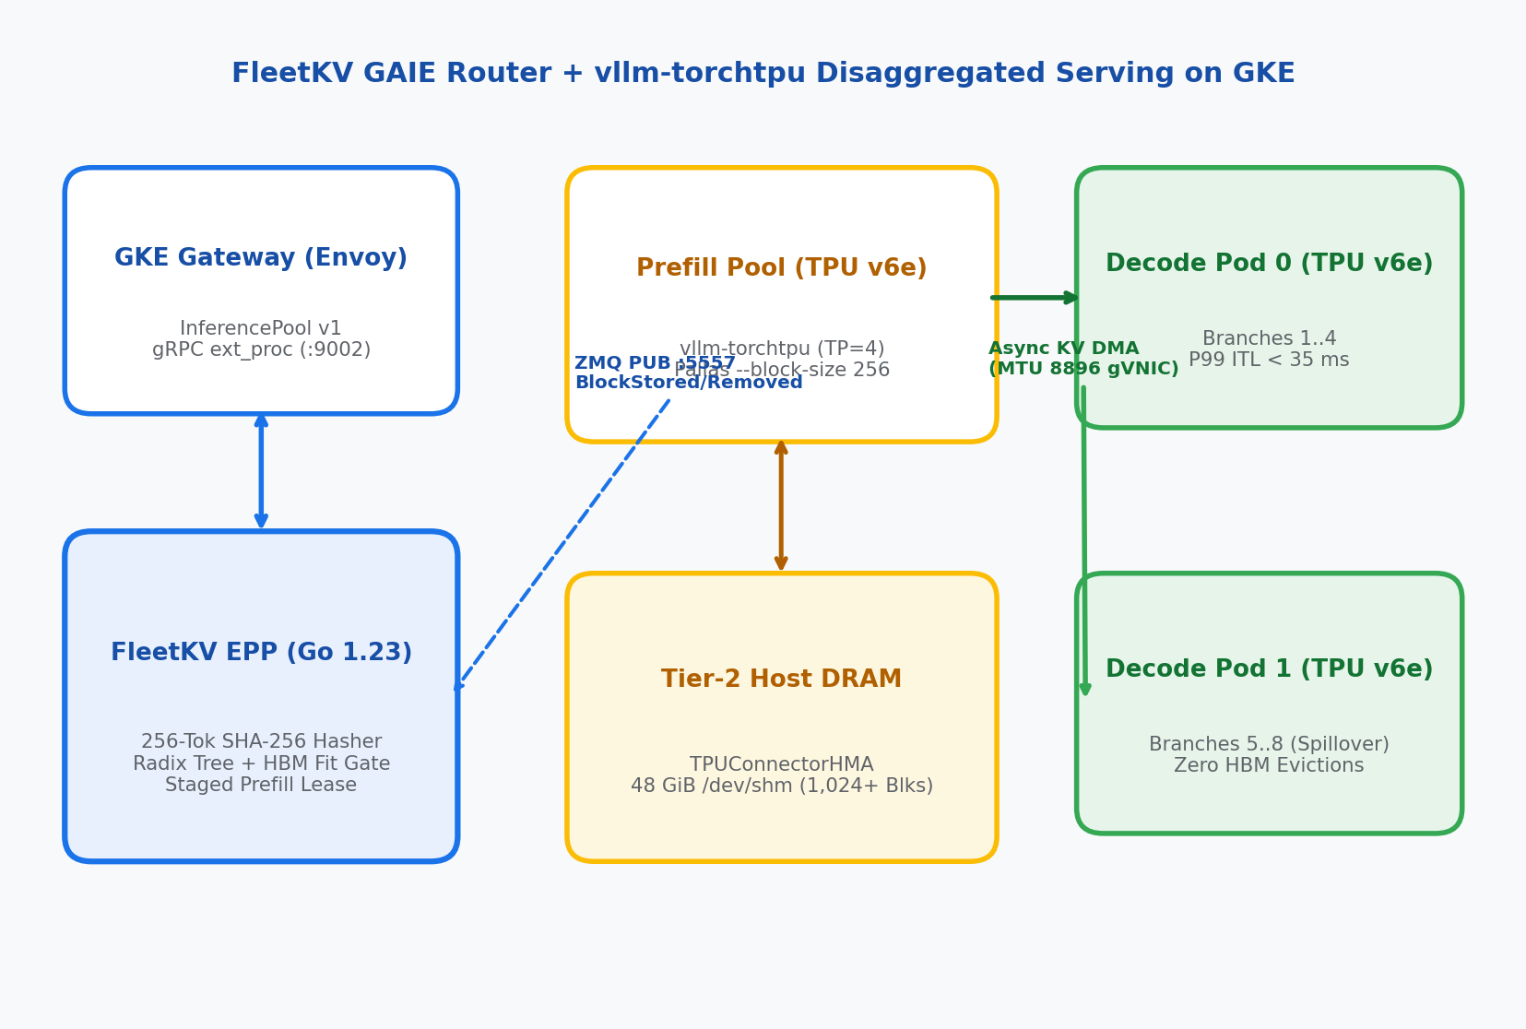
Data Plane: vllm-torchtpu + TPUConnectorHMA on GKE
DisaggregatedSet on Trillium ct6e-standard-4t (2x2) with 48 GiB Tier-2 Host DRAM
Upstream PyTorch models lowered via torch.compile(backend='tpu') onto Pallas paged-attention kernels:
• Pallas 256-Token Blocks: vllm-torchtpu runs Qwen/Qwen3-30B-A3B-FP8 with --block-size 256 so block tables fit in TPU v6e Scalar Memory (SMEM).
• Tier-2 Host DRAM (/dev/shm): Prefill pods mount a 64 GiB memory volume and allocate 48 GiB (1,024+ blocks) to TPUConnectorHMA so trunks never recompute.
• Async KV DMA (MTU 8896): Delta KV blocks stream over jumbo-frame gVNIC from the selected Prefill pod (x-fleetkv-prefill-endpoint) to Decode TPUs.
• GAIE Endpoint Picker Headers: fleetkv-epp sets x-gateway-destination-endpoint and ClearRouteCache=true on Envoy v3 BodyResponse.
Notes:
[07:30 - 08:30]
On the data plane, our DisaggregatedSet runs vllm-torchtpu on GKE Trillium ct6e-standard-4t node pools. Prefill pods mount a 64 GiB /dev/shm volume and allocate 48 GiB to TPUConnectorHMA as a Tier-2 host DRAM cache, keeping shared agent trunks warm even when active branch deltas cycle through HBM.
Once a prefill pod computes the branch delta, it transfers the KV blocks asynchronously over an MTU-8896 gVNIC network to the Decode pod selected by fleetkv-epp. Let's switch to the live terminal and watch all three stages under load.

Slide 10
Live Demo: 3-Stage Traffic Flip Under 64-Branch Fork-Storm
1
Stage 1: Stateless K8s Round-Robin
LIVE ON STAGE • 4-COLUMN TUI
./bench/demo_ctl.sh stage1
Watch Completed Stages Freeze Side-by-Side
As demo_ctl.sh hot-swaps policies via POST /admin/policy (or patches the GKE HTTPRoute), bench/stage_tui.py freezes the completed stage's 10-second sliding-window telemetry so all 3 stages remain visible side-by-side.
2
Stage 2: Naive Longest-Prefix Sticky
./bench/demo_ctl.sh stage2
Operator Shell — 3-Pane Conference TUI
3
Stage 3: FleetKV Fit + Disagg P/D
./bench/demo_ctl.sh stage3
# Launch 3-pane tmux layout (Scorecard TUI + EPP Route Stream + Shell)
./bench/demo_ctl.sh prep
# Flip live traffic across all 3 architectures:
./bench/demo_ctl.sh stage2 # Trigger single-pod herd & HBM thrash
./bench/demo_ctl.sh stage3 # Enable FleetKV Fit Gate + Disagg P/D
Notes:
[08:30 - 11:45]
[SWITCH TO TMUX TERMINAL]
1. Stage 1 (round_robin): Point out the 4-pod even traffic split (25% each), low cache hit rate (~30.8% in the local twin, ~19.4% on 8-chip GKE), and P99 decode ITL at 133 ms from prefill-decode interference.
2. Run ./bench/demo_ctl.sh stage2: Watch Stage 1 freeze in Column 1 while Stage 2 skews onto a single hot pod as all 8 forked branches match the 80-block trunk. HBM evictions climb past 10,500 blocks and P95 tail TTFT spikes to 33.4 seconds—worse than Stage 1.
3. Run ./bench/demo_ctl.sh stage3: Watch fleetkv-epp emit herd_spillover decisions, pinning the trunk in prefill HBM/DRAM while splitting decode streams evenly across decode-0 and decode-1. HBM evictions drop to 0, hit rate reaches 86.1% (91.6% on GKE), and P99 ITL drops to 33.1 ms (< 40 ms SLO).

Slide 11
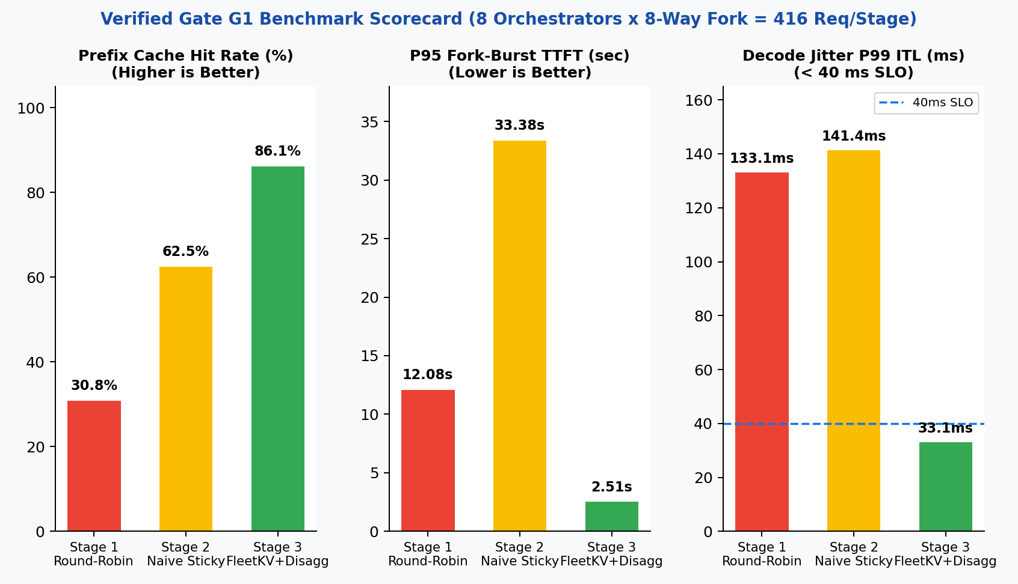
Benchmark Scorecard: Gate G1 Twin & GKE Cloud TPU v6e
• Effective Prefix Hit Rate: 30.8% (S1) -> 62.5% (S2 thrashing) -> 86.1% Twin / 91.6% GKE (S3 HBM + Tier-2 DRAM).
• Median TTFT (P50): 6,498 ms (S1) -> 5,581 ms (S2) -> 1,153 ms Twin (-82.3%) / 315 ms GKE (-88%).
• Fork-Burst Tail TTFT (P95): 12,083 ms (S1) -> 33,377 ms (S2 herd stall!) -> 2,507 ms Twin (-79.2%) / 485 ms GKE (-86%).
• Decode Jitter (P99 ITL): 133.1 ms (S1) -> 141.4 ms (S2) -> 33.1 ms Twin / 27 ms GKE (< 40 ms interactive SLO).
• Cluster Output Goodput: 31.6 tok/s (1.0x S1) -> 18.5 tok/s (0.59x S2) -> 134.7 tok/s (4.26x Twin / 2.55x GKE).
• Lost HBM Block Evictions: 17,377 (S1) -> 10,585 (S2 self-eviction) -> 0 in Stage 3 (pinned in 48 GiB Host DRAM).
Verified Gate G1 run (`make gate-g1`, 416 streaming requests/stage) & 8-chip GKE TPU v6e (`2x ct6e-standard-4t`) reference.
Notes:
[11:45 - 12:30]
Here are both sets of numbers side by side: the local trace-calibrated twin verified by make gate-g1 on 416 requests per stage, and the 8-chip GKE TPU v6e hardware reference (2x ct6e-standard-4t).
In both environments, Stage 2's naive sticky routing makes P95 tail TTFT worse than stateless round-robin—33.4 seconds in the 4-pod twin and 3.89 seconds on GKE—because all 8 forked branches queue on a single replica and evict over 10,500 HBM blocks. Stage 3 cuts median TTFT by 82 to 88 percent, eliminates HBM evictions, and keeps P99 decode ITL at 27 to 33 milliseconds.

Slide 12

Three Production Invariants (Audited in CI by Gate G2)
1. Pin PYTHONHASHSEED="0"
Across Every Pod
2. Match --block-size 256
on TPU v6e Pallas
3. Headless ZMQ Service +
MTU-8896 gVNIC VPC
Python randomizes process hash seeds by default. Set PYTHONHASHSEED="0" on every vllm-torchtpu worker and fleetkv-epp container so chained 256-token block hashes match across processes.
GPU pools often default to block size 64. On Trillium TPU v6e, 64-token blocks overflow Scalar Memory (SMEM) in Pallas paged-attention kernels. Set --block-size 256 in both vLLM and fleetkv-epp.
Expose ports 8000 and 5557 via Headless Services (clusterIP: None) so fleetkv-epp resolves every pod IP via DNS, filter ZMQ to llm-d.ai/role=prefill, and set VPC mtu: 8896 for TPUConnectorHMA.
Notes:
[12:30 - 13:30]
Three operational invariants before you deploy this on GKE—all enforced by tests/test_g3_k8s_manifests.py in CI.
First, set PYTHONHASHSEED="0" on every container; otherwise Python's per-process hash randomization causes block hash mismatches across workers. Second, set --block-size 256 on both vllm-torchtpu and fleetkv-epp so Pallas paged-attention kernels fit inside TPU v6e Scalar Memory. Third, use a Kubernetes Headless Service (clusterIP: None) filtered to llm-d.ai/role=prefill so the router subscribes to every prefill pod's ZMQ socket individually, and configure mtu: 8896 on your gVNIC VPC.

Slide 13
Reproduce Locally in 60 Seconds or Deploy on GKE TPU v6e
Local Digital Twin & CI Gates
GKE Cloud TPU v6e Production Stack
Runs on macOS / Linux without TPU hardware
2x ct6e-standard-4t + GAIE v1 + DisaggregatedSet
snippet / command
snippet / command
# Run all verification gates (Go race + E2E SLOs + K8s YAML)
make gate-all
# Launch interactive 3-pane conference TUI
./bench/demo_ctl.sh prep
./bench/demo_ctl.sh stage2
./bench/demo_ctl.sh stage3
./deploy/gke/00-bootstrap-gke-tpu.sh
kubectl apply -f deploy/gke/01-baseline-agg-service.yaml
kubectl apply -f deploy/gke/02-disaggregatedset-torchtpu.yaml
kubectl apply -f deploy/gke/03-fleetkv-epp-and-pool.yaml
FLEETKV_GATEWAY_URL="http://${GATEWAY_VIP}" \
./bench/demo_ctl.sh stage3 --target=gke
• Gate G0: Go 1.23 race tests + cross-language SHA-256 & ZMQ parity
• Gate G1: Full 416-request/stage Envoy ext_proc + Twin SLO verification
• Gate G2: Audits PYTHONHASHSEED=0, --block-size 256, Headless ZMQ & MTU=8896
• Zero Client Changes: Same Go EPP binary & OpenAI benchmark client across Twin and GKE
Notes:
[13:30 - 14:00]
Here is the complete command reference for both environments. On the left, make gate-all runs our Go race-detector unit tests, cross-language SHA-256 block-hash parity checks, the 3-stage end-to-end fork-storm benchmark, and the Kubernetes manifest audit. On the right are the four commands to bootstrap the MTU-8896 GKE cluster, apply the DisaggregatedSet and InferencePool manifests, and run the exact same stage controller against a live GKE Gateway VIP.

Slide 14

Companion GitHub Repo (Apache-2.0)
Thank You!
Defeating the Prefix-Cache Penalty on GKE
• Agent trees fork in bursts: gate KV routing on HBM fit
• Release prefill leases on ResponseHeaders (TTFT)
• Disaggregate Prefill & Decode with Tier-2 Host DRAM
Connect on LinkedIn
Interactive Slide Deck & Script
Notes:
[14:00 - 15:00]
To wrap up: agent fleets generate tree-structured bursts, not independent linear turns. By combining a fit-aware GAIE ext_proc router with disaggregated vllm-torchtpu and Tier-2 host DRAM on GKE, you keep shared trunks warm without herding parallel sub-agents onto a single pod.
The Go router, GKE manifests, local digital twin, and automated test gates are all in the companion repository. Thank you—happy to take questions!

