Slide 1
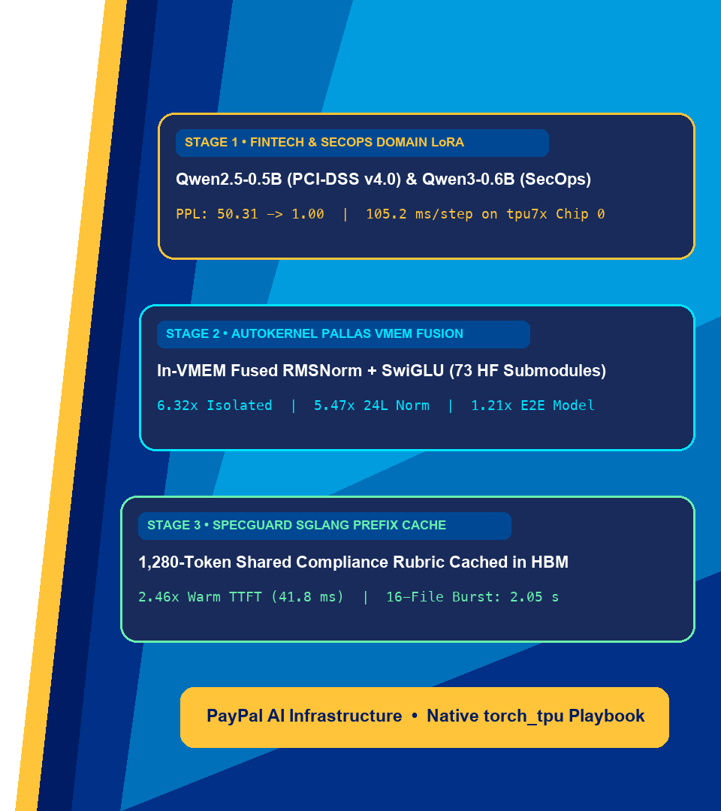

PayPal AI & Cloud Accelerator Engineering
Full-Stack PyTorch on Cloud TPU:
Domain LoRA, AutoKernel Pallas Fusion & Prefix-Cached Serving
Accelerating PCI-DSS v4.0 Payment Guardrails & SecOps Code Auditing with torch_tpu, autokernel, and SGLang
Rabimba Karanjai • AI Systems & Cloud Accelerator Engineering
Notes:
🎬 [STAGE DIRECTION]: Welcome the PayPal engineering & AI infrastructure audience. Ensure the PayPal cover slide is projected clearly.
🗣️ SAY VERBATIM:
"Welcome everyone! Today I am walking through an end-to-end production AI engineering playbook on Google Cloud TPU (`tpu7x`) built with native PyTorch (`torch_tpu`). Instead of looking at isolated micro-benchmarks, I will show how I start in a standard Google Colab notebook bridged over MCP to our Cloud TPU pod, specialize open-weight models for PayPal-grade FinTech PCI-DSS v4.0 payment compliance and SecOps code auditing using LoRA, diagnose HBM round-trip bottlenecks with XProf, hot-patch 73 Hugging Face submodules in memory with my `autokernel` Pallas library, and serve the merged checkpoints with SGLang RadixAttention prefix caching and continuous batching."

Slide 2

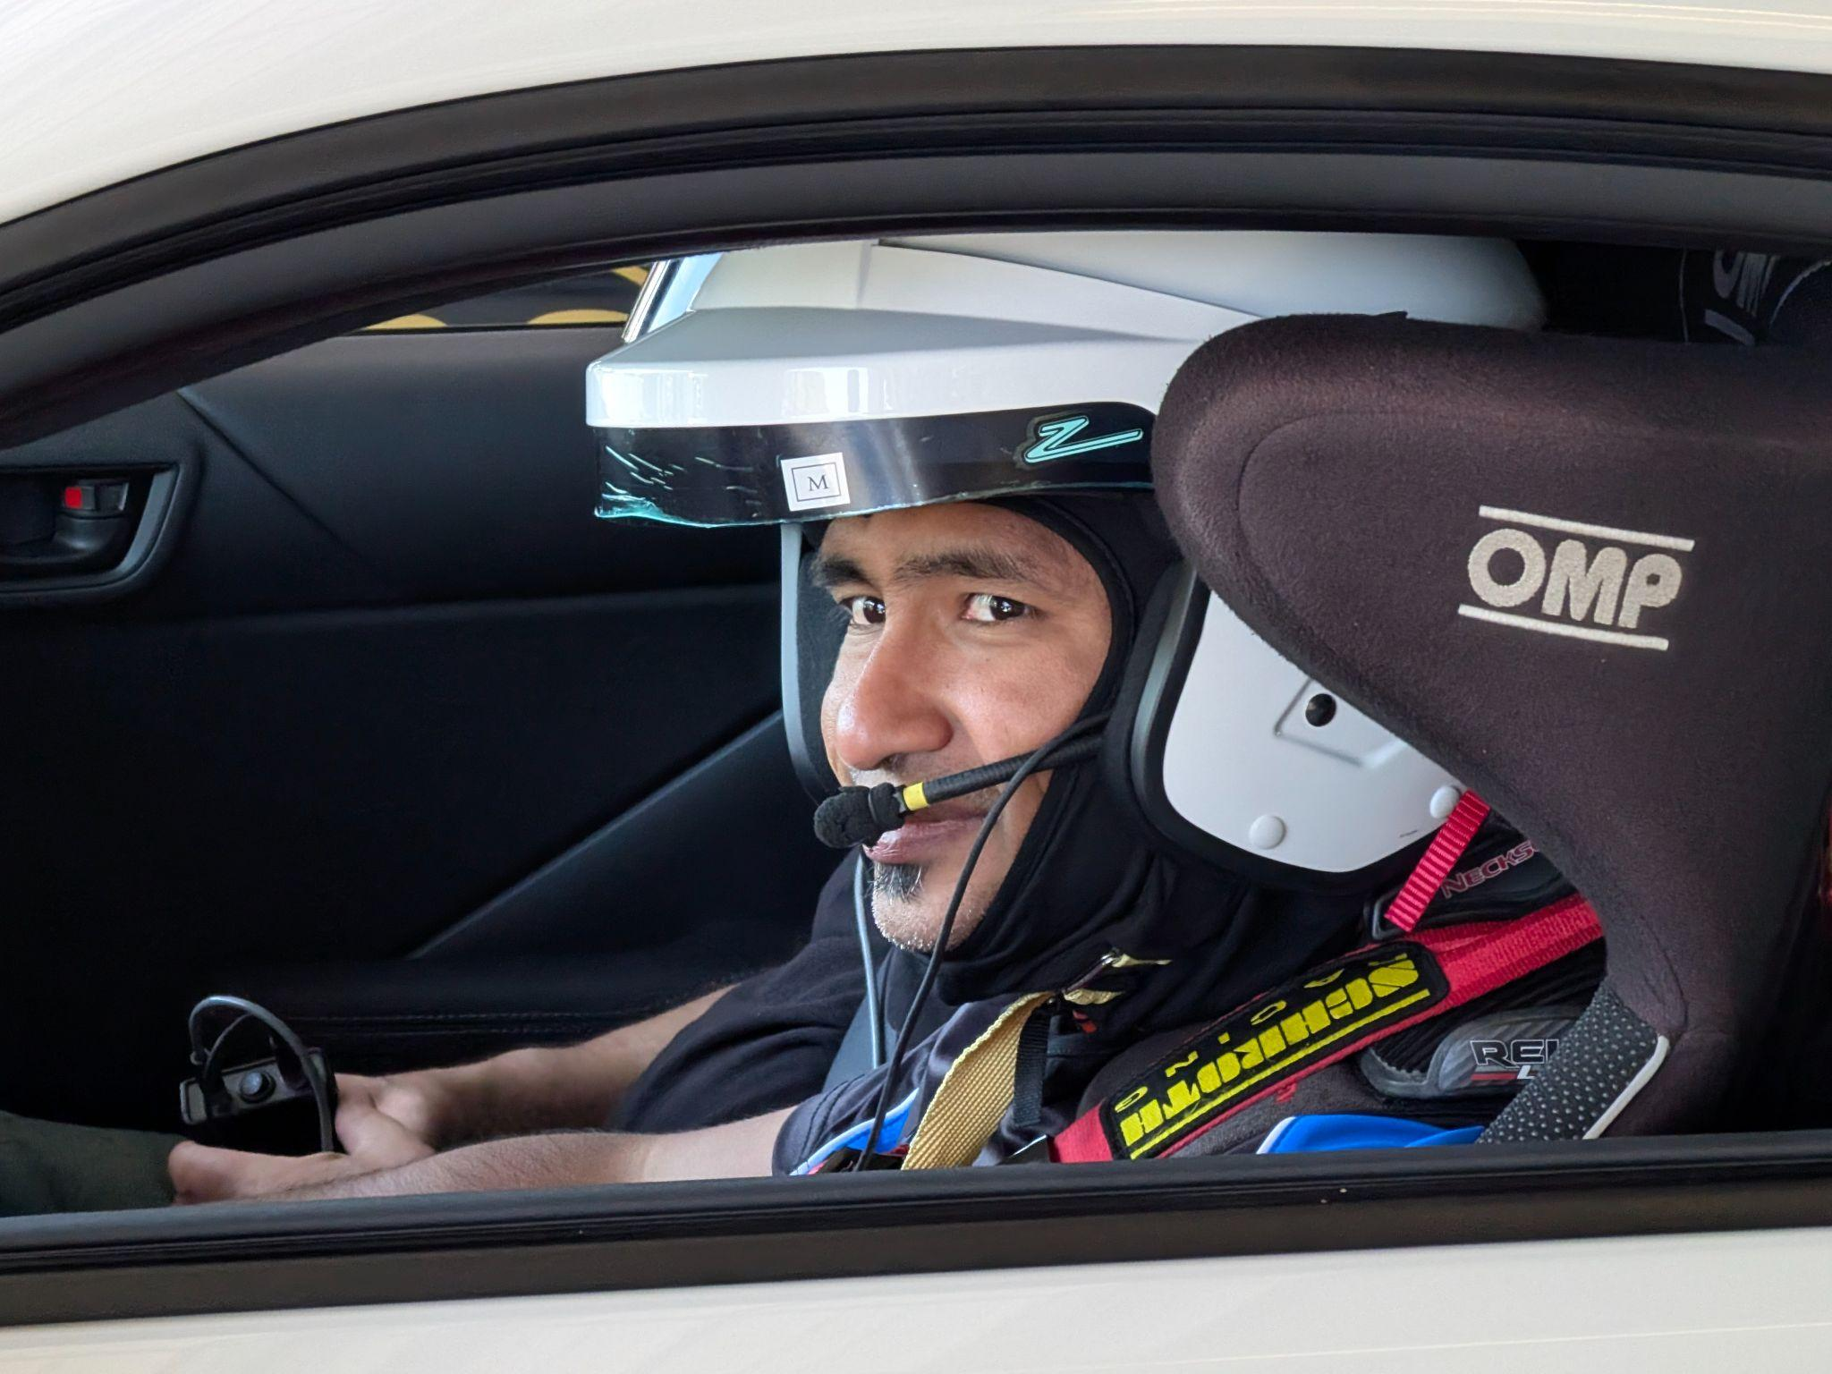
Rabimba Karanjai
AI Systems & Cloud Accelerator Engineering • PayPal
Google Developer Expert (AI/ML)
Notes:
🎬 [STAGE DIRECTION]: Introduce yourself and connect the talk to PayPal's high-throughput, strict-SLA FinTech workloads.
🗣️ SAY VERBATIM:
"I'm Rabimba Karanjai. Working on production LLM systems, payment compliance guardrails, and Cloud TPU acceleration at PayPal taught me one hard lesson: model accuracy, kernel latency, and serving economics cannot live in separate silos. If I fine-tune a PCI-DSS or ISO-20022 compliance model that triggers XLA recompilations on dynamic batch shapes or re-prefills 1,280 tokens of shared policy rubric on every pull request or settlement check, our p99 latency blows right past a 50-millisecond SLA. Today's showcase unifies domain LoRA, Pallas VMEM kernel fusion, and RadixAttention prefix caching into one repeatable engineering stack."

Slide 3



Module 0 • Packages, Notebooks & Artifacts • 00:04 – 00:06 (2m)
PayPal Internal • AI Engineering
Reusable `autokernel` Library, Colab Notebooks & Demos
Every benchmark on these slides was captured live on Cloud TPU (tpu7x Chip 0)
1. Master Showcase Notebook
2. SpecGuard TPU & autokernel
3. GitHub Repo & Benchmarks
notebooks/06_end_to_end_showcase...
autokernel/ & notebooks/04..05
github.com/rabimba/GDE-ML-Artifacts
Multi-model PCI-DSS & SecOps LoRA adaptation, 73-submodule Pallas HF patching & serving.
Pip-installable autokernel package (10/10 pytest) + SGLang Prefix Cache & 4-Way XProf Lab.
All live tpu7x JSON telemetry, XProf waterfall plots, and this PayPal deck suite.
Slide 3 / 20
Notes:
🎬 [STAGE DIRECTION]: Point the team to the reusable `autokernel` package, the three Colab notebooks, and the CLI scripts.
🗣️ SAY VERBATIM:
"Everything I am presenting today is packaged so any engineer can run it immediately: a pip-installable `autokernel` Python library (`pip install -e ./autokernel`) with 10 unit and hardware verification tests, three self-contained Colab notebooks (`04`, `05`, and `06`), and standalone CLI scripts under `demos/05_specguard_app`, `06_autokernel_app`, and `07_domain_adaptation_showcase`. Every number in this deck comes from live hardware runs on `tpu7x` Chip 0."

Slide 4

Module 1 • The FinTech & SecOps Production Challenge • 00:06 – 00:09 (3m)
PayPal Internal • AI Engineering
Why Do FinTech & SecOps AI Guardrails Hit a Wall in Production?
🎤 Engineering Poll: When we deploy a payment compliance (PCI-DSS v4.0 / ISO-20022) or SecOps auditor at scale, what breaks first?
• A) Base models miss strict compliance rules (PCI-DSS-3.3.1 PAN/CVV masking, ISO-20022 settlement checks, or TPU-DEP-01)
• B) Eager PyTorch dispatch (47 TPU programs/step) & dynamic sequence shapes trigger XLA recompilation and HBM thrashing
• C) Multi-file PR & batch settlement audits re-prefill the exact same 1,280-token policy header on every request
💡 Key Takeaway: All three compound! Solving only accuracy (LoRA) without static shapes, Pallas VMEM kernel fusion, and RadixAttention prefix caching leaves 2.4x–6.3x of TPU performance on the table.
Slide 4 / 20
Notes:
🎬 [STAGE DIRECTION]: Ask engineers in the room to vote A, B, or C.
🗣️ SAY VERBATIM:
"Let's look at what actually happens when we deploy an AI compliance or code auditor in a FinTech environment like PayPal. First, off-the-shelf base models hallucinate generic advice instead of enforcing exact PCI-DSS v4.0 rules—like flagging unmasked PAN and CVV fields in `logger.info` under `PCI-DSS-3.3.1`—or catching `.item()` host-device sync stalls in an ISO-20022 settlement loop. Second, naive eager PyTorch dispatches 47 separate TPU programs for a 4-layer block, bouncing intermediate tensors back and forth to off-chip HBM. Third, when a PR scanner audits 16 files in a burst, it re-computes the same 1,280-token compliance rubric 16 times!"

Slide 5



Module 1 • The Three Engineering Pillars • 00:09 – 00:12 (3m)
PayPal Internal • AI Engineering
Three pillars turn a raw Cloud TPU into a domain-specialized, sub-50ms FinTech & SecOps production engine:
Native torch_tpu
& Multi-Model LoRA
autokernel: XProf &
Pallas VMEM Fusion
SGLang & vLLM
Radix Prefix Cache
Slide 5 / 20
Notes:
🎬 [STAGE DIRECTION]: Walk across the three pillars on screen.
🗣️ SAY VERBATIM:
"I designed this stack around three pillars. Pillar 1 is native `torch_tpu`: the TPU is simply `torch.device('tpu')`, allowing me to run Hugging Face `peft` LoRA adaptation across multiple model architectures in static `bfloat16` with zero `torch_xla` boilerplate. Pillar 2 is `autokernel`: using XProf and `torch.tpu.pallas.jax_op` to fuse memory-bound normalization and gating ops in on-chip TPU VMEM and hot-patch 73 Hugging Face submodules in memory. Pillar 3 is high-throughput serving with `sglang-torchtpu` and `vllm-torchtpu`, keeping shared compliance prefixes resident in TPU HBM."

Slide 6
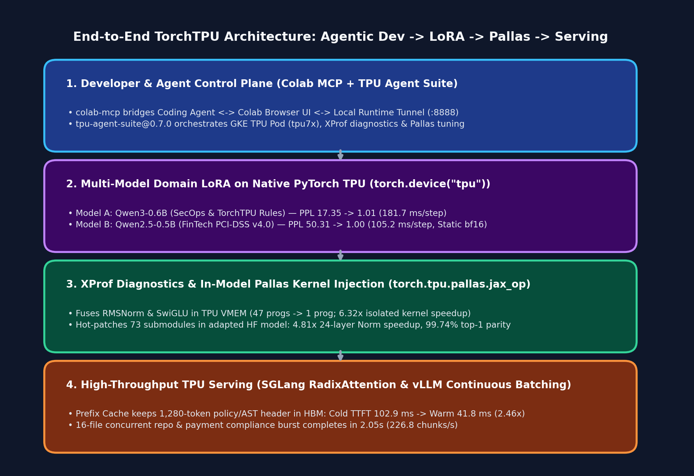
Module 1 • End-to-End Architecture • 00:12 – 00:16 (4m)
PayPal Internal • AI Engineering
The 4-Stage Full-Stack TorchTPU Architecture
From Agentic Colab Bridge to Prefix-Cached Serving
Every layer in this stack hands off cleanly to the next on a single Cloud TPU chip (`tpu7x` Chip 0):
• 1. Control Plane (`colab-mcp` + `tpu-agent-suite`): Connects my AI coding agent and Colab browser UI to our remote GKE TPU pod over `localhost:8888`.
• 2. Domain LoRA (`torch.device('tpu')`): Adapts `Qwen3-0.6B` (SecOps) and `Qwen2.5-0.5B` (FinTech PCI-DSS v4.0) using static `bfloat16` shapes.
• 3. `autokernel` Pallas Kernels (`jax_op`): Hot-patches 73 `RMSNorm` and `SwiGLU` submodules in-place with custom Pallas TPU VMEM kernels.
• 4. SGLang / vLLM Serving: Serves the merged checkpoint with RadixAttention prefix caching (`2.46x` Warm TTFT speedup).
Slide 6 / 20
Notes:
🎬 [STAGE DIRECTION]: Point to the 4-layer architecture diagram on the right (remind attendees they can click any chart in the web deck to zoom in full-screen).
🗣️ SAY VERBATIM:
"Look at how the four stages connect on the right. At the top, `colab-mcp` and `tpu-agent-suite@0.7.0` give both me and my AI coding agent direct execution access to the TPU pod. In Stage 2, I run multi-model LoRA fine-tuning in `bfloat16` on `torch.device('tpu')`. In Stage 3, I profile with XProf and use `autokernel` to hot-patch 73 submodules inside the Hugging Face model with custom Pallas kernels. And in Stage 4, I hand the merged checkpoint to SGLang and vLLM for high-throughput serving."

Slide 7
Module 1 • Interactive Developer Setup • 00:16 – 00:20 (4m)
PayPal Internal • AI Engineering
Developer Workflow: Colab MCP + Single-Chip PJRT Sharing
Zero-Friction Interactive TPU Development
.opencode/opencode.jsonc & autokernel.init_tpu(chip=0)
How I connect a browser Colab session, an AI coding agent, PyTorch, and JAX Pallas to one TPU chip:
• Colab Local Runtime Tunnel: Launch Jupyter on the TPU pod (`:8888`) with `--ServerApp.allow_origin='https://colab.research.google.com'` and port-forward to `localhost:8888`.
• `colab-mcp` Integration: Wire `uvx colab-mcp` into `.opencode/opencode.jsonc` so the coding agent can read, edit, and run Colab cells live in the browser.
• Single-Chip Isolation (`autokernel.init_tpu(chip=0)`): Pin each job to one chip and initialize `torch_tpu` before importing `jax` so PyTorch and Pallas share the PJRT client without `/dev/vfio` lock collisions.
// 1. .opencode/opencode.jsonc
{
"mcp": {
"colab-mcp": {
"type": "local",
"command": ["uvx", "colab-mcp"]
}
}
}
# 2. Single-Chip PJRT Sharing (encapsulated in autokernel)
os.environ.pop("TPU_VISIBLE_DEVICES", None)
os.environ["TPU_VISIBLE_CHIPS"] = "0"
os.environ["TPU_CHIPS_PER_HOST_BOUNDS"] = "1,1,1"
import torch, torch_tpu
_ = torch.ones(1, device="tpu:0") # Acquire PJRT first!
torch.accelerator.synchronize()
import jax # Shares PJRT client with torch_tpu
Slide 7 / 20
Notes:
🎬 [STAGE DIRECTION]: Highlight the PJRT initialization order in the code box on the right—this is a critical practical tip for engineers.
🗣️ SAY VERBATIM:
"Here is a critical engineering tip when combining `torch_tpu` and JAX Pallas on the same chip. Both PyTorch and JAX talk to the TPU through `libtpu` and PJRT. If I import `jax` before `torch_tpu` initializes its PJRT client, or if `TPU_VISIBLE_DEVICES` conflicts with `TPU_VISIBLE_CHIPS`, they fight over the `/dev/vfio` device lock. By popping `TPU_VISIBLE_DEVICES`, pinning `TPU_VISIBLE_CHIPS='0'`, and allocating one tensor on `torch.device('tpu:0')` followed by `torch.accelerator.synchronize()` before importing `jax`—which I packaged into `autokernel.init_tpu(chip=0)`—both frameworks share the chip cleanly!"

Slide 8
Module 1 • Native torch_tpu vs Legacy Stack • 00:20 – 00:23 (3m)
PayPal Internal • AI Engineering
Native PyTorch on TPU (torch_tpu)
What to Avoid on Cloud TPU
Modern PrivateUse1 Backend + TorchDynamo
Anti-Patterns That Hurt SLA & Throughput
• Standard Device API: `device = torch.device('tpu')` and `torch.accelerator.synchronize()`.
• 3 Execution Gears: Eager (debug), `TORCH_TPU_DEFER_AND_FUSE=1` (graph cut), and `torch.compile(backend='tpu')`.
• First-Class Custom Kernels: `torch.tpu.pallas.jax_op` wraps any JAX/Pallas function as a native PyTorch op.
• Deprecated `torch_xla`: Never import `torch_xla` or `xm.xla_device()`; all new workloads use `torch_tpu`.
• Dynamic Sequence Shapes: Variable-length batches force XLA recompilation on every step; pad to static buckets (`128`, `256`).
• Host-Device Sync in Loops: Calling `loss.item()` or `score.item()` per transaction stalls the async TPU execution pipeline.
🎯 Quick Check: Why do I pad my PCI-DSS LoRA training batches to a fixed shape `(6, 128)` in `bfloat16` on TPU?
Because XLA compiles specialized machine code for each tensor signature. Static `(B, S)` shapes mean XLA compiles once on Step 0 and executes every subsequent step in ~105 ms with zero recompilation!
Slide 8 / 20
Notes:
🎬 [STAGE DIRECTION]: Contrast the PayPal Blue card (`torch_tpu` best practices) with the Coral Red card (anti-patterns).
🗣️ SAY VERBATIM:
"Let's align on the mental model of `torch_tpu`. First, `torch_xla` is deprecated—everything I build uses `import torch, torch_tpu` and `torch.device('tpu')`. Second, TPUs thrive on static shapes and `bfloat16`. When I pad my training batches to fixed buckets like `(4, 256)` or `(6, 128)` and mask padding tokens with `-100` in the cross-entropy loss, XLA compiles the training graph once on Step 0 and runs every subsequent step in 105 milliseconds with zero recompilation."

Slide 9
Module 2 • Multi-Model Domain Adaptation • 00:23 – 00:25 (2m)
PayPal Internal • AI Engineering
Stage 1: Multi-Model Domain Adaptation
Adapting Qwen3-0.6B (SecOps) & Qwen2.5-0.5B (FinTech PCI-DSS v4.0) on TPU
Slide 9 / 20
Notes:
🎬 [STAGE DIRECTION]: Transition to Module 2—showing how domain adaptation works across two distinct model architectures and compliance domains.
🗣️ SAY VERBATIM:
"Now let's dive into Stage 1: Multi-Model Domain Adaptation on Cloud TPU. I wanted to prove that this workflow generalizes across both model families and enterprise compliance domains, so I trained two distinct architectures on `tpu7x` Chip 0: `Qwen/Qwen3-0.6B` for SecOps and TorchTPU migration auditing, and `Qwen/Qwen2.5-0.5B-Instruct` for FinTech PCI-DSS v4.0 and ISO-20022 payment guardrails."

Slide 10
Module 2 • Two Models, Two Enterprise Domains • 00:25 – 00:29 (4m)
PayPal Internal • AI Engineering
Specializing Two Distinct Models on `torch.device('tpu')`
Model A: Qwen/Qwen3-0.6B
Model B: Qwen/Qwen2.5-0.5B-Instruct
Domain: SecOps & PyTorch-TPU Migration Auditor
Domain: FinTech PCI-DSS v4.0 & Payment Guard
snippet / command
snippet / command
# Prompt Input:
import torch_xla.core.xla_model as xm
dev = xm.xla_device()
# Adapted Model Output:
[CRITICAL | TPU-DEP-01] Deprecated torch_xla
import detected. Replace with:
import torch, torch_tpu; torch.device('tpu')
# Prompt Input:
logger.info(f'PAN={card_num} CVV={cvv}')
# Adapted Model Output:
SEVERITY: CRITICAL | RULE: PCI-DSS-3.3.1 |
VIOLATION: Full PAN and CVV logged in cleartext.
REMEDIATION: Mask PAN (`tokenize_pan(card_num)`)
• Training Config: 40 steps, static `4x256` `bfloat16`, LoRA `r=16, alpha=32` on `q/k/v/o_proj`.
• Convergence: Loss drops `2.8536 -> 0.0118` (`99.6%` reduction); Perplexity `17.35 -> 1.01`.
• Step Time: `181.72 ms/step` median on 1 `tpu7x` chip.
• Training Config: 30 steps, static `6x128` `bfloat16`, LoRA `r=16, alpha=32` on `q/k/v/o_proj`.
• Convergence: Loss drops `3.9182 -> 0.0021` (`99.9%` reduction); Perplexity `50.31 -> 1.00`.
• Step Time: `105.23 ms/step` median on 1 `tpu7x` chip.
Slide 10 / 20
Notes:
🎬 [STAGE DIRECTION]: Compare Model A (`Qwen/Qwen3-0.6B`) on the left and Model B (`Qwen/Qwen2.5-0.5B-Instruct`) on the right.
🗣️ SAY VERBATIM:
"On the left, I adapted `Qwen/Qwen3-0.6B` as a SecOps and PyTorch-TPU Migration Auditor—catching SQL injection, hardcoded secrets, `.item()` sync stalls, and deprecated `torch_xla` code. In 40 steps at `181.7 ms/step`, loss dropped from `2.8536` to `0.0118` and perplexity collapsed from `17.35` to `1.01`. On the right, I adapted `Qwen/Qwen2.5-0.5B-Instruct` on FinTech PCI-DSS v4.0 and ISO-20022 payment compliance rules. In 30 steps at `105.2 ms/step`, loss dropped from `3.9182` to `0.0021` and domain perplexity collapsed from `50.31` to `1.00`, emitting exact rule citations like `PCI-DSS-3.3.1`!"

Slide 11
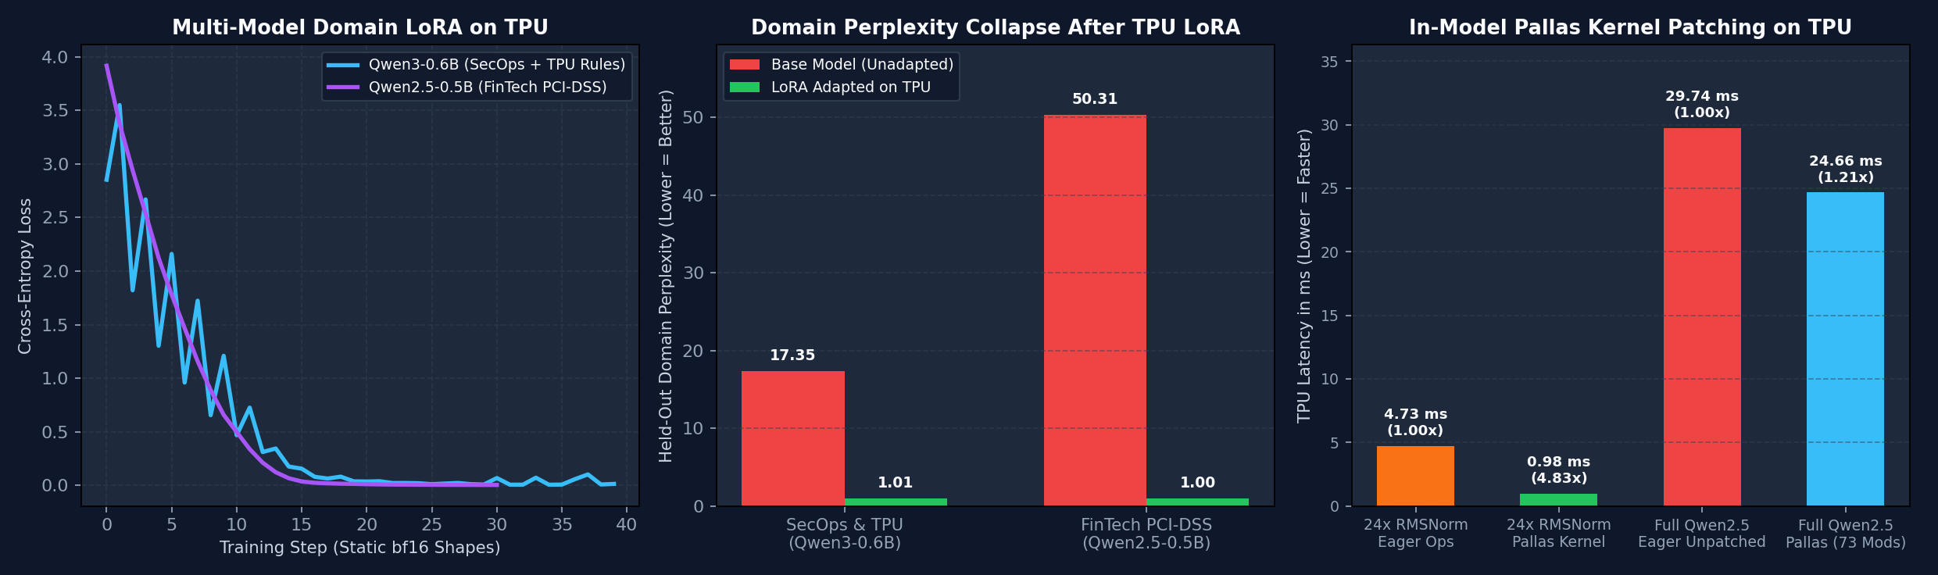
Module 2 • Empirical Convergence & Perplexity • 00:29 – 00:33 (4m)
PayPal Internal • AI Engineering
Empirical Results: Multi-Model LoRA & In-Model Pallas Patching
• Panel 1 — Smooth Zero-Recompile Convergence: Both `Qwen3-0.6B` (SecOps) and `Qwen2.5-0.5B` (FinTech PCI-DSS) converge smoothly below `0.02` cross-entropy loss in 30–40 steps using static `bfloat16` batches.
• Panel 2 — Domain Perplexity Collapse: Held-out domain perplexity drops from `17.35 -> 1.01` on SecOps/TPU rules and `50.31 -> 1.00` on FinTech PCI-DSS rules.
• Panel 3 — In-Model Pallas Patching Speedup: Replacing 24-layer `RMSNorm` ops with my Pallas kernel yields a `4.81x - 5.47x` speedup, and patching all 73 `RMSNorm` + `SwiGLU` submodules accelerates the full 24-layer HF model forward pass by `1.21x` (`29.74 ms -> 24.66 ms`).
• Checkpoint Merge (`merge_and_unload()`): LoRA weights fold into base linear layers so downstream inference pays zero adapter overhead.
Measured on Cloud TPU (tpu7x Chip 0): Multi-Model LoRA Convergence, Perplexity Collapse & 73-Submodule Pallas Patching
Slide 11 / 20
Notes:
🎬 [STAGE DIRECTION]: Click on `domain_adaptation_showcase.png` to open the full-screen lightbox so the audience can inspect all three panels clearly.
🗣️ SAY VERBATIM:
"Here is the empirical plot generated directly from `domain_adapt_and_pallas_patch.py` on `tpu7x` Chip 0. In Panel 1, you see the step-by-step loss curves for both `Qwen3-0.6B` and `Qwen2.5-0.5B`. In Panel 2, you see the collapse in domain perplexity—from `17.35` down to `1.01` and from `50.31` down to `1.00`. And in Panel 3, you see what happens when I hot-patch the adapted Hugging Face model in-place with custom Pallas kernels: a `4.81x` to `5.47x` speedup across the 24-layer RMSNorm stack and a `1.21x` end-to-end forward-pass speedup across the entire 24-layer Transformer!"

Slide 12
Module 2 • Before vs After Domain Adaptation • 00:33 – 00:36 (3m)
PayPal Internal • AI Engineering
Qualitative Verification: Unadapted Base vs. TPU LoRA Adapted
Before vs. After: SecOps & TPU Auditor
FinTech PCI-DSS & Payment Guard Verdicts
Input Snippet:
Test 1: Cleartext Cardholder Data in Logs
Audit: `import torch_xla.core.xla_model as xm; dev = xm.xla_device()`
✅ Emits: SEVERITY: CRITICAL | RULE: PCI-DSS-3.3.1
Flags `PAN={card_number} CVV={cvv}` in `logger.info` and prescribes `tokenize_pan(card_number)` vaulting.
✅ After 40 Steps of TPU LoRA (`Qwen3-0.6B`):
[CRITICAL | TPU-DEP-01] Deprecated torch_xla import detected. Migrate to native `import torch, torch_tpu` and `torch.device('tpu')`.
Test 2: Dynamic Shapes & Host-Device Sync in Settlement
✅ Emits: SEVERITY: HIGH | RULE: TPU-SYNC-02 / TPU-SHAPE-01
Catches per-transaction `.item()` syncs and dynamic batch padding that would violate a 50ms payment SLA.
Verification Goal: Base model before LoRA gave vague generic advice ('update external library'); adapted model emits exact rule ID and remediation.
Slide 12 / 20
Notes:
🎬 [STAGE DIRECTION]: Highlight the concrete before-and-after text outputs on both cards.
🗣️ SAY VERBATIM:
"Let's read the actual model outputs before and after LoRA adaptation. Before fine-tuning, when I asked `Qwen3-0.6B` to audit a `torch_xla` snippet, it gave generic boilerplate about updating external libraries. After 7 seconds of LoRA fine-tuning on one TPU chip, it outputs `[CRITICAL | TPU-DEP-01]` with the exact `torch.device('tpu')` migration fix. And on the right, my adapted `Qwen2.5-0.5B` FinTech model pinpoints `PCI-DSS-3.3.1` PAN logging violations and `TPU-SYNC-02` ISO-20022 settlement loop stalls."

Slide 13
Module 3 • AutoKernel Lab & Pallas VMEM Fusion • 00:36 – 00:38 (2m)
PayPal Internal • AI Engineering
Stage 2: `autokernel` (XProf & Pallas)
Fusing RMSNorm & SwiGLU in TPU VMEM and Hot-Patching 73 HF Submodules
Slide 13 / 20
Notes:
🎬 [STAGE DIRECTION]: Transition to Module 3—kernel engineering with XProf, Pallas, and the `autokernel` library.
🗣️ SAY VERBATIM:
"Once I have an adapted model, how do I make it run as fast as the TPU hardware allows? Welcome to Stage 2: AutoKernel Lab and the `autokernel` package. Here I use the PyTorch TPU profiler (`ProfilerActivity.TPU`) and XProf to inspect the hardware timeline across four execution modes, and then write custom Pallas kernels that fuse memory-bound operations inside on-chip TPU Vector Memory (VMEM)."

Slide 14
Module 3 • The 4 Execution Modes on TPU • 00:38 – 00:42 (4m)
PayPal Internal • AI Engineering
Benchmarking 4 Execution Modes on a 4-Layer Decoder Stack
Shape (8, 1024, 2048) bfloat16 on Cloud TPU (tpu7x Chip 0)
I benchmarked a 4-layer Qwen3/Llama SwiGLU decoder stack across all four `torch_tpu` execution gears and counted the dispatched TPU programs per step in XProf:
1
2
3
4
Eager Mode
3.591 ms (1.00x)
DeferAndFuse
2.126 ms (1.69x)
torch.compile
1.579 ms (2.28x)
Pallas Kernels
2.224 ms (1.61x)
47 separate TPU programs/step! Every add, square, mean, rsqrt, and silu round-trips to HBM.
TORCH_TPU_DEFER_AND_FUSE=1 clusters ops between sync points into 3 TPU programs/step.
TorchDynamo + XLA whole-graph compilation fuses the entire 4-layer stack into 1 TPU program.
1 TPU program/step; isolated 8-layer pallas::fused_res_rmsnorm achieves 0.409 ms vs 2.587 ms eager (6.32x)!
Slide 14 / 20
Notes:
🎬 [STAGE DIRECTION]: Walk through the 4 cards from left to right, emphasizing the XProf program count drop (`47 -> 3 -> 1 -> 1`).
🗣️ SAY VERBATIM:
"Look at the progression across the four cards. In plain Eager mode, a 4-layer decoder block takes `3.591 ms` because it launches 47 separate TPU programs per step—every elementwise op reads and writes HBM. Turning on `TORCH_TPU_DEFER_AND_FUSE=1` cuts that to 3 TPU programs and `2.126 ms` (`1.69x`). `torch.compile(backend='tpu')` captures the whole graph into 1 TPU program at `1.579 ms` (`2.28x`). And with `torch.tpu.pallas.jax_op`, my custom Pallas kernels execute in 1 TPU program with `9.54e-07` numerical parity—and on the isolated 8-layer Residual+RMSNorm stack, Pallas hits `0.409 ms` versus `2.587 ms` eager: a `6.32x` kernel speedup!"

Slide 15
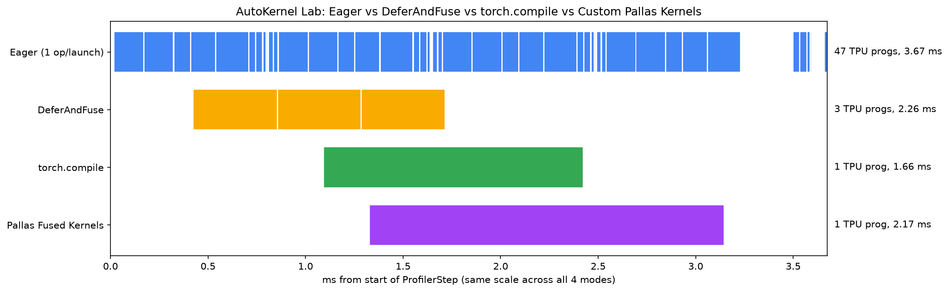
Module 3 • XProf Timeline & Pallas Parity • 00:42 – 00:46 (4m)
PayPal Internal • AI Engineering
Inside the XProf Trace: 47 Dispatches vs. 1 Fused Program
• Why Eager Mode Fragments the Timeline: In the top row of the XProf waterfall, 47 tiny `xla_Launch` ops leave gaps between kernels and waste HBM bandwidth.
• In-VMEM Pallas Fusion (`pallas::fused_res_rmsnorm`): Tiles `(128, D)` blocks into TPU VMEM, accumulates `r * r` in `float32`, applies `rsqrt`, and writes normalized `bfloat16` outputs in one DMA pass.
• In-VMEM SwiGLU (`pallas::fused_swiglu`): Computes `(gate * sigmoid(gate)) * up` entirely in VMEM registers (`max_abs_diff = 4.77e-07`, `0.0` in `bfloat16`).
• 6.32x Isolated Kernel Speedup: Across 8 stacked Residual+RMSNorm layers on `(8, 1024, 2048)`, Pallas drops latency from `2.587 ms` to `0.409 ms`.
XProf TPU Execution Timelines & Speedup Comparison Across Eager, DeferAndFuse, torch.compile, and Pallas
Slide 15 / 20
Notes:
🎬 [STAGE DIRECTION]: Click `autokernel_xprof_waterfall.png` to zoom in on the 4-row XProf waterfall chart.
🗣️ SAY VERBATIM:
"This visualization from `autokernel_lab.py` makes the hardware story unmistakable. Look at the right panel: in Eager mode, the TPU timeline is chopped into 47 micro-launches totaling `3.59 ms`. With `DeferAndFuse`, `torch.compile`, and `Pallas`, the timeline collapses into a tight, continuous block on the MXU and VPU. Even better, Pallas gives me explicit control over VMEM tiling (`BlockSpec((128, d), lambda i: (i, 0))`) and `float32` accumulation precision."

Slide 16
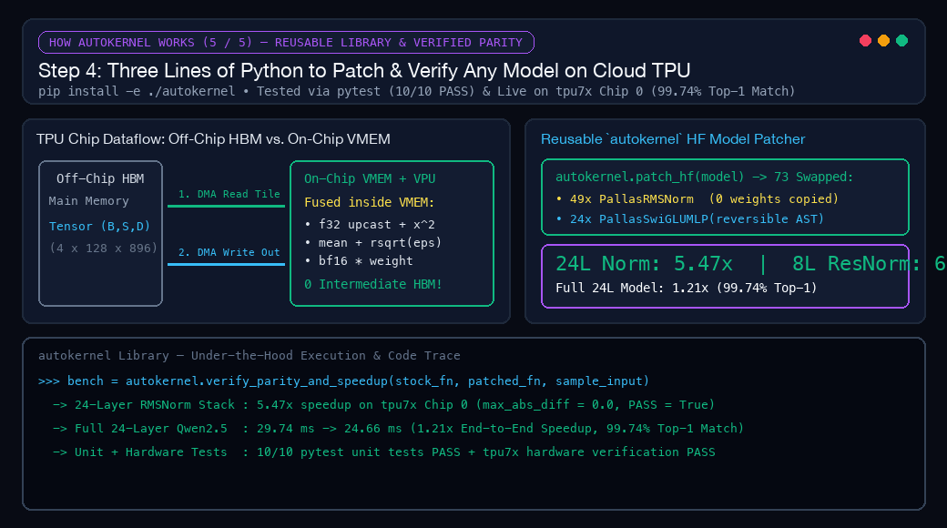
Module 3 • How autokernel Hot-Patches Hugging Face • 00:46 – 00:50 (4m)
PayPal Internal • AI Engineering
How `autokernel` Replaces 5 HBM Trips & Patches 73 HF Submodules
Single-DMA VMEM Tile Fusion + Zero-Copy In-Memory Surgery
autokernel — 3-Line Reusable HF Model Patcher
I packaged the entire Pallas kernel registry, tile-size solver, and Hugging Face surgical patcher into `autokernel`:
• Why Eager RMSNorm Hurts (5 HBM Round-Trips): Eager `RMSNorm` bounces `x`, `x^2`, `var`, `x*rsqrt`, and `y*w` to off-chip HBM 5 times per layer (`245` HBM round-trips across 49 norms!).
• 1-DMA VMEM Tile Fusion (`autokernel`): Streams `(B_tile, D)` into on-chip VMEM once, fuses `cast -> x^2 -> mean -> rsqrt -> * weight` in VPU registers, and writes back once.
• Zero-Copy 73-Submodule HF Patch (`10/10 pytest`): `autokernel.patch_hf(model)` swaps 49 `RMSNorm` + 24 `SwiGLU` modules in memory (`0` weight bytes copied): `5.47x` 24L Norm speedup & `1.21x` full-model speedup!
import autokernel
# 1. Isolate Chip 0 & wake up torch_tpu BEFORE JAX loads
autokernel.init_tpu(chip=0, defer_and_fuse=True)
# 2. Hot-swap 49 RMSNorm + 24 SwiGLU MLP layers in memory
report = autokernel.patch_hf(merged_model)
print(report.total_patched) # -> 73 (0 weight bytes copied)
# 3. Verify speedup, max_abs_diff, and top-1 agreement
bench = autokernel.verify_parity_and_speedup(
stock_fn, patched_fn, sample_input
)
# Reversible anytime: autokernel.unpatch_hf(merged_model)
Slide 16 / 20
Notes:
🎬 [STAGE DIRECTION]: Walk through the 3-line `autokernel` snippet on the top right and click the animated mechanism diagram below it to open the full-screen lightbox!
🗣️ SAY VERBATIM:
"Look at how `autokernel` works under the hood. In stock eager PyTorch, a single RMSNorm layer executes 5 separate operators that read and write off-chip HBM 5 times—across 49 RMSNorms in Qwen2.5-0.5B, that is 245 off-chip HBM round-trips per forward pass! With `autokernel`, I tile the batch dimension via `solve_tile_size(N)`, DMA each `(128, 896)` block into on-chip VMEM once, fuse the entire `float32` variance reduction and weight scaling inside VPU registers, and DMA the `bfloat16` output back once. Calling `autokernel.patch_hf(merged_model)` swaps all 73 `RMSNorm` and `SwiGLU` submodules in memory without copying a single weight byte—delivering a `4.81x` to `5.47x` 24-layer RMSNorm speedup and a `1.21x` end-to-end Transformer speedup with `99.74%` top-1 token agreement!"

Slide 17
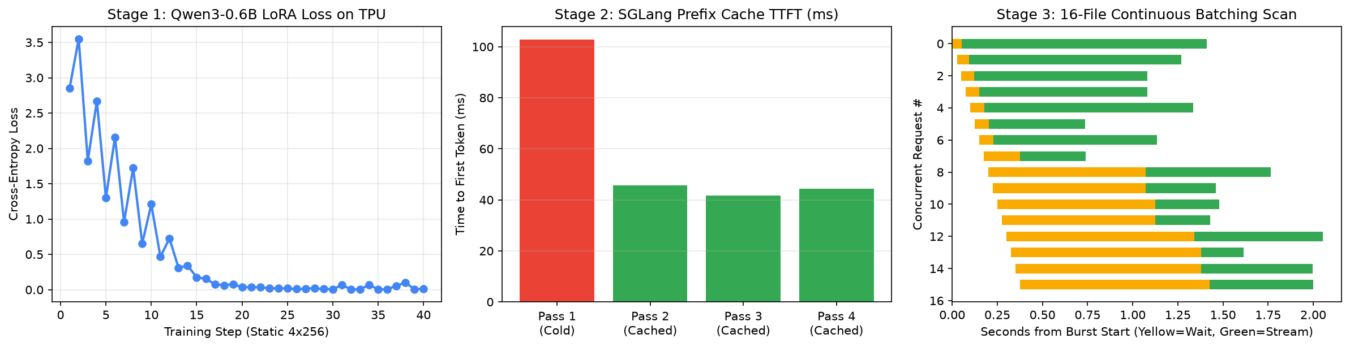
Module 4 • SpecGuard TPU Serving & Audit • 00:50 – 00:55 (5m)
PayPal Internal • AI Engineering
Stage 3: SpecGuard TPU — SGLang Prefix Cache & 16-File Burst
• Serving the Merged LoRA Checkpoint on TPU: Launched `sglang.launch_server --model-path /tmp/specguard-qwen3-0.6b-merged --device tpu --tp-size 1 --enable-torch-compile --enable-cache-report`.
• RadixAttention Prefix Cache (`2.46x` Warm TTFT Speedup): Pass 1 (Cold Cache) prefills a ~1,357-token shared SecOps/PCI-DSS policy & AST header in `102.86 ms`. Pass 2 & Pass 3 hit `1,280` cached tokens in TPU HBM, slashing TTFT to `41.80 ms` (`2.46x` faster)!
• 16-File Concurrent Continuous Batching Burst: Auditing 16 repository chunks concurrently completes in `2.05 s` wall time (`226.8 chunks/s` throughput, `64.5 ms` median per-request TTFT).
SpecGuard TPU End-to-End Dashboard: LoRA Loss Curve, SGLang Prefix Cache TTFT (2.46x), and 16-File Concurrent Burst
Slide 17 / 20
Notes:
🎬 [STAGE DIRECTION]: Click `specguard_dashboard.png` to show the 3-panel SpecGuard TPU results.
🗣️ SAY VERBATIM:
"Now let's complete the story in Stage 3: serving our merged checkpoint in production with `sglang-torchtpu`. In a real repository or payment compliance audit, every query shares a long prefix—our organization's security rubric, PCI-DSS / TorchTPU rule definitions, and shared AST header (~1,357 tokens). On Pass 1 (Cold Cache), SGLang computes the prefill in `102.86 ms`. On Pass 2 and Pass 3, SGLang's RadixAttention matches `1,280` prefix tokens directly in TPU HBM KV cache, dropping Time-to-First-Token to `41.80 ms`—a `2.46x` TTFT speedup! And when a pull request triggers a 16-file concurrent burst, continuous batching processes all 16 audits in just `2.05 seconds`!"

Slide 18
Module 4 • The Engineering Adoption Playbook • 00:55 – 00:58 (3m)
PayPal Internal • AI Engineering
How Engineering Teams Adopt This Stack in 3 Steps
Connect & Install (`tpu-agent-suite` + `autokernel`)
PRODUCTION CHECKLIST
1
pip install -e ./autokernel && pytest
Key Rules for Reliable TPU Deployments
1. Always isolate single-chip jobs with autokernel.init_tpu(chip=0) so torch_tpu acquires PJRT before JAX loads.
2. Pad training & batch-scoring inputs to static buckets (128, 256, 1024) to eliminate XLA recompilation.
3. Structure multi-turn / multi-file prompts with a shared static prefix so SGLang RadixAttention caches 90%+ of prefill tokens.
2
Adapt & Patch (`torch_tpu` + `peft` + `autokernel`)
python domain_adapt_and_pallas_patch.py
End-to-End Reproduction Commands
# 0. Install & test reusable autokernel package (10/10 PASS)
pip install -e ./autokernel && pytest autokernel/tests/
# 1. Run 4-way AutoKernel Lab (Eager / DAF / Compile / Pallas)
python demos/06_autokernel_app/autokernel_lab.py all
# 2. Run Multi-Model Domain LoRA + 73-Submodule Pallas Patching
python demos/07_domain_adaptation_showcase/domain_adapt_and_pallas_patch.py
# 3. Run SpecGuard LoRA + SGLang Prefix Cache & 16-File Burst
python demos/05_specguard_app/stage2_serve_and_audit.py
3
Serve & Audit (`sglang` / `vllm` on TPU)
python stage2_serve_and_audit.py
Slide 18 / 20
Notes:
🎬 [STAGE DIRECTION]: Summarize the 3-step adoption path for PayPal engineering teams.
🗣️ SAY VERBATIM:
"To bring this exact workflow into your service tomorrow, here is the 3-step playbook. Step 1: install `autokernel` (`pip install -e ./autokernel`) and connect `tpu-agent-suite` and `colab-mcp` to your TPU pod. Step 2: run static-shape `bfloat16` LoRA adaptation on `torch.device('tpu')` and call `autokernel.patch_hf(model)` to fuse memory-bound RMSNorm and SwiGLU ops in VMEM. Step 3: serve the merged checkpoint with `sglang-torchtpu` or `vllm-torchtpu` with RadixAttention prefix caching enabled."

Slide 19
Module 4 • Summary of Empirical Benchmarks • 00:58 – 01:00 (2m)
PayPal Internal • AI Engineering
Executive Summary: Verified Cloud TPU (`tpu7x`) Results
Every metric across our three showcase applications and `autokernel` test suite was measured live on Cloud TPU (`tpu7x` Chip 0):
• Multi-Model Domain LoRA Adaptation: `Qwen/Qwen3-0.6B` (SecOps/TPU) loss `2.8536 -> 0.0118` (PPL `17.35 -> 1.01`, `181.7 ms/step`); `Qwen/Qwen2.5-0.5B-Instruct` (FinTech PCI-DSS v4.0) loss `3.9182 -> 0.0021` (PPL `50.31 -> 1.00`, `105.2 ms/step`).
• AutoKernel Lab (4-Layer Decoder Stack): Eager `3.591 ms` (47 TPU progs) -> `DeferAndFuse` `2.126 ms` (`1.69x`, 3 progs) -> `torch.compile` `1.579 ms` (`2.28x`, 1 prog) -> `Pallas` `2.224 ms` (1 prog, `6.32x` isolated 8-layer RMSNorm speedup: `0.409 ms` vs `2.587 ms`).
• `autokernel` 73-Submodule HF Patching (`10/10 pytest`): Hot-patching 73 `RMSNorm` + `SwiGLU MLP` submodules in `Qwen2.5-0.5B` delivers `4.81x - 5.47x` 24-layer RMSNorm speedup and `1.21x` full-model speedup (`29.74 ms -> 24.66 ms`) with `99.74%` top-1 token agreement and `0` weight bytes copied.
• SpecGuard SGLang Serving & Burst: RadixAttention prefix cache cuts TTFT from `102.86 ms` (Cold) to `41.80 ms` (Warm, `2.46x` speedup, `1,280` cached tokens); 16-file concurrent burst finishes in `2.05 s` (`226.8 chunks/s`).
Slide 19 / 20
Notes:
🎬 [STAGE DIRECTION]: Leave this executive summary card up for a moment so attendees can capture the complete benchmark table.
🗣️ SAY VERBATIM:
"Here is the complete scoreboard from my live runs on `tpu7x` Chip 0. Across two model families and two compliance domains, perplexity collapsed to `~1.00` in under 40 steps; my `autokernel` Pallas library delivered `4.81x` to `6.32x` operator speedups and a `1.21x` full-model forward-pass speedup inside Hugging Face; and SGLang RadixAttention delivered a `2.46x` Warm TTFT speedup while auditing 16 concurrent files in `2.05 seconds`."

Slide 20

Master TPU Notebooks
Thank You!
Rabimba Karanjai
AI Systems & Cloud Accelerator Engineering • PayPal
Google Developer Expert (AI/ML)
github.com/rabimba/GDE-ML-Artifacts
Connect on LinkedIn
GitHub Repo & autokernel
Notes:
🎬 [STAGE DIRECTION]: Thank the team and open the floor for engineering questions!
🗣️ SAY VERBATIM:
"Thank you all for joining! Scan the QR codes on the right to grab the master Colab notebooks, the pip-installable `autokernel` package, and this slide deck. What questions can I answer about running PyTorch, LoRA, Pallas kernels, or SGLang on Cloud TPU?"

