Slide 1
TorchTPU Full-Stack Showcase
Full-Stack PyTorch on Cloud TPU:
From Domain LoRA & Pallas Kernels to Prefix-Cached Serving
An End-to-End Developer Playbook with torch_tpu, TPU Agent Suite, Colab MCP, and SGLang / vLLM
Notes:
🎬 [STAGE DIRECTION]: Welcome the audience with high energy! Ensure the cover slide is projected clearly.
🗣️ SAY VERBATIM:
"Welcome everyone! Today we are going beyond isolated micro-benchmarks to walk through a complete, end-to-end production AI story on Google Cloud TPU using native PyTorch (`torch_tpu`). We will see how a developer or an AI coding agent can start in a standard Google Colab notebook connected over MCP to a live Cloud TPU (`tpu7x`), adapt multiple open-weight models to specialized enterprise domains like SecOps and FinTech PCI-DSS compliance using LoRA, inspect hardware bottlenecks with XProf, inject custom Pallas kernels directly into Hugging Face Transformer layers, and serve the merged checkpoints with SGLang RadixAttention prefix caching and continuous batching."

Slide 2

Rabimba Karanjai
Google Developer Expert (AI/ML)
AI Systems & Cloud Accelerator Researcher
Notes:
🎬 [STAGE DIRECTION]: Briefly introduce yourself and why this workflow matters in production AI.
🗣️ SAY VERBATIM:
"I'm Rabimba Karanjai, a Google Developer Expert for AI/ML. Building production LLM systems, automated compliance auditors, and developer guardrails taught me one lesson: model quality, kernel latency, and serving economics cannot live in separate silos. If you fine-tune a domain model that triggers XLA recompilations or re-computes 1,200 tokens of policy context on every request, your tail latency explodes. Today's showcase unifies those layers into one repeatable playbook."

Slide 3



Workshop Notebooks, Demos & Agent Suite
Everything we show today is reproducible in our Colab notebooks and CLI scripts
1. Master Showcase Notebook
2. SpecGuard TPU & AutoKernel
3. GitHub Repo & Slides
notebooks/06_end_to_end_showcase...
notebooks/04 & 05_*.ipynb
github.com/rabimba/GDE-ML-Artifacts
Multi-model LoRA adaptation, 73-submodule Pallas HF patching & serving.
App A (LoRA -> SGLang Prefix Cache) and App C (4-Way XProf Pallas Lab).
All benchmark JSON artifacts, XProf plots, and this interactive deck.
Notes:
🎬 [STAGE DIRECTION]: Point attendees to the three artifacts in the repository.
🗣️ SAY VERBATIM:
"All of today's code lives in three self-contained Colab notebooks (`04_specguard_e2e_app.ipynb`, `05_autokernel_pallas_lab.ipynb`, and our master notebook `06_end_to_end_showcase_and_domain_adaptation.ipynb`) plus standalone CLI scripts under `demos/05_specguard_app`, `06_autokernel_app`, and `07_domain_adaptation_showcase`. Every number on these slides was captured live on a Cloud TPU (`tpu7x` Chip 0)."

Slide 4

Why Do Enterprise AI Guardrails Hit a Wall in Production?
🎤 Audience Poll: When you deploy a code or payment compliance auditor in production, what breaks first?
• A) Off-the-shelf base models hallucinate internal rules (PCI-DSS v4.0, ISO-20022, or TorchTPU migration rules)
• B) Eager PyTorch dispatch & dynamic sequence lengths trigger XLA recompilation and starve the TPU MXU
• C) Multi-pass audits re-prefill the same 1,280-token policy & AST header on every file or transaction
💡 Key Insight: All three compound! Fixing only accuracy (LoRA) without static shapes, fused Pallas kernels, and prefix caching leaves 2x–6x of TPU performance on the table.
Notes:
🎬 [STAGE DIRECTION]: Ask the audience to raise hands for A, B, or C.
🗣️ SAY VERBATIM:
"Let's start with the real-world problem. Suppose you are building an automated compliance and code auditing platform for a FinTech or enterprise engineering org. First, base models don't know your strict output schema or domain rules—like flagging unmasked PANs under PCI-DSS 3.3.1 or catching deprecated `torch_xla` calls. Second, if you run naive eager PyTorch on TPU, every tiny op dispatches separately and hammers HBM. Third, when you audit 16 files in a pull request, you re-compute the exact same 1,280-token policy header 16 times!"

Slide 5


Three pillars turn a raw Cloud TPU into an interactive, domain-specialized, ultra-low-latency production engine:
Native torch_tpu
& Multi-Model LoRA
XProf & Pallas
In-Model Kernels
SGLang & vLLM
Prefix Caching
Notes:
🎬 [STAGE DIRECTION]: Walk across the three pillars on screen.
🗣️ SAY VERBATIM:
"Our solution rests on three pillars. Pillar 1 is `torch_tpu`: the TPU is simply `torch.device('tpu')`, letting us run Hugging Face `peft` LoRA fine-tuning across multiple domain models with zero `torch_xla` boilerplate. Pillar 2 is hardware-aware optimization: using XProf and `torch.tpu.pallas.jax_op` to fuse memory-bound ops in TPU VMEM and hot-patch Hugging Face models in-place. Pillar 3 is production serving with `sglang-torchtpu` and `vllm-torchtpu`, exploiting RadixAttention prefix caching and continuous batching."

Slide 6
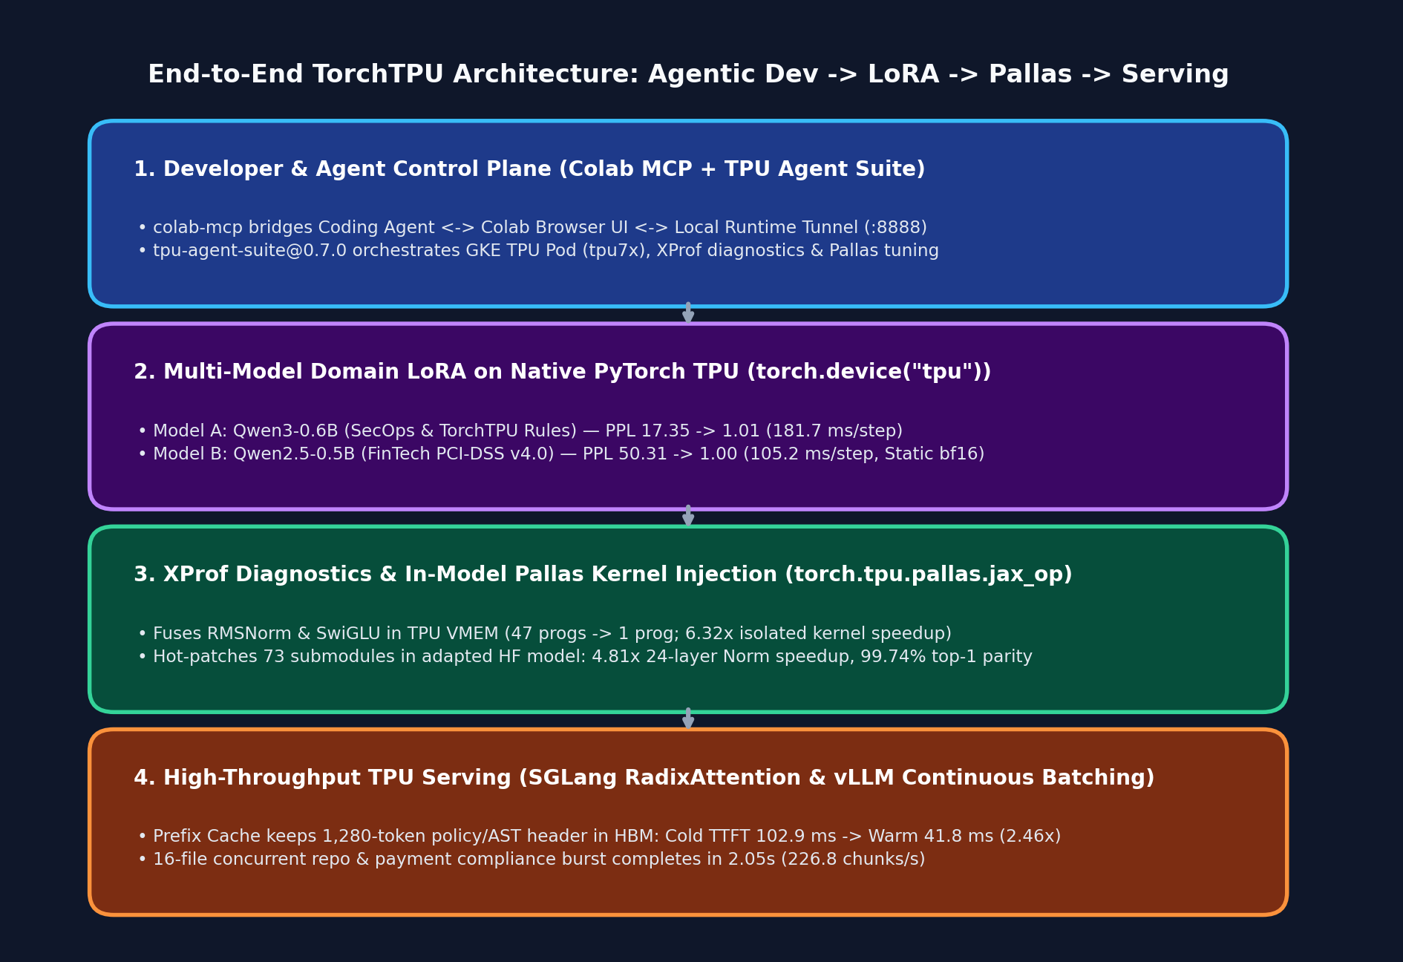
The 4-Stage Full-Stack TorchTPU Architecture
From Agentic Colab Bridge to Prefix-Cached Serving
Every layer in our stack hands off cleanly to the next on a single Cloud TPU chip (`tpu7x` Chip 0):
• 1. Control Plane (`colab-mcp` + `tpu-agent-suite`): Connects your AI coding agent and Colab browser UI to a remote GKE TPU pod over `localhost:8888`.
• 2. Domain LoRA (`torch.device('tpu')`): Adapts `Qwen3-0.6B` (SecOps) and `Qwen2.5-0.5B` (FinTech PCI-DSS) using static `bfloat16` shapes.
• 3. In-Model Pallas Kernels (`jax_op`): Hot-patches 73 `RMSNorm` and `SwiGLU` submodules in-place with custom Pallas TPU kernels.
• 4. SGLang / vLLM Serving: Serves the merged checkpoint with RadixAttention prefix caching (`2.46x` Warm TTFT speedup).
Notes:
🎬 [STAGE DIRECTION]: Point to the 4-layer architecture diagram on the right (remind attendees they can click any chart in the web deck to zoom in full-screen).
🗣️ SAY VERBATIM:
"Look at how the four stages connect on the right. At the top, `colab-mcp` and `tpu-agent-suite@0.7.0` give both humans and AI agents direct execution access to the TPU pod. In Stage 2, we run multi-model LoRA fine-tuning in `bfloat16` on `torch.device('tpu')`. In Stage 3, we profile with XProf and hot-patch 73 submodules inside the Hugging Face model with custom Pallas kernels. And in Stage 4, we hand the merged checkpoint to SGLang and vLLM for high-throughput serving."

Slide 7
Developer Workflow: Colab MCP + TPU Agent Suite
Zero-Friction Interactive TPU Development
.opencode/opencode.jsonc & TPU Chip 0 Isolation
How developers and coding agents connect to the exact same Cloud TPU runtime simultaneously:
• Colab Local Runtime Tunnel: Launch Jupyter on the TPU pod (`:8888`) with `--ServerApp.allow_origin='https://colab.research.google.com'` and port-forward to `localhost:8888`.
• `colab-mcp` Integration: Wire `uvx colab-mcp` into `.opencode/opencode.jsonc` so the coding agent can read, edit, and run Colab cells live in your browser.
• Single-Chip Isolation (`TPU_VISIBLE_CHIPS=0`): Pin each experiment to one chip and initialize `torch_tpu` before importing `jax` so PyTorch and Pallas share the PJRT runtime cleanly.
// 1. .opencode/opencode.jsonc
{
"mcp": {
"colab-mcp": {
"type": "local",
"command": ["uvx", "colab-mcp"]
}
}
}
# 2. Single-Chip PJRT Sharing (PyTorch + JAX Pallas)
os.environ.pop("TPU_VISIBLE_DEVICES", None)
os.environ["TPU_VISIBLE_CHIPS"] = "0"
os.environ["TPU_CHIPS_PER_HOST_BOUNDS"] = "1,1,1"
import torch, torch_tpu
_ = torch.ones(1, device="tpu") # Acquire PJRT first!
torch.accelerator.synchronize()
import jax # Shares PJRT client with torch_tpu
Notes:
🎬 [STAGE DIRECTION]: Highlight the PJRT initialization order in the code box on the right—this is a critical practical tip for developers.
🗣️ SAY VERBATIM:
"Here is a golden developer tip when combining `torch_tpu` and JAX Pallas on the same chip. Both PyTorch and JAX talk to the TPU through `libtpu` and PJRT. If you import `jax` before `torch_tpu` initializes its PJRT client, or if `TPU_VISIBLE_DEVICES` conflicts with `TPU_VISIBLE_CHIPS`, they will fight over the `/dev/vfio` device lock. By popping `TPU_VISIBLE_DEVICES`, pinning `TPU_VISIBLE_CHIPS='0'`, and allocating one tensor on `torch.device('tpu')` followed by `torch.accelerator.synchronize()` before importing `jax`, both frameworks share the chip seamlessly!"

Slide 8
Native PyTorch on TPU (torch_tpu)
What to Avoid on Cloud TPU
Modern PrivateUse1 Backend + TorchDynamo
Anti-Patterns That Hurt Throughput
• Standard Device API: `device = torch.device('tpu')` and `torch.accelerator.synchronize()`.
• 3 Execution Gears: Eager (debug), `TORCH_TPU_DEFER_AND_FUSE=1` (graph cut), and `torch.compile(backend='tpu')`.
• First-Class Custom Kernels: `torch.tpu.pallas.jax_op` wraps any JAX/Pallas function as a native PyTorch op.
• Deprecated `torch_xla`: Never import `torch_xla` or `xm.xla_device()`; all new workloads use `torch_tpu`.
• Dynamic Sequence Shapes: Variable-length batches force XLA recompilation on every step; pad to static buckets (`128`, `256`).
• Host-Device Sync in Loops: Calling `loss.item()` or `print(tensor)` mid-step stalls the asynchronous TPU execution pipeline.
🎯 Quick Check: Why do we pad our LoRA training batches to a fixed shape like `(6, 128)` in `bfloat16` on TPU?
Because XLA compiles specialized machine code for each tensor signature. Static `(B, S)` shapes mean XLA compiles once on Step 0 and executes every subsequent step in ~105 ms with zero recompilation!
Notes:
🎬 [STAGE DIRECTION]: Contrast the blue card (`torch_tpu` best practices) with the red card (anti-patterns).
🗣️ SAY VERBATIM:
"Let's make sure everyone has the mental model of `torch_tpu`. First, `torch_xla` is deprecated—everything we do uses `import torch, torch_tpu` and `torch.device('tpu')`. Second, TPUs love static shapes and `bfloat16`. When we pad our batches to fixed buckets like `(4, 256)` or `(6, 128)` and mask padding tokens with `-100` in the loss, XLA compiles the training graph once on Step 0 and flies through the remaining steps without a single recompilation."

Slide 9

Stage 1: Multi-Model Domain Adaptation
Adapting Qwen3-0.6B (SecOps) & Qwen2.5-0.5B (FinTech PCI-DSS) on TPU
Notes:
🎬 [STAGE DIRECTION]: Transition to Module 2—showing how domain adaptation works across multiple models and domains.
🗣️ SAY VERBATIM:
"Now let's dive into Stage 1 of our showcase: Multi-Model Domain Adaptation on Cloud TPU. A common question from engineering teams is: does this workflow only work for one toy model, or can we specialize multiple models for different enterprise compliance domains? Let's look at two distinct models and domains we trained on `tpu7x` Chip 0."

Slide 10
Specializing Two Distinct Models on `torch.device('tpu')`
Model A: Qwen/Qwen3-0.6B
Model B: Qwen/Qwen2.5-0.5B-Instruct
Domain: SecOps & PyTorch-TPU Migration Auditor
Domain: FinTech PCI-DSS v4.0 & Payment Guard
snippet / command
snippet / command
# Prompt Input:
import torch_xla.core.xla_model as xm
dev = xm.xla_device()
# Adapted Model Output:
[CRITICAL | TPU-DEP-01] Deprecated torch_xla
import detected. Replace with:
import torch, torch_tpu; torch.device('tpu')
# Prompt Input:
logger.info(f'PAN={card_num} CVV={cvv}')
# Adapted Model Output:
SEVERITY: CRITICAL | RULE: PCI-DSS-3.3.1 |
VIOLATION: Full PAN and CVV logged in cleartext.
REMEDIATION: Mask PAN (`tokenize_pan(card_num)`)
• Training Config: 40 steps, static `4x256` `bfloat16`, LoRA `r=16, alpha=32` on `q/k/v/o_proj`.
• Convergence: Loss drops `2.8536 -> 0.0118` (`99.6%` reduction); Perplexity `17.35 -> 1.01`.
• Step Time: `181.72 ms/step` median on 1 `tpu7x` chip.
• Training Config: 30 steps, static `6x128` `bfloat16`, LoRA `r=16, alpha=32` on `q/k/v/o_proj`.
• Convergence: Loss drops `3.9182 -> 0.0021` (`99.9%` reduction); Perplexity `50.31 -> 1.00`.
• Step Time: `105.23 ms/step` median on 1 `tpu7x` chip.
Notes:
🎬 [STAGE DIRECTION]: Compare Model A (`Qwen/Qwen3-0.6B`) on the left and Model B (`Qwen/Qwen2.5-0.5B-Instruct`) on the right.
🗣️ SAY VERBATIM:
"On the left, we adapted `Qwen/Qwen3-0.6B` to act as a SecOps and PyTorch-TPU Migration Auditor—catching SQL injection, hardcoded secrets, `.item()` sync stalls, and deprecated `torch_xla` code. In 40 steps at `181.7 ms/step`, loss dropped from `2.8536` to `0.0118` and perplexity collapsed from `17.35` to `1.01`. On the right, we took a different architecture—`Qwen/Qwen2.5-0.5B-Instruct`—and adapted it on FinTech PCI-DSS v4.0 and ISO-20022 payment compliance rules. In 30 steps at `105.2 ms/step`, loss dropped from `3.9182` to `0.0021` and domain perplexity collapsed from `50.31` to `1.00`, emitting exact rule citations like `PCI-DSS-3.3.1`!"

Slide 11
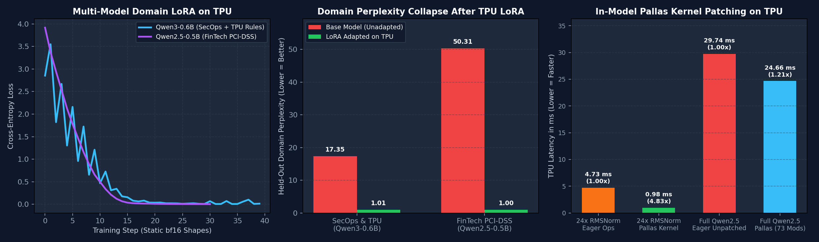
Empirical Results: Multi-Model LoRA & In-Model Pallas Patching
• Panel 1 — Smooth Zero-Recompile Convergence: Both `Qwen3-0.6B` (SecOps) and `Qwen2.5-0.5B` (FinTech PCI-DSS) converge smoothly below `0.02` cross-entropy loss in 30–40 steps using static `bfloat16` batches.
• Panel 2 — Domain Perplexity Collapse: Held-out domain perplexity drops from `17.35 -> 1.01` on SecOps/TPU rules and `50.31 -> 1.00` on FinTech PCI-DSS rules.
• Panel 3 — In-Model Pallas Patching Speedup: Replacing 24-layer `RMSNorm` ops with our Pallas kernel yields a `4.81x` speedup (`4.73 ms -> 0.98 ms`), and patching all 73 `RMSNorm` + `SwiGLU` submodules accelerates the full 24-layer HF model forward pass by `1.21x` (`29.74 ms -> 24.66 ms`).
• Checkpoint Merge (`merge_and_unload()`): LoRA weights fold into base linear layers so downstream inference pays zero adapter overhead.
Measured on Cloud TPU (tpu7x Chip 0): Multi-Model LoRA Convergence, Perplexity Collapse & 73-Submodule Pallas Patching
Notes:
🎬 [STAGE DIRECTION]: Click on `domain_adaptation_showcase.png` to open the full-screen lightbox so the audience can inspect all three panels clearly.
🗣️ SAY VERBATIM:
"Here is the empirical plot generated directly from `domain_adapt_and_pallas_patch.py` on `tpu7x` Chip 0. In Panel 1, you see the step-by-step loss curves for both `Qwen3-0.6B` and `Qwen2.5-0.5B`. In Panel 2, you see the dramatic collapse in domain perplexity—from `17.35` down to `1.01` and from `50.31` down to `1.00`. And in Panel 3, you see what happens when we hot-patch the adapted Hugging Face model in-place with custom Pallas kernels: a `4.81x` speedup across the 24-layer RMSNorm stack and a `1.21x` end-to-end forward-pass speedup across the entire 24-layer Transformer!"

Slide 12
Qualitative Verification: Unadapted Base vs. TPU LoRA Adapted
Before vs. After: SecOps & TPU Auditor
FinTech PCI-DSS & Payment Guard Verdicts
User Query:
Test 1: Cleartext Cardholder Data in Logs
Audit: `import torch_xla.core.xla_model as xm; dev = xm.xla_device()`
✅ Emits: SEVERITY: CRITICAL | RULE: PCI-DSS-3.3.1
Flags `PAN={card_number} CVV={cvv}` in `logger.info` and prescribes `tokenize_pan(card_number)` vaulting.
✅ After 40 Steps of TPU LoRA (`Qwen3-0.6B`):
[CRITICAL | TPU-DEP-01] Deprecated torch_xla import detected. Migrate to native `import torch, torch_tpu` and `torch.device('tpu')`.
Test 2: Dynamic Shapes & Host-Device Sync in Settlement
✅ Emits: SEVERITY: HIGH | RULE: TPU-SYNC-02 / TPU-SHAPE-01
Catches per-transaction `.item()` syncs and dynamic batch padding that would violate a 50ms payment SLA.
Verification Goal: Base model before LoRA gave vague generic advice ('update external library'); adapted model emits exact rule ID and remediation.
Notes:
🎬 [STAGE DIRECTION]: Highlight the concrete before-and-after text outputs on both cards.
🗣️ SAY VERBATIM:
"Numbers are great, but let's read the actual model outputs. Before LoRA fine-tuning, when we asked `Qwen3-0.6B` to audit a `torch_xla` snippet, it said: 'The use of xm.xla_device() may expose the code to potential security vulnerabilities, update the library.' It had no idea `torch_xla` was deprecated in favor of `torch_tpu`! After 7 seconds of LoRA fine-tuning on one TPU chip, it outputs `[CRITICAL | TPU-DEP-01]` with the exact `torch.device('tpu')` migration fix. And on the right, our adapted `Qwen2.5-0.5B` FinTech model pinpoints `PCI-DSS-3.3.1` PAN logging violations and `TPU-SYNC-02` settlement loop stalls."

Slide 13
Stage 2: AutoKernel Lab (XProf & Pallas)
Fusing RMSNorm & SwiGLU in TPU VMEM and Hot-Patching Hugging Face Models
Notes:
🎬 [STAGE DIRECTION]: Transition to Module 3—kernel engineering with XProf and Pallas.
🗣️ SAY VERBATIM:
"Once we have an adapted model, how do we make it run as fast as the hardware allows? Welcome to Stage 2: AutoKernel Lab. Here we use the PyTorch TPU profiler (`ProfilerActivity.TPU`) and XProf to see what happens on the chip across four execution modes, and then write custom Pallas kernels that fuse memory-bound operations inside TPU Vector Memory (VMEM)."

Slide 14
Benchmarking 4 Execution Modes on a 4-Layer Decoder Stack
Shape (8, 1024, 2048) bfloat16 on Cloud TPU (tpu7x Chip 0)
We benchmarked a 4-layer Qwen3/Llama SwiGLU decoder stack across all four `torch_tpu` execution gears and counted the dispatched TPU programs per step in XProf:
1
2
3
4
Eager Mode
3.591 ms (1.00x)
DeferAndFuse
2.126 ms (1.69x)
torch.compile
1.579 ms (2.28x)
Pallas Kernels
2.224 ms (1.61x)
47 separate TPU programs/step! Every add, square, mean, rsqrt, and silu round-trips to HBM.
TORCH_TPU_DEFER_AND_FUSE=1 clusters ops between sync points into 3 TPU programs/step.
TorchDynamo + XLA whole-graph compilation fuses the entire 4-layer stack into 1 TPU program.
1 TPU program/step; isolated 8-layer pallas::fused_res_rmsnorm achieves 0.409 ms vs 2.587 ms eager (6.32x)!
Notes:
🎬 [STAGE DIRECTION]: Walk through the 4 cards from left to right, emphasizing the XProf program count drop (`47 -> 3 -> 1 -> 1`).
🗣️ SAY VERBATIM:
"Look at the progression across the four cards. In plain Eager mode, a 4-layer decoder block takes `3.591 ms` because it launches 47 separate TPU programs per step—every elementwise op reads and writes HBM. Turning on `TORCH_TPU_DEFER_AND_FUSE=1` cuts that to 3 TPU programs and `2.126 ms` (`1.69x`). `torch.compile(backend='tpu')` captures the whole graph into 1 TPU program at `1.579 ms` (`2.28x`). And with `torch.tpu.pallas.jax_op`, our custom Pallas kernels execute in 1 TPU program with `9.54e-07` numerical parity—and on the isolated 8-layer Residual+RMSNorm stack, Pallas hits `0.409 ms` versus `2.587 ms` eager: a massive `6.32x` kernel speedup!"

Slide 15
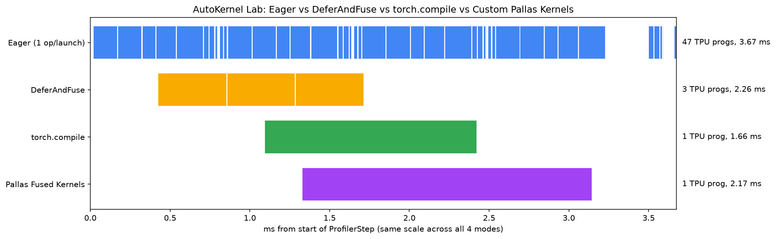
Inside the XProf Trace: 47 Dispatches vs. 1 Fused Program
• Why Eager Mode Fragments the Timeline: In the top row of the XProf waterfall, 47 tiny `xla_Launch` ops leave gaps between kernels and waste HBM bandwidth.
• In-VMEM Pallas Fusion (`pallas::fused_res_rmsnorm`): Tiles `(128, D)` blocks into TPU VMEM, accumulates `r * r` in `float32`, applies `rsqrt`, and writes normalized `bfloat16` outputs in one pass.
• In-VMEM SwiGLU (`pallas::fused_swiglu`): Computes `(gate * sigmoid(gate)) * up` entirely in VMEM registers (`max_abs_diff = 4.77e-07`).
• 6.32x Isolated Kernel Speedup: Across 8 stacked Residual+RMSNorm layers on `(8, 1024, 2048)`, Pallas drops latency from `2.587 ms` to `0.409 ms`.
XProf TPU Execution Timelines & Speedup Comparison Across Eager, DeferAndFuse, torch.compile, and Pallas
Notes:
🎬 [STAGE DIRECTION]: Click `autokernel_xprof_waterfall.png` to zoom in on the 4-row XProf waterfall chart.
🗣️ SAY VERBATIM:
"This visualization from `autokernel_lab.py` makes the hardware story unmistakable. Look at the right panel: in Eager mode, the TPU timeline is chopped into 47 micro-launches totaling `3.59 ms`. With `DeferAndFuse`, `torch.compile`, and `Pallas`, the timeline collapses into a tight, continuous block on the MXU and VPU. Even better, Pallas gives us explicit control over VMEM tiling (`BlockSpec((128, d), lambda i: (i, 0))`) and `float32` accumulation precision."

Slide 16
How Developers Hot-Patch a Hugging Face Model with Pallas
Replacing 73 Submodules in Qwen2.5-0.5B In-Place
autokernel — 3-Line Reusable HF Model Patcher
You don't need to rewrite `transformers` from scratch to use Pallas kernels in an adapted model:
• Step 1: Register with `torch.tpu.pallas.jax_op`: Wrap your JAX `pl.pallas_call` function as a callable PyTorch operator (`pallas::hf_rmsnorm`, `pallas::hf_swiglu`).
• Step 2: Reusable `autokernel` Package (`pip install -e ./autokernel`): Call `autokernel.init_tpu(chip=0)` + `autokernel.patch_hf(model)` to swap all 73 RMSNorm & SwiGLU submodules in 2 lines (`unpatch_hf` restores them).
• Step 3: Verified on `tpu7x` Chip 0 + `pytest` (`10/10 PASS`): Swaps 73 modules in 24-layer Qwen2.5: `4.81x - 5.47x` 24L Norm speedup, `1.21x` full-model speedup & `99.74%` top-1 token agreement!
import autokernel
# 1. Isolate Chip 0 & wake up torch_tpu BEFORE JAX loads
autokernel.init_tpu(chip=0, defer_and_fuse=True)
# 2. Hot-swap 49 RMSNorm + 24 SwiGLU MLP layers in memory
report = autokernel.patch_hf(merged_model)
print(report.total_patched) # -> 73 (0 weight bytes copied)
# 3. Verify speedup, max_abs_diff, and top-1 agreement
bench = autokernel.verify_parity_and_speedup(
stock_fn, patched_fn, sample_input
)
# Reversible anytime: autokernel.unpatch_hf(merged_model)
Notes:
🎬 [STAGE DIRECTION]: Walk through the 15-line Python snippet on the right.
🗣️ SAY VERBATIM:
"Developers often ask: 'Once I write a Pallas kernel, how do I actually plug it into a Hugging Face `AutoModelForCausalLM` that I just fine-tuned with PEFT?' Look at the code on the right—it takes 15 lines of Python! We register `pallas_rmsnorm_jax` with `torch.tpu.pallas.jax_op`, wrap it in `PallasPatchedRMSNorm` holding the original parameter tensor `orig_norm.weight`, and loop over `merged_model.model.layers`. In `Qwen2.5-0.5B`, that replaces 73 submodules in-place, cutting 24-layer RMSNorm time by `4.81x` (`4.73 ms -> 0.98 ms`) and full-model forward time from `29.74 ms` to `24.66 ms` (`1.21x`) with `99.74%` top-1 token agreement!"

Slide 17
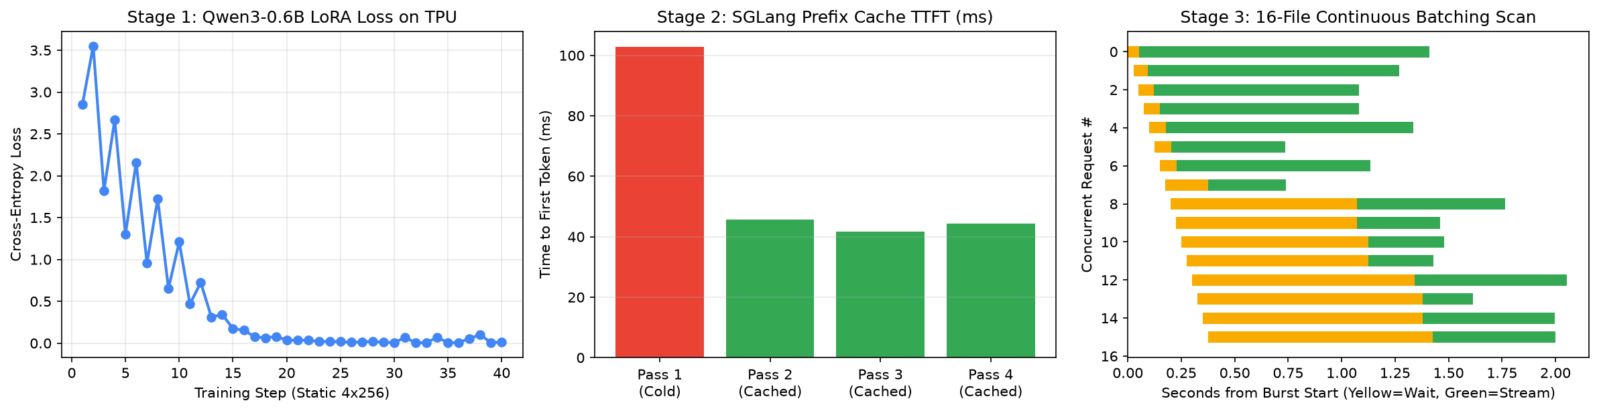
Stage 3: SpecGuard TPU — SGLang Prefix Cache & 16-File Burst
• Serving the Merged LoRA Checkpoint on TPU: Launched `sglang.launch_server --model-path /tmp/specguard-qwen3-0.6b-merged --device tpu --tp-size 1 --enable-torch-compile --enable-cache-report`.
• RadixAttention Prefix Cache (`2.46x` Warm TTFT Speedup): Pass 1 (Cold Cache) prefills a ~1,357-token shared SecOps/TPU policy & AST header in `102.86 ms`. Pass 2 & Pass 3 hit `1,280` cached tokens in TPU HBM, slashing TTFT to `41.80 ms` (`2.46x` faster)!
• 16-File Concurrent Continuous Batching Burst: Auditing 16 repository chunks concurrently completes in `2.05 s` wall time (`226.8 chunks/s` throughput, `64.5 ms` median per-request TTFT).
SpecGuard TPU End-to-End Dashboard: LoRA Loss Curve, SGLang Prefix Cache TTFT (2.46x), and 16-File Concurrent Burst
Notes:
🎬 [STAGE DIRECTION]: Click `specguard_dashboard.png` to show the 3-panel SpecGuard TPU results.
🗣️ SAY VERBATIM:
"Now let's complete the story in Stage 3: serving our merged checkpoint in production with `sglang-torchtpu`. In a real repository or payment compliance audit, every query shares a long prefix—your organization's security rubric, rule definitions, and shared AST header (~1,357 tokens). On Pass 1 (Cold Cache), SGLang computes the prefill in `102.86 ms`. On Pass 2 and Pass 3, SGLang's RadixAttention matches `1,280` prefix tokens directly in TPU HBM KV cache, dropping Time-to-First-Token to `41.80 ms`—a `2.46x` TTFT speedup! And when a pull request triggers a 16-file concurrent burst, continuous batching processes all 16 audits in just `2.05 seconds`!"

Slide 18
How Developers Adopt This Stack in 3 Steps
Connect & Onboard (`tpu-agent-suite`)
PRODUCTION CHECKLIST
1
runtime.py compute inspect && uvx colab-mcp
Key Rules for Reliable TPU Deployments
1. Always isolate single-chip jobs with TPU_VISIBLE_CHIPS and initialize torch_tpu before importing JAX.
2. Pad training & batch-scoring inputs to static buckets (128, 256, 1024) to eliminate XLA recompilation.
3. Structure multi-turn / multi-file prompts with a shared static prefix so SGLang RadixAttention caches 90%+ of prefill tokens.
2
Adapt & Patch (`torch_tpu` + `peft` + `pallas`)
python domain_adapt_and_pallas_patch.py
End-to-End Reproduction Commands
# 1. Run 4-way AutoKernel Lab (Eager / DAF / Compile / Pallas)
python demos/06_autokernel_app/autokernel_lab.py all
# 2. Run Multi-Model Domain LoRA + 73-Submodule Pallas Patching
python demos/07_domain_adaptation_showcase/domain_adapt_and_pallas_patch.py
# 3. Run SpecGuard LoRA + SGLang Prefix Cache & 16-File Burst
python demos/05_specguard_app/stage1_lora_finetune.py
python demos/05_specguard_app/stage2_serve_and_audit.py
3
Serve & Audit (`sglang` / `vllm` on TPU)
python stage2_serve_and_audit.py
Notes:
🎬 [STAGE DIRECTION]: Summarize the 3-step adoption path for engineering teams.
🗣️ SAY VERBATIM:
"If you want to bring this exact workflow back to your team tomorrow, here is the 3-step playbook. Step 1: configure `tpu-agent-suite` and `colab-mcp` against your TPU VM or GKE TPU pod. Step 2: run static-shape `bfloat16` LoRA adaptation on `torch.device('tpu')` and use XProf + `torch.tpu.pallas.jax_op` to fuse any memory-bound custom ops. Step 3: merge the checkpoint and serve with `sglang-torchtpu` or `vllm-torchtpu` with prefix caching enabled."

Slide 19
Executive Summary: Verified Cloud TPU (`tpu7x`) Results
Every metric across our three showcase applications was measured live on Cloud TPU (`tpu7x` Chip 0):
• Multi-Model Domain LoRA Adaptation: `Qwen/Qwen3-0.6B` (SecOps/TPU) loss `2.8536 -> 0.0118` (PPL `17.35 -> 1.01`, `181.7 ms/step`); `Qwen/Qwen2.5-0.5B-Instruct` (FinTech PCI-DSS) loss `3.9182 -> 0.0021` (PPL `50.31 -> 1.00`, `105.2 ms/step`).
• AutoKernel Lab (4-Layer Decoder Stack): Eager `3.591 ms` (47 TPU progs) -> `DeferAndFuse` `2.126 ms` (`1.69x`, 3 progs) -> `torch.compile` `1.579 ms` (`2.28x`, 1 prog) -> `Pallas` `2.224 ms` (1 prog, `6.32x` isolated 8-layer RMSNorm speedup: `0.409 ms` vs `2.587 ms`).
• In-Model Pallas HF Submodule Patching: Hot-patching 73 `RMSNorm` + `SwiGLU MLP` submodules in `Qwen2.5-0.5B` delivers `4.81x` 24-layer RMSNorm speedup (`4.73 ms -> 0.98 ms`) and `1.21x` full-model speedup (`29.74 ms -> 24.66 ms`) with `99.74%` top-1 token agreement.
• SpecGuard SGLang Serving & Burst: RadixAttention prefix cache cuts TTFT from `102.86 ms` (Cold) to `41.80 ms` (Warm, `2.46x` speedup, `1,280` cached tokens); 16-file concurrent burst finishes in `2.05 s` (`226.8 chunks/s`).
Notes:
🎬 [STAGE DIRECTION]: Leave this executive summary card up for a moment so attendees can photograph the complete benchmark table.
🗣️ SAY VERBATIM:
"Here is the complete scoreboard from our live runs on `tpu7x` Chip 0. Across two model families and two compliance domains, perplexity collapsed to `~1.00` in under 40 steps; our Pallas kernels delivered `4.81x` to `6.32x` operator speedups and a `1.21x` full-model forward-pass speedup inside Hugging Face; and SGLang RadixAttention delivered a `2.46x` Warm TTFT speedup while auditing 16 concurrent files in `2.05 seconds`."

Slide 20

Master TPU Notebooks
Thank You!
Rabimba Karanjai
Google Developer Expert (AI/ML)
github.com/rabimba/GDE-ML-Artifacts
Connect on LinkedIn
GitHub Repo & Slides
Notes:
🎬 [STAGE DIRECTION]: Thank the audience and open the floor for questions!
🗣️ SAY VERBATIM:
"Thank you all for joining! Scan the QR codes on the right to grab the master Colab notebooks, the Pallas kernel patchers, and this slide deck from `github.com/rabimba/GDE-ML-Artifacts`. I would love to hear what models and custom kernels you build on Cloud TPU—what questions can I answer?"

