Slide 1
VEGETABLE RECOGNITION AND PRICE VIEWER SYSTEM
Project supervisor
Er. Sudarshan subedi
RABIN GHIMIRE (073/BCT/28)
ANIL SHRESTHA (073/BCT/50)
AJIT DHAMI (073/BCT/51)

Slide 2
Introduction
Recognizing different kinds of vegetables is perhaps the most difficult task in supermarkets and fruit shops and people also need to ask the price of every vegetable price to shopkeeper.
This projects aims to solve this problem by recognizing the vegetable and view its currenty market price of the vegetable. Also prevents consumer from being paid overpriced.

Slide 3
Objective
To develop a system that recognize vegetable from the real time live camera using CNN.
To get the current market price of the recognized vegetable.

Slide 4
Scope And Application
Consumers can use this system to recognize vegetable and get its price that prevents them from paid overpriced.
Supermarket and vegatable storages can use this system to distinguish vegatable using machines and prevent the vegetable to be mixed up

Slide 5
Requirement Analysis-Functional Requirements
Accurate recognition of vegatable
Easy and user friendly interface
Display accurate price of recognized vegetable.

Slide 6
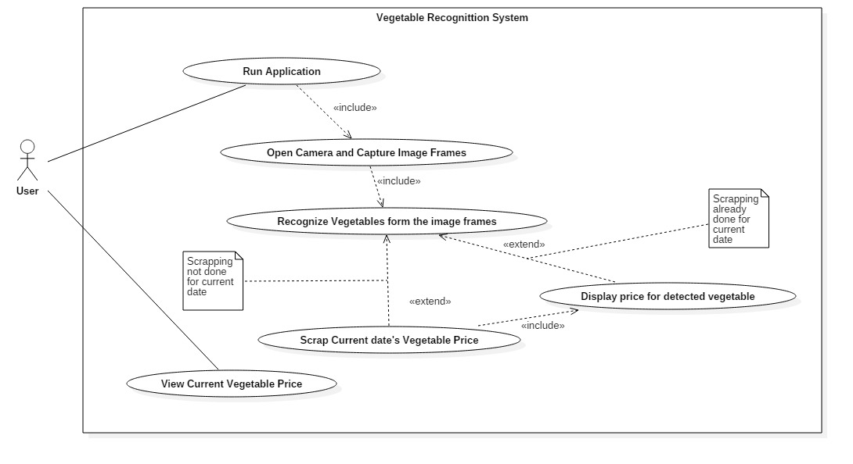
Use Case Diagram

Slide 7
Requirement Analysis-Non-Functional Requirements
Scalability
Error Free
Maintainability:
Portability:

Slide 8
Tools and Techniques Used
Python
PyCharm
Tensorflow
OpenCV
BeautifulSoup
PyQt5
Matplotlib
Pandas
Keras
NumPy

Slide 9
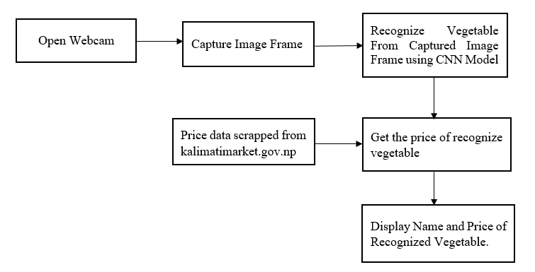
System Design- Block Diagram

Slide 10
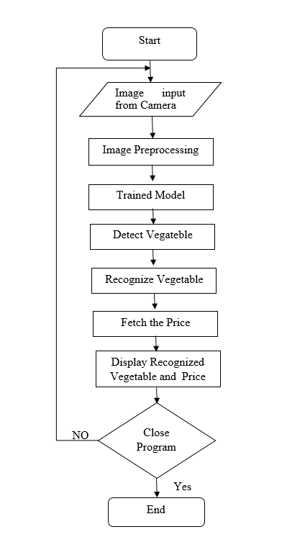
System Design-Flowchart

Slide 11
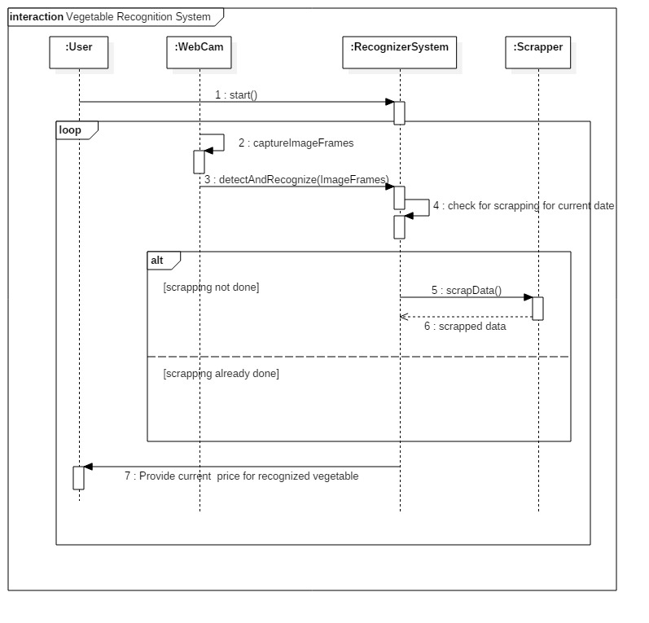
SYSTEM Design-Sequence Diagram

Slide 12
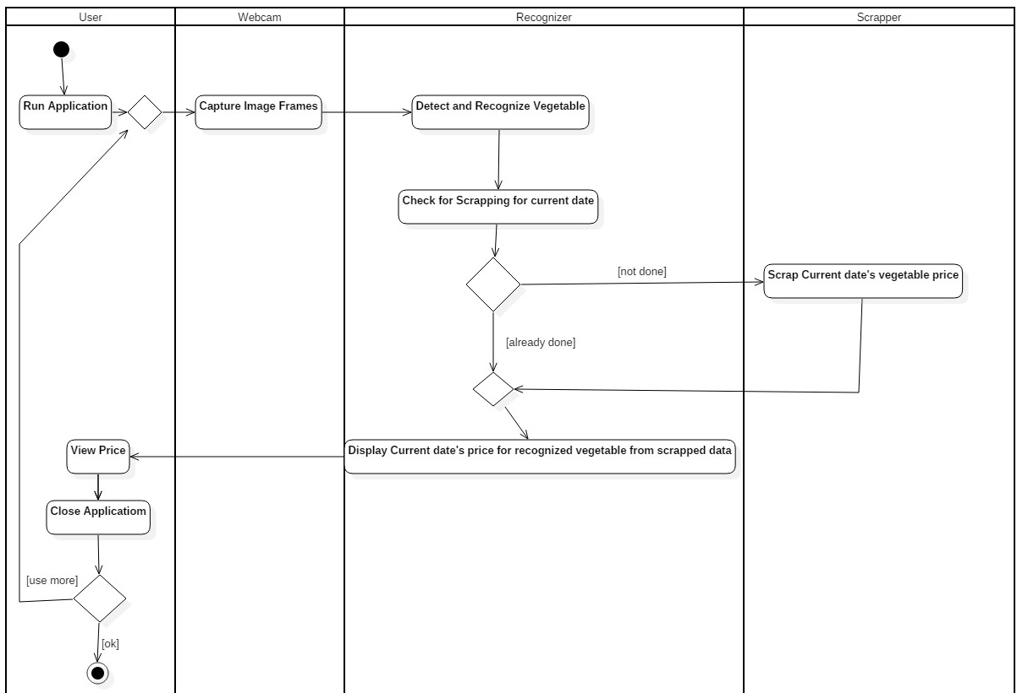
System Design-Activity Diagram

Slide 13
Methodology
Collection of Vegetable images
Fruits360 dataset from kaggle is used for dataset.
Preparing the Images to Train
Three different vegatables; Onion, Tomato and Potato
Image size used is 50*50.
These images are kept into different paths/directory and are labeled.

Slide 14
Methodology
Model Creation and Training
Convolutional Neural Netwok is used to train the images.
The detail on the architecture of CNN used in this project is explained in next slide.
Set up for the live images from camera module
OpenCV is used for the live video capturing from the camera.
The vegetables is detected as soon as the system detects any images of vegetables in the live video.
. The frame of the video is taken and the frame is used to predict the vegetable that is shown in the camera.

Slide 15
Methodology
Web Scrapping
The price of vegetable is scrapped from the website: kalimatimarket.gov.np. Using BeautifulSoup Library.
As soon as the system detects the vegetable, the price of the recognized vegetable is displayed along with its Name.
GUI
PyQt5 is used for making simple GUI to make the system easy to use.
A window is displayed that has a simple UI, consist of Button labeled “Start Recognition”. It opens the camera and starts to capture video.

Slide 16
Algorithm
CNN Algorithm
A Convolutional Neural Network (ConvNet/CNN) is a Deep Learning algorithm which can take in an input image, assign importance (learnable weights and biases) to various aspects/objects in the image and be able to differentiate one from the other
A CNN has
Convolutional layers
Pooling layers
a Fully connected layer

Slide 17
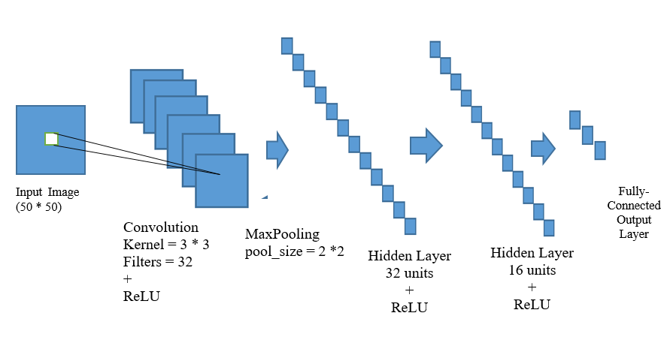
CNN Architecture of the Project

Slide 18
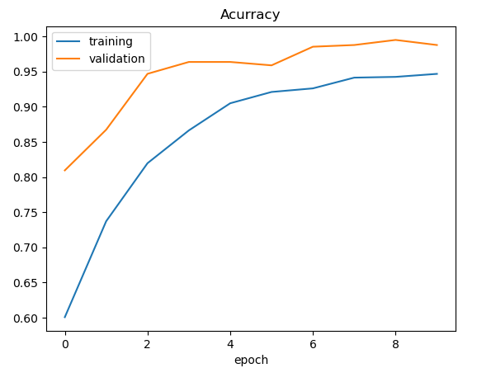
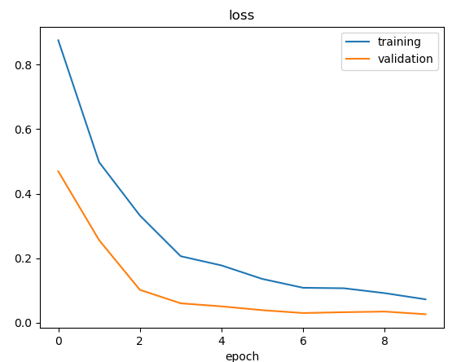
Result and Analysis
The system has successfully recoginzed the vegatables and display the current market price of recognized vegetable.
The acuracy of the system is approx 97%.

Slide 19
`
THANK YOU

