Slide 1
PRESENTATION
ON
“AI CHATBOT”
Presented by :
Lasata Tuladhar (5-2-410-12-2014)
Rabina Sthapit(5-2-410-25-2014)
MAY 18th ,2018 Rabince Shrestha(5-2-410-26-2014)
BSc. CSIT, 7th Semester
Prime College, Khusibu

Slide 2
Introduction
What is a chatbot?
Automated service - a chat based interface
Conversation between machine and human
Talk-bot, Chatterbot, or simply bot
Two kinds of chatbot
Rule based
Natural language

Slide 3
Problem statement
Own knowledge base and feature
Checks the knowledge base and response
More efficient
Connects to a human if specific answer is not in the knowledge base.

Slide 4
Objectives
• To implement the concept of machine learning and its application in a computer software
• To implement Natural language processing
• To provide automated customer services
• To reduce operational and service expense

Slide 5
Literature Review
Messenger Bots
Epytom Stylist
Weather Bot
Meditate Bot
SIRI
CORTANA

Slide 6
Requirement Analysis
Functional Requirements
User-End Requirement
- text in the textbox to chat
- English font
- proper formatting of sentences
System-End Requirement
-meaningful answer
-entertain the user
-reply in a polite way
-knowledge base related to different topics

Slide 7
Non-Functional Requirements
Performance requirement
Security requirements
Flexibility
Maintainability
Scalability
Testability

Slide 8
Feasibility Analysis
Operational Feasibility
Chatbot will help to balance the workload of employees.
Customer do not have to wait long to get a reply.
Technical Feasibility
Web based application that even runs in low bandwidth
Compatible in all browsers

Slide 9
Economic Feasibility
Documentation Printing
Internet Expenses
Electricity Expenses
Schedule Feasibility
Task | Start Date | Due Date | Duration(days)
Requirement Collection | 15-03-18 | 20-03-18 | 5
Planning | 21-03-18 | 31-03-18 | 10
Analysis | 01-04-18 | 10-04-18 | 10
Design | 11-04-18 | 22-04-18 | 11
Implementation | 22-04-18 | 26-05-18 | 36
Testing | 27-05-18 | 02-06-18 | 7
Documentation | 03-06-18 | 10-06-18 | 7

Slide 10
Gantt Chart

Slide 11
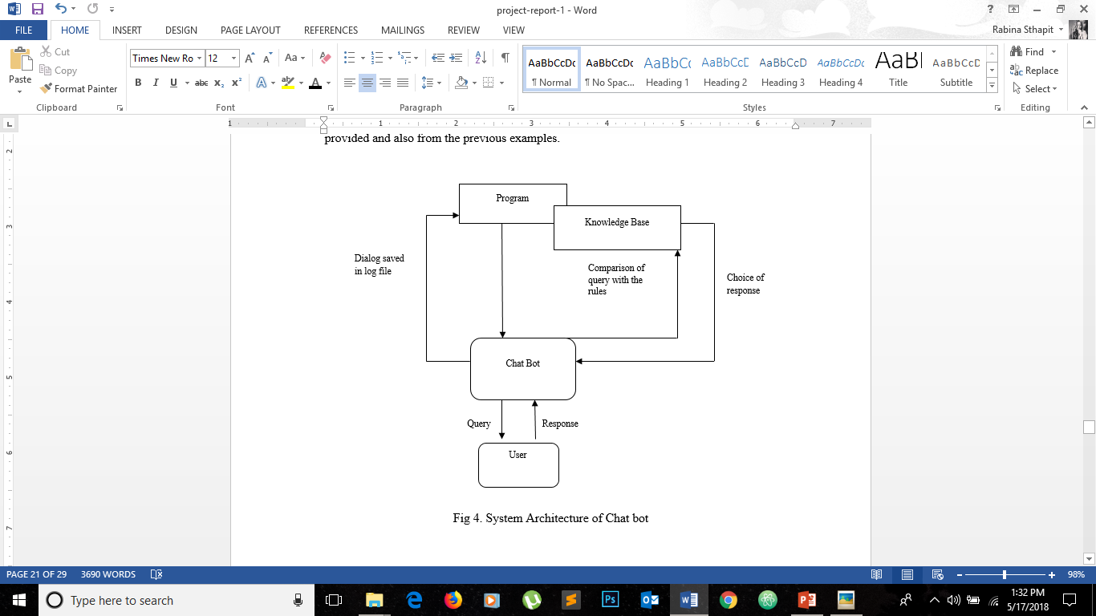
System Architecture Diagram

Slide 12
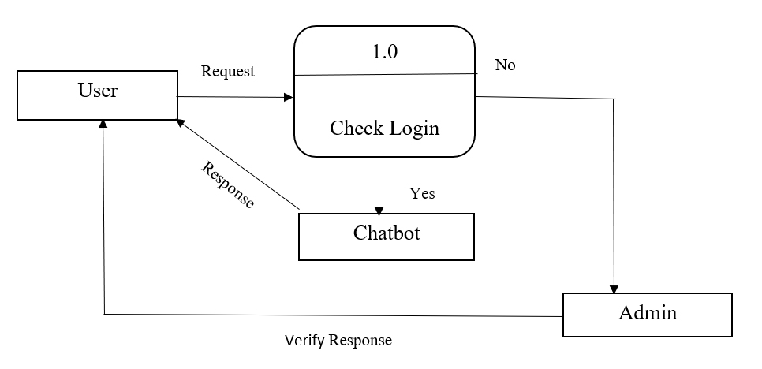
Context Diagram

Slide 13
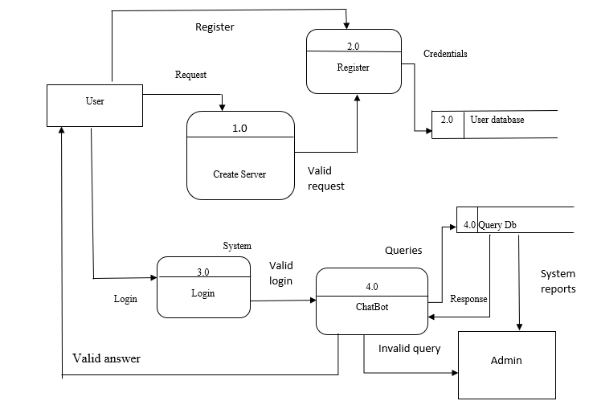
DFD Level-1

Slide 14
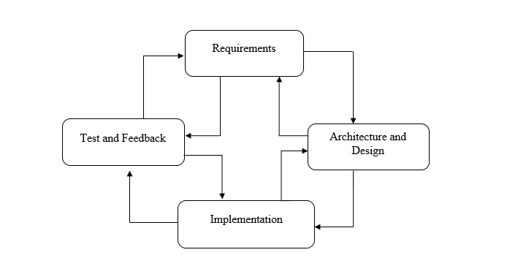
System Implementation
Fig. Agile Method

Slide 15
Data Collection Method
Internet research
Interaction
Existing reports

Slide 16
Tools used
Front End
Html , CSS, JavaScript, Adobe Photoshop
Back End
Python : Django Framework
PostgreSQL : Database

Slide 17
Expected Outcome
Easy interactions with customers and their queries.
Reduce work load on employees.
Flexible working system
Learn from previous working examples.

Slide 18
Conclusion
Chatbots are going to impact the future of marketing.
AI automations
Familiarize businesses to put them to good use.
Learn from mistakes.

Slide 19
References
Anderson, D. L. (n.d.). Intelligence and computers.
Ellis Pratt. (n.d.). AI and chatbots.
Quoc, M. (2016). conversational chatbot. chatbot magazine.

Slide 20
THANK YOU

