Slide 1

Documenting REST API with Swagger
Rabindra Panigrahy

Slide 2
Introducing Swagger
Swagger is the world’s largest open source framework of API developer tools for the OpenAPI Specification(OAS), enabling development across the entire API lifecycle, from design and documentation, to test and deployment.
Define a standard, language-agnostic interface to a REST API.
Allow both humans and computers to discover and understand the capabilities of the service without access to source code.
Consumer can understand and interact with the remote service with a minimal amount of implementation logic.
Swaggydoc plugin makes it easy to document grails REST controllers using swagger.
Integrate Swagger with Jenkins to automate the testing of exposed REST Web API's.

Slide 3
Introducing Open API
What is Open API Specification?
Specification creates the RESTful contract for your API, detailing all of its resources and operations in a human and machine readable format for easy development, discovery, and integration.
OpenAPI Specification follows Json data format.
Ref link : https://swagger.io/specification/
What is the difference between Swagger and OpenAPI?
The easiest way to understand the difference is:
OpenAPI = Specification
Swagger = Tools for implementing the specification

Slide 4
Detail descriptions
Is API Documentation require?
To visualize and interact with the API’s resources without having any of the implementation logic in place. It’s automatically generate from your Swagger specification, with the visual documentation making it easy for back end implementation and client side consumption.
More Detailed Answer…
Dependency Free : Host your Swagger UI in any environment.
Human Friendly : Allow end developers to effortlessly interact and try out every single operation your API exposes for easy consumption.
Easy to Navigate : Quickly find and work with resources and endpoints with neatly categorized documentation.

Slide 5
Detail descriptions
2 ways of writing the Open API Specification for REST Web API’s Technical Writer approach / Top-Down approach / Manual
- Need to understand the Open API standards, keywords, syntax and then write the spec in Swagger UI Editor to create the Swagger definition. Once the Swagger definition is done, the Swagger UI tool (integrated Swagger Codegen tool) will generate the server implementations and spec language into human readable document format(backed by html5 syntax and semantics)
- Make sense for smaller no of API's / already exposed API's (if API rewrite/development effort option is restricted)
Developer Centric approach / Bottom-Up approach / Automate
- Need to understand the Open API standards, keywords, Annotations, syntax and then design/write the Web API by applying the Open API Spec annotations.
- Make sense in case of design larger no of Web API's.
- Integration of Swagger Codegen utility tool is require for auto-generate the Open API Spec documents.

Slide 6
Swagger Modules
Swagger Core
Swagger Editor
{specification}
json, yaml
Swagger Codegen
Swagger UI
Notes:
Swagger Core
Java-related libraries for generating and reading Swagger definitions
Swagger Codegen
Command-line tool / Template driven engine for generating both client and server side code by parsing the Swagger definition
Swagger UI
Browser based UI for exploring a Swagger defined API
Swagger Editor
Browser based editor for authoring Swagger definitions in YAML or JSON format

Slide 7
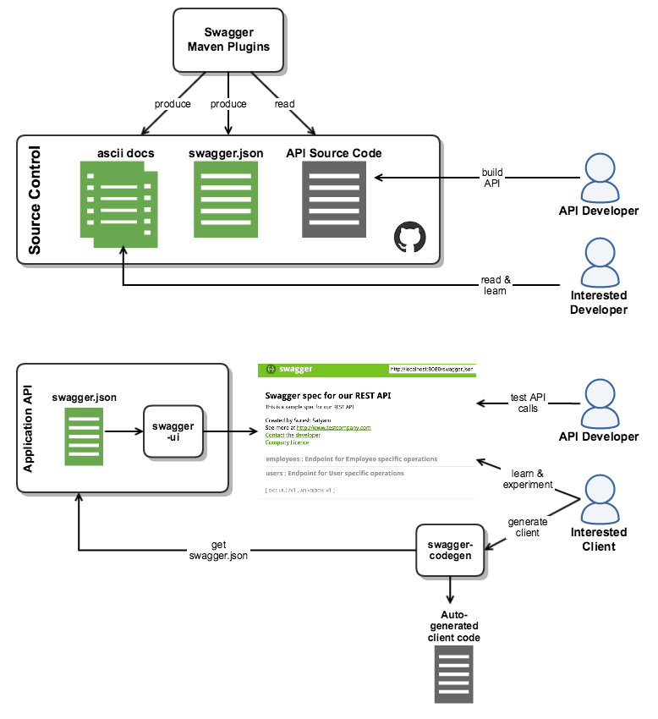
Swagger Implementation High Level Design Diagram

Slide 8




Swagger UI
Swagger UI
Webserver
/api-docs
HTML
{specification}
json, yaml
CSS
JS

Slide 9
Specification
{specification 1.2}
json
{specification 2.0}
json, yaml
Resource listing
swagger.json
API declaration
API declaration

Slide 10
Specification webservices
Backend
Frontend
{specification}
api-docs
Interpretation
Validation
API
webservices
CRUD
Database

Slide 11
Resources
Swagger
http://swagger.io/
https://swagger.io/open-source-integrations/
https://swagger.io/swagger-ui/
https://www.slideshare.net/NexThoughts/grails-with-swagger/1
http://blog.nbostech.com/2015/10/integrate-swagger-ui-with-grails-application/
http://idratherbewriting.com/learnapidoc/pubapis_swagger.html
https://tech.homeaway.com/development/2016/06/02/generating-swagger-spec.html

