Slide 1
Hello and
welcome to my
Presentation!
1

Slide 2
PRISoN MANAG E M E NT SYSTEM
Submitted By : MD. RABIUL ISLAM Roll: ASH1401061M
Supervised By :
ABUL KALAM AZAD
Assistant Professor
Dept. of CSTE
2

Slide 3
Contents
Introduction
Existing System
Problem Statement
Proposed System
Objectives
Methodology
Tools & Technologies
Prison Management System Features
System Design
Future Plan
Conclusion
3

Slide 4
Introduction
This project is aimed at developing a prison management system that is a collection of data for the effective management of prisons. This system contain data for prisoners, employees, doctors, and duty officers. Administrators will be able to store, search and delete data of the Prison which includes the basics of a prisoner, doctors , employees and duty officer. duty officer will be able to view the prisoner and employees data. This project Includes information about prisoners their crime and lodging pattern. it also records, tracks and monitors the movement of prisoners.
4

Slide 5
Existing System
Existing system for prison management is a manual system. In this system, the personal details, case details, parole details of prisoner, visitors details are kept in a register in the handwritten format. The details of the prisoner are accessed from this register at the time of need.
4.1

Slide 6
Problem Statement
Information or documents are shared via only website.
Collection of data is very complex.
Difficult to collect important information.
Time consuming.
Difficult to fetch data and display those to the users.
Sometimes difficult to see specific data.
4.2

Slide 7
Proposed System
The proposed system which is very fast and efficient can be used conveniently as an alternative to the existing manual system.
Reduces the manual work
Keep the users up to date
Maintain records, notices, and other information in the dynamic
process
Administrator can have and update all the details of prisoners and
guards.
4.3

Slide 8
Objectives
We have the database of prisoners , guards and administrator
Administrator can schedule jobs for prisoners and guards
Through feedback management guards can records the
performance of prisoners
Maintain records, notices, and other information in the dynamic
process
Administrator can have and update all the details of prisoners and
guards
4.3

Slide 9
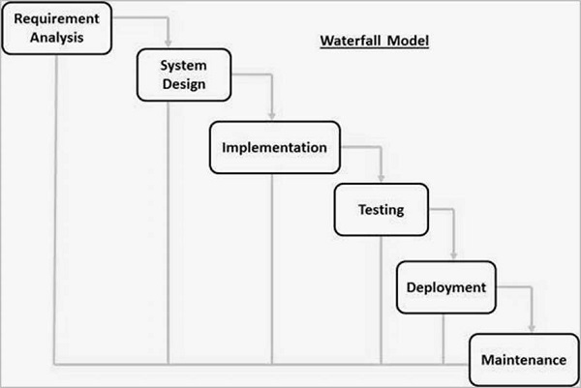
Methodology
In order to develop the system I considered to use a development methodology and it is the waterfall model.
5

Slide 10
Why I am using this model
My requirements are clear, well known and fixed.
Technology is understood.
Project is short.
Product definition is stable.
There is no ambiguous requirements.
5.1

Slide 11
Tools & Technologies
PHP
MySql
HTML
CSS
JavaScript
Bootstrap
XAMPP
6

Slide 12
Prison Management System Features
Login system
Prisoner Registration
Admin Homepage
Prisoner List
Add Duty Officer
Search Prisoner by ID
Examinee Registration
Duty Officer List
Delete Duty Officer
Add Employee
Employee List
Delete Employee
Add Doctor
Doctor List
Delete Doctor
Visitor Registration
Visitor List
7

Slide 13
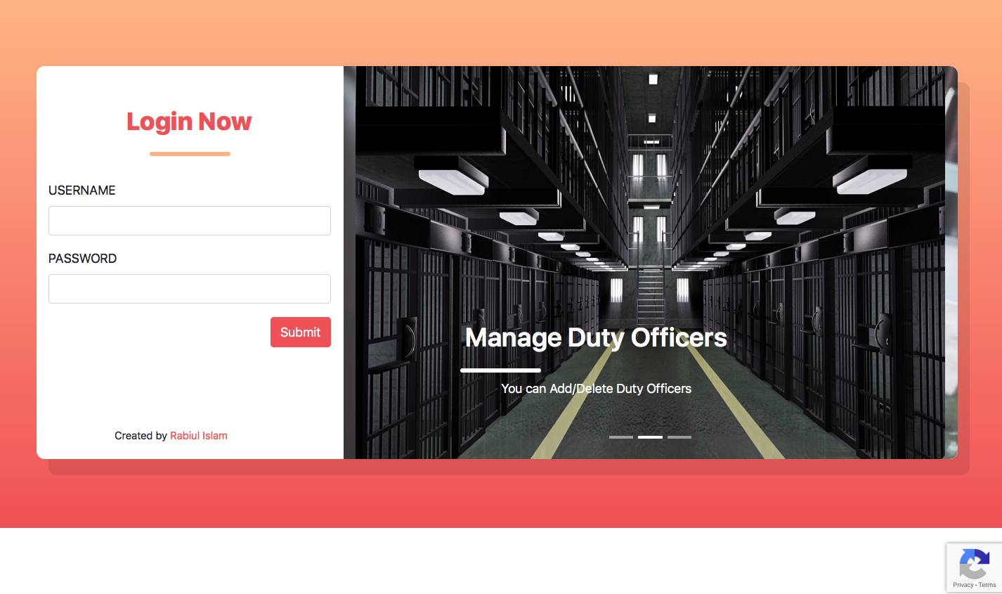
Login System
7.1

Slide 14
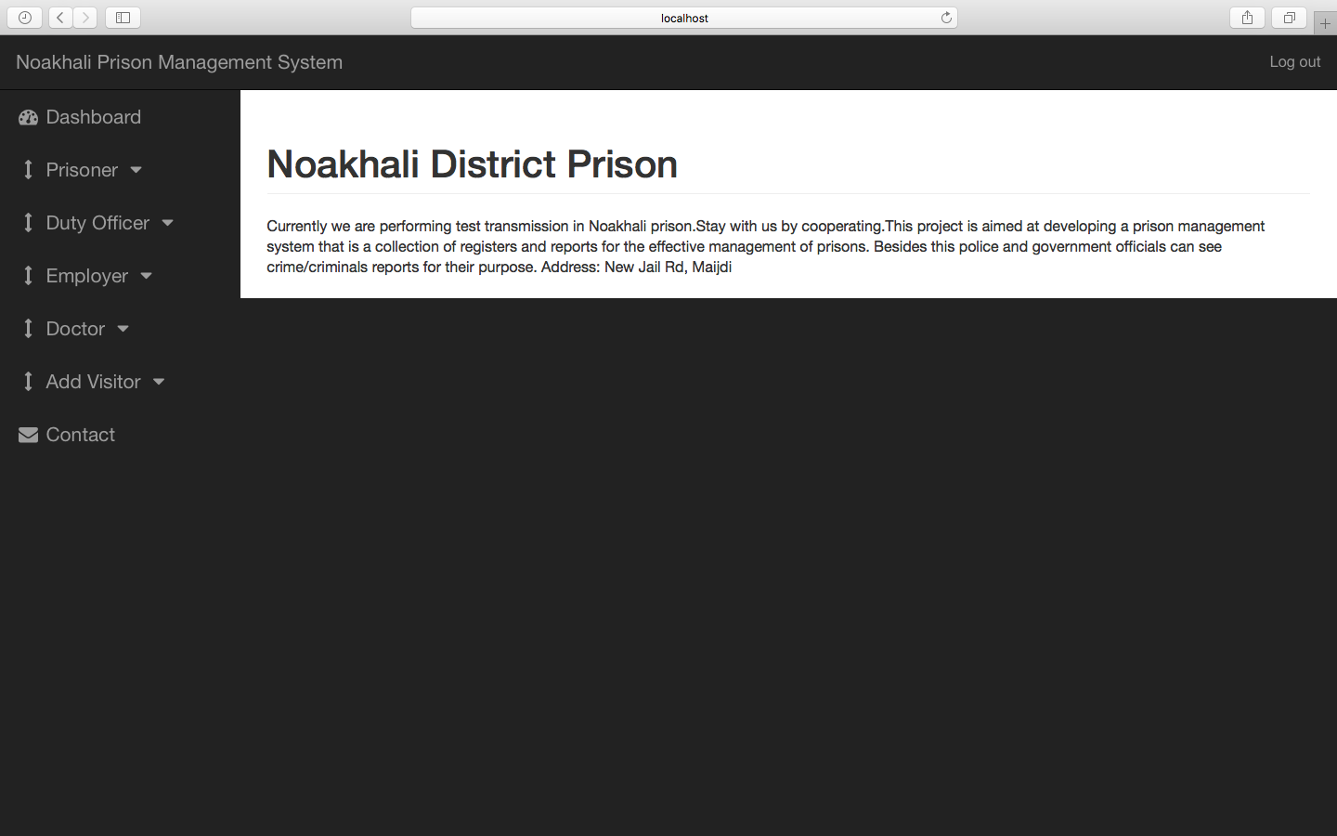
Admin Homepage
7.2

Slide 15
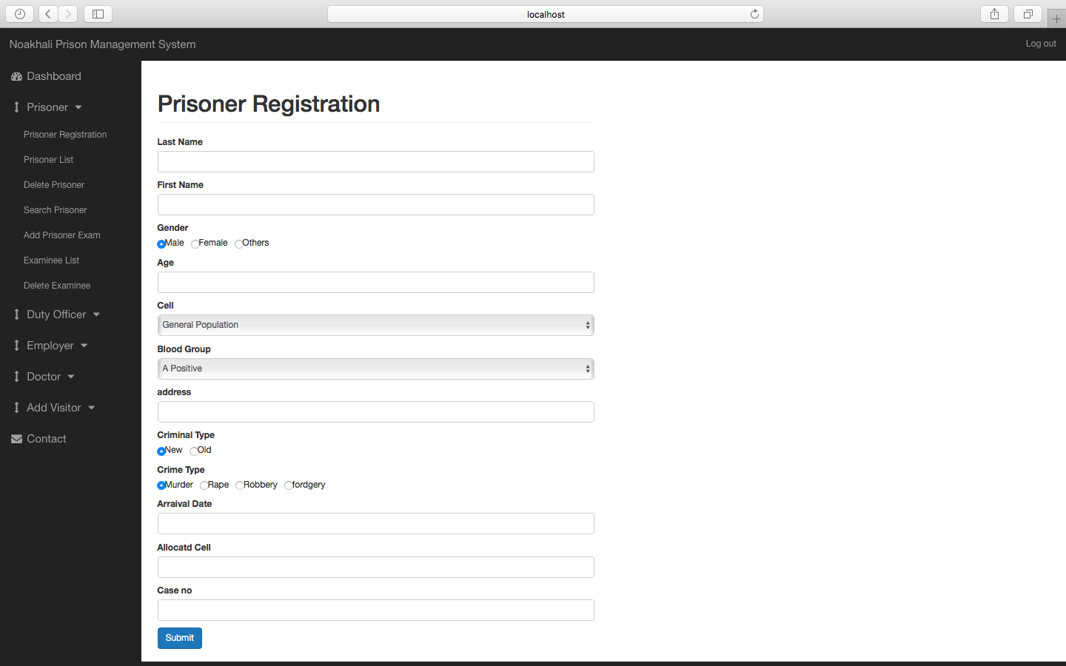
Prisoner Registration
7.3

Slide 16
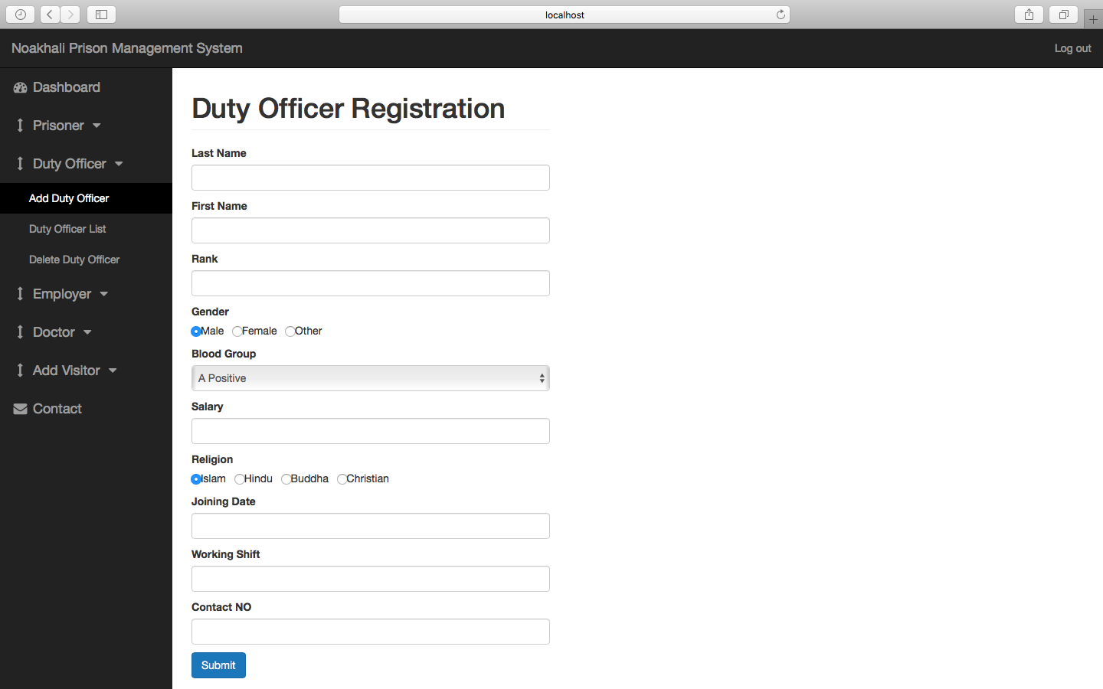
Duty Officer Registration
7.3
7.4

Slide 17
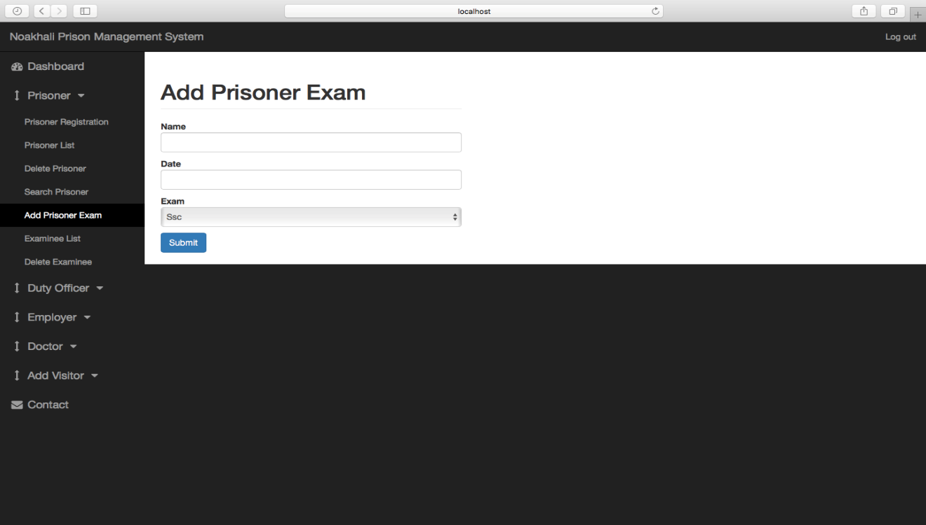
Examinee Registration
7.4
7.4
7.5

Slide 18
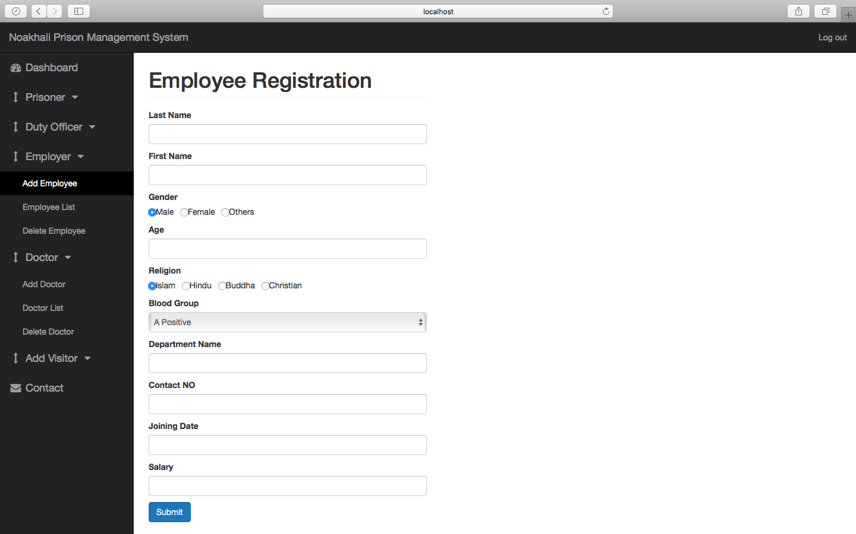
Employee Registration
7.6

Slide 19
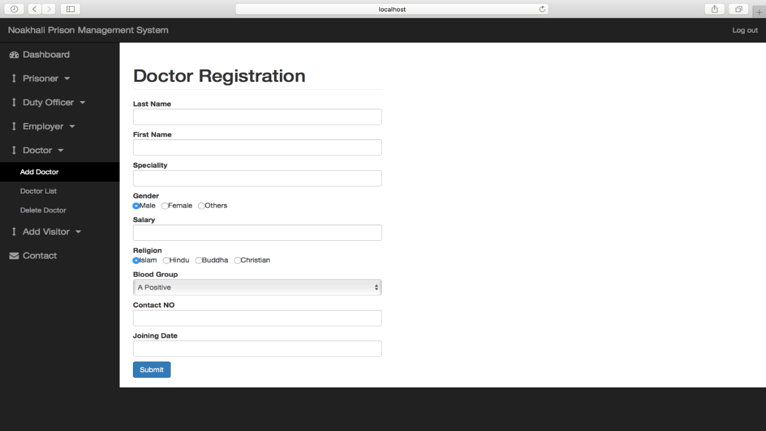
Doctor Registration
7.6
7.7

Slide 20
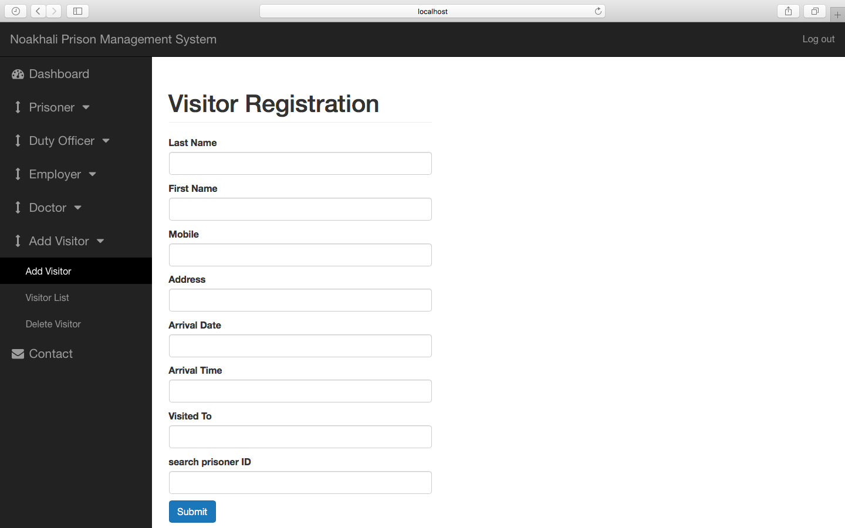
Visitor Registration
7.8

Slide 21
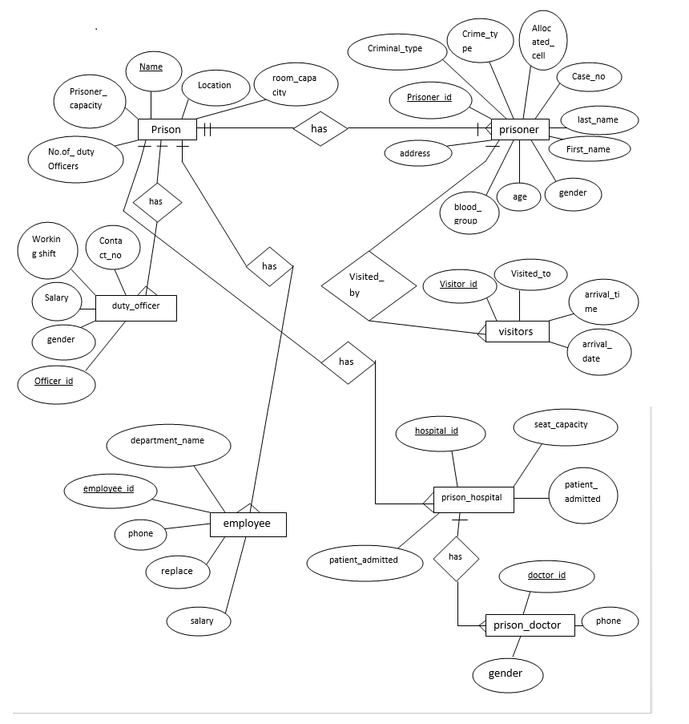
System Design (E-R Diagram)
7.8
7.8
8

Slide 22
Future Plan & Analysis
The future scope of this project is very broad. Few of them are:
This can be implemented in less time for prison management process.
This can be accessed anytime anywhere by the administrator, since it is a web application provided only an internet connection for authentication.
Can be upgraded with new features like sms alerts for the guards and supervisors regarding their job shift time
The administrator can give feedback of corresponding work sections, after analyzing overall productivity details.
PMS can be extended with regional language support for ease of access to users.
9

Slide 23
Conclusion
This system will contain sensitive information. My main goal is to add and manipulate Data from database. I have two types of user. Admin will
have full access (write and read) data but officer in charge only could read the data. We are in the age up gradation but our situation & environment doesn’t provide all materials to support the new age of up gradation & modern era. So we need to come out our self to support us by developing something which helps people to get the taste of modern technology.
10

Slide 24
Thanks
☺
11

