Slide 1
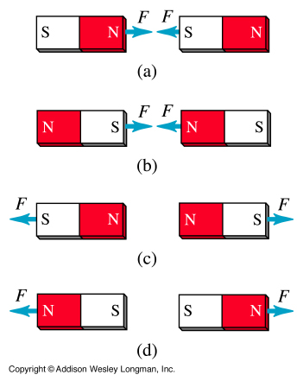
Facts about Magnetism
Magnets have 2 poles (north and south)
Like poles repel
Unlike poles attract
Magnets create a MAGNETIC FIELD around them

Slide 2
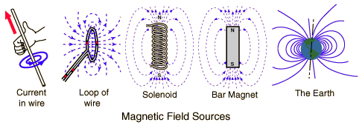
Magnetic Field Sources
Magnetic fields are produced by electric currents, which can be macroscopic currents in wires, or microscopic currents associated with electrons in atomic orbits.

Slide 3
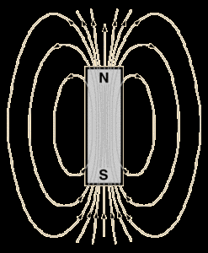
Magnetic Field:
A bar magnet has a magnetic field around it. This field is 3D in nature and often represented by lines LEAVING north and ENTERING south
To define a magnetic field you need to understand the MAGNITUDE and DIRECTION
We sometimes call the magnetic field a B-Field as the letter “B” is the SYMBOL for a magnetic field with the TESLA (T) as the unit.

Slide 4
The Biot-Savart Law:
Biot and Savart recognized that a conductor carrying a steady current produces a force on a magnet.
Biot and Savart produced an equation that gives the magnetic field at some point in space in terms of the current that produces the field.

Slide 5
Biot-Savart law says that if a wire carries a steady current I, the magnetic field dB at some point P associated with an element of conductor length ds has the following properties:
The vector dB is perpendicular to both ds (the direction of the current I) and to the unit vector r directed from the element ds to the point P.

Slide 6
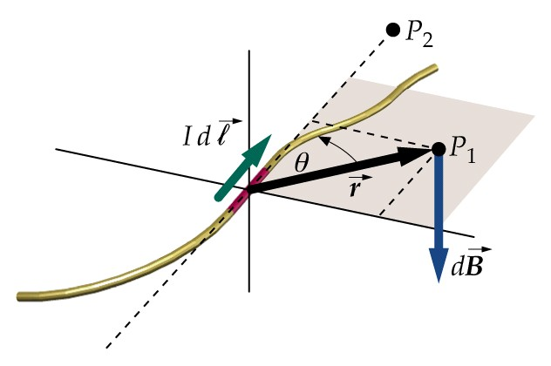
The magnitude of dB is inversely proportional to r², where r is the distance from the element ds to the point P.
The magnitude of dB is proportional to the current I and to the length ds of the element.

Slide 7
The magnitude of dB is proportional to sin θ, where θ is the angle between the vectors ds and r.
Biot-Savart law:
μ_{o} is a constant called the permeability of free space; μ_{o} = 4·π x 10⁻⁷ T·m/A

Slide 8
Biot-Savart law gives the magnetic field at a point for only a small element of the conductor ds.
To determine the total magnetic field B at some point due to a conductor of specified size, we must add up every contribution from all elements ds that make up the conductor (integrate)!

Slide 9
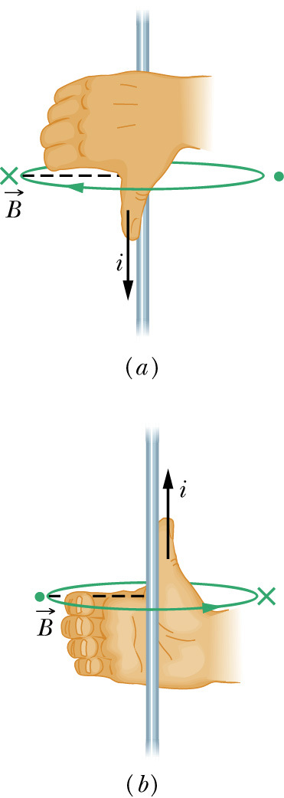
The direction of the magnetic field due to a current carrying element is perpendicular to both the current element ds and the radius vector r.
The right hand rule can be used to determine the direction of the magnetic field around the current carrying conductor:
Thumb of the right hand in the direction of the current.
Fingers of the right hand curl around the wire in the direction of the magnetic field at that point.

Slide 10
Ampere’s Law
Ampere’s Law states that the integral of B around any closed path equals μ₀ times the current, i, enclosed by the loop.
or

Slide 11
Where the integral is a line integral.
B.ds is integrated around a closed loop called an Amperian loop.
The current i is net current enclosed by the loop.
Direction of
integration

Slide 12
Magnetic Flux:
Magnetic flux is the measure of the magnetic field lines passing through a surface (such as a conducting coil).
or
(If B has constant magnitude & direction over a planer area)
The SI unit of magnetic flux is the weber
1 weber =1 tesla.m²

Slide 13
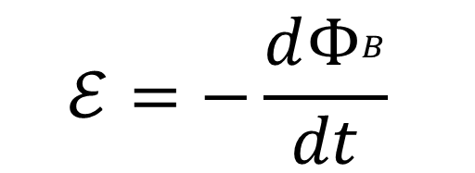
Faraday’s law:
The induced emf in a closed loop equals the negative of the time rate of change of magnetic flux through the loop
For a coil with N turns Faraday’s law becomes,

Slide 14
The polarity (direction) of the induced emf is determined by Lenz’ Law.
Lenz’ law:
“An induced current in a closed conduction loop always flows in such a direction that it opposes the change that produced it”.

Slide 15
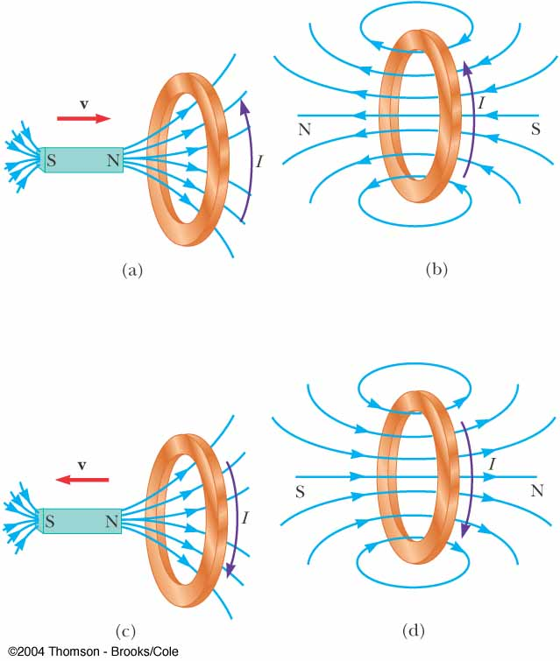

Slide 16
Magnetic Materials:
When the electrons revolves around the nucleus, Orbital magnetic moment arises, similarly when the electron spins, spin Magnetic moment arises.
The permanent Magnetic Moments can arise due to the
1.The orbital magnetic moment of the electrons
2.The spin magnetic moment of the electrons, and
3.The spin magnetic moment of the nucleus.

Slide 17
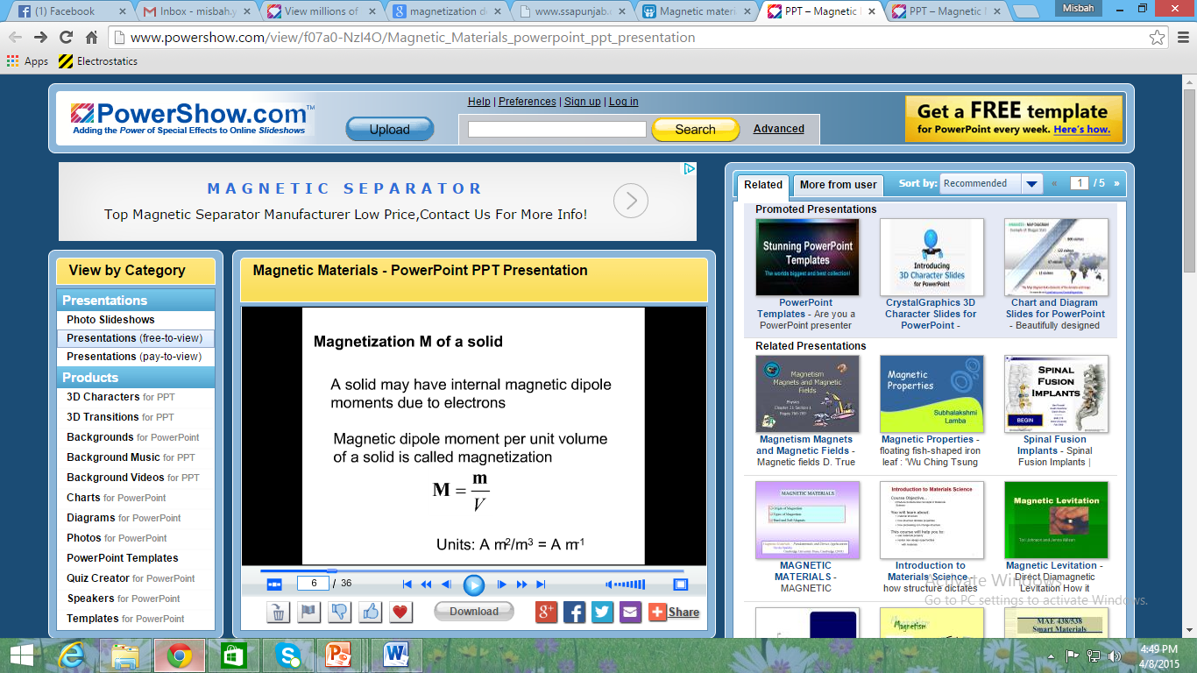
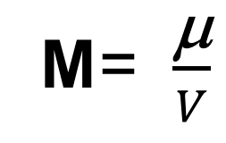
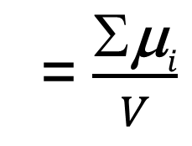
Magnetization (M):
It is expressed in ampere/metre.

Slide 18
1.Diamagnetism:
Diamagnetic substances are those substances which are feebly repelled by a magnet.
E.g: Antimony, Bismuth, Copper, Gold, Mercury,
Water, & Hydrogen.
Atoms have no permanent magnetic dipole moment.

Slide 19
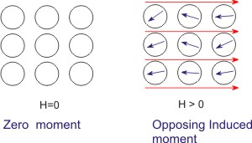
When placed in a magnetic field, it is weakly magnetized in the direction opposite to the inducing filed.

Slide 20
2.Paramagnetism:
Paramagnetic substances are those substances which are feebly attracted by a magnet.
E.g: Aluminum, Chromium, Alkaline earth
metals, Platinum & Oxygen
Atoms have permanent magnetic dipole moments.

Slide 21
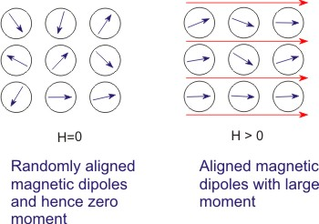
When placed in a magnetic field, it is weakly magnetized in the direction of the inducing filed.

Slide 22
3.Ferromagnetism:
Ferromagnetic substances are those substances which are strongly attracted by a magnet.
E.g: Iron, Cobalt and Nickle.
Atoms have permanent magnetic dipole moments.

Slide 23
There is a strong interaction between neighboring atomic dipole moments that keep them aligned even when the external magnetic field is removed.
When placed in a magnetic field, it is strongly magnetized in the direction of the inducing filed.

Slide 24
