Slide 1
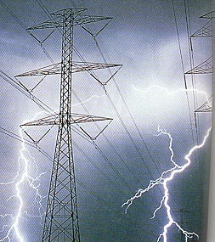
Electrostatics

Slide 2
What is Electrostatics?
Electrostatics is the study of the interactions between stationary electrically charged particles.
Electrostatic laws deal with the attractive and repelling forces that exist between positive and negative electric charges.

Slide 3
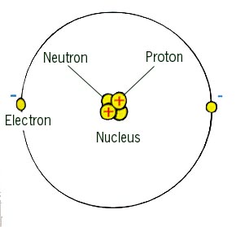
A Quick Chemistry Review

Slide 4
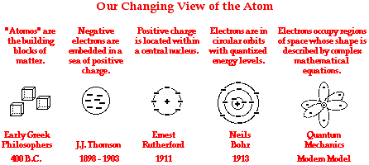
History of the Atom

Slide 5
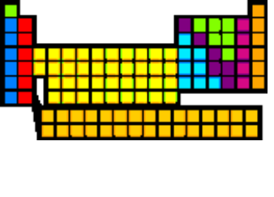
A Little More Review
Particle | Proton | Electron | Neutron
Location | Nucleus | Energy Levels | Nucleus
Charge | +1.6 x 10⁻¹⁹ C | -1.6 x 10⁻¹⁹ C | No Charge
Mass | 1.67 x 10⁻²⁷kg | 9.11 x 10⁻³¹kg | 1.68 x 10⁻²⁷kg

Slide 6
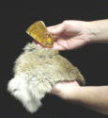
What’s the Origin of the Word “Electricity”?
William Gilbert, a 17th century physician and scientist coined the term from the Greek root “elektron” meaning amber. Amber was the material that ancient Greek philosophers had noticed would mysteriously attract small particles after it had been rubbed with fur.

Slide 7
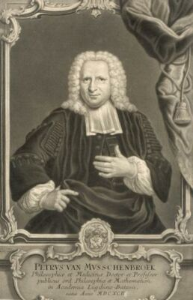
A Brief History…
We needed bigger shocks…
Since electricity from frictional sources was usually weak, electricians of the eighteenth century searched for ways to increase charge and to accumulate as much of it as possible on a substance. If charge could be accumulated the electricians could then broaden their research with the mystical phenomenon.

Slide 8
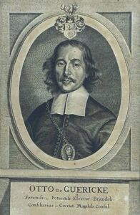
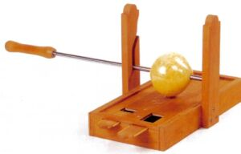
Otto van Guericke (1602-1686)
In 1663, the Burgomaster of Magdeburg in Germany invented the first electric generator which produced static electricity by rubbing a pad against a large rotating sulphur ball.

Slide 9
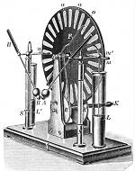
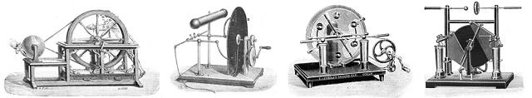
Electrostatic Machines
Many different versions of this electrostatic generator followed:

Slide 10
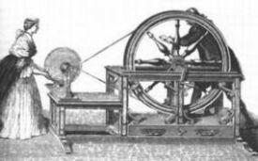
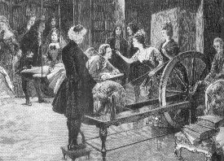
Often, these were used for entertainment…
…As well as for scientific experimentation…

Slide 11
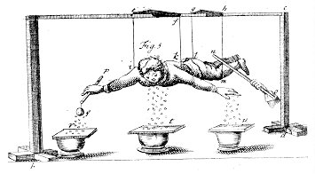
Stephen Gray (1666-1736)
This British chemist, is credited with discovering that electricity can flow (1729), and was the first to identify the properties of conductors and insulators. He also transmitted electricity over a wire, which eventually led to the development of the telegraph.
The figure shows that the electric force of a rubbed glass could be sent, through a wire, to the body of a person.

Slide 12
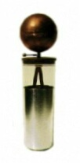
E.G. von Kleist (1700-1748) and
Pieter van Musschenbroek (1692-1761)
This German administrator and cleric, and the Dutch physicist separately and independently discovered the Leyden jar, a fundamental electric circuit element for storing electric charge, now referred to as a capacitor. Musschenbroek nearly killed his friend discharging the capacitor.

Slide 13
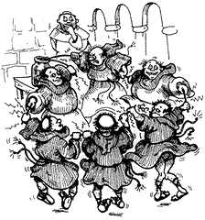
Jean-Antoine Nollet (1700-1770)
This French clergyman decided to test his theory that electricity traveled far and fast. He did the natural thing on a fine spring day in 1746, sending 200 of his monks out in a line 1 mile long.
Once aligned, Nollet hooked up a Leyden jar to the end of the line and all the monks started swearing, contorting, or otherwise reacting simultaneously to the electric shock. A successful experiment: an electrical signal can travel a mile and it does so quickly.

Slide 14
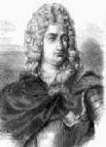
Charles-François de Cisternay Du Fay (1698-1739)
Du Fay discovered two types of electric charge and was the first to suggest that electricity consisted of two fluids: "vitreous" (from the Latin for "glass"), or positive, electricity; and "resinous," or negative, electricity, and recognized that similar fluids repel, and dissimilar attract.

Slide 15
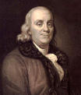
Benjamin Franklin (1706-1790)
Benjamin Franklin invents the theory of one-fluid electricity in which one of Nollet's fluids exists and the other is just the absence of the first. He proposes the principle of conservation of charge and calls the fluid that exists and flows ``positive''. This educated guess ensures that undergraduates will always be confused about the direction of current flow. He also discovers that electricity can act at a distance in situations where fluid flow makes no sense.

Slide 16
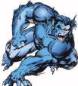

Negative,Positive,
What’s the Difference???
The two ‘opposite’ charges may as well have been called the ying and the yang. All that is important to know is that they are different beasts, and that opposites attract, and likes repel…

Slide 17

Charles Augustin de Coulomb
(1736-1806)
Coulomb developed a theory of attraction and repulsion between bodies of the same and opposite electrical charge. He demonstrated an inverse square law for such forces and went on to examine perfect conductors and dielectrics. He also is credited with creating the torsion balance.

Slide 18
Which scientist accidentally shocked the heck out of himself and/or his friends/family/colleages?
(a) Ben Franklin
(b) Jean-Antoine Nollet
(c) Stephen Gray
(d) All of the above.

Slide 19
What is charge, anyway???
Again, we know that charged particles exert forces on each other. The MORE charge (meaning more protons, and/or more electrons), the BIGGER the forces…
A clump of six protons is separated from an electron by distance D. A clump of 18 protons is also separated from an electron by distance D. Which clump exerts a greater force on the electron?
+
+
+
+
+
+
+
+
+
+
+
+
+
+
+
+
+
-
+
+
+
+
+
+
+
D
D

Slide 20


What is Net Charge?
Net charge is the amount of excess charge; a neutral object has an equal number of electrons and protons, and therefore, no net charge.
No Net Charge
Positive Net Charge

Slide 21

The Coulomb
We use a new unit, the coulomb (C), to measure charge.
The charge on any object, whether it is positive or negative is quantized, meaning that the charge consists of an integer number of protons and electrons.
quantized - To limit the possible values (of a magnitude or quantity) to a discrete or countable set of values.

Slide 22
A negatively charged object has:
(a) Only positive charges.
(b) Only negative charges.
(c) More positive charges than negative.
(d) More negative charges than positive.

Slide 23
A negatively charged object has:
(d) More negative charges than positive.
JUST BECAUSE AN OBJECT IS NEGATIVELY CHARGED DOES NOT MEAN IT HAS NO PROTONS ☺.

Slide 24
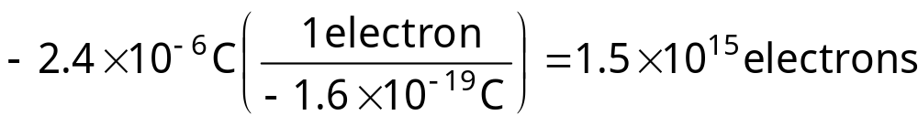
Practice Problem
A metal sphere has a net charge of –2.4 x 10⁻⁶ C. How many excess electrons does the sphere contain?
GIVEN:
Q = -2.4 x 10⁻⁶ C
-e = -1.6 x 10⁻¹⁹ C
#electrons = ???

Slide 25
Law of Conservation of Charge
Like other conservation laws, the law of conservation of electric charge states that the net charge (which is basically the sum of the charge on each proton and electron in a system) of an isolated system remains constant.

Slide 26
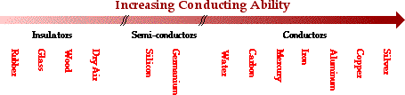
Conductors and Insulators
An electric conductor is a material, such as copper, that allows for the easy movement (conduction) of charge. In general, metals are good electric conductors because they don’t hold on to their electrons very tightly.
An electric insulator is a material, such as rubber, that doesn’t allow for the easy movement of charge.

Slide 27
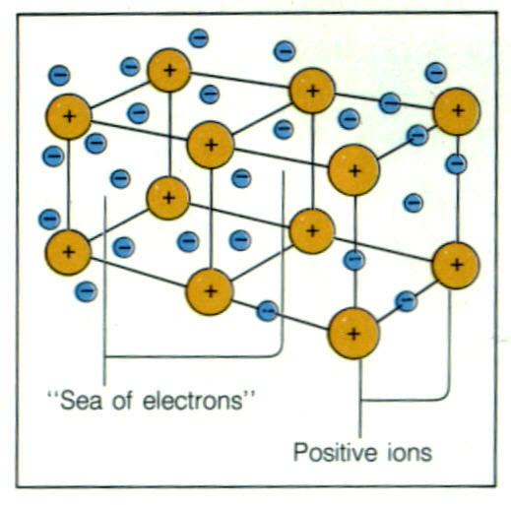
Charges that Move
When charges move through a solid conductor, IT IS THE NEGATIVELY CHARGED PARTICLES, THE ELECTRONS, THAT ARE FREE TO MOVE. The protons are relatively bound in space:

Slide 28

How Might an Object Become Charged???
Charging by Friction
Charging by Contact (Insulators and Conductors)
Charging by Induction (Conductors Only)
?

Slide 29
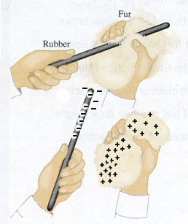
Charging by Friction
This is called charging by friction. It’s basically the same phenomenon that occurs when you drag your feet across a carpet on a dry day, or rubbed a balloon through your chair. Electrons, NOT PROTONS, are, with a little bit of energy, “scraped” off, and transferred.

Slide 30
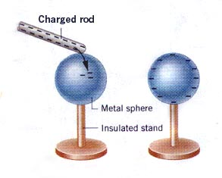
Charging by Contact
Also, charging by conduction, it is the process of giving an object a net electric charge by placing it in contact with an object that is already charged. It should be noted that it is nearly always electrons that are exchanged.

Slide 31
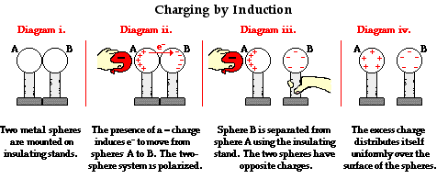
Charging by Induction
It is possible to charge a neutral conductor without contact:

Slide 32
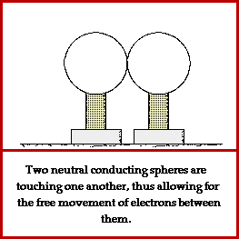
Charging by Induction

Slide 33
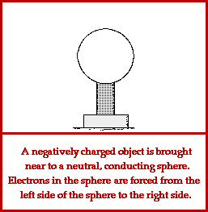
Charging by Induction

Slide 34

Insulators Can’t Be Charged by Induction
As you might expect, insulators cannot become charged by induction because charged particles are not free to move within an insulator.
However, if an insulator is in the midst of an electric field, the individual molecules, while not able to move freely, may orient themselves so that there is a polarization of charge.

Slide 35
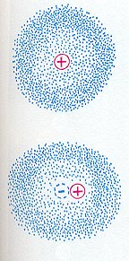
What is Charge Polarization??
An unpolarized atom.
With an external electric field, the center of electron cloud shifts to the left, or polarizes.

Slide 36
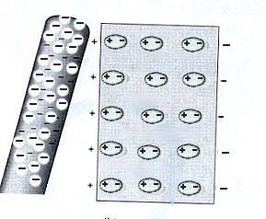
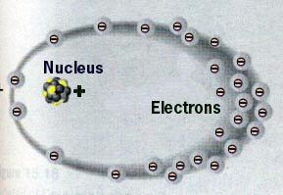
Charge Polarization

Slide 37
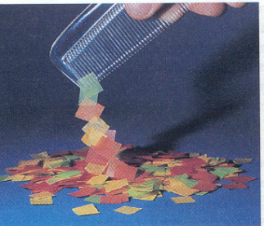
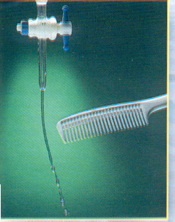
Charge Polarization
Neutral objects may be a attracted to charged objects through charge polarization:

Slide 38
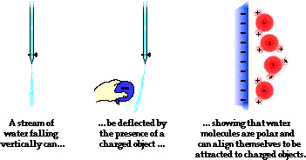
Charge Polarization

Slide 39
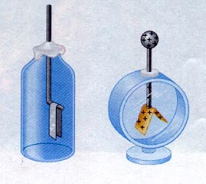
The Electroscope
In 1748, Nollet invented one of the first electrometers, the electroscope, which can detect the presence of an electric field.

Slide 40
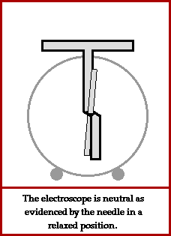
The Electroscope

Slide 41
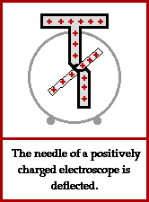
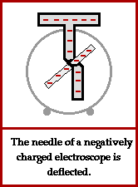
The Electroscope

Slide 42
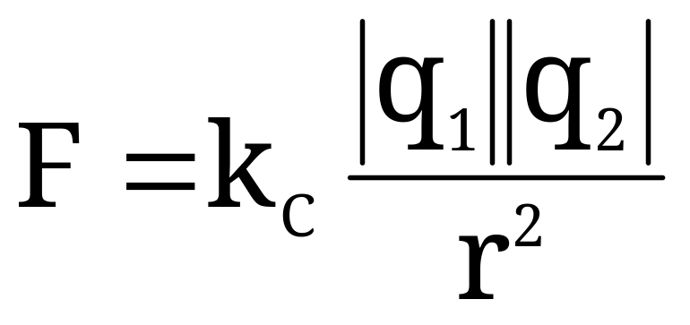
Coulomb’s Law
We know that charges exert forces on other charges. You are going to be given the means to calculate these forces. The force (F) between two point charges is...
Proportional to the magnitude of each charge
Inversely proportional to square of the separation between their centers (r)
Directed along the line connecting their centers
k_{c} = 8.99 x 10⁹ N·m²/C²

Slide 43
Field Forces
As mentioned previously, the electric force is like the gravitational force in that it is a field force. Unlike contact forces, which require physical contact between objects, field forces are capable of acting through space.

