Slide 1
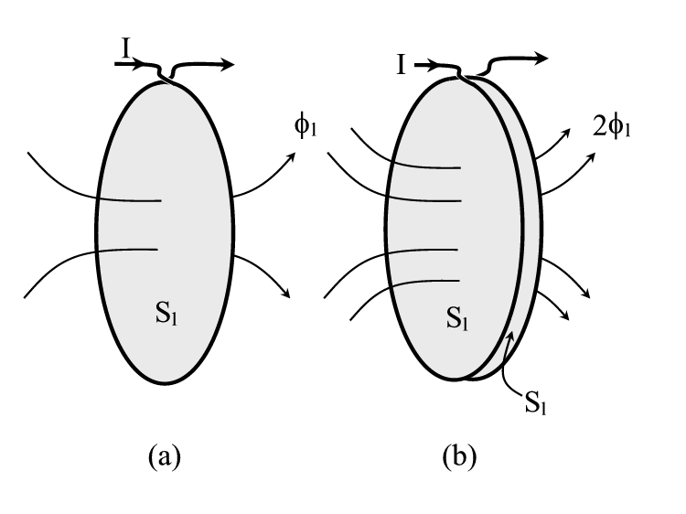
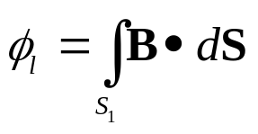
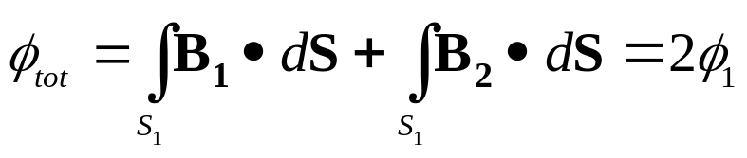

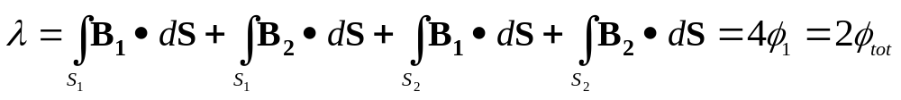

Magnetic Flux
Magnetic Flux in one loop:
Let us consider a loop of current I shown in Figure(a). The flux φ₁ that passes through the area S₁ bounded by the loop is
Magnetic Flux in two loops:
Suppose we pass the same current I through two loops, wrapped very close together, as indicated in Figure(b). Each loop generates φ₁ of flux, and since they are so closely spaced, the total flux through each loop 1 is
Using
How much flux passes through the total area bounded by the loops, 2S₁?
Well, since φ₁ passes through the surface of each loop, the answer is 2φ_{tot} or 4φ₁.
We say that the two loops of current are linked by the total flux φ_{tot}.
Using

Slide 2
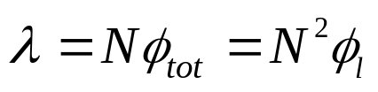
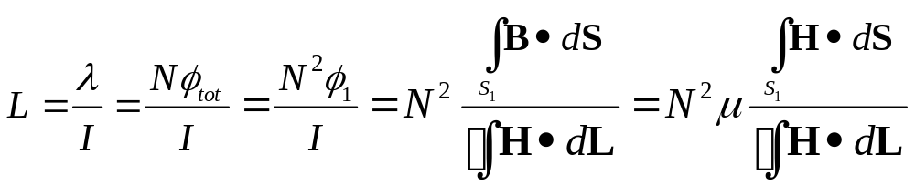
Magnetic Flux and Inductance
We define the flux linkage λ as the total flux passing through the surface bounded by the contour of the circuit carrying the current.
For a tightly wrapped solenoid, the flux linkage is the number of loops multiplied by the total flux linking them. If we have a tightly wrapped solenoid with N turns,
Where φ₁ is the flux generated by a single loop.
Now we define inductance L as the ratio of the flux linkage to the current I generating the flux,
This has the units of henrys (H), equal to a weber per amp. Inductors are devices used to store energy in the magnetic field, analogous to the storage of energy in the electric field by capacitors.

Slide 3
Inductance Calculation
Inductors most generally consist of loops of wire, often wrapped around a ferrite core, and their value of inductance is a function only of the physical configuration of the conductor along with the permeability of the material through which the flux passes.
A procedure for finding the inductance is as follows:
1) Assume a current I in the conductor.
2) Determine B using the Law of Biot-Savart, or Ampere’s Circuit Law if there is sufficient symmetry.
3) Calculate the total flux φ_{tot} linking all the loops.
4) Multiply the total flux by the number of loops to get the flux linkage; λ = Nφ_{tot}.
5) Divide λ by current I to get the inductance: L = λ/I. The assumed current will divide out.

Slide 4
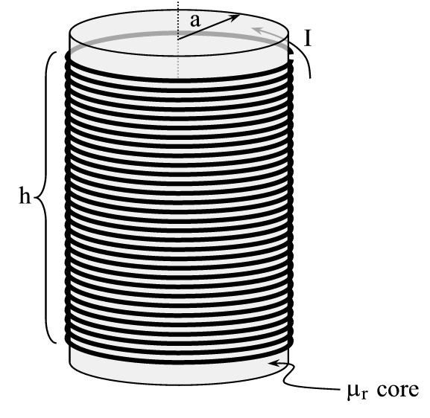
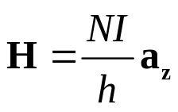
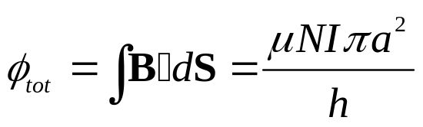
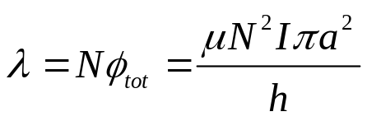
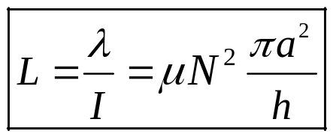
Inductance
Example 3.12: Let’s calculate the inductance for a solenoid with N turns wrapped around a μ_{r} core as shown in Figure.
Our first step is to assume current I going into one end of the conductor. We know that the field inside a solenoid is given by
Then, within the μ_{r} core we have
The total flux is given by
The flux linkage is given by
Finally, we divide out the current to find the inductance,

Slide 5
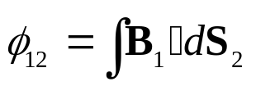
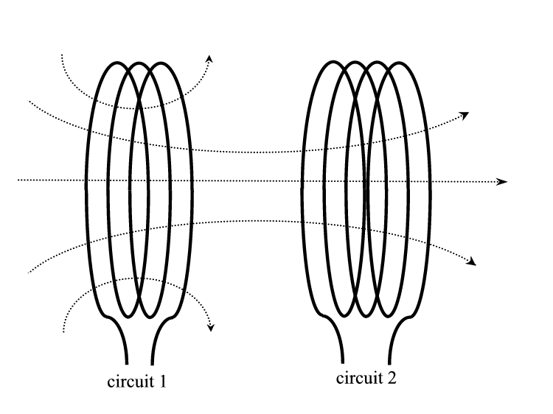

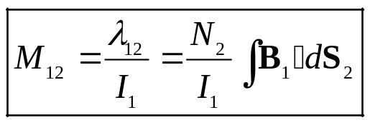
Mutual Inductance
So far, what we have discussed has been a self-inductance , where the flux is linked to the circuit containing the current that produced the flux.
But we could also determine the flux linked to a different circuit than the flux generating one. In this case we are talking about mutual inductance, which is fundamental to the design and operation of transformers.
The flux from B₁ of circuit 1 that links to circuit 2
Driving Coil 1
(N₁ turns)
Receiving Coil 2
(N₂ turns)
Finally, the mutual inductance M₁₂ is
I₁
I₂

