Slide 1
House Price Analysis Dashboard

Slide 2
Objective
Understand house price trends
Identify key influencing factors
Build dashboards for decision-making

Slide 3
Dataset Overview
4600+ records
Features: Price, Sqft, Bedrooms, Location
Real-world housing dataset

Slide 4
Data Cleaning
Missing values handled
Duplicates removed
Outliers treated

Slide 5
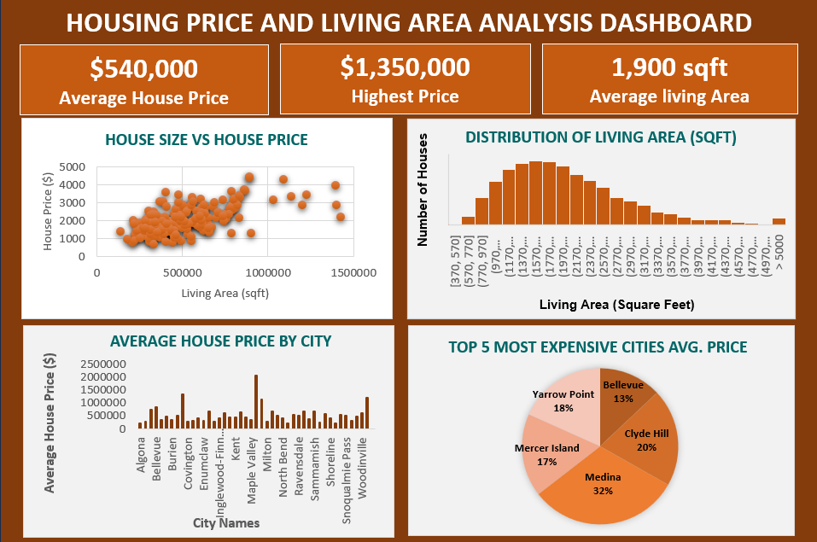
Excel Dashboard

Slide 6
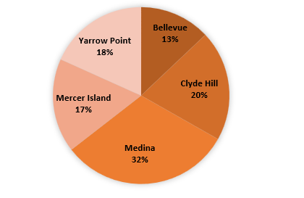
Top 5 Most Expensive Cities (Avg Price)

Slide 7
Excel Insights
Majority houses in lower price range
Clear distribution pattern
Quick business summary

Slide 8
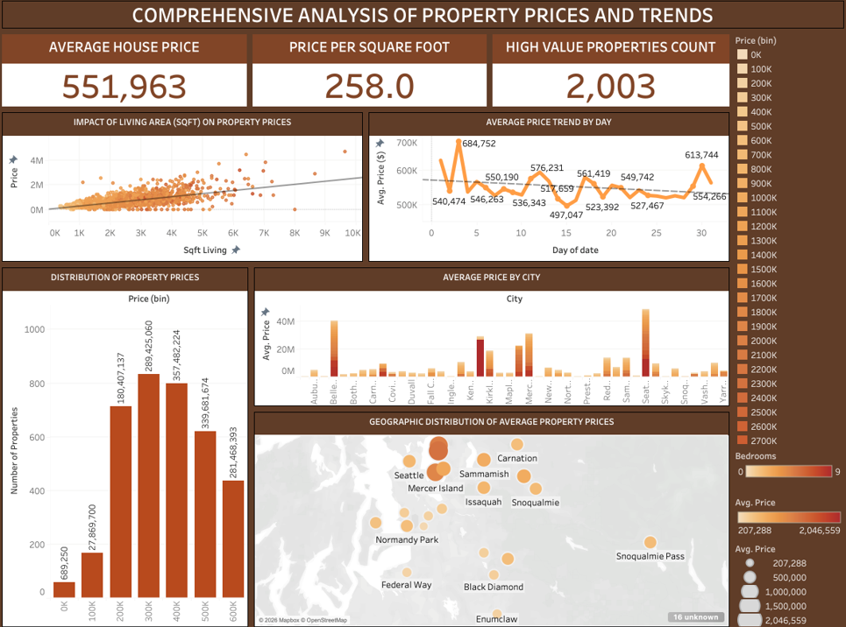
Tableau Dashboard

Slide 9
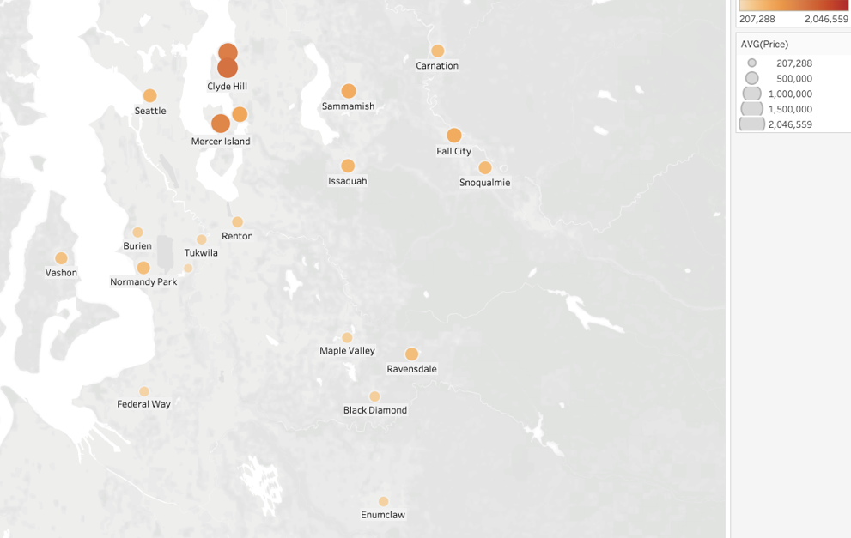
Geographic Distribution of Average Property Prices

Slide 10
Tableau Insights
Price varies by location
Trends across categories
Interactive decision support

Slide 11
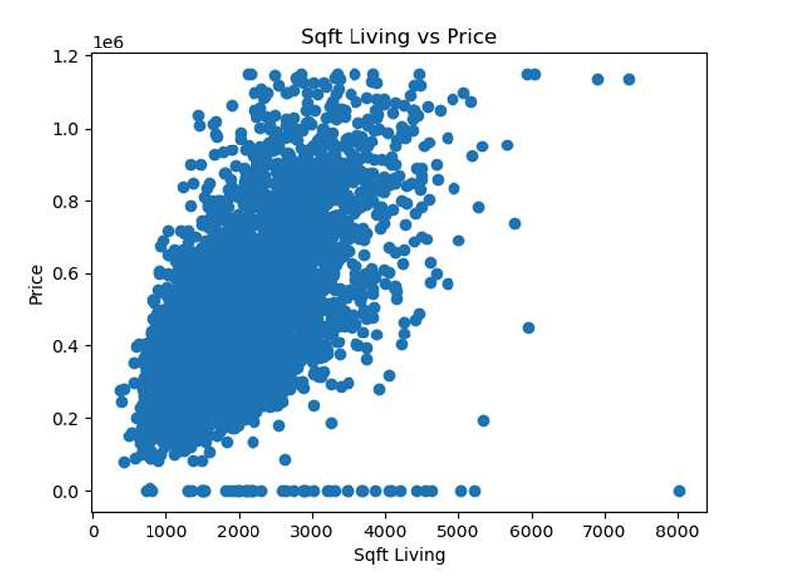
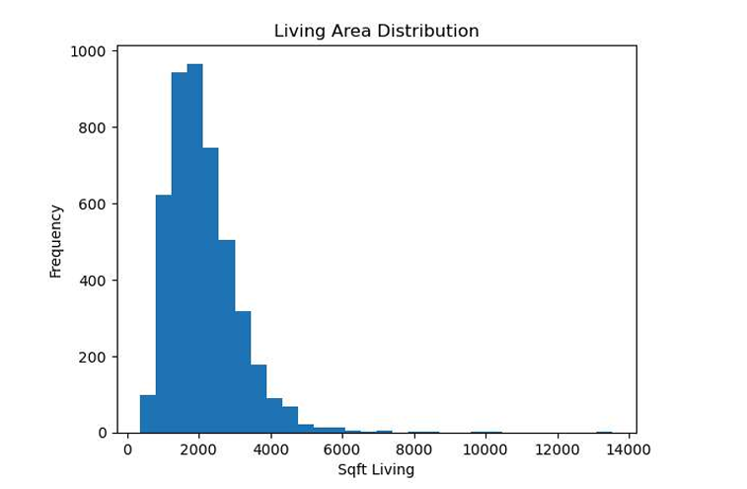
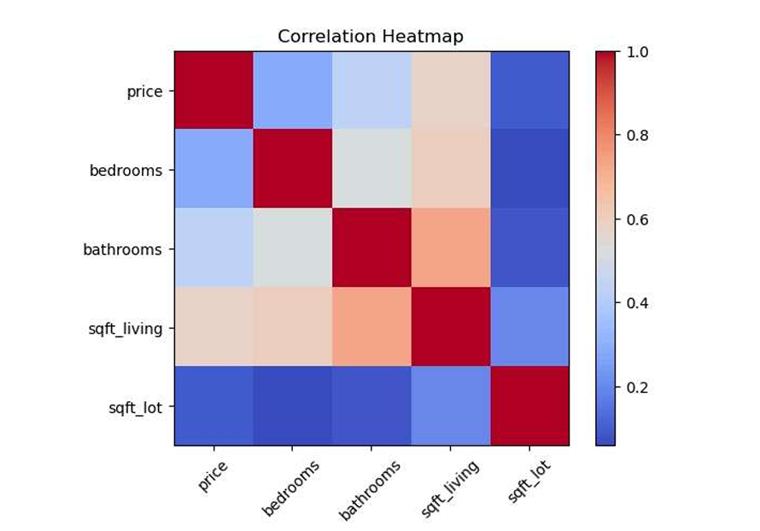
Python Analysis

Slide 12
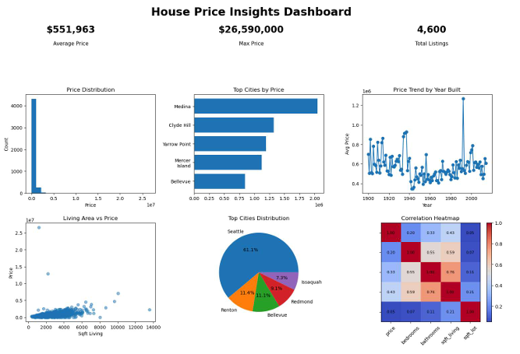
Python Dashboard

Slide 13
Key Insights
Square footage drives price
Location impacts value
Data cleaning improves accuracy

Slide 14
Conclusion
Data → Insights → Decisions
Multi-tool analysis approach
Business-focused visualization

