Slide 1
BUSINESS CONTINUITY PLANNING AND ERP IN A PANDEMIC: INSIGHTS AND LESSONS LEARNED FROM COVID-19
SHOBITHA SIVAKUMAR
RABIA OTRY

Slide 2
Introduction
It is critical for supply chains to be resilient, otherwise businesses can experience devastating losses of revenue and customers due to halts in productivity and/or unreliable fulfillment.
Topics we will cover are:
Enterprise resource planning
Business continuity planning
Supply chain management
COVID-19’s impact on supply chains
Insights and lessons learned from COVID-19

Slide 3
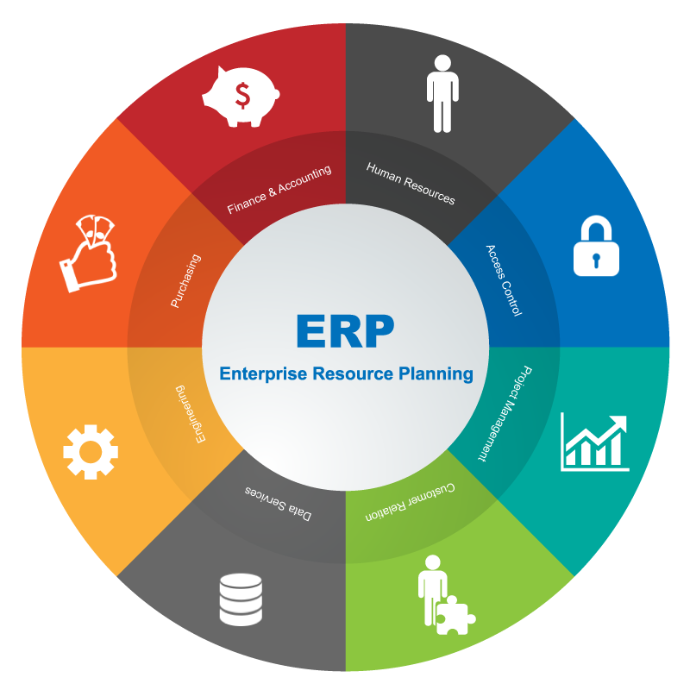
Enterprise Resource planning (ERP)
Enterprise Resource Planning (ERP) is a category of software used by businesses to manage day-to-day activities across numerous departments all integrated into a single system.
Typically, ERP systems consists of multiple modules corresponding to each business area:
Financial
Management accounting
Human resources
Manufacturing
Order processing
Supply chain management
Project management
Customer relationship management
Data services

Slide 4
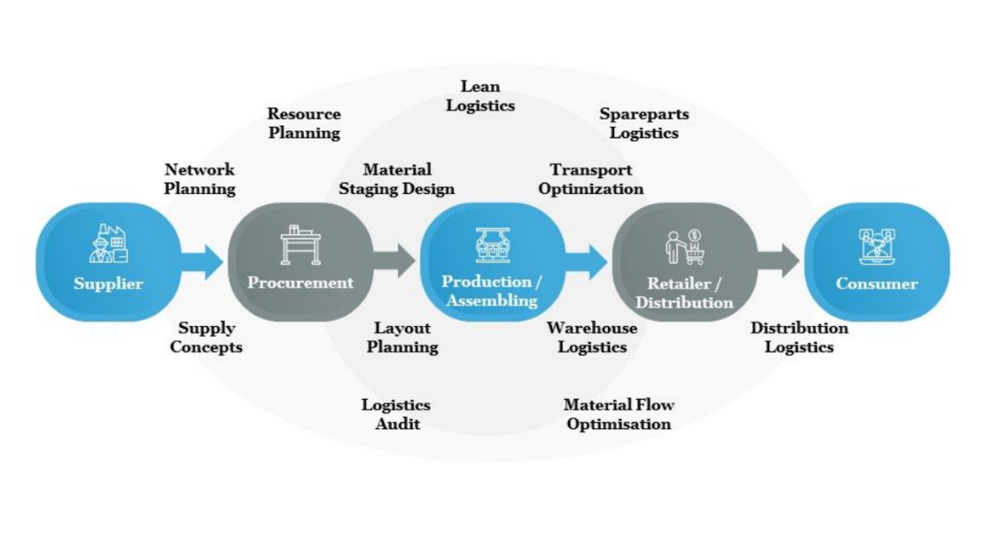
Role of ERP in Supply Chain Management
SCM consists of multiple processes across different roles that are interconnected.
ERP in SCM allows for real-time communication between suppliers, procurement, production, retail/distribution, and customer business areas to enabling a smooth and efficient workflow from start to finish.

Slide 5
Role of ERP in Supply Chain Management
Benefits of ERP in SCM:
Provides tools for demand and planning, procurement, production, and shipment
Integrates the financial expenses of the SCM process into the modules for finance and accounting roles
Allows for a competitive advantage by having a lean inventory with effective forecasting, mitigate bottlenecks in production
Creates transparency across the business aiding in decision-making

Slide 6

Business continuity planning (BCP)
Maintaining business operations or resuming them soon after a major disruption.
Typically consists of the procedures and instructions to be followed by the company, in the event of such disasters.
The BCP generally has the following steps:
Identify the scope of the plan.
Identify key business areas.
Identify critical processes.
Identify how the business areas are associated.
Determine manageable downtime for each critical process.
Create a plan to maintain operations.

Slide 7
ROLE OF ERP SYSTEMS IN BUSINESS CONTINUITY PLANNING
ERP systems possess the ability to mitigate rapid business changes due to unforeseen circumstances.
ERP systems can maintain the business operations through
Remote access
Automated reporting capability
Electronic data exchange
Real-time remote facility controls.

Slide 8
ROLE OF ERP SYSTEMS - Manufacturing environment
Empowering employees working from home
Keeping production on track
Managing demand fluctuations

Slide 9
SUPPLY CHAIN MANAGEMENT DURING COVID-19
The COVID-19 outbreak has led to various events from nationwide lockdowns to closed air and ocean transport, which brought about an unprecedented disruption in the supply chains of most economies.
Supply shock
Demand shock

Slide 10
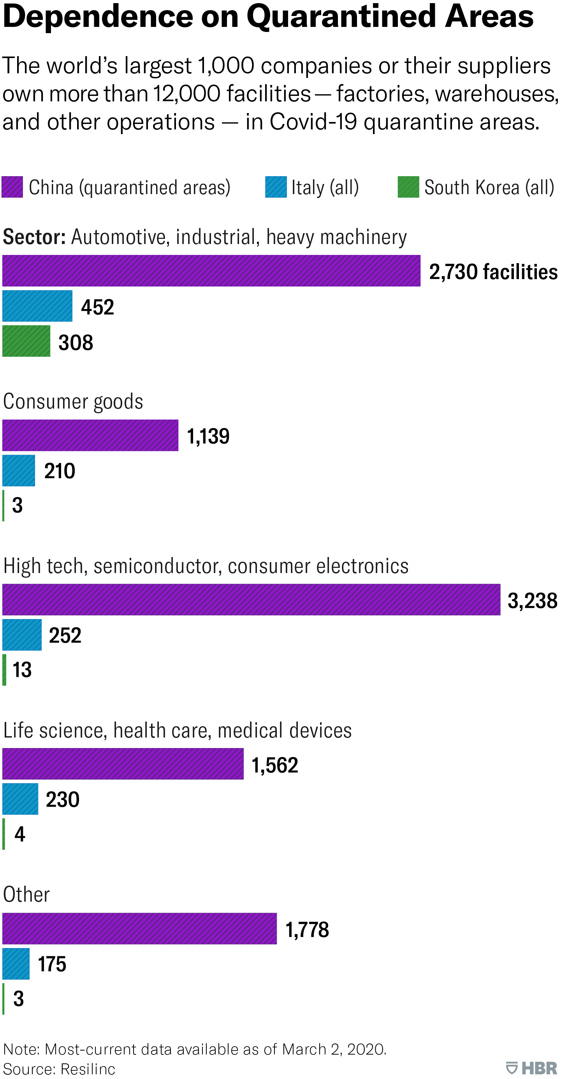
Long term shift in global supply chains
The pandemic has exposed the vulnerability of global supply chains and highlights the risks of relying on a single country’s manufacturing facilities.
Industries are considering reshoring part of their operations and shifting their operations near home country.

Slide 11
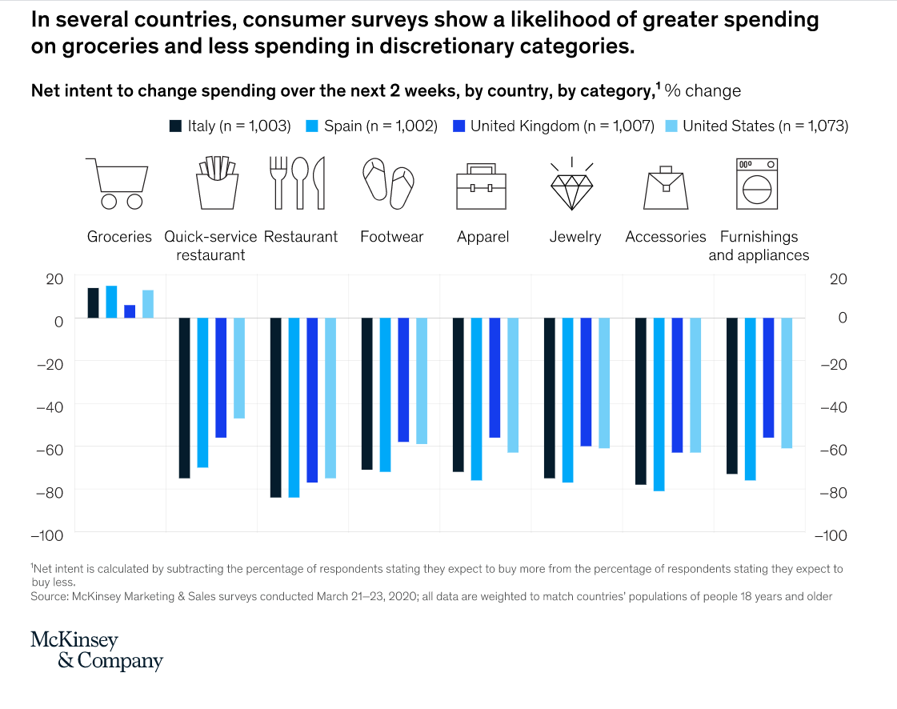
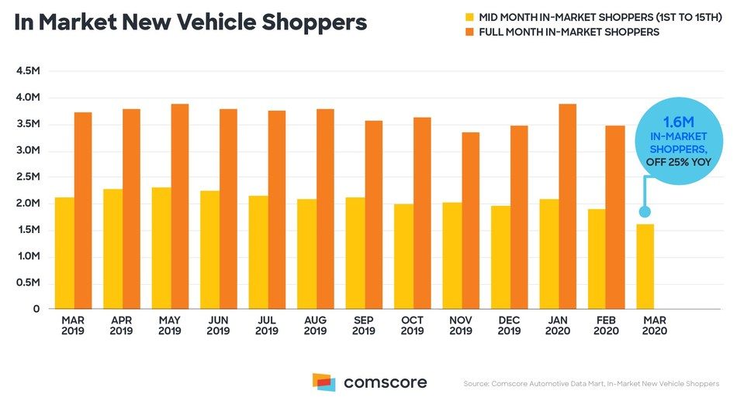
Consumer spending pattern

Slide 12
Insights gained from lessons learned
ERP systems can help map businesses’ supply networks, allowing them to be better prepared and informed in near real-time
Businesses should determine which products are their top revenue producers to focus on the tiers of suppliers needed to produce those products
Fully integrated ERP systems, with BCP, and supply network mapping enable businesses to avoid and respond to large scale supply chain disruptions

Slide 13
Resources
Business Wire. (2020, May 6). COVID-19 impact on global supply chains: Quantzig brings you three success stories from the front lines. https://www.businesswire.com/news/home/20200506005546/en/COVID-19-Impact-Global-Supply-Chains-Quantzig-Brings
Choi, T. Y., Rogers, D., and Vakil, B. (2020, March 27). Coronavirus is a wake-up call for supply chain management. Harvard Business Review. Retrieved from https://hbr.org/2020/03/coronavirus-is-a-wake-up-call-for-supply-chain-management
Comscore. Figure 6. In market new vehicle shoppers. (2020, March 23). Retrieved from https://www.prnewswire.com/news-releases/comscores-monthly-new-vehicle-demand-index-analyzes-the-impact-of-covid-19-on-the-auto-industry-301027952.html
Deskera. (n.d.) ERP for supply chain management. Retrieved from https://www.deskera.com/erp-for-supply-chain-management/#:~:text=An%20ERP%20meant%20for%20SCM,all%20elements%20of%20supply%20chain.
Harvard Business Review. Figure 5. Dependence on Quarantined Areas. Coronavirus is proving we need more resilient supply chains. (2020, March 5). Retrieved from https://hbr.org/2020/03/coronavirus-is-proving-that-we-need-more-resilient-supply-chains
Lepercq, P. (2007). Figure 9. Supply chain process and information system map. Retrieved from http://www.supplychainmagazine.fr/TOUTE-INFO/Lecteurs/MAP-SC-PROCESSES.pdf
Lepercq, P. (2007). Mapping integrated supply chain systems and processes. Supply Chain Magazine. Retrieved from http://www.supplychainmagazine.fr/TOUTE-INFO/Lecteurs/MAP-SC-PROCESSES.pdf
Markets and Markets. Figure 8. COVID-19 impact on logistics market. (2020, April). Retrieved from https://www.marketsandmarkets.com/Market-Reports/covid-19-impact-on-logistics-supply-chain-industry-market-244593137.html
McKinsey & Company. Figure 7. Net intent to change spending over next 2 weeks, by country, by category. (2020, April 2). Retrieved from https://www.mckinsey.com/industries/retail/our-insights/five-actions-retail-supply-chains-can-take-to-navigate-the-coronavirus-pandemic?cid=-soc-------&sid=3246934262&linkId=85769808
MH&L Staff. (2020, February 14). Material Handling & Logistics. https://www.mhlnews.com/global-supply-chain/article/21122993/impact-of-the-coronavirus-on-global-supply-chain
Oracle. (2020). Figure 1. Benefits of ERP. Retrieved from https://www.oracle.com/applications/erp/what-is-erp.html
Oracle. (2020). What is ERP? Oracle. https://www.oracle.com/applications/erp/what-is-erp.html
Oxford Business Group. (2020, April 24). The impact of covid-19 on global supply chains. https://oxfordbusinessgroup.com/news/impact-covid-19-global-supply-chains
RSM. (2019). Figure 4. RSM’s business continuity planning methodology. Retrieved from https://rsmus.com/what-we-do/services/risk-advisory/enterprise-strategy-risk/business-continuity.html
SAP. (n.d.). Benefits of ERP. SAP. https://www.sap.com/products/what-is-erp.html
Schmalz, F. (2020, March 26). The coronavirus outbreak is disrupting supply chains around the world – here’s how companies can adjust and prepare. https://www.businessinsider.com/covid-19-disrupting-global-supply-chains-how-companies-can-react-2020-3
Seric, A., Gorg, H., Mosle, S., and Windisch, M. (2020, April). Managing COVID-19: How the pandemic disrupts global value chains. Industrial Analytics Platform. https://iap.unido.org/articles/managing-covid-19-how-pandemic-disrupts-global-value-chains
Slideteam. Figure 3. Procurement and SCM process. Retrieved from https://www.slideteam.net/procurement-and-supply-chain-management-process.html
Subpng. (n.d.). Figure 2. ERP business areas. Retrieved from https://www.subpng.com/png-aagnqh/download.html
Wikipedia. (2020, June 9). Wikipedia. https://en.wikipedia.org/wiki/Enterprise_resource_planning

