Slide 1
ELMv1-BeTR-ReSOM

Slide 2
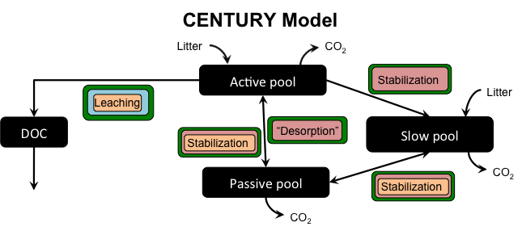
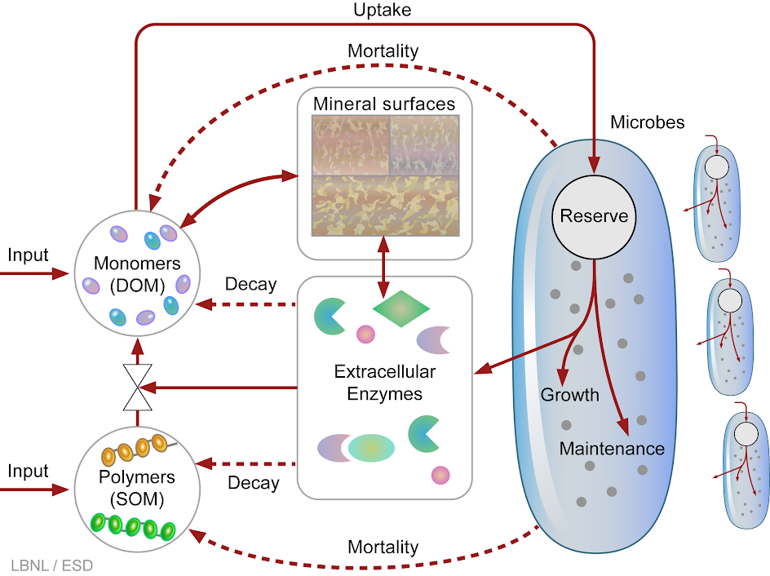
Replaces Century with ReSOM
Both take inputs from litter and mineralize C:N:P that exit via plant uptake, efflux, or leaching

Slide 3
Overview of Directories
E3SM
BeTR
Soil-farm
ReSOM
Multi-layer wrapper around single-layer soil bgc model
~/E3SM
$E3SMROOT
components
cime/scripts create_newcase
Soil Reactions
cam
biogeochem
Plant Soil Interface
cice
biogeophys
bgcfarm_util
N layer
Main Type
clm
src
SOM Type
external models/sbetr/src/Applications/soil-farm
ReSOM
1 layer
NitDen Type
cice
Decomp Type
mosart
main
cdom-ECA
Parameters
Deb Growth Func
cpl
Deb Type
mpas-landice
Index Type
utils
Century-ECA
Math Funcs
mpas-ocean
mpas-seaice

