Slide 1


Slide 2

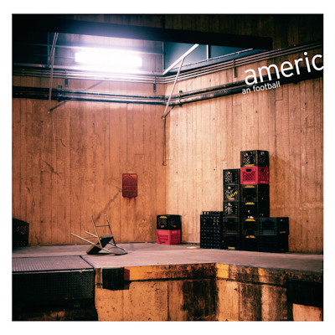


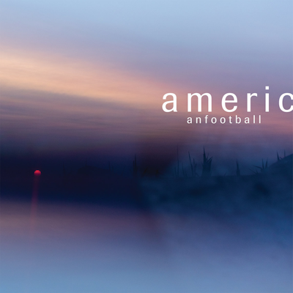
Discography
American Football
EP (1998)
American Football
LP1 (1999)
American Football
LP2 (2016)
American Football
LP3 (2019)

Slide 3
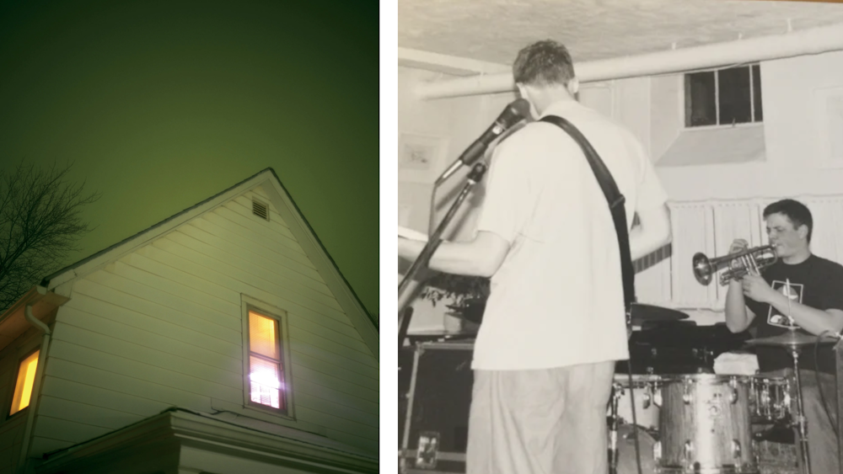
LP1
1999

Slide 4


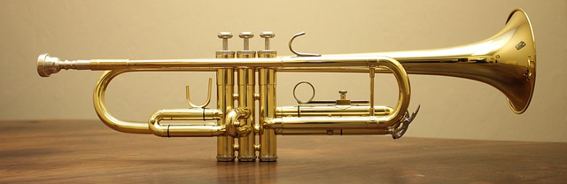

Slide 5
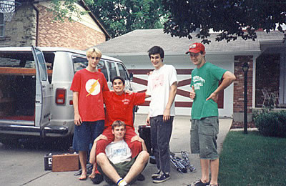
“That van Gogh sky shrinks the city that shrinks me”
Cap’n Jazz
Flashpoint: Catheter (1995)

Slide 6

Tracklisting
Never Meant
The Summer Ends
Honestly?
For Sure
You Know I Should Be Leaving Soon
But the Regrets Are Killing Me
I’ll See You When We’re Both Not So Emotional
Stay Home
The One With the Wurlitzer

Slide 7

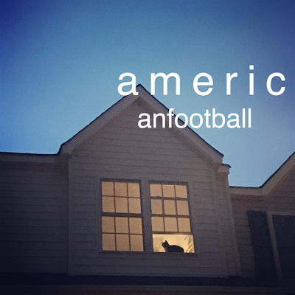



Slide 8

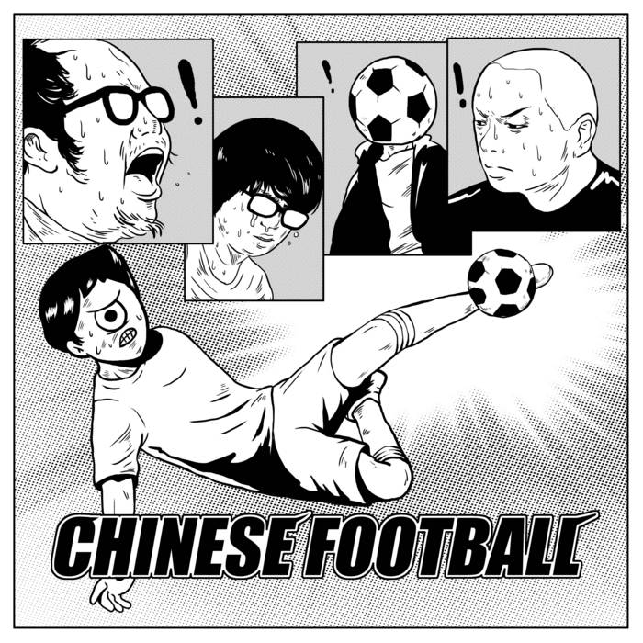
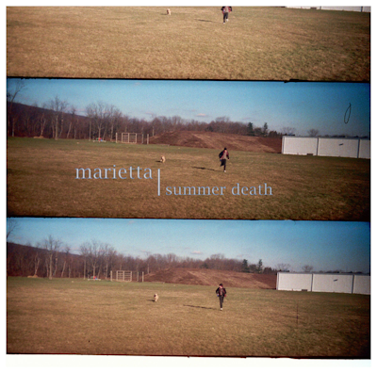


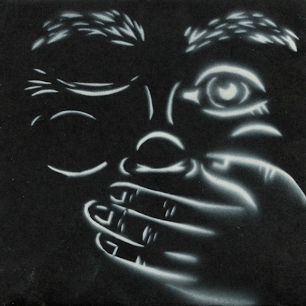
Influence
TTNG
Chinese Football
Marietta
Merchant Ships
As a Sketch Pad
Midwest Pen Pals

