Slide 1
Capstone project: provider fraud anomaly detection in healthcare with autoencoders
By ramzi abujamra

Slide 2
Background-Medicare and fraud
Medicare is a FFS government program from CMS for older Americans (and for some on disability)
US CMS spends billions on health care in the US: $750.2 billion in 2018, $787 billion in 2019 ¹
Fraud is estimated to cost as much as 10% of health care spending (FBI) ²
1. https://www.cms.gov/Research-Statistics-Data-and-Systems/Statistics-Trends-and-Reports/NationalHealthExpendData/NHE-Fact-Sheet
2. https://www.cms.gov/Outreach-and-Education/Medicare-Learning-Network-MLN/MLNProducts/MLN-Publications-Items/MLN4649244.html?DLPage=1&DLEntries=10&DLFilter=frau&DLSort=0&DLSortDir=descending

Slide 3
Goal of the study
The goal of the study is to identify providers who are fraud from CMS claims data
In addition, the prediction tool should be efficiently designed to minimize error which are costly.
Type I (False positive): Identifying as Normal when provider is Fraud
This is a costly error as fraud is left unrecognized
Type II (False negative): Identifying as Fraud when provider is Normal
There is wasted resources in pursuing this provider, also there is loss of goodwill (harder to measure)

Slide 4
Data Sets
Medicare Part B
Professional and outpatient services
Medicare Part D
Prescription drugs
List of Excluded Individuals and Entities (LEIE) from the Office of the Inspector General (Dept of Health and Human Services)

Slide 5
Data processing
Aggregate both Medicare B and Medicare D at the provider (NPI) level
Datasets are at Provider/Procedure code (Drug for Part D) level in original data
Analysis will be performed at the Provider (NPI) level
For Medicare B, aggregate at NPI, gender and provider type (or provider specialty)

Slide 6
Data processing
Medicare B fields:
Field | Summary
Hcpcs_code | # Unique
Drug Indicator, Place of Service | Indicator, >0.5 occurrence
Line_Srvc_Cnt, Bene_Unique_Cnt, Bene_Day_Srvc_Cnt, Average_Submitted_Chrg_Amt, Average_Medicare_Payment_Amt | Sum, mean, std, min, max,

Slide 7
Data processing
Medicare D fields:
Field | Summary
Total_Claim_Count, Total_30_Day_Fill_Count, Total_Day_Supply, Total_Drug_Cost | Sum, mean, std, min, max,

Slide 8
Data processing
Combine both datasets Medicare B and Medicare D on NPI fields
Gender and Provider type included from Medicare B
Finally, combine with labels (fraud/nonfraud) from LEIE dataset
Data set size: 621,017 x 51
Fraud prevalence: 246 fraud (or .0004 rate) – very small!

Slide 9
Data processing
First create dummy variables for categorical fields (gender and provider type)
New data size: 620,771 x 129
Then, due to imbalanced data, use SMOTE to balance the data
Creates 620,771 instances for both fraud=0 and fraud=1
New data size: 1,241,542 x 129

Slide 10
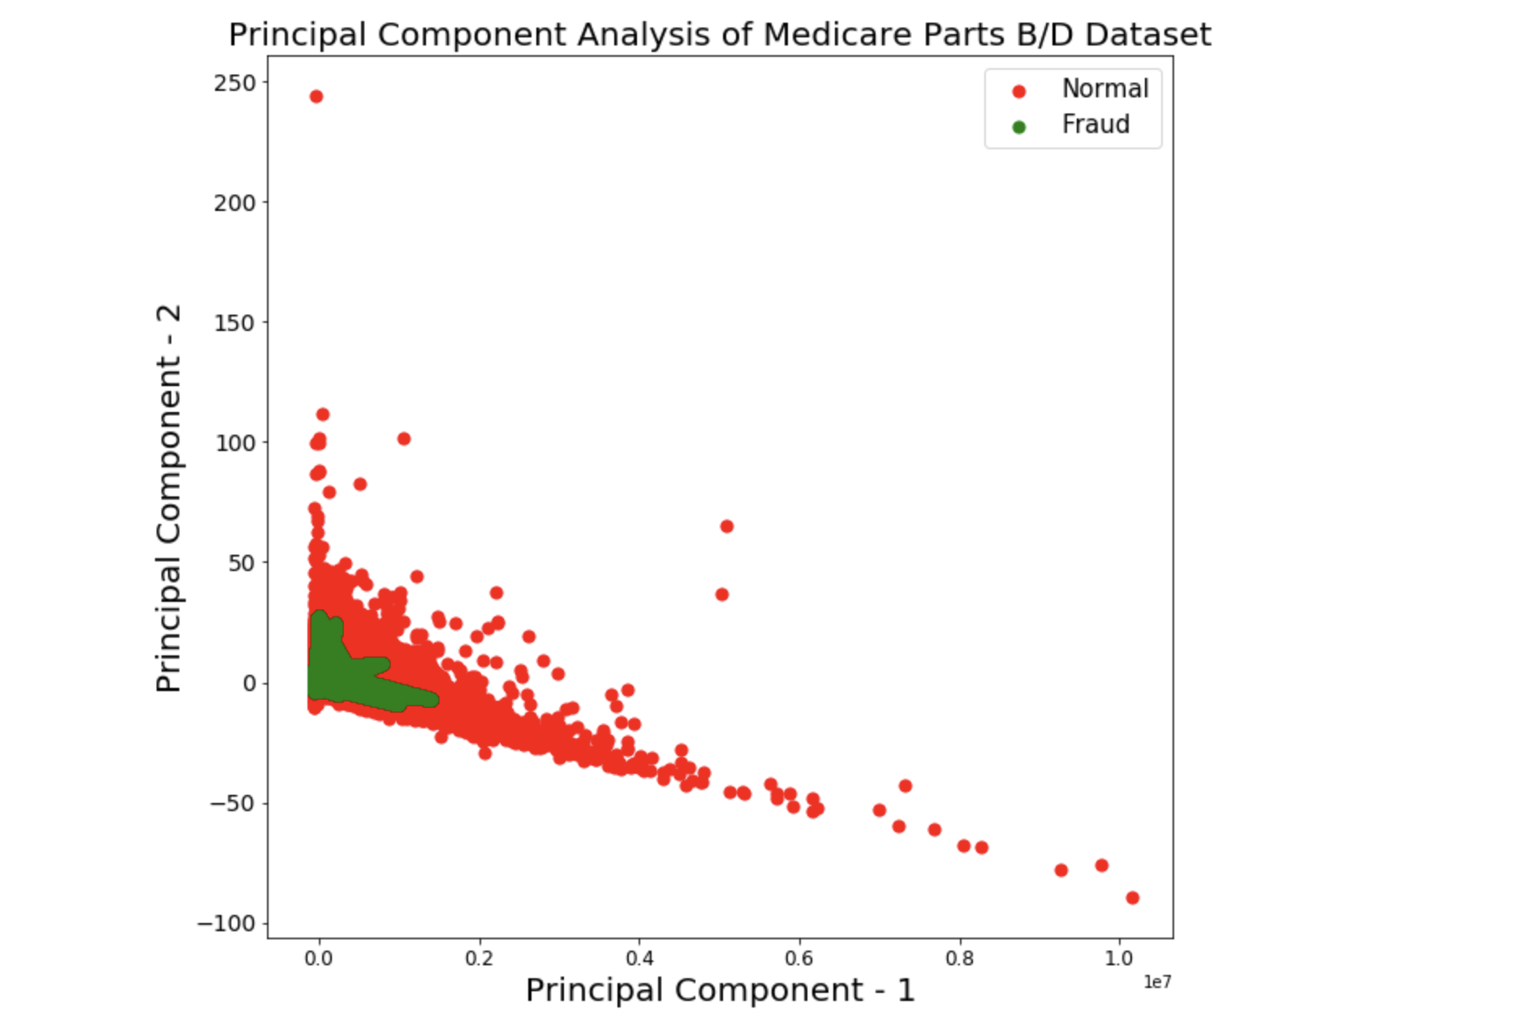
PCA scatter plot: fraud vs. normal (first 2 components)

Slide 11
I. supervised learning
First approach is to use general supervised learning models
Logistic regression and Random Forest models are used
Full data sets is used (split by train/test)

Slide 12
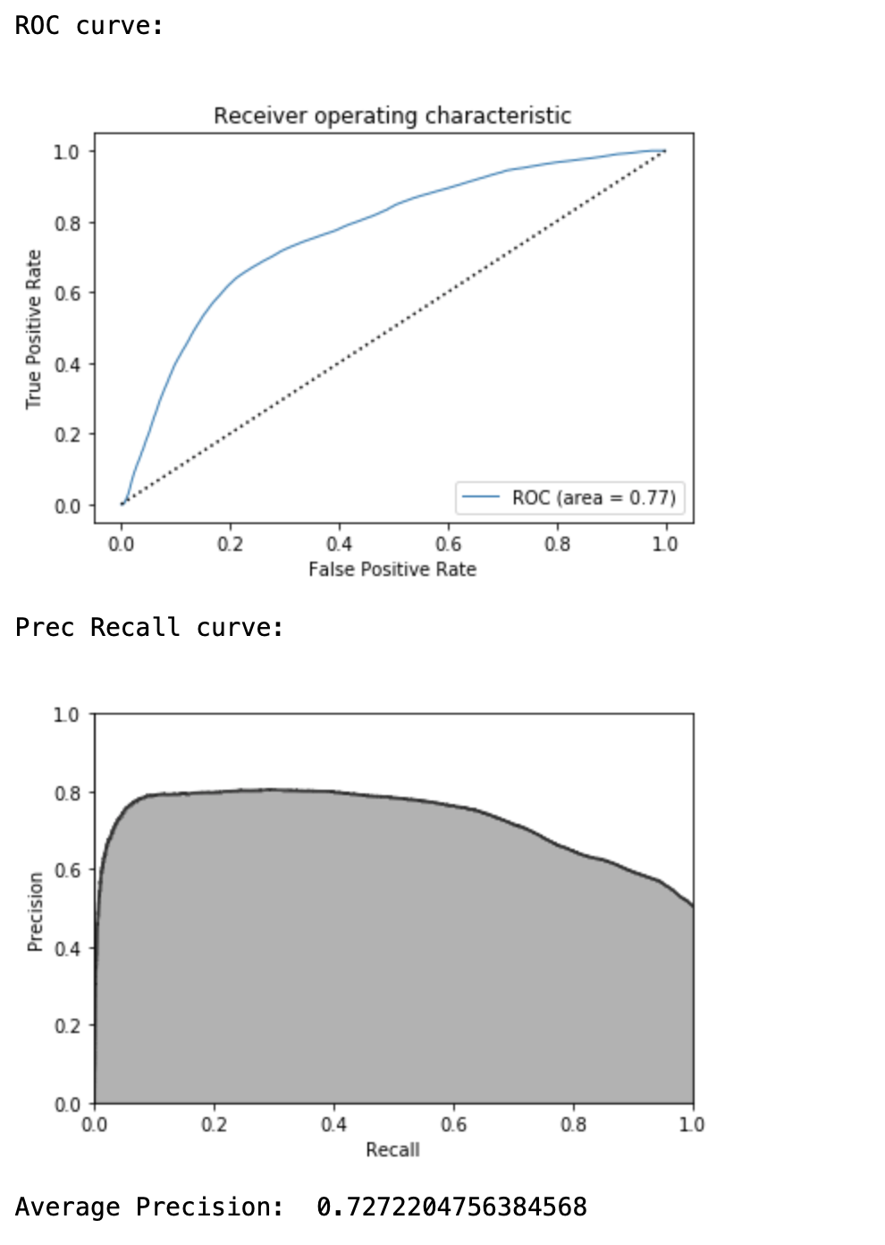
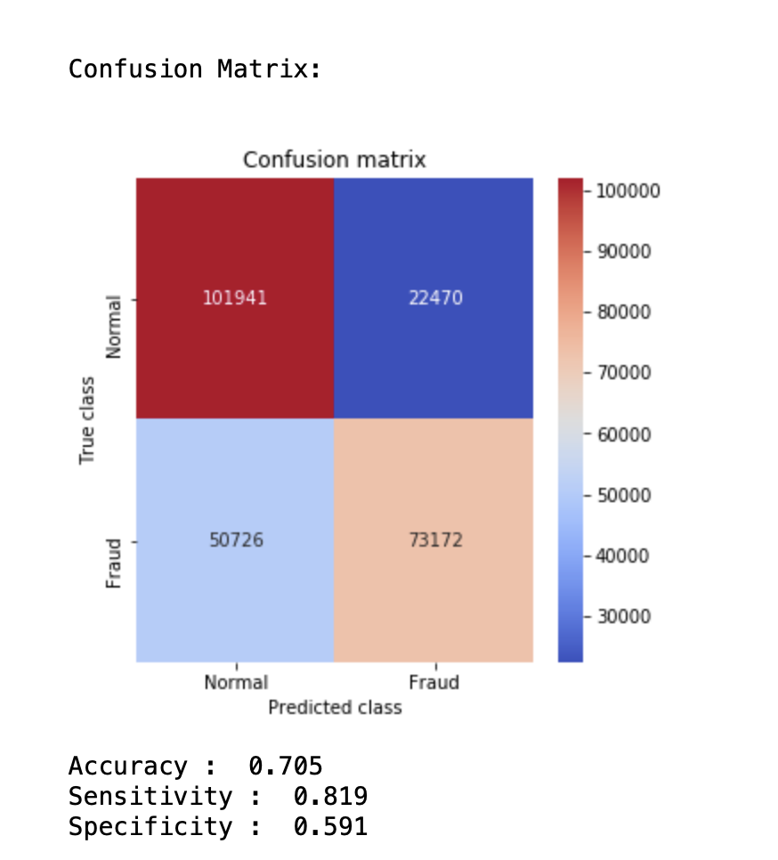
Results: logistic regression

Slide 13
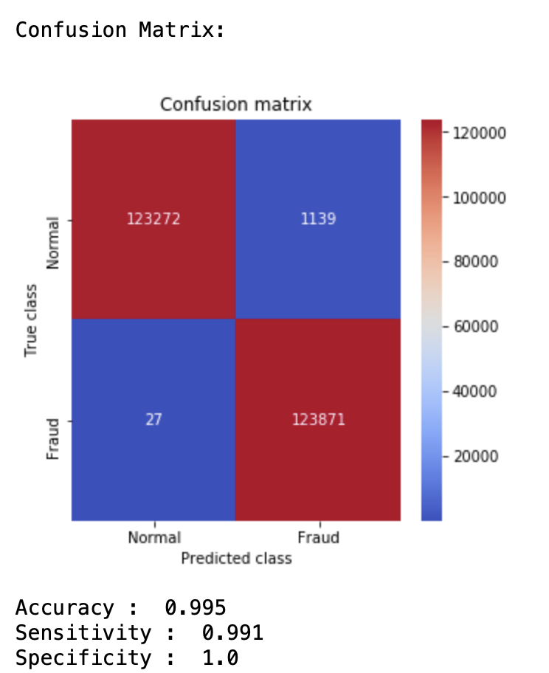
Results: random forest

Slide 14
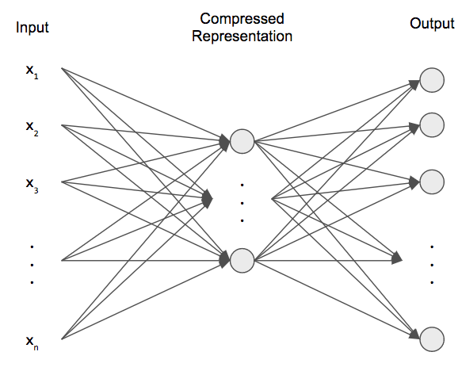
II. Unsupervised learning: Autoencoders
Autoencoders are deep learning models
They are unsupervised models: no labels are used
The features are compressed (encoded) and then uncompressed (decoded) back to the features
Reconstruction error captures the loss accuracy
Outliers will have a large reconstruction error!
Obtained from https://pythonmachinelearning.pro/all-about-autoencoders/

Slide 15
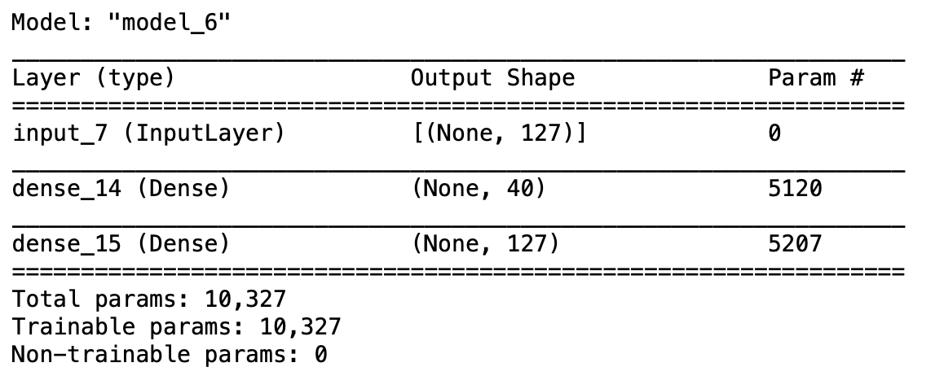
Autoencoder model
Very simple autoencoder model is implemented
127 x 40 x 127 (our feature set size is 127 after dropping NPI and fraud)
Model implemented using Keras
50,000 samples are used in model
Only Normal class is used

Slide 16
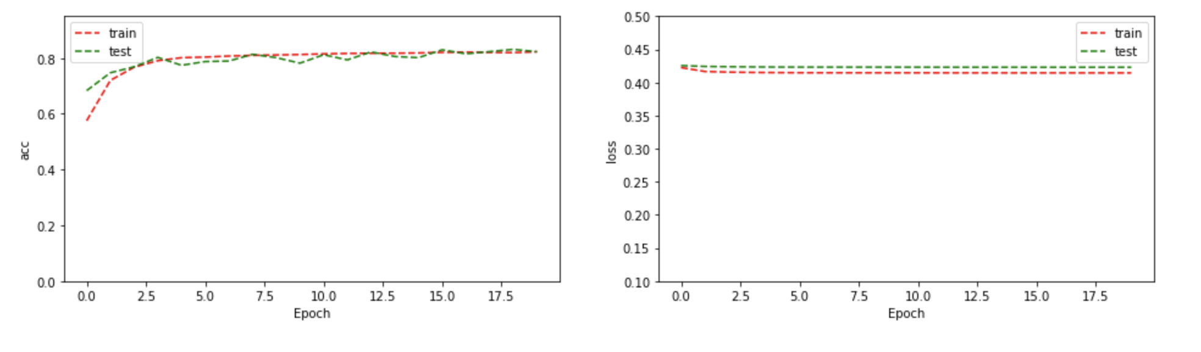
Autoencoder training results

Slide 17
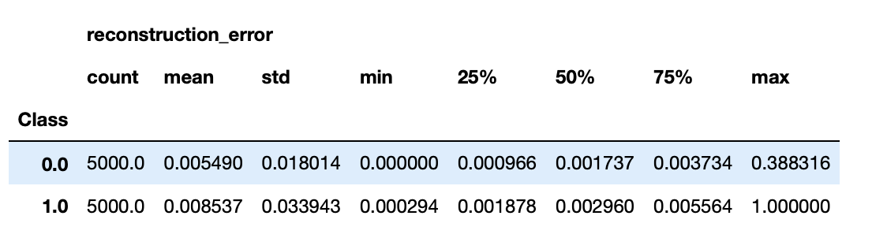
Autoencoder evaluation: reconstruction error
Reconstruction error is larger for Class 1 (fraud) than Class 0
Reconstruction error threshold set at mean of Class 0 + 1*std dev (=.00485)

Slide 18
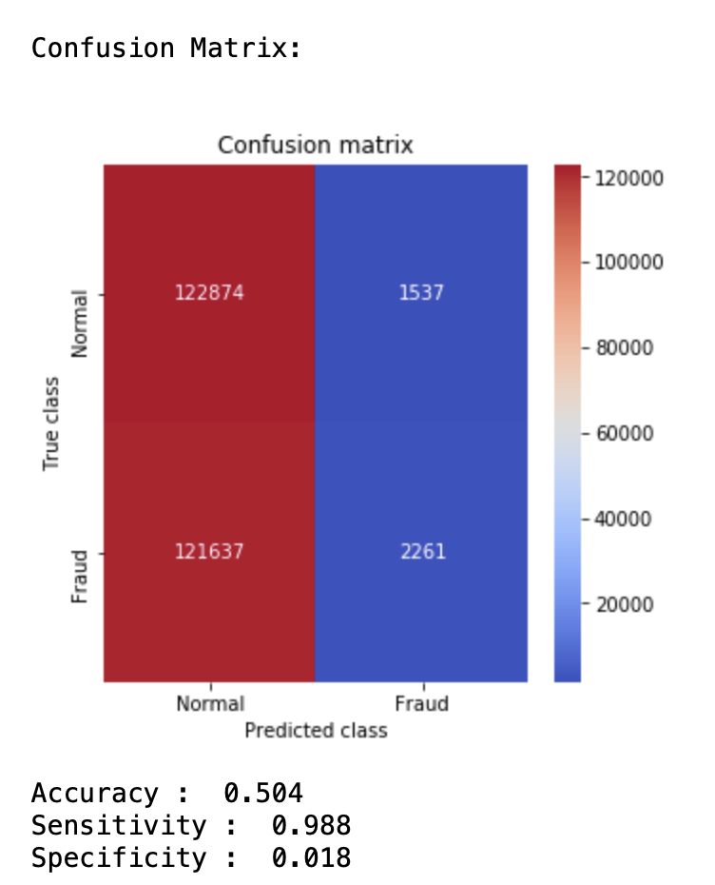
Autoencoder evaluation: confusion matrix
Results are not stellar but still pretty good considering no labels are used!
Autoencoder could also be improved with modeling (deeper layer, regularization, etc.)
The next step is to use the encoder representation as input to our supervised model-this is Semi-Supervised learning

Slide 19
III. Semi-supervised learning
Combination of both supervised and unsupervised learning
Use encoder layer of autoencoder as input to logistic regression supervised model
Note this is only the encoding layer (dimension = 40, not 127)
Use very small sample-only 5,000 from each class (of 50,000 samples)
This will demonstrate that not as many samples are needed when we use the encoding layer from the autoencoder to achieve high accuracy!

Slide 20
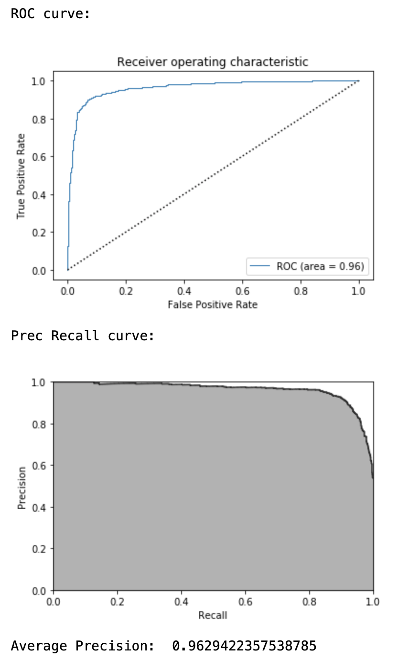
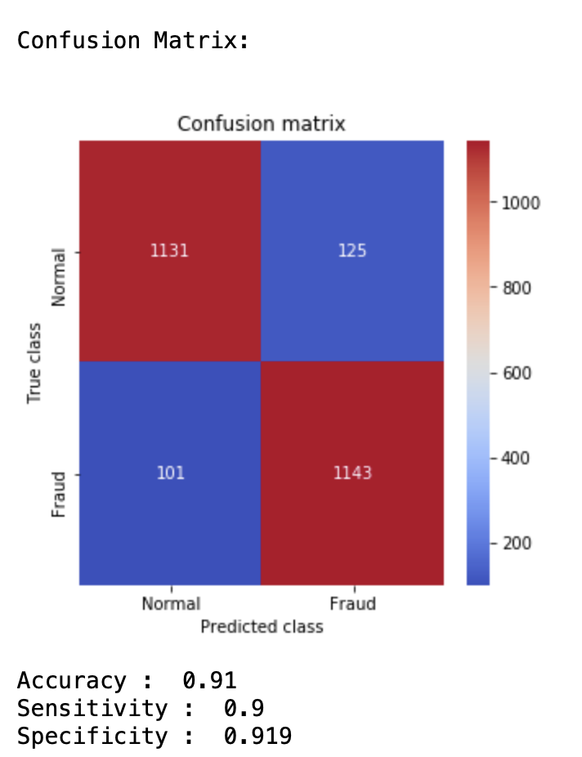
Results: logistic regression
Results significantly improve!
Specificity has gone up from .591 to .911
While Accuracy and Sensitivity both improved!

Slide 21
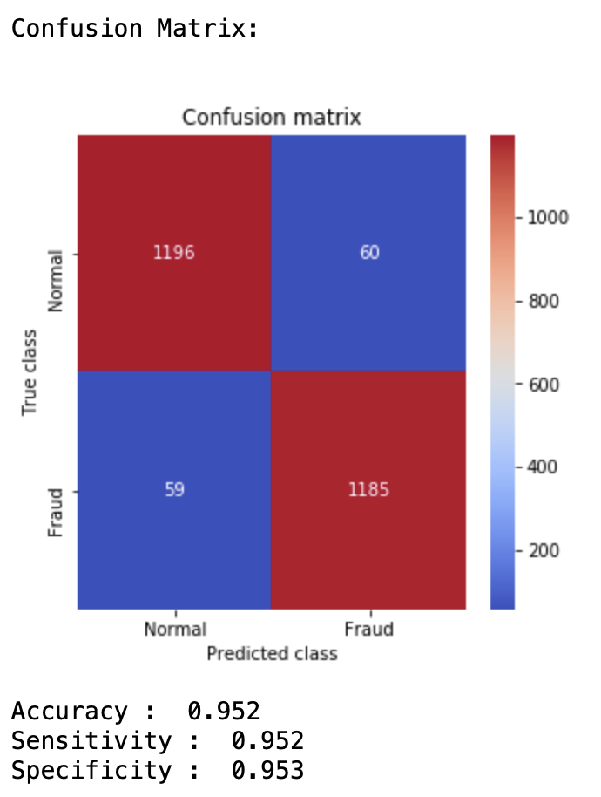
Results: random forest

Slide 22
Example: error cost estimation for Logistic regression predictor
Cost of resource to pursue fraud provider: $100 per hour
5 hours labor on average
Cost of goodwill lost: $5,000
Cost of fraud provider: $25,000
From Logistic Regression model:
FNR: 1– Sens = .0995
FPR: 1 – Spec = .0812
Total providers: 600,000
Category | Providers | Error Cost
Total | 600,000
FN | 600,000*FNR= 59,713 | 59,713*5,500= $3.28 million
FP | 600,000*FPR= 48,714 | 48,714*25,000= $1.2 billion

