Slide 1
Iowa Housing Prices: Machine Learning Project
By Ramzi Abujamra

Slide 2

I. Data Processing

Slide 3
Data Set: Big Picture
Train: 1460 x 81 (including SalePrice, outcome variable)
Test: 1459 x 80
Combine Train/Test for processing
Column Types:
Type | Total
Numeric | 37
Categorical | 43

Slide 4
Data Transformation: Ordinal
Transform these ordinal columns to numeric:
['ExterQual', 'ExterCond', 'BsmtQual', 'BsmtCond', 'HeatingQC’, 'KitchenQual’, 'FireplaceQu', 'GarageQual', 'GarageCond', 'PoolQC’, 'GarageFinish', 'LandSlope’, 'BsmtFinType1', 'BsmtFinType2’, 'BsmtExposure’]
Updated column types:
Type | Total
Numeric | 52
Categorical | 28

Slide 5
Data Transformation: Categorical
Dummify the following are the categorical columns:
['MSSubClass','MSZoning','Street','Alley','LotShape','LandContour','Utiliti es','LotConfig','Neighborhood','Condition1','Condition2','BldgType','House Style','RoofStyle','RoofMatl','Exterior1st','Exterior2nd','MasVnrType',’Fou ndation','Heating','CentralAir','Electrical','GarageType','PavedDrive','Fenc e','SaleType','SaleCondition’]
Before dummifying, bucket columns with high unique value count
Place low values in ‘Other’ bucket

Slide 6
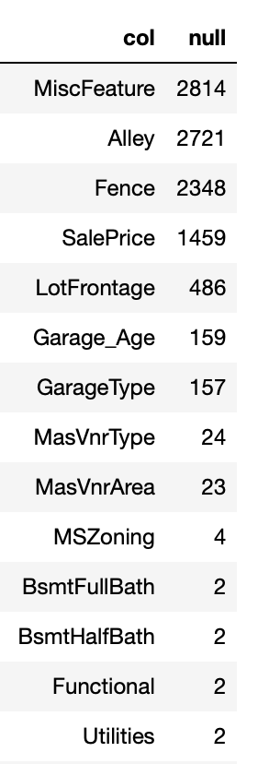
Data Imputation
List of columns containing nulls (totals)
MiscFeature is dropped-due to excessive nulls
Other columns imputed either with:
Other values in columns (median/mode)
Zero
‘None’

Slide 7
Data Transformation: Standardization
Standardization of all numeric columns (all columns at this point)
Exclude output variable
Use StandardScalar() in scikit-learn

Slide 8
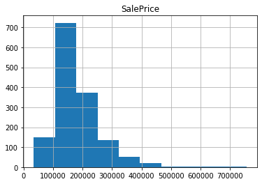
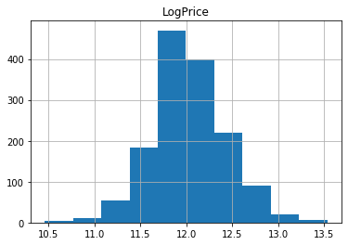
SalePrice: Log Transformation

Slide 9
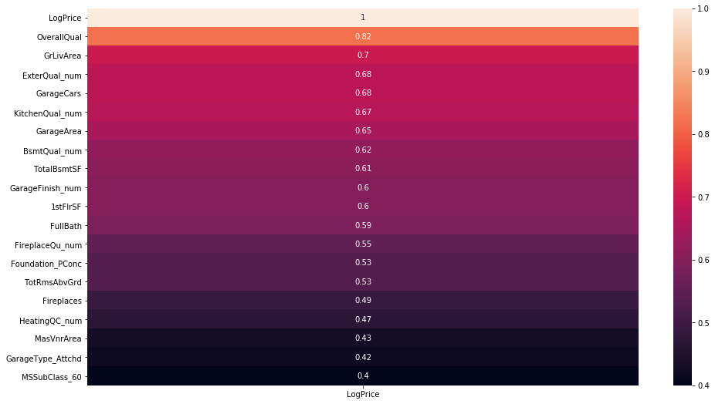
Correlation Matrix- Top 20 Features Correlated with LogPrice

Slide 10
II. Machine Learning

Slide 11
Five Models Considered
Lasso Regression
Random Forest Regression
Gradient Boosting Regression
XGBoost Regression
Ensemble Stacking

Slide 12
Overall Process
Select model
Select parameters
Grid search (lasso/random forest) or manually (gradient boosting/xgboosting/stacking)
Obtain RMSE and R2
Perform 5-fold cross-validation
Fit model
Select important features (excluding stacking model)

Slide 13
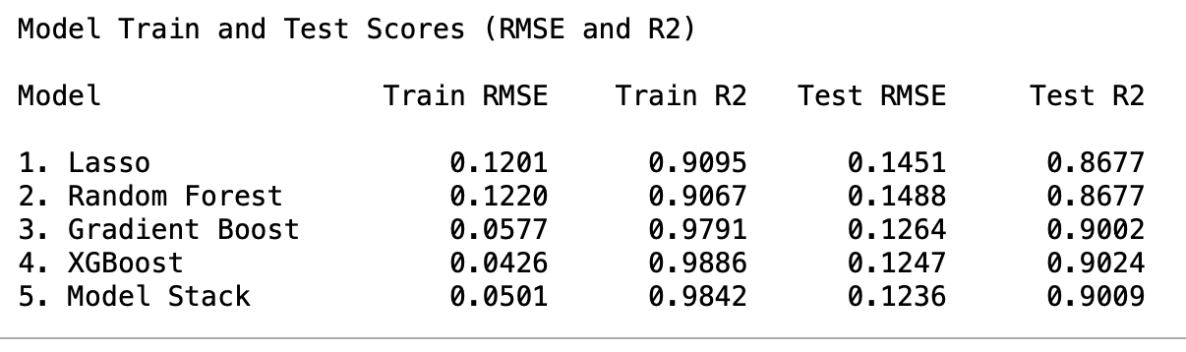
Results: Model Comparisons
SelectedModel

Slide 14
Feature Importance

Slide 15
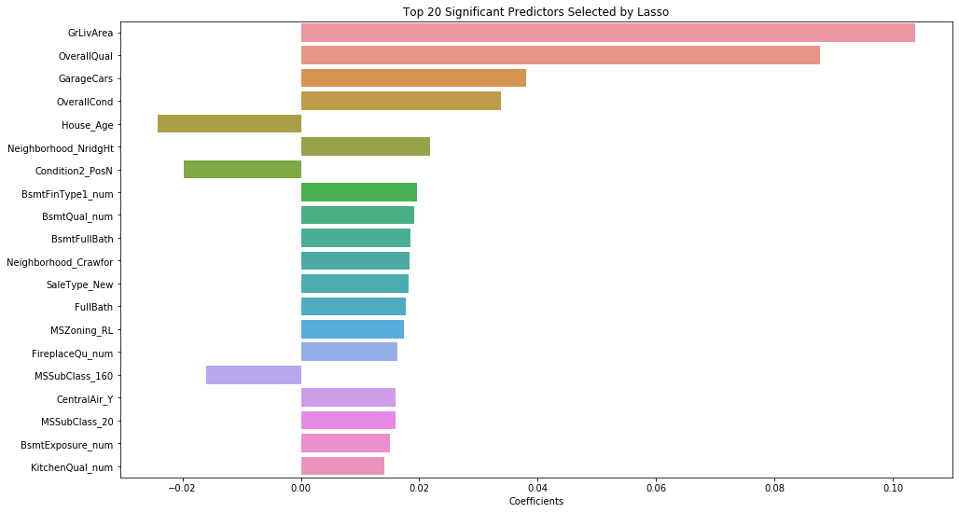
Feature Importance (Lasso)

Slide 16
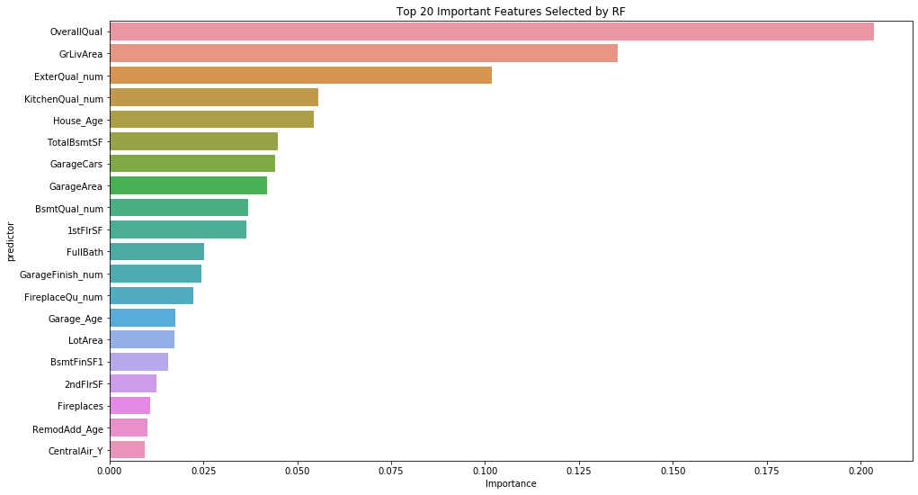
Feature Importance (RF)

Slide 17
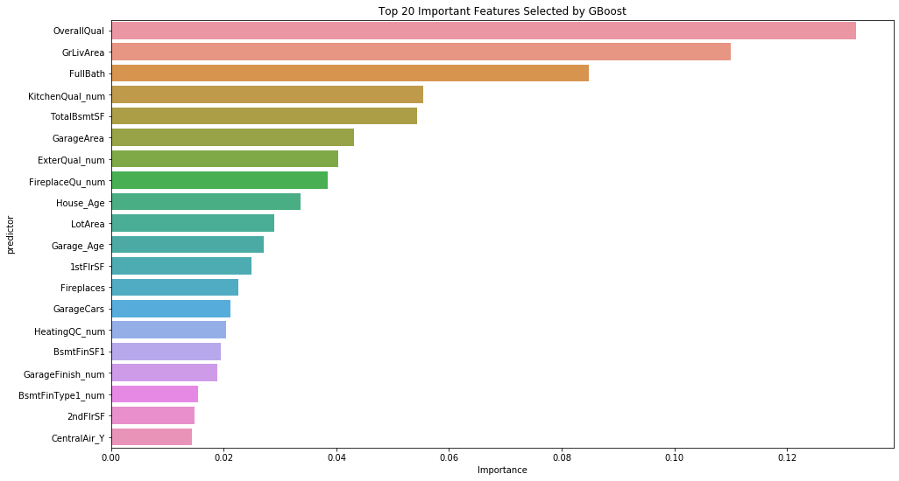
Feature Importance (Boosting)

Slide 18
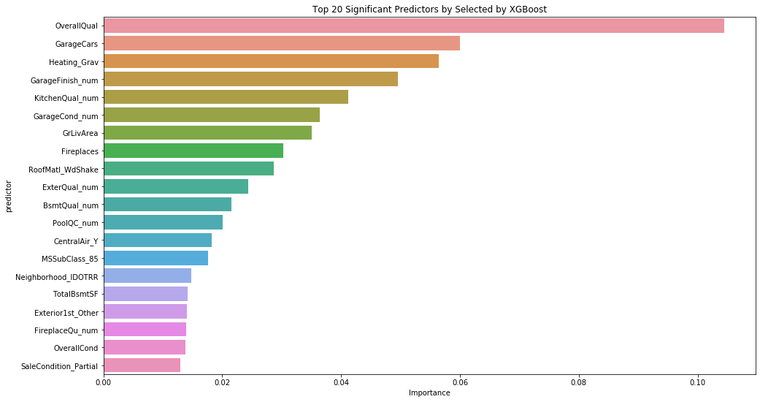
Feature Importance (XGBoost)

Slide 19
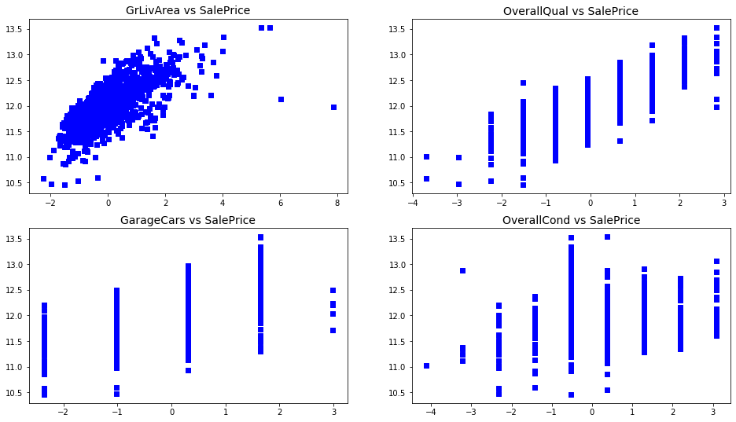
Top Features vs SalePrice (Lasso)

Slide 20
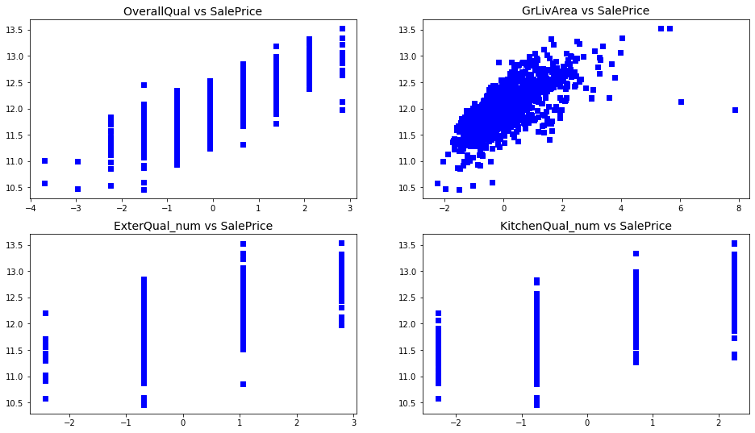
Top Features vs SalePrice (RF)

Slide 21

Top Features vs SalePrice (Boosting)

Slide 22
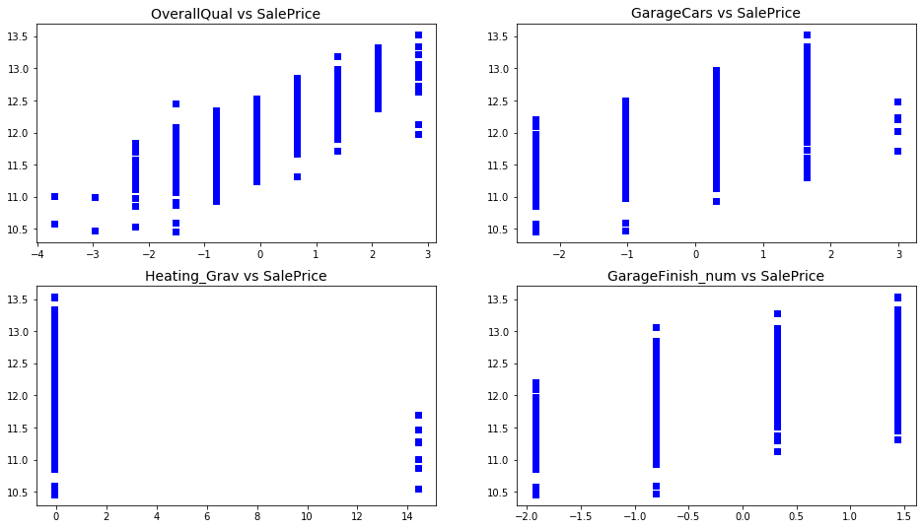
Top Features vs SalePrice (XGBoost)

Slide 23
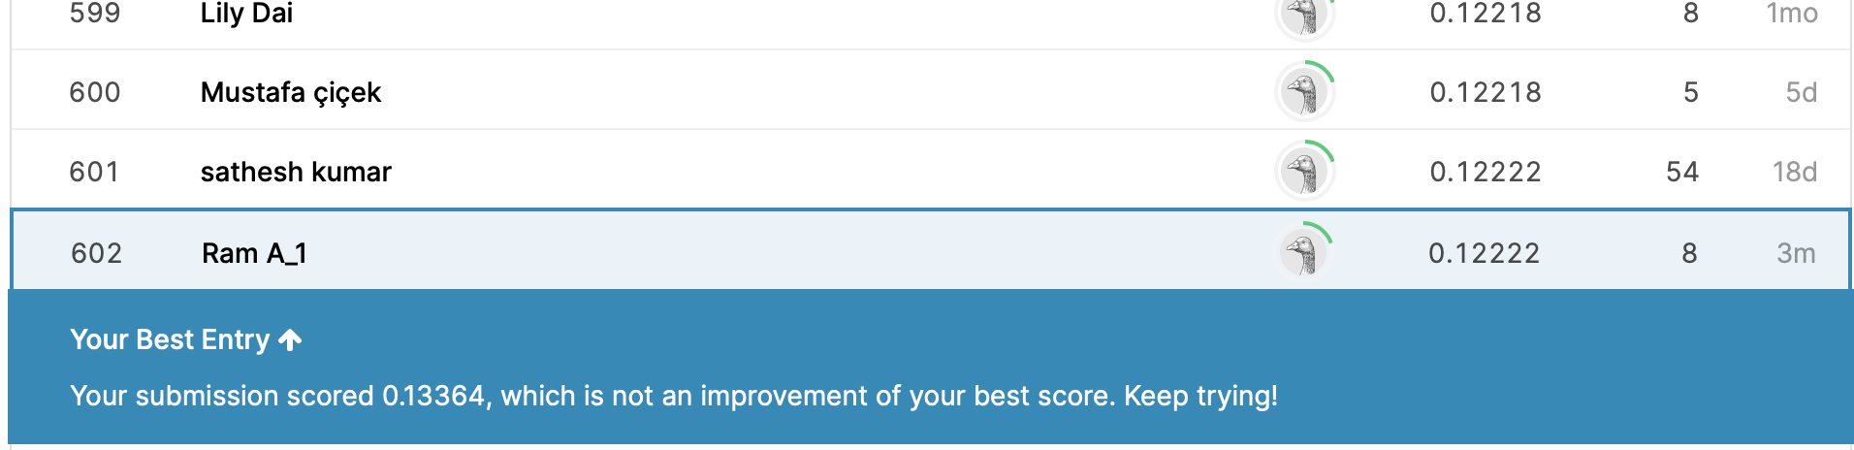
Top Finisher #602 on Kaggle!

Slide 24
Thank you

