Slide 1


ATP Tennis
Web Scraping Project 2
By Ramzi Abujamra

Slide 2
Background
Scrapped website: ATPTour.org
Contains ranking and details of players in ATP Tennis Tour
Singles ranking only
Used Scrapy to perform web scraping
Scrapped on 2/3/2020 (!)

Slide 3
Web scraping
Results scraped from table on main ranking webpage: https://www.atptour.com/en/rankings/singles
Scraped following items from main table for each player:
First name, last name, age, year pro, weight, height, birthplace, rank (2020), rank (career), win (career), loss (career), titles, prize (career), left hand, backhand
Also scrapped finals (career) on link from tab from main table

Slide 4
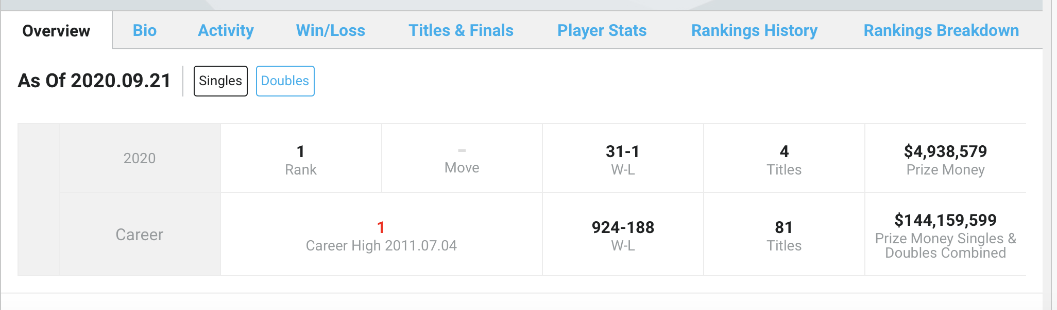
Web scraping
Scrapping had to accommodate Single vs Double issue (resolved by using ‘extract_first()’ in Scrapy)

Slide 5
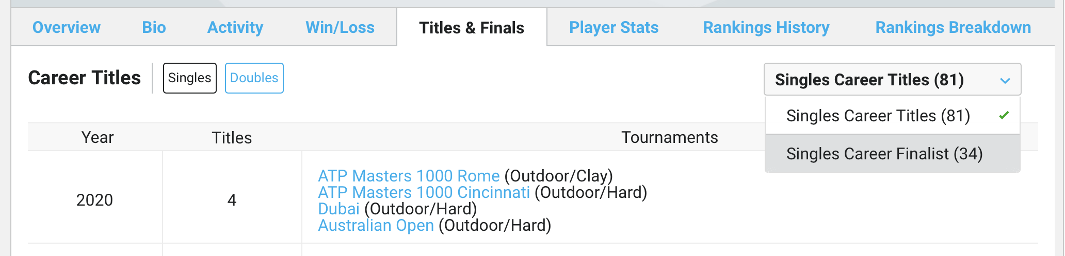
Web scraping
Scraping finals (career) from tab link on main table.

Slide 6
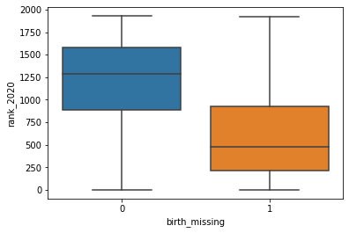
Data Cleaning
Data required some cleaning before analysis (Initial sample=1,934)
Removed those who had no birthplace in the data (N=1,064)
Study sample=870
Missing birthplace had much higher ranking, as expected

Slide 7
Data cleaning
Removed rows with both height and weight missing (N=21)
Sample size = 849
Dropped variable ‘year pro’, as it had 469 missing (out of 849)
Remaining height/weight missing imputed based on column means

Slide 8
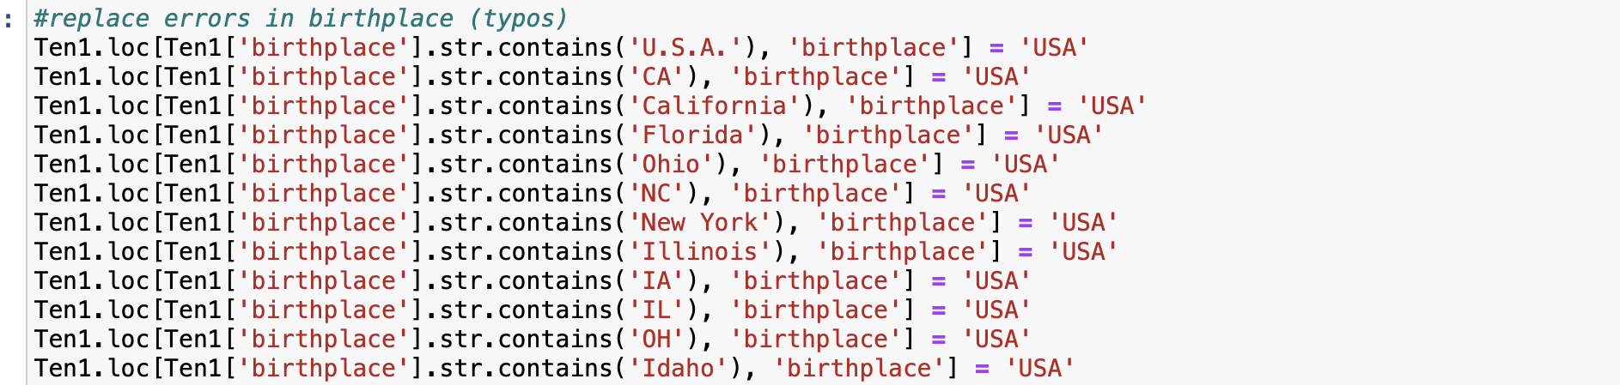
Data cleaning
Finally, significant cleaning of birthplace (manual process!)

Slide 9
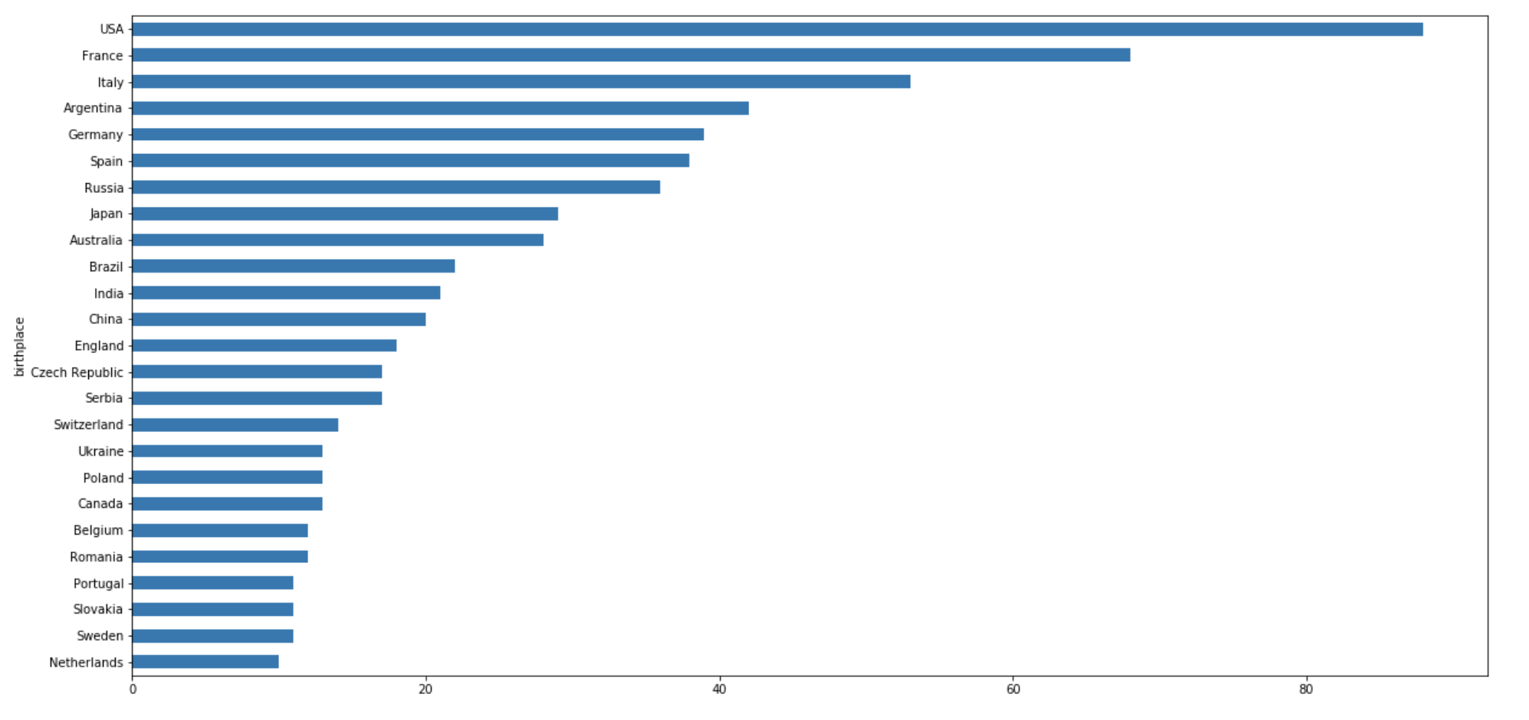
Data exploration: countries with most players

Slide 10
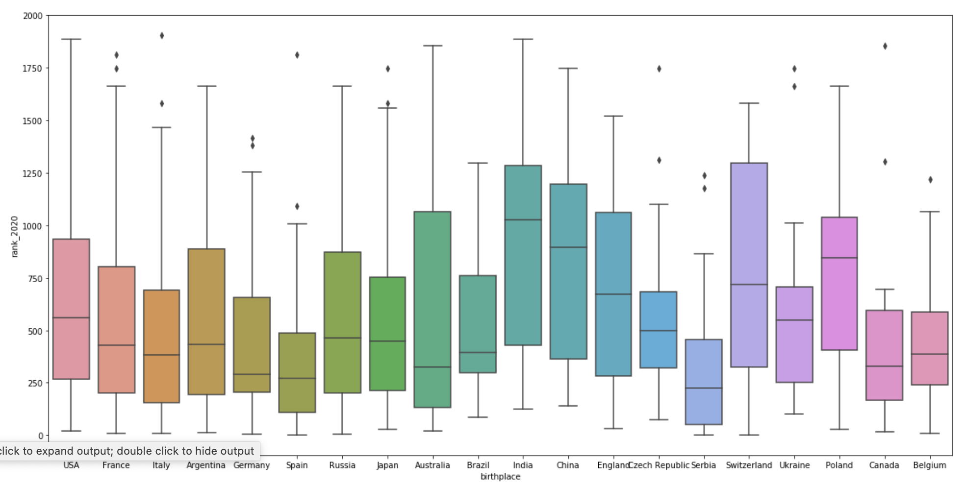
Data exploration: countries with most players

Slide 11
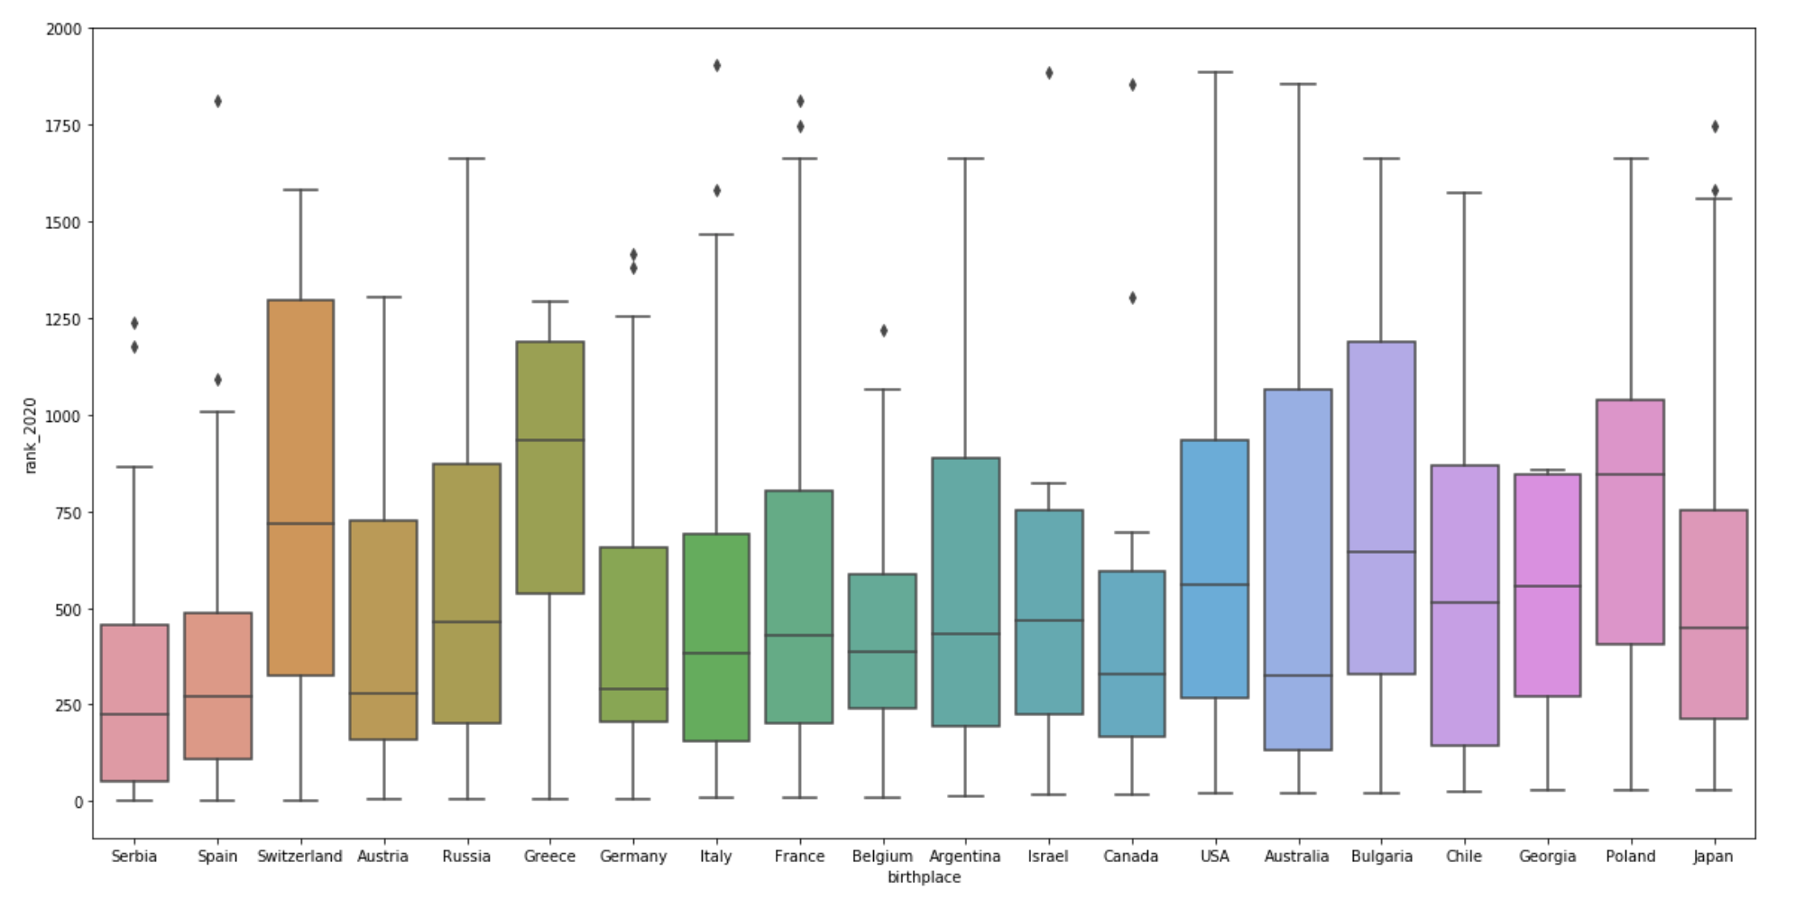
Data exploration: lowest ranking by countries

Slide 12
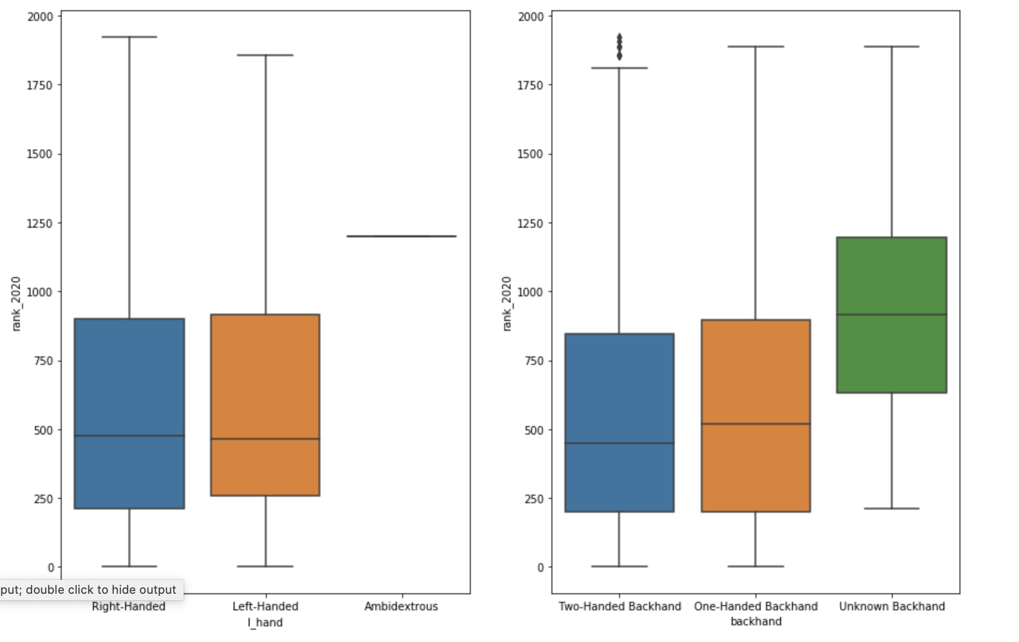
Data exploration: Left-handed and backhand players

Slide 13
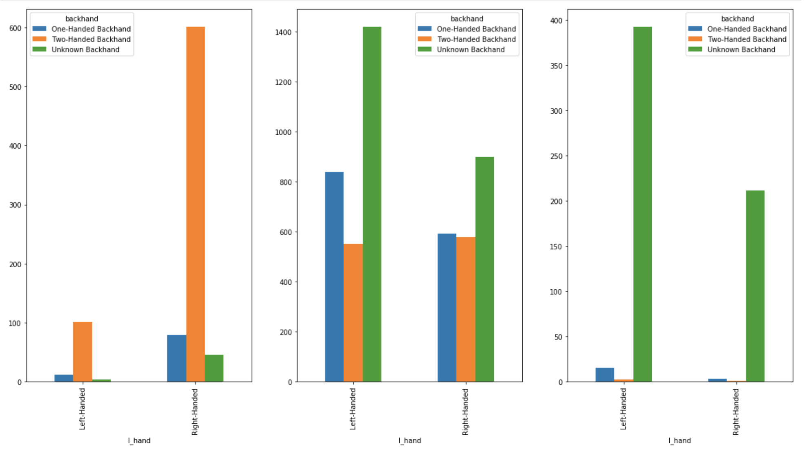
Data exploration: Left-handed and backhand players

Slide 14
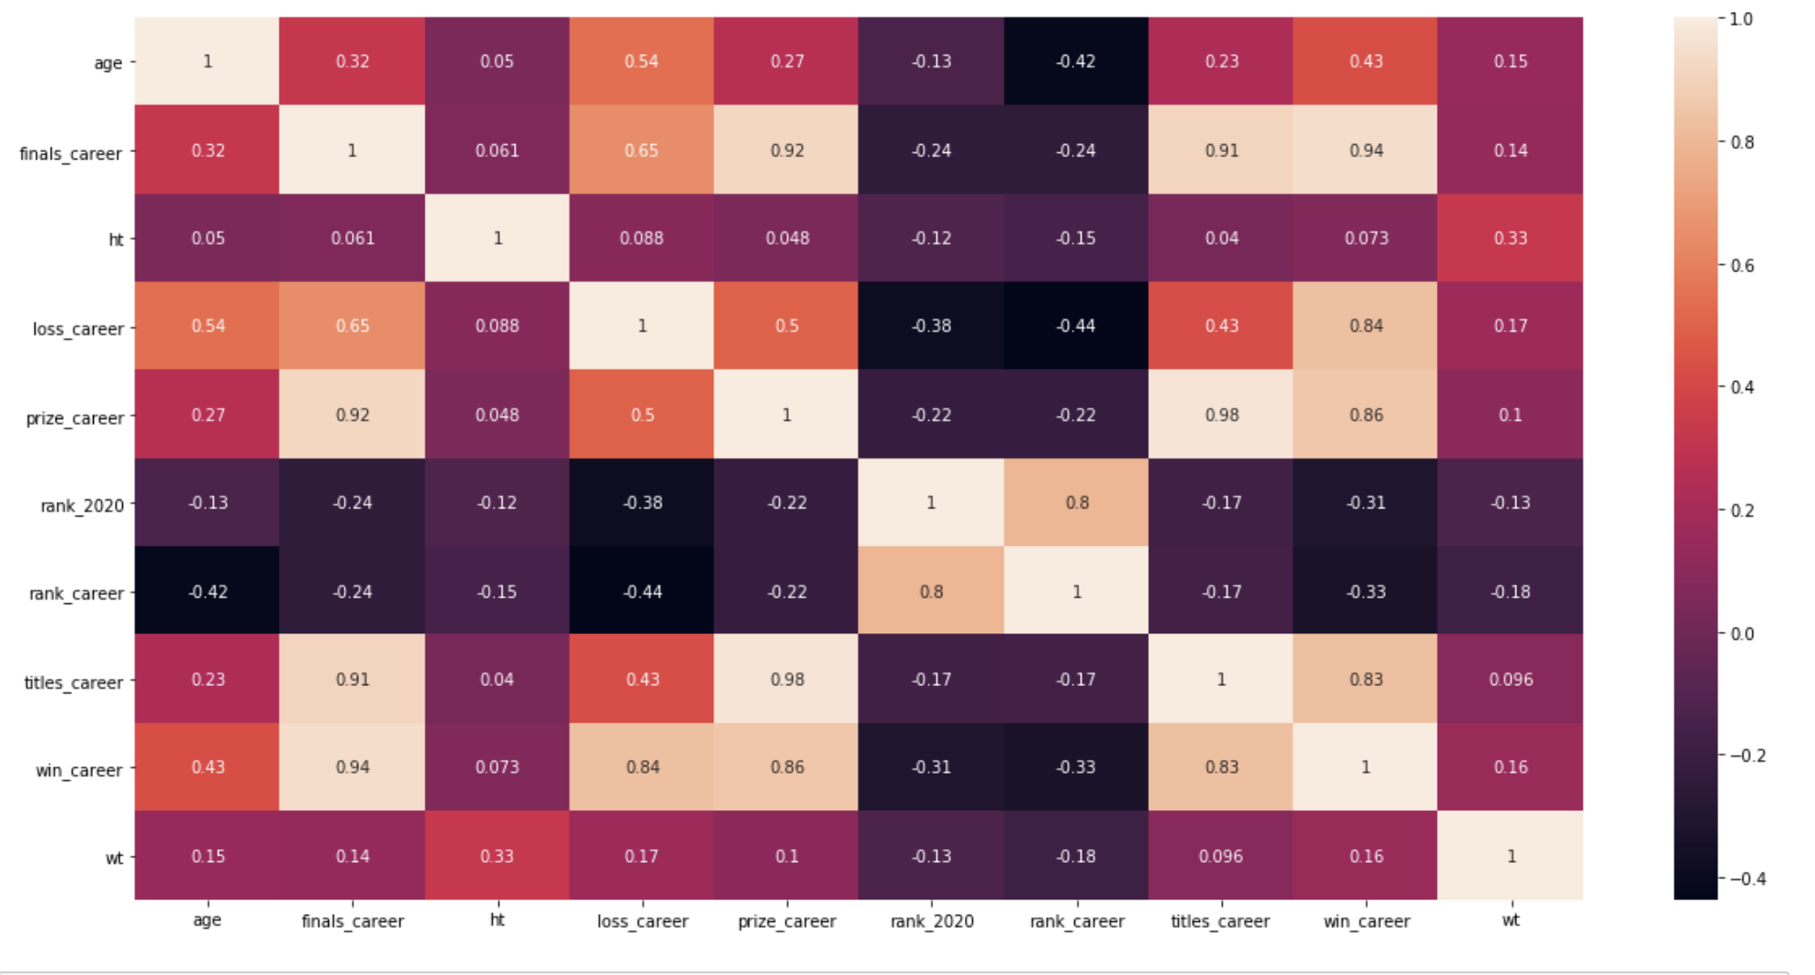
Data exploration: PCA Analysis-correlation matrix

Slide 15
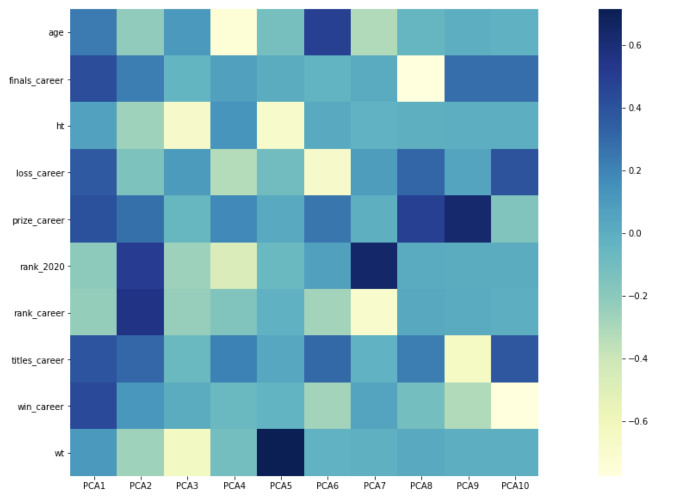
Data exploration: PCA Analysis-factor loading

Slide 16
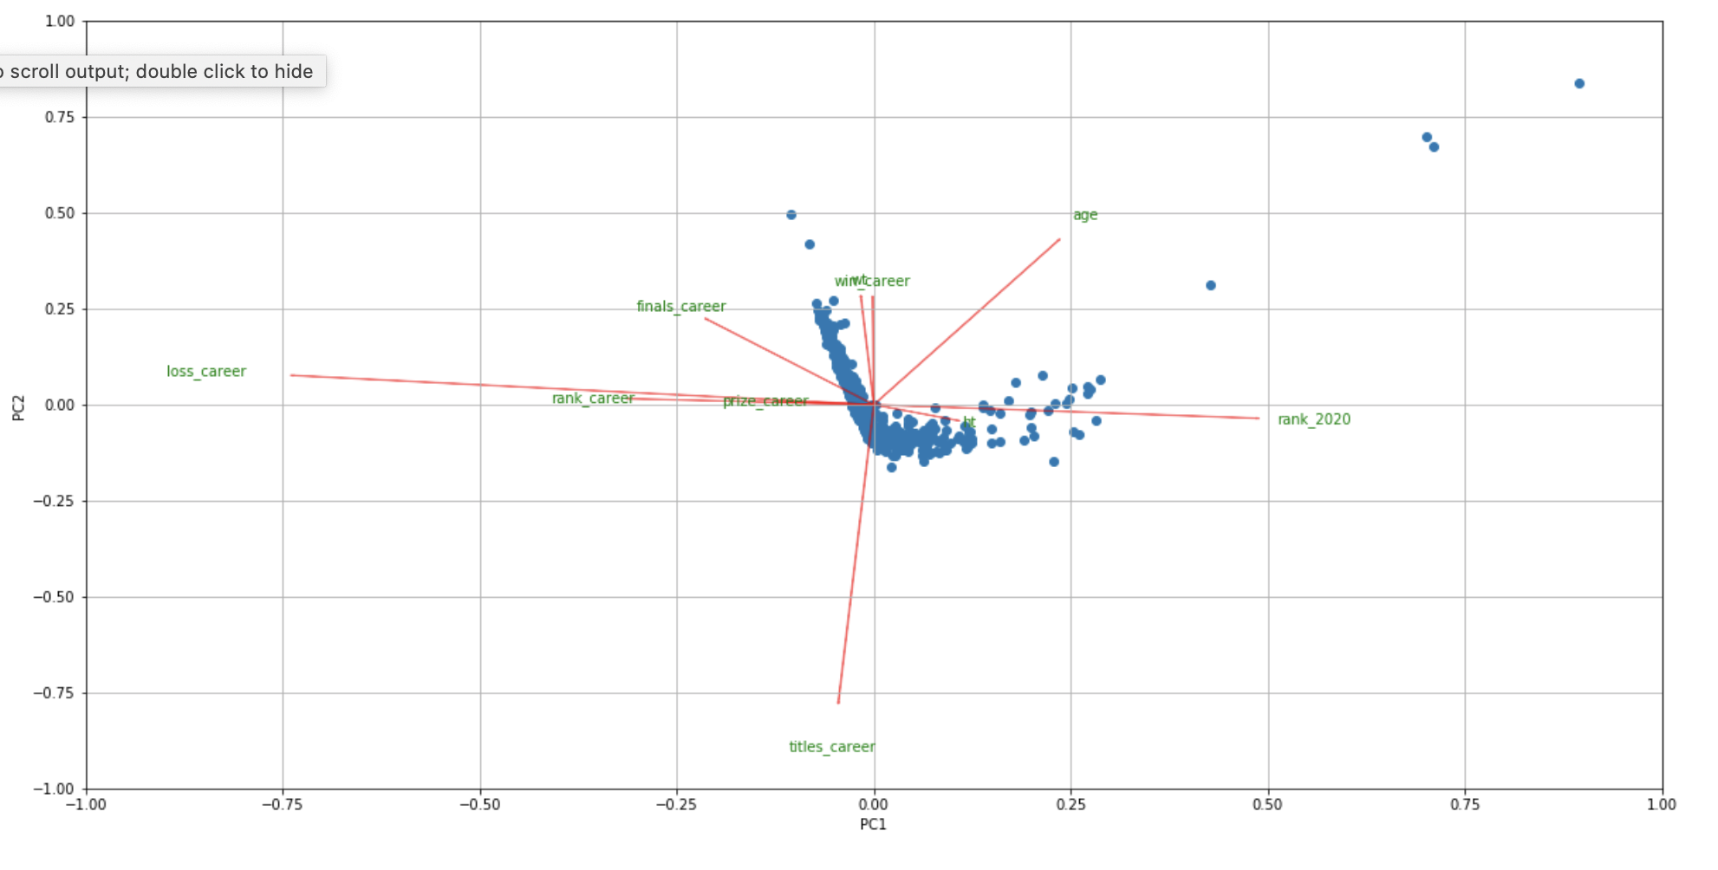
Data exploration: PCA Analysis-biplot

