Slide 1
Uplift Modeling for Care Management Programs
By Ramzi Abujamra, PHD, ASA and Zhen Yen, FSA

Slide 5
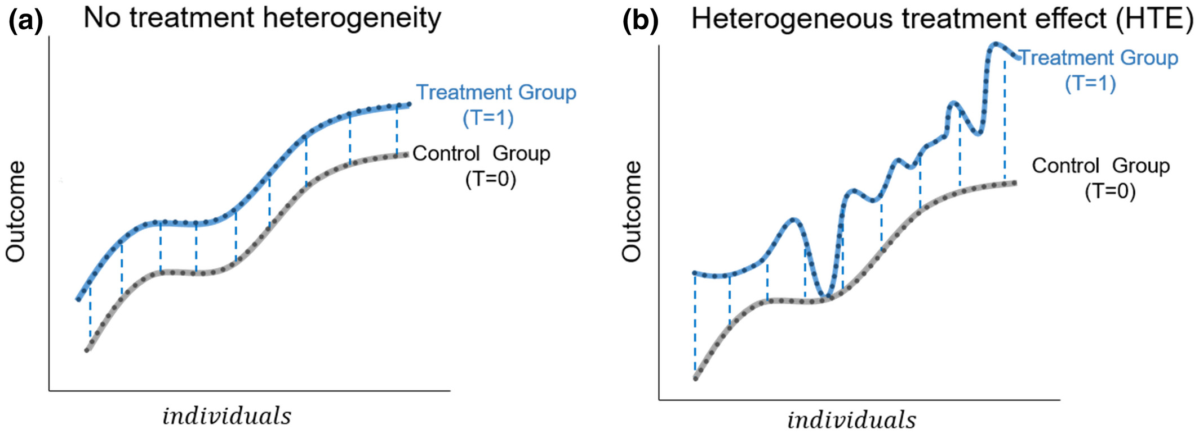
Heterogeneous treatment effect analysis based on machine‐learning methodology
CPT Pharmacom & Syst Pharma, Volume: 10, Issue: 11, Pages: 1433-1443, First published: 30 October 2021, DOI: (10.1002/psp4.12715)
Notes:
(a) Homogenous treatment effect (no treatment heterogeneity): the outcome of the treatment shows variation across the individuals and between treatment groups, but the treatment effect (i.e., the difference of the outcomes depicted by the dotted lines between the two treatment outcome curves) is the same for every individual. (b) Heterogeneous treatment effect (HTE): treatment effect varies among individuals. Some individuals benefit more, some less, and some might not benefit at all from the treatment
IF THIS IMAGE HAS BEEN PROVIDED BY OR IS OWNED BY A THIRD PARTY, AS INDICATED IN THE CAPTION LINE, THEN FURTHER PERMISSION MAY BE NEEDED BEFORE ANY FURTHER USE. PLEASE CONTACT WILEY'S PERMISSIONS DEPARTMENT ON PERMISSIONS@WILEY.COM OR USE THE RIGHTSLINK SERVICE BY CLICKING ON THE 'REQUEST PERMISSIONS' LINK ACCOMPANYING THIS ARTICLE. WILEY OR AUTHOR OWNED IMAGES MAY BE USED FOR NON-COMMERCIAL PURPOSES, SUBJECT TO PROPER CITATION OF THE ARTICLE, AUTHOR, AND PUBLISHER.

Slide 6
