Slide 1


A single Test to rule them all
Page Objects with Selendroid
Michel Racic, GDG Zürich

Slide 2


Slide 3
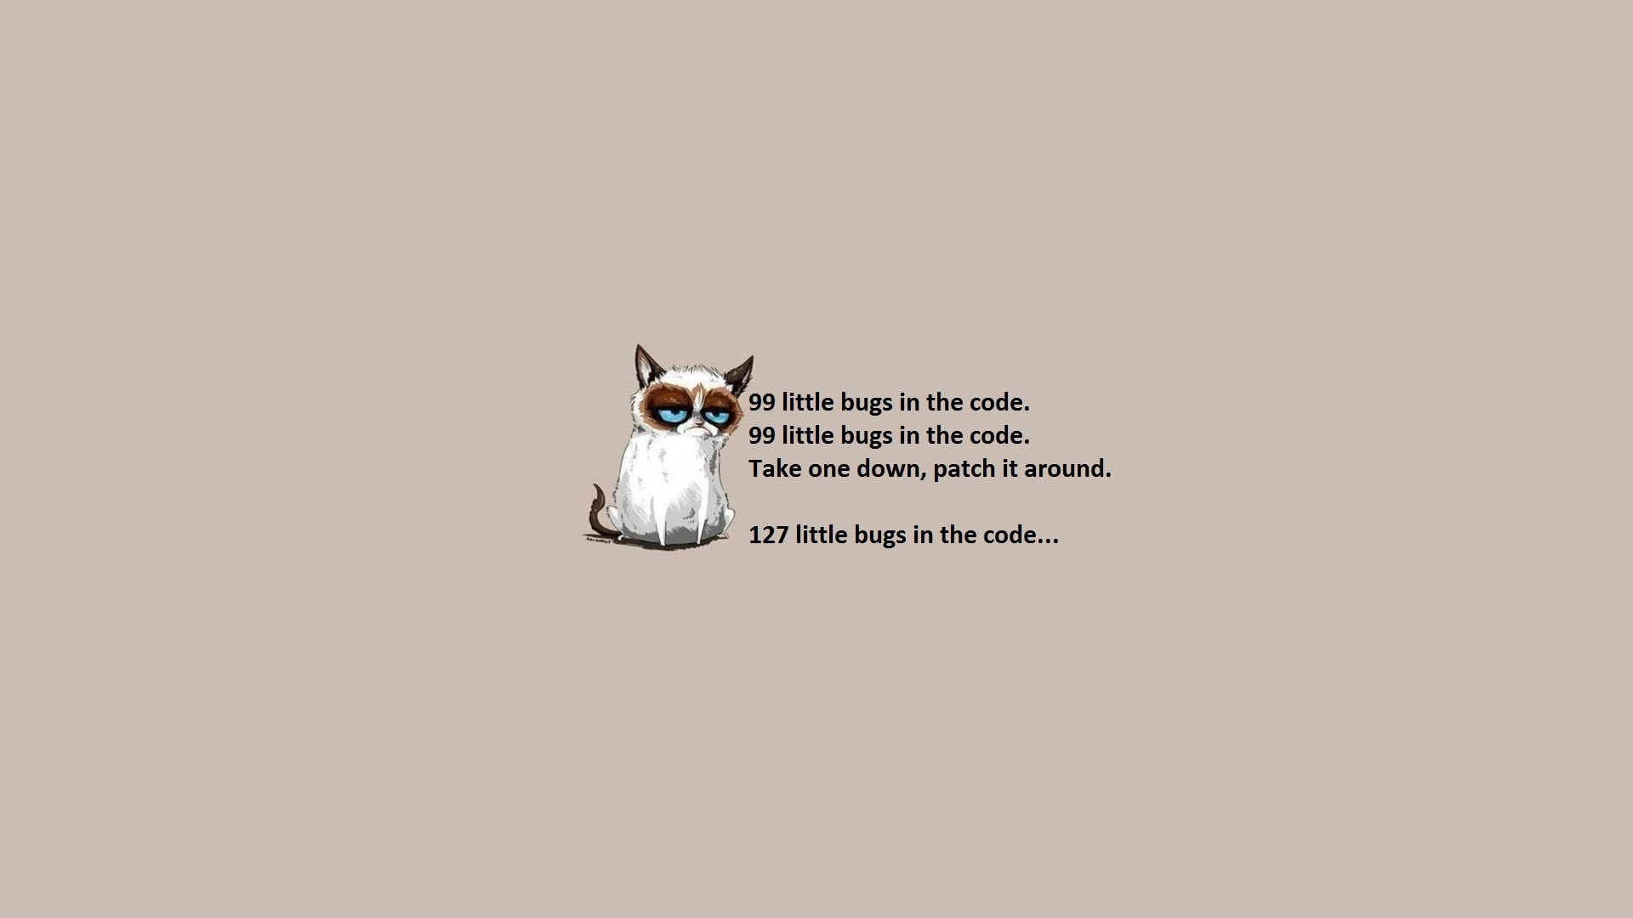
Why automation?
Notes:
Automated testing is not bug finding in the first place but ensuring quality and avoiding regression bugs.
Regression bugs found by customers are a nightmare for your professional image.
Automation won't free you from manual testing but it can help you in reducing the time needed to execute your regression tests which means your precious testing time can be focused on the high risks area which is usually new functionality that you just introduced.

Slide 4

Benefits of a regression suite
Source: baldocomics.com
Notes:
Building a stable regression suite should start at the beginning of the project and you have always to keep in mind that it probably lives much longer than your project. It shall be an artifact of your software which stays until the last customer decommissioned the application under test.
Having strongly tied in a regression suite will help you from staging to user acceptance tests on production near environments.
The key to success is maintainability and the stability over several releases and a continuous execution of the tests, for that it's needed to invest a bit more in the beginning but you will be rewarded in the long run.

Slide 5
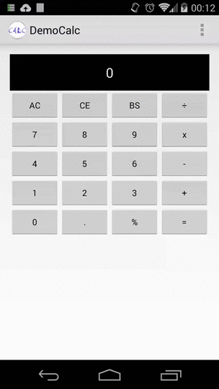
Overworked, sleepless and over the deadline...
The customer plays around after it gets published...
Notes:
You all know the situation when you haven't slept longer than 2 hours d

Slide 6
Overworked, sleepless and over the deadline...
The customer plays around after it gets published...
Notes:
You all know the situation when you haven't slept longer than 2 hours d

Slide 7


Slide 8
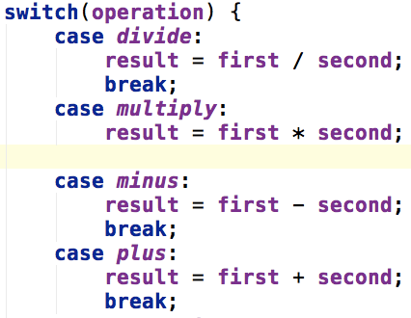
What happened?
Seems Krund Rodec, the intern in that team, did delete a break statement by accident but as everything compiled and no continuous testing was in place...
...it just got published to the play store

Slide 9



selendroid.io
What is
Background image source => marcscott.github.io
Notes:
Selendroid is a Selenium driver which connects your native Android app to the Selenium API, exactly the same as you would test a Web-Application. All you have to do is use another dependency and load a different driver. It comes packed with a handy Native UI to HTML model translator which means you can inspect your elements the same way as you would do with a web application using your browser.
Take a look at the selendroid.io page where you find the documentation and some sample source or look at the demo code I made for this presentation on my github.
Dominik Dary, who initiated this project, and all the other commiter did a great job and feel free to do pull request if you enhance it.

Slide 10
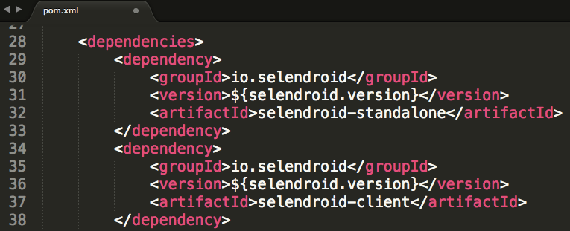
How to use it in your project
Notes:
If your asking yourself of how to get started... nothing easier than that.
Create an empty maven project, define the selendroid dependencies and use the selendroid driver as any other selenium driver.
Either you already have a grid setup for executions, have a standalone selendroid server started or just start and stop the server in your setup/teardown methods.

Slide 11
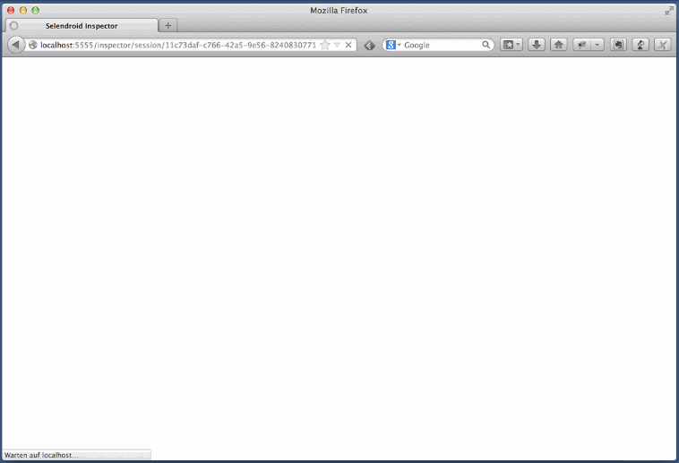
Inspect your objects
Source: selendroid.io

Slide 12
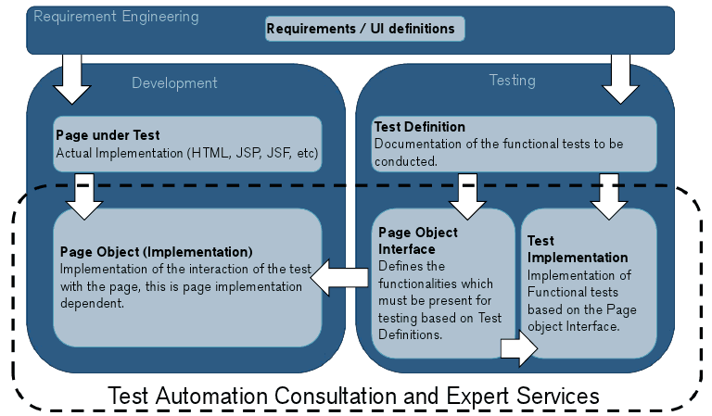
Page Objects

Slide 13
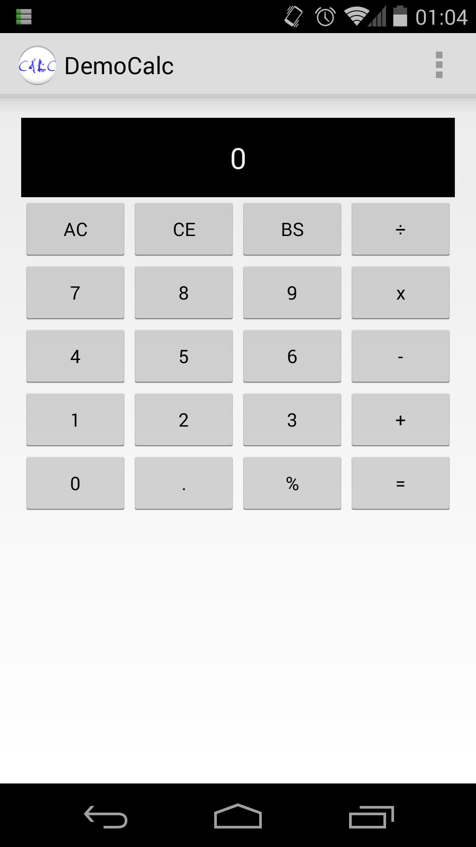
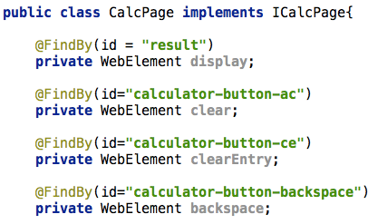
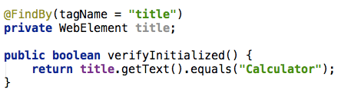
CalcDemo on Android

Slide 14

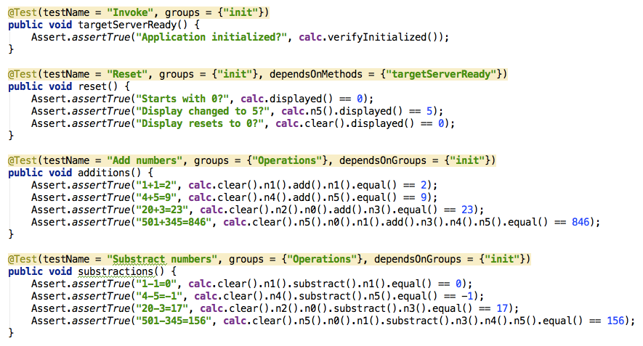
Modifications to test code?
Notes:
No modifications need to be done in the tests itself as the Page Object takes care of its implementation and shares the same contract.

Slide 15

Demo time
The time constraints of this slot don't leave a place for live demo but to those interested I will be around @ Android Developer Days and on sunday @ GDG Istanbul event to show you the code and execution.
All the code is on my github to try for yourself and if demand exists I will organize a live demo over hangout.

Slide 16




You can find the demo source and this presentation on my github
google.com/+MichelRacic
gdgzh.ch
github.com/rac2030
github.com/rac2030/Page-Object-Pattern-and-Selendroid-Talk

