Slide 1
TRPL analyzer (beta)
Rigo
04/17/202

Slide 2
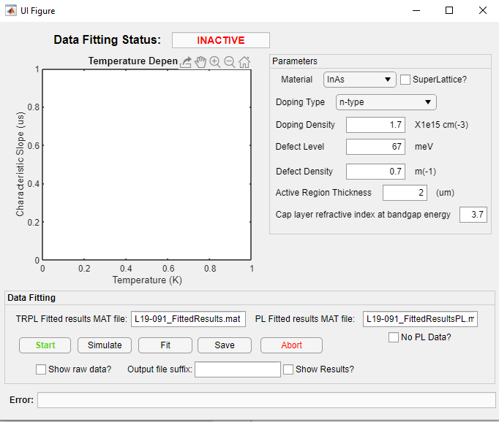
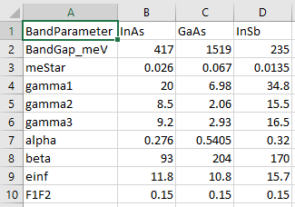
initial interface
Choose your material, band parameters and
inputs are located in “Band Parameters.csv”
Note: there is an alloy “InAsSb”, it uses
the band parameters of InAs for inputs
superlattice checkbox currently does nothing..
Doping Type: n-type or p-type or intrinsic
(most of the time we have unintentional
doping)
Doping density: your carrier concentration (you
could also put 0 to similute intrinsic behavior)
Defect level: location of the defect level, it is
relative to the conduction band.
Defect density:
Active region thickness and cap layer refractive index
inputs are for photon recycling factor

Slide 3
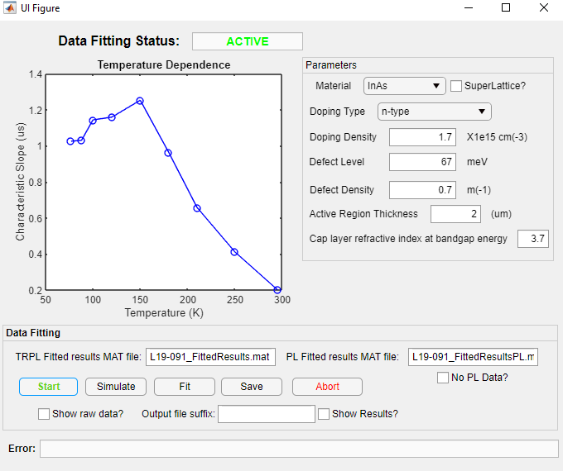
Load data
Click “start” to load both the TRPL results data and the PL results
The “no PL Data?” checkbox won’t load any PL data, but will rather use temperature dependent band gap Varshni equation parameters from the materials data base to calculate the temperature dependent band gap.
The Bottom (“Show raw data?”; “output file suffix”; “show results?”) don’t do anything (I bet you know where I got my template XD)
The “Fit” and “Save” buttons don’t do anything yet either

Slide 4
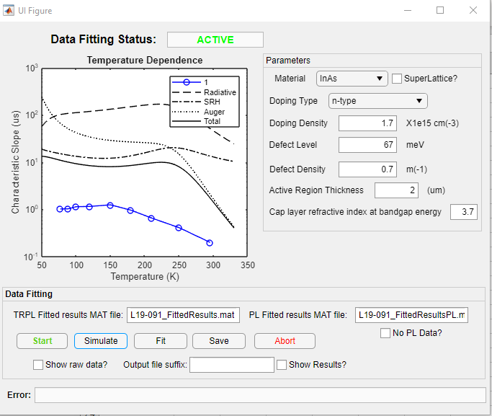
Simulate data
Click on “simulate” to begin the simulation
You can repeat this by changing the numbers and inputs in the parameters checkbox

Slide 5
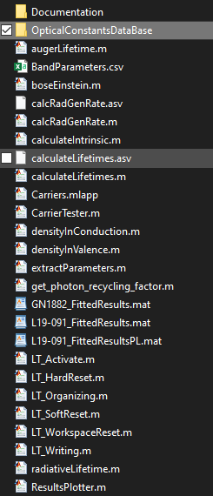
Final remark
The optical constants are located in the “opticalConstantsDataBase” folder. Some files may be formatted differently from each other, so the app is hard coded to load the files then calculate to a convention (energy in wavelength, use n and k)
The files should be excel friendly so you can take a look at the plots yourself

