Slide 1
Fundamentos GIT

Slide 3
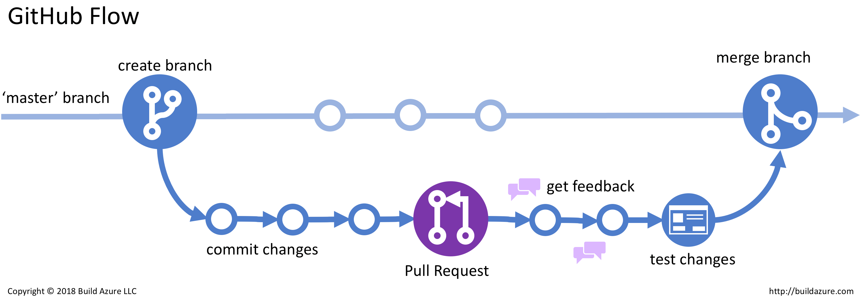


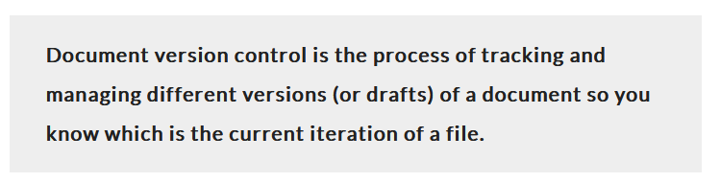

Version Control

Slide 4
Why Do We Need A VCS?
VCSs Track File Changes
Code is organized within a repository.
VCSs Tell Us:
Who made the change?
So you know whom to blame
What has changed (added, removed, moved)?
Changes within a file
Addition, removal, or moving of files/directories
Where is the change applied?
Not just which file, but which version or branch
When was the change made?
Timestamp
Why was the change made?
Commit messages
Basically, the Five W’s

Slide 5
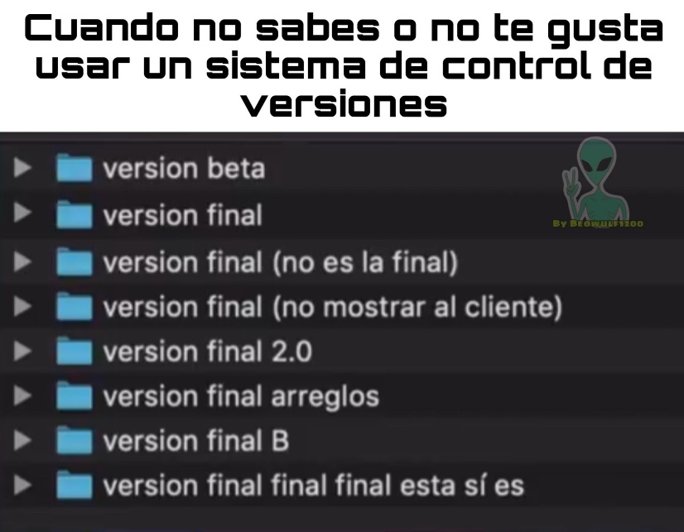
Control Version 0
This is NOT version control!!!

Slide 6
Brief History Of Version Control Software
First Generation – Local Only
SCCS – 1972
Only option for a LONG time
RCS – 1982
For comparison with SCCS, see this 1992 forum link
Second Generation – Centralized
CVS – 1986
Basically a front end for RCS
SVN – 2000
Tried to be a successor to CVS
Perforce – 1995
Proprietary, but very popular for a long time
Second Generation (Cont.)
Team Foundation Server – 2005
Microsoft product, proprietary
Good Visual Studio integration
Third Generation – Decentralized
BitKeeper – 2000
GNU Bazaar – 2005
Canonical/Ubuntu
Mercurial – 2005
Git – 2005
Team Foundation Server – 2013

Slide 7
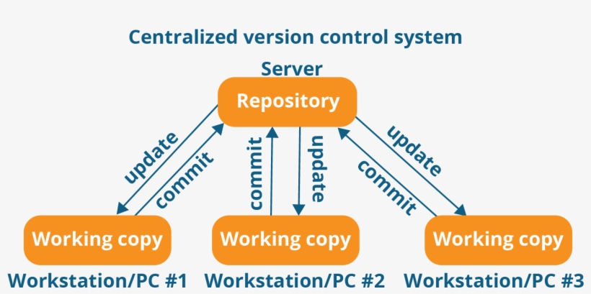
Centralized Version Control CVS
In centralized version control, each user gets his or her own working copy, but there is just one central repository. As soon as you commit, it is possible for your co-workers to update and to see your changes. For others to see your changes, 2 things must happen:
You commit
They update
No connection? Conflict in remote? Multiple branches?

Slide 8
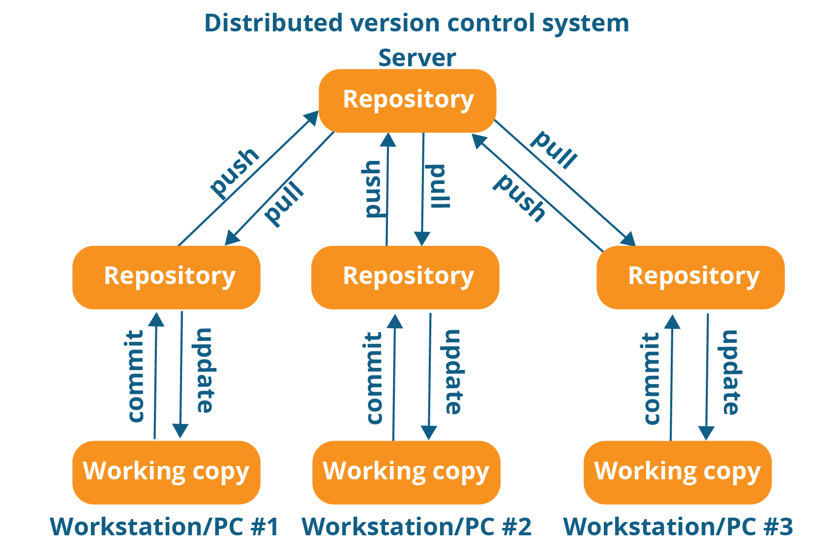
Distributed Version Control CVS
In distributed version control, each user gets his or her own repository and working copy. After you commit, others have no access to your changes until you push your changes to the central repository. When you update, you do not get others' changes unless you have first pulled those changes into your repository. For others to see your changes, 4 things must happen:
You commit
You push
They pull
They update
Notes:
Cundo lo bajamos por primera vez de internet, no se dice pull, se dice clone. (cuando se hace el clon, se hace todo el todo el Workstation.)
Fetch: para saber si hay algo nuevo antes de enviarlo.

Slide 9
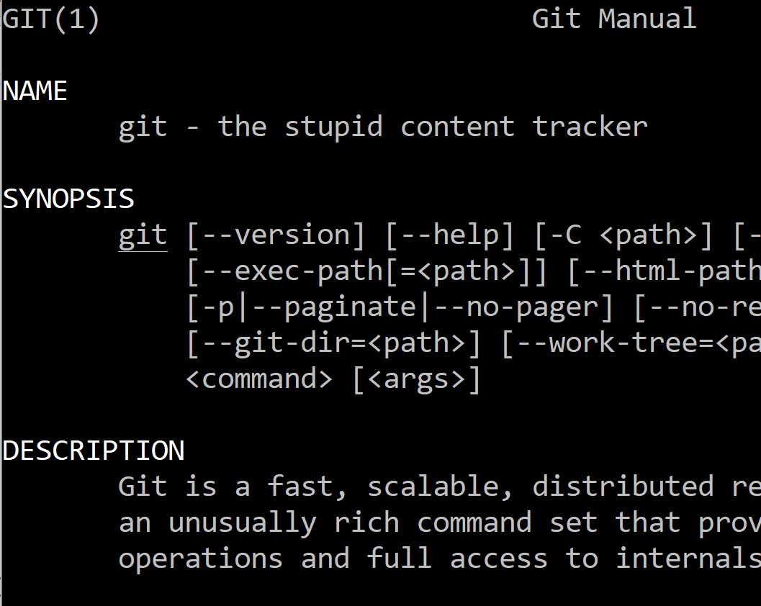
Git – The Stupid Content Tracker
Started by Linus Torvalds – 2005
After the BitKeeper debacle
Efficient for large projects
E.g., Linux
Was an order of magnitude faster than other contemporary solutions
Non-linear development!
Branching is cheap and easy!!!!
Official Site, Wikipedia,
Initial README commit (some profanity)

Slide 10
Terminology
Branch
A history of successive changes to code
A new branch may be created at any time, from any existing commit
May represent versions of code
Version 1.x, 2.x, 3.x, etc.
May Represent small bugfixes/feature development
Branches are cheap
Fast switching
Easy to “merge” into other branches
Easy to create, easy to destroy
See this guide for best practices
Commit
Set of changes to a repository’s files
More on this later
Tag
Represents a single commit
Often human-friendly
Version Numbers
A Repository may be created by:
Cloning an existing one (git clone)
Creating a new one locally (git init)

Slide 11
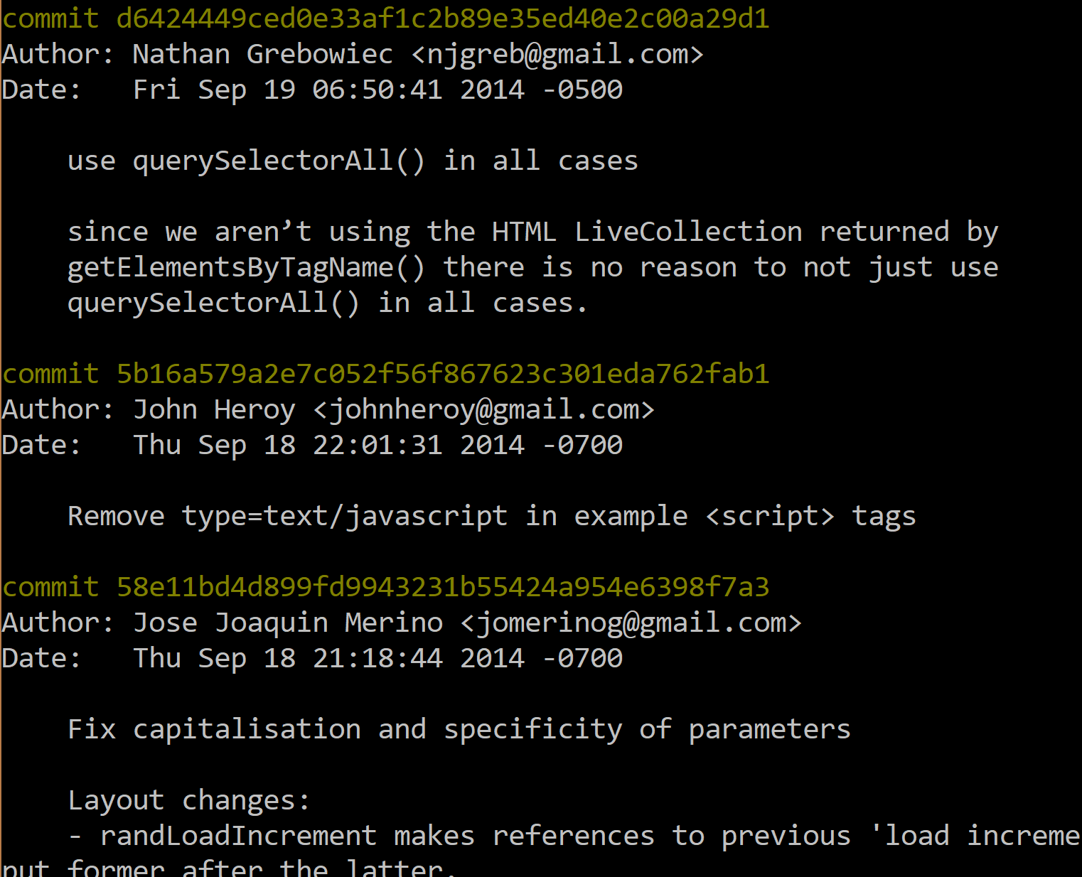
What is a Commit?
Specific snapshot within the development tree
Collection of changes applied to a project’s files
Text changes, File and Directory addition/removal, chmod
Metadata about the change
Identified by a SHA-1 Hash
Can be shortened to approx. 6 characters for CLI use
(e.g., “git show 5b16a5”)
HEAD – most recent commit
ORIG_HEAD – after a merge, the previous HEAD
<commit>~n – the nth commit before <commit>
e.g., 5b16a5~2 or HEAD~5
master@{01-Jan-2018} – last commit on master branch before January 1, 2018

Slide 12
Branches, Commits, and Tags, Oh My!
c4d00a
Add Cool Feature 1
e11bd4
Add Cool Feature 2
9e35ed
Add Cool Feature 3
f1c2b8
Change the API (again)
a2e7c0
Initial Commit
fd9943
Change the API
Master
(branch)
8f645f
Add Stuff
9fd132
Bugfix 1
af1c2b
Bugfix 2
1.x
(branch)
1.0
1.1
619cec
Add Stuff
(tag)
(tag)
2.x
(branch)

Slide 13
Practical Guidelines
Do’s
Make small, incremental commits (within reason) are good. Avoid monolithic commits at all cost.
Use a separate branch for each new bug/feature request.
Write nice commit messages. Otherwise, the commit log is useless.
Use a .gitignore to keep cruft out of your repo.
Search engines are your friend. Someone else has had the same question/mistake/situation as you, and they have already asked the question online. It’s probably on StackOverflow.
Don’ts
Do not commit commented-out debug code.
It’s messy. It’s ugly. It’s unprofessional.
Do not mix your commits. (e.g., Don’t commit two bugfixes at the same time.)
Do not commit sensitive information (passwords, database dumps, etc.)
Do not commit whitespace differences, unless it is specifically needed.
Do not commit large binaries.

Slide 14


Slide 15

Markdown is a lightweight markup language with plain-text-formatting syntax, created in 2004 by John Gruber with Aaron Swartz. Markdown is often used for formatting readme files, for writing messages in online discussion forums, and to create rich text using a plain text editor.
https://www.markdownguide.org/cheat-sheet/
https://stackedit.io/

Slide 16
Exercise
Create a Welcome Page as a cover for your work in the Master
Name
Email
EDEM image and link to master
Master Topics

Slide 17


Slide 18
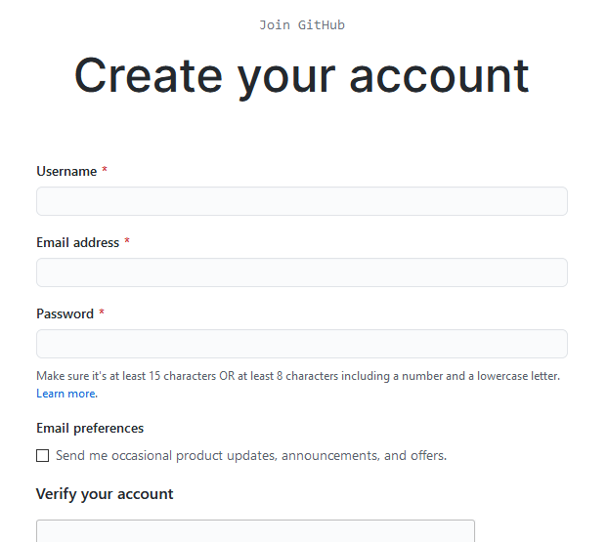
Create your account
Navigate to your profile and spend some time setting your information

Slide 19
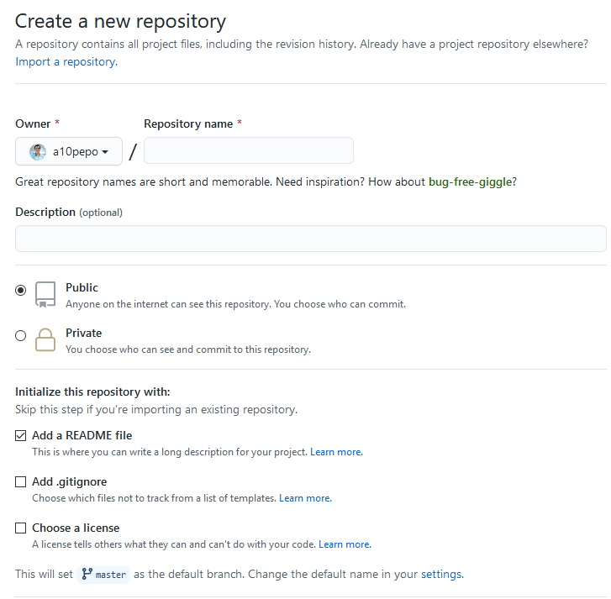
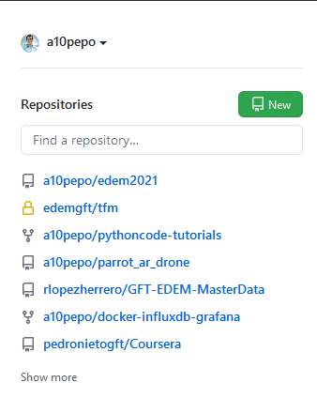
Create your first Repo

Slide 20
Exercise
Edit your README and include the content from previous chapter

Slide 21
Commands

Slide 22
Remote
Local
Working
Stage

Slide 23
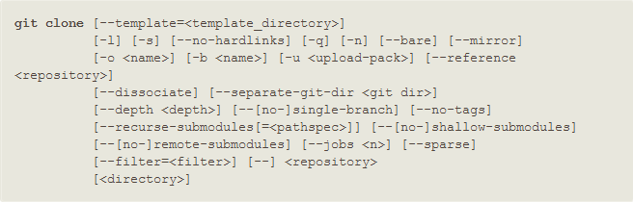
CLONE
Clones a repository into a newly created directory, creates remote-tracking branches for each branch in the cloned repository (visible using git branch --remotes), and creates and checks out an initial branch that is forked from the cloned repository’s currently active branch.
$ git clone git://git.kernel.org/pub/scm/.../linux.git my-Linux
$ git clone https://username@github.com/username/repository.git
Notes:
Crear un posit
Comit y que cada uno tenga su copia

Slide 24
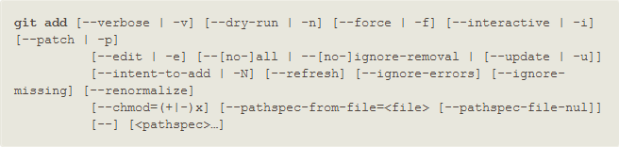
ADD / STATUS
This command updates the index using the current content found in the working tree, to prepare the content staged for the next commit. It typically adds the current content of existing paths as a whole, but with some options it can also be used to add content with only part of the changes made to the working tree files applied, or remove paths that do not exist in the working tree anymore.
The "index" holds a snapshot of the content of the working tree, and it is this snapshot that is taken as the contents of the next commit. Thus after making any changes to the working tree, and before running the commit command, you must use the add command to add any new or modified files to the index.
$ git add *.txt
Notes:
Include in the stage area

Slide 25
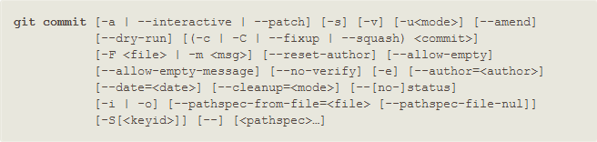
COMMIT
Create a new commit containing the current contents of the index and the given log message describing the changes. The new commit is a direct child of HEAD, usually the tip of the current branch, and the branch is updated to point to it (unless no branch is associated with the working tree, in which case HEAD is "detached" as described in git-checkout
$ git commit –m “Message”
Notes:
Crear un posit
Comit y que cada uno tenga su copia

Slide 26
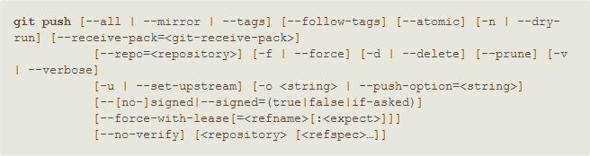
PUSH
Updates remote refs using local refs, while sending objects necessary to complete the given refs.
$ git push
Notes:
Crear un posit
Comit y que cada uno tenga su copia

Slide 27
Exercises
Clone your own repo and include one file named A.txt
Delete A.txt file
Create one folder for Unix and Git session and commit changes
Include in Unix all scripts from previous session an commit

Slide 28
Other Actions

Slide 29

Repeat with me!!!

Slide 30
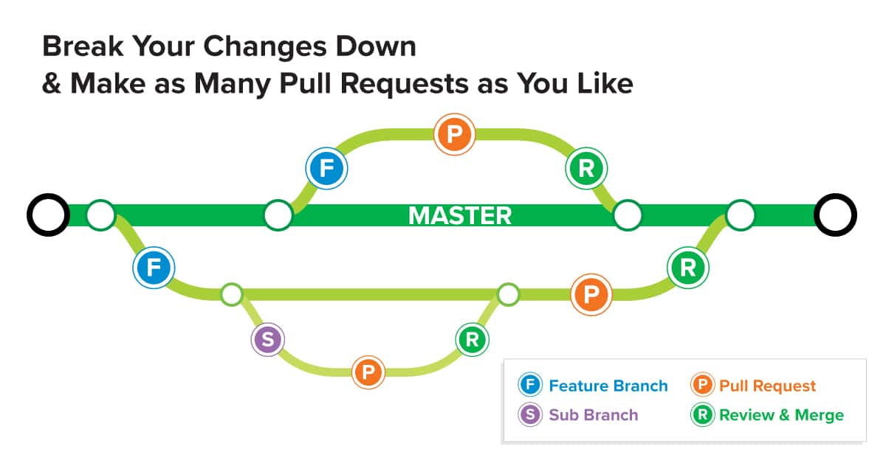
Pull Request
Pull Requests are commonly used by teams and organizations collaborating using the Shared Repository Model, where everyone shares a single repository and topic branches are used to develop features and isolate changes. Many open source projects on Github use pull requests to manage changes from contributors as they are useful in providing a way to notify project maintainers about changes one has made and in initiating code review and general discussion about a set of changes before being merged into the main branch.

Slide 31
Demo
Our first PR

Slide 32
Command line?

Slide 33


Slide 34
Exercises
Clone collaborative repo
Create a folder in alumnos with your name
Include a file in the folder with a txt file
Edit the README file and include your name in the list of Alumnos
Open Scripts folder and copy all scripts to your folder
fix each script and commit each of them in different PR for approval

Slide 35
Subhead
GFT [please insert your GFT entity – see notes] First name Last name Position
Street address 12345 City
T +xx xxxx xxx-xxxx Firstname.Lastname@gft.com
Notes:
GFT Brasil Consultoria Informática Ltda.
GFT Canada Inc.
GFT Costa Rica S.A.
GFT Experts GmbH
GFT Financial Limited
GFT France S.A.S.
GFT Holding Italy S.r.l.
GFT IT Consulting S.L.U.
GFT Italia S.r.l.
GFT México S.A. de C.V.
GFT Poland Sp. z o.o.
GFT Real Estate GmbH
GFT Schweiz AG
GFT Smart Technology Solutions GmbH
GFT Technologies Belgique S.A.
GFT Technologies Canada Inc.
GFT Technologies S.A.U.
GFT Technologies SE
GFT Technologies Toronto Inc.
GFT UK Limited
GFT USA Inc.
GFT Appverse, S.L.U.

