Slide 1
Machine learning ae2
Supervised machine learning In the search for Higgs bosons.
Student 23220004

Slide 2
The machine learning problem
Higgs bosons are produced by smashing particles together, but they decay too fast to be observed directly.
We can observe evidence of the presence of a Higgs boson by looking at data about the particle collision.
Signal events are collisions which theoretically produced a Higgs boson, and background events are collisions which did not.
Classifying an event as signal or background is the binary classification problem attempted here.

Slide 3
Literature review pt. 1
"The Higgs Boson Machine Learning Challenge."
Kaggle challenge created by ATLAS.
Aimed to find successful classifiers for Higgs boson discovery.
AMS as scoring metric.
Deep NNs & ensemble learning, XGBoost, Regularised Greedy Forest.
"Application of Machine Learning Algorithms for Searching BSM Higgs Bosons Decaying to a Pair of Bottom Quarks."
Compares 3 tree-based algorithms and one NN.
Discarded highly correlated features in the dataset.
Found adaptive boosting to be only slightly worse than the NN.

Slide 4
Literature review pt. 2
"Stacking Machine Learning Classifiers to Identify Higgs Bosons at the LHC"
Shows stacked generalisation improves on XGBoost.
Slightly worse performance than Deep NN at a fraction of the cost.
"Higgs Boson Discovery using Machine Learning Methods with PySpark"
Compares LR, DT, RF, GBT.
Mostly to demonstrate successful PySpark implementation.
GBT outperformed the other models.
"Searching for Exotic Particles in High-Energy Physics with Deep Learning."
Compared Deep NN vs shallow NN & BDT.
DNN performed best
DNN performance also stable across high-level and low-level feature datasets.

Slide 5

Research Methodology
Top-down quantitative research methodology.
Models have been selected from the literature- two different types of BDT, XGBoost (Gradient Boosted Tree) and AdaBoost (Adaptive Boosting, using Decision Tree as a base learner).
They will be tested and evaluated on the Higgs Boson Machine Learning Challenge Dataset from ATLAS & CERN.

Slide 6
Implementation Methodology
& Data processing pipeline

Slide 7
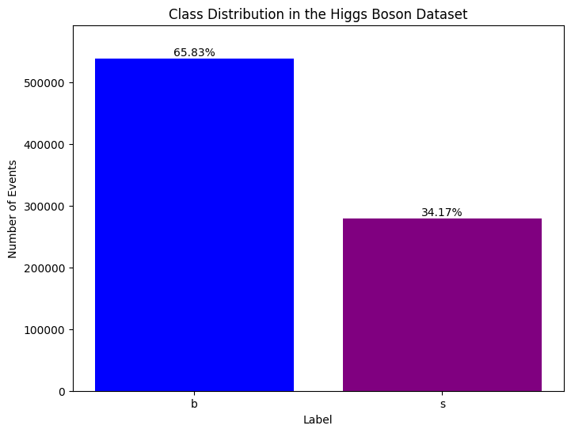
The higgs boson Ml challenge dataset
818,238 events.
279,500 signal, 538,678 background (negative bias).
30 features (13 high-level, 17 low-level).
Missing data represented by "-999".
Quite a lot of missing data due to the jet features.
Skewed features on different scales.

Slide 8
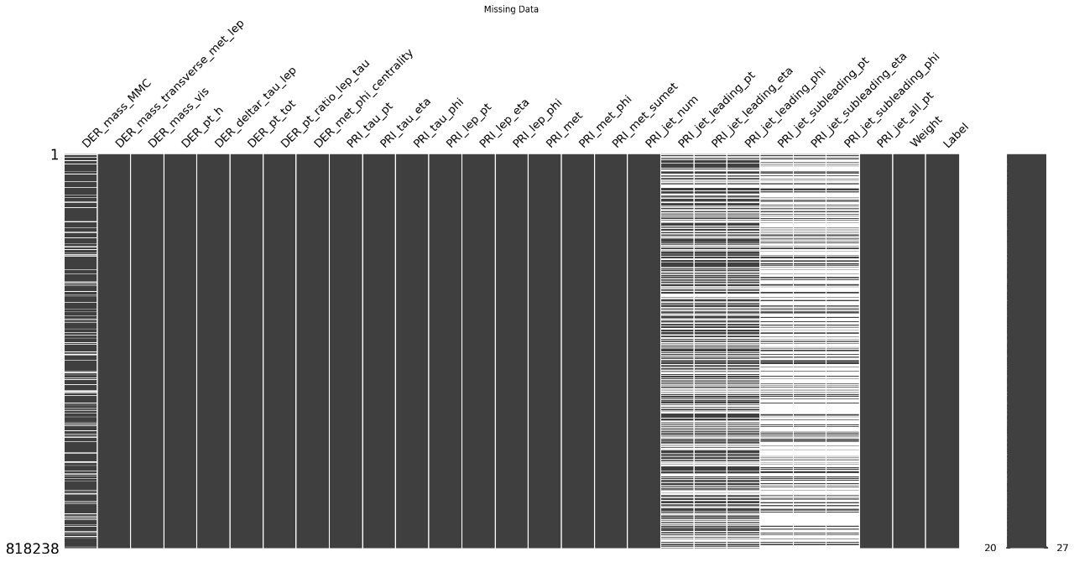
Implementation Methodology
& Data processing pipeline

Slide 9
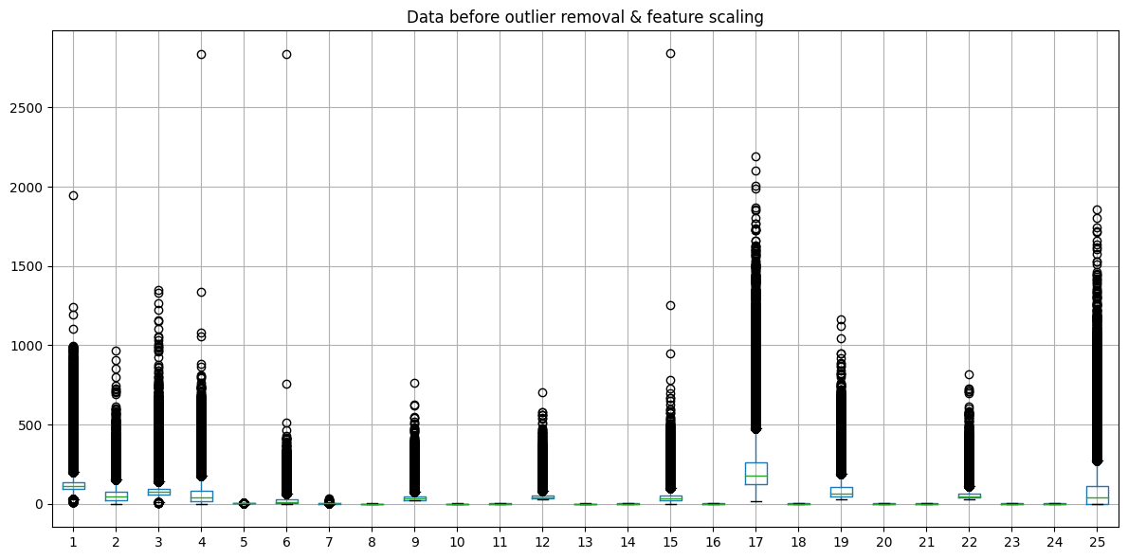
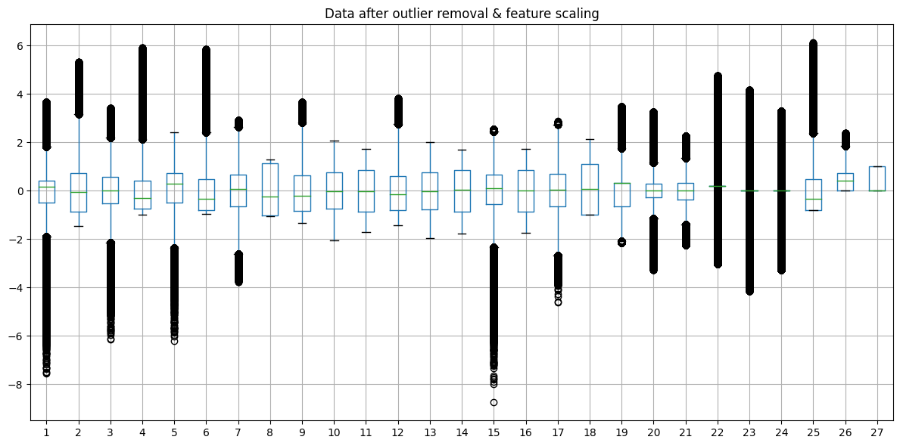
Pipeline
Handle missing values. (skLearn SimpleImputer, mean)
Discard high-level features which have a high correlation ( r > 0.9) with low-level features.
Detect & remove outliers (z_score, threshold=5).
Feature scaling (log transform to reduce skew, then skLearn SimpleScaler).

Slide 10
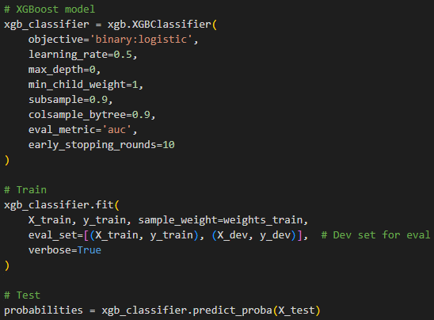
Model 1: xgboost classifier
Gradient boosted decision tree
Tuned using Gridsearch, metric f1 score
Performance was cross-validated using a stratified 4-fold split of the training data & XGBoost's own xgb.cv
Had issues with underfitting at first, so increased model complexity by setting max_depth=0
80% train, 10% dev, 10% test
Things that didn't work:
Stepwise tuning
Optimising for AMS
Letting XGB handle missing values
Using any probability threshold above 0.1

Slide 11
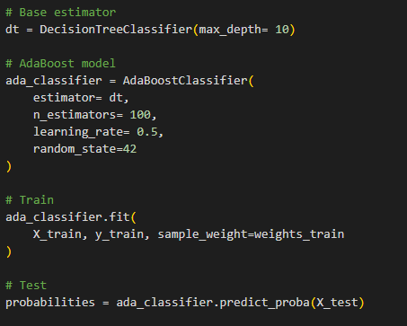
Model 2: adaboost classifier
Adaptive boosting using decision trees as base learners
Tuned partially using Gridsearch, metric f1 score
Performance could not be cross-validated, model too slow
More base estimators increased performance but increased computational cost drastically.
90% train, 10% test
Things that didn't work:
Large parameter grid for GridSearch
Cross-Validation
Increasing base estimators
Using very low or very high probability thresholds

Slide 12
Evaluation &
Results

Slide 13
PERFORMANCE mETRICS
METRIC | XGBoost P > 0.08 | AdaBoost P > 0.45 | BEST
AMS (to 2 d.p) | 1.05 | 0.88 | XGB
Accuracy | 77 | 82 | ADA
Precision (signal) | 0.92 | 0.80 | XGB
Recall (signal) | 0.36 | 0.62 | ADA
F1 Score (signal) | 0.52 | 0.70 | ADA
XGB higher precision & AMS
ADA higher recall, accuracy & F1
XGB good at minimising false positives, whilst ADA better at minimising false negatives.

Slide 14
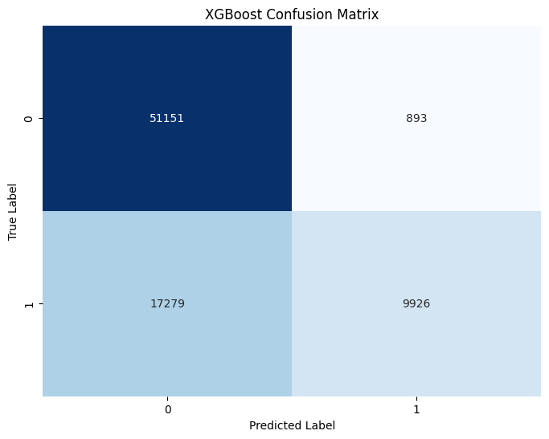
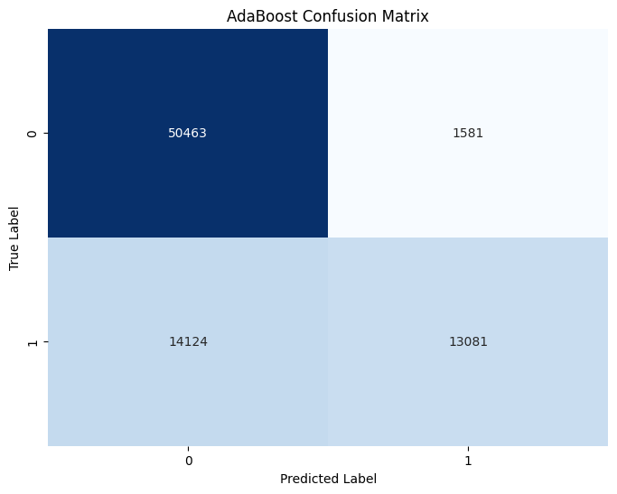
Confusion matrix
False Positives
True Negatives
False Positives
True Negatives
False Negatives
True Positives
False Negatives
True Positives

Slide 15
Suggested Improvements
AdaBoost may benefit from more resources for hyperparameter tuning, tuning for precision, and more estimators/ higher max_depth.
XGBoost may benefit from tuning for recall & a more extensive GridSearch.
Both models may improve with further data processing experimentation in terms of feature selection, feature scaling, and imputation methods.

Slide 16
ethics
Transparency vs. Accuracy
Transparent classification processes could unveil key scientific insights.
Reliance on DNNs may hinder scientific understanding through lack of interpretability.
Accountability in Scientific Breakthroughs:
If an AI makes a major discovery, who do we attribute the discovery to?
Responsible parties must be identified for recognition, but also accountability.
Societal Costs of Advancement:
Rapid AI-driven discoveries may outpace regulatory measures, posing risks to society.
Distrust in AI may lead to distrust in scientific establishments & their major discoveries.

Slide 17
THANK YOU
Student Number 23220004

