Slide 1
SMART Weight Check
Weigh at source. Check every tonne.
An independent scale in the Europress compactor checks every lift and every per-tonne invoice line, and a human approves every proposal.
Notes:
0:00-0:15. Customers pay for waste by the lift and by the tonne, but the only scale they ever see belongs to their operator. SMART Weight Check puts an independent scale in the Europress compactor and checks every lift and every invoice line.

Slide 2
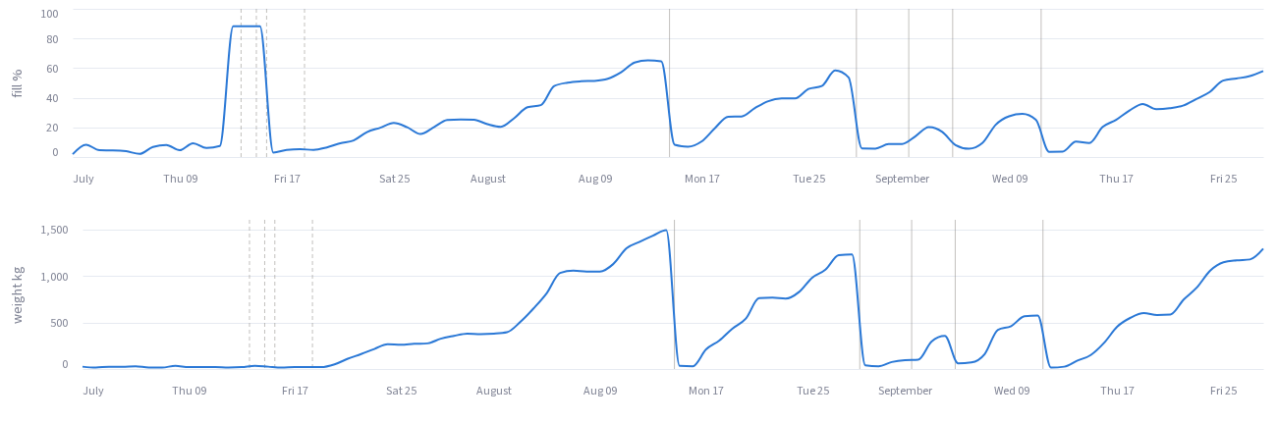
Customers pay per tonne they never see
2.3×
€ per tonne vs the contract benchmark: €258 vs €110 (estimated)
€346
for 4 wasted trips while the fill reading was stuck (observed)
CMP-00046 · cardboard · Lohja · Jul–Sep 2026. Top: fill % · bottom: container weight, kg (simulated). Dashed lines: trips without a lift.
July: the fill reading stuck at 88 % while the scale read ~0 kg. Four trucks came for nothing.
Nobody did anything wrong. Nobody could see it.
6–25 %
fill at three customer-ordered lifts in September (simulated)
Notes:
0:15-0:50. Meet compactor 46, a cardboard press in Lohja. In July its fill reading stuck at 88 % while the container scale read almost nothing: four trucks came for nothing, 346 euros of wasted-trip fees. In September the customer ordered three lifts at 6 to 25 % full. Over the quarter it paid 258 euros per tonne, 2.3 times its contract benchmark. Nobody did anything wrong. Nobody could see it. All of this is synthetic data.

Slide 3



Weigh, check, propose: a human decides
1 · Weigh
2 · Check
3 · Propose
Four load cells under the container. Gross before the lift minus tare after = collected kg. A free zero check on every lift.
Every lift and every per-tonne invoice line against device weight, the operator's ticket and the contract. Combined loads and side waste are explained, not blamed.
Each difference becomes a proposal with a reason and a check before acting. Approve, reject, undo. Nothing executes by itself.
Every number carries its evidence:
observed
read from a record
simulated
SMART device data
estimated
our calculation
hypothetical
an assumption
Notes:
0:50-1:15. Our answer has three steps. Weigh: four load cells under the container. Check: every lift and every per-tonne invoice line against the device weight, the operator's ticket and the contract. Propose: every difference becomes a proposal with a reason and a check, and a human approves it. Nothing runs by itself.

Slide 4
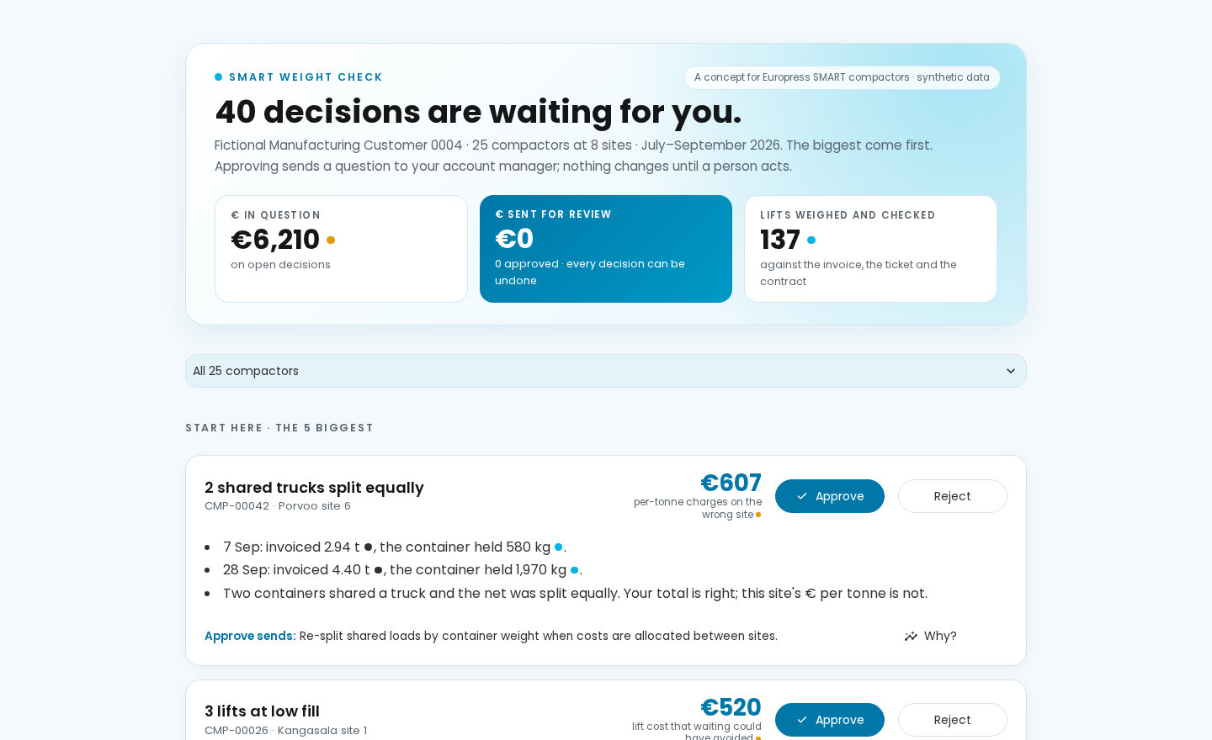
Live demo: every lift checked
Demo path
1
CMP-00046: the stuck fill line vs the flat weight line; 2.3× € per tonne
2
CMP-00042: invoiced 2.94 t, container held 580 kg. A shared truck, split equally: re-split by device weight
3
CMP-00047: no ticket, invoice 425 kg above the scale: ask for the ticket
4
Approve, then undo
341 lifts checked: 205 agree · 38 explained · 4 billing questions · 13 devices: check the scale
Notes:
1:15-2:30. LIVE DEMO: streamlit run app/app.py. 1) CMP-00046 opens: point at the stuck fill line vs the flat weight line, then 2.3x per tonne. 2) Switch to CMP-00042: this site was invoiced 2.94 tonnes for a container that held 580 kg. Two containers shared a truck and the net was split equally. The customer's total is right, but this site's euro per tonne is wrong; the device weight re-splits it. A fact, not blame. 3) CMP-00047: no ticket shared, the invoice says 425 kg more than the container weighed. Proposal: ask for the ticket. 4) Click Approve, then Undo: a human decides, and it can always be undone. If the demo fails, use the backup screenshots in the appendix.

Slide 5
From load cell to customer decision
Weigh frame
SMART device
SMART cloud
Weight Check engine
Customer portal
4 load cells → 4-channel ADC in the SMART cabinet
existing controller and modem; hourly mass + lift events
telemetry_hourly, collection_events: same schema as the dataset
contract cost per lift, weight check, early-lift rules
every proposal flagged “requires human approval”; approve, reject, undo
Customer
contracts and invoices (upload or e-invoice feed)
Operator
weighbridge tickets, when shared
Runs on what SMART already has: the cabinet, the modem, the telemetry pipeline. The weight is the customer's own measurement; it is shared with the operator only with consent.
Notes:
2:30-2:50. It fits SMART as it is: the weighing module sits in the SMART cabinet, uses the existing modem, and its fields map one-to-one onto SMART telemetry and collection events. Proposals leave as an API payload that says: requires human approval.

Slide 6
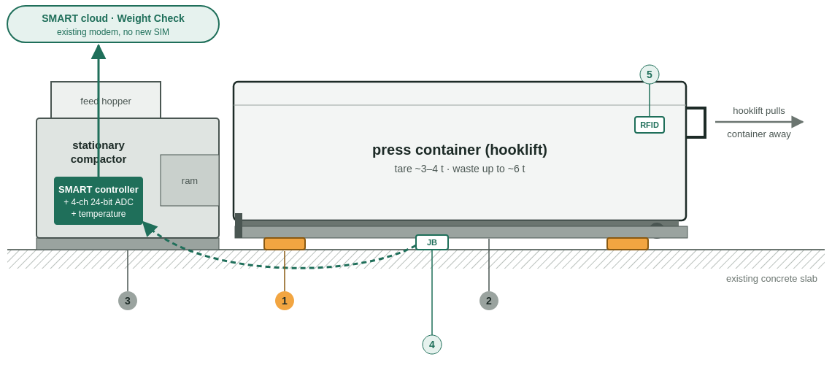
A weigh frame under the container
σ 1.5 %
design target; ~1.0 % accuracy budget (estimate)
€1,200
factory option · €3,400 installed retrofit (hypothetical BOM)
Self-checking
auto-zero every time the container leaves; span checked against the operator's tickets
How one lift is weighed: stable gross reading with the ram idle, minus the tare when the empty container comes back. While the container is away the frame must read zero: a free zero check on every lift. Four separate cells reveal ice or debris under one corner.
Validation
2-week yard test with water tanks → 20-site pilot, 3 months → winter
Notes:
2:50-3:25. The scale: four 10-tonne load cells in low-profile rails under the container. Every time the truck takes the container away, the frame reads zero, a free calibration check on every lift, and each lift is compared with the operator's own ticket to catch drift. Target accuracy 1.5 %. 1,200 euros as a factory option, 3,400 as a retrofit. Validation: a yard test with water tanks, a 20-site pilot, then a winter.

Slide 7
Accuracy decides what weight is worth
≤ 1.75 %
keeps ≥ 95 % of 3 t loads within ±100 kg: the challenge target
> 2.5 %
and checking the operator's tonnage stops working
7 %
best estimate without a scale (ML or rotating kit): a free value scan, not an invoice check
Competition data, 10,342 shared single-load tickets; examples/weighing_accuracy_value.py (estimated)
Notes:
3:25-3:50. Why a real scale? At 1.5 % accuracy, 98 % of 3-tonne loads land within plus or minus 100 kg and 95 % of 10 % overbilling is caught. Above 2.5 % that collapses. We tried estimating weight without a scale: 7 % at best. Good for a trend, so it becomes our free value scan, but not good enough to check an invoice.

Slide 8
€15 per device-month, priced from value
€36
Yearly profit after onboarding, € (hypothetical, 52 synthetic customers)
price / adoption | 10 % | 25 % | 40 %
€10 | 943 | 2,358 | 3,773
€15 | 2,148 | 5,370 | 8,592
€25 | 1,735 | 4,338 | 6,941
median realisable value per device-month (estimated): the customer keeps 2.4× the fee
2.0 years
payback of onboarding at €15 and 25 % adoption (hypothetical)
Price matters most. €15 maximises fee revenue; at €10 small customers cost more to support than they pay (6.5-year payback).
Sell to fleets of 6+ devices
Weigh where it pays
Hypothesis: per-tonne full service
16+ devices: ~€4.0 k profit per customer-year; 2–5 devices lose money at €50 support
factory option pays back in 2.9 years at the median device, retrofit in 8.2
3 % margin ≈ €156 k/year on this sample; needs verified weight and a new role
Notes:
3:50-4:30. Price: 15 euros per device per month. The median customer can realise about 36 euros per device-month, so they keep 2.4 times the fee. Price matters most: at 10 euros it takes six and a half years to earn back the onboarding, at 15 two years. And the scale should go where it pays: the factory option pays back in under three years for half the devices, a retrofit only for the top ones. The big prize, a per-tonne full service with Europress in the middle, needs verified weight first. That's a hypothesis, and we label it that way.

Slide 9
What we have not proven, and next steps
Not proven
Next steps
that customers pay €15 per device-month: no interviews yet
that the savings are real: synthetic world, hypothetical tariffs
that the frame reaches σ 1.5 % on a real compactor in winter
the hardware cost: indicative BOM, no supplier quotes
that operators accept device weight as evidence
1
10 customer interviews: willingness to pay
2
2-week yard test: water-tank steps, hooklift cycles
3
20-site pilot, 3 months, vs weighbridge tickets
Weigh at source. Check every tonne.
Notes:
4:30-5:00. What we have not proven: that customers pay, that the savings are real, and that the frame reaches 1.5 % in a Finnish winter. So the next steps are ten customer interviews, a two-week yard test and a 20-site pilot. Weigh at source, check every tonne. Thank you.

Slide 10
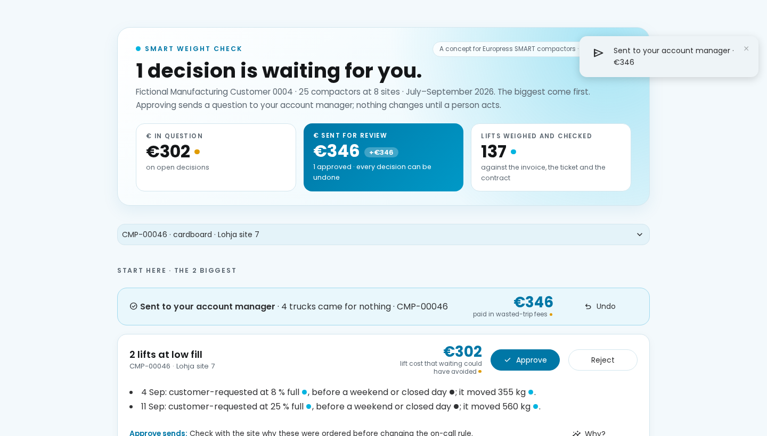
Backup: proposals, a human decides
CMP-00046: proposals with a reason and a check; one approved, with Undo. Weight rules add the early lifts on 4 and 11 September.
Notes:
Backup slide if the live demo fails. All screenshots: notes/screenshots/.

Slide 11
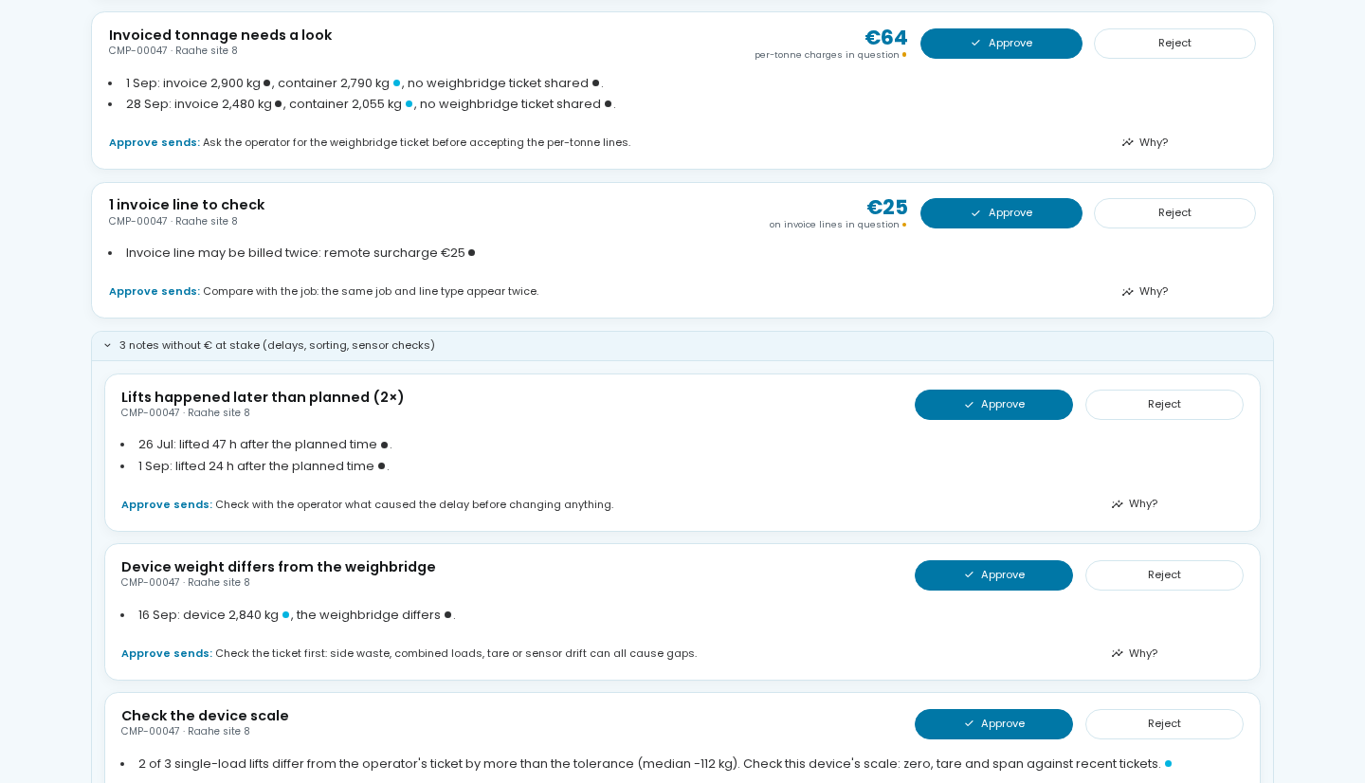
Backup: a lift without a ticket
CMP-00047: two lifts invoiced without a shared ticket differ from the device weight, so the proposal is to ask for the ticket. The scale-check note points at the device, not the operator.
Notes:
Backup slide if the live demo fails. All screenshots: notes/screenshots/.

Slide 12
Run it, sources and licences
Run the demo
python -m venv .venv && source .venv/bin/activate
pip install -e ".[dev,app]"
python baselines/b1_economic_calculator.py data/quickstart/public my_task_a.csv
python baselines/b2_rules_anomaly.py data/quickstart/public my_task_b.csv
streamlit run app/app.py
Where everything is
submission/1_WEIGHING_CONCEPT.md: sensor, BOM, calibration, validation
submission/2_SOFTWARE_DEMO.md: walkthrough, SMART integration
submission/3_BUSINESS_CASE.md: value, pricing, sensitivity, limits
submission/THIRD_PARTY.md: every library, dataset and service, with licence
notes/FINDINGS.md: every number with its source table or script
Data: Europress × Since AI synthetic dataset v1.0.1 (use per the hackathon rules). Code: Python with numpy, pandas, DuckDB, Streamlit, Altair, scikit-learn, matplotlib (BSD, MIT, Apache-2.0 and PSF-style licences, all allow commercial use). AI assistance: Claude (Anthropic) via Claude Code.
Notes:
Reference slide for the jury: how to run, where the documents are, and licences.

