Slide 1

NAME: RACHIT SHARMA
EXPOSYS DATA LABS
DATA SCIENCE
MACHINE LEARNING PROJECT

Slide 2
ABSTRACT
The field of machine learning is introduced at a conceptual level. Ideas such as supervised and unsupervised as well as regression and classification are explained. In this project we were provided with real world dataset. In the given dataset, R&D Spend, Administration Cost and Marketing Spend of 50 Companies are given along with the profit earned. The target was to prepare an ML model to predict the profit value of the company. We were expected to gain experience using a common machine learning library.

Slide 3
2.Table of content
S.No | TOPIC | DOS
1 | Different Regression algorithms Linear regression Logistic regression Ridge algorithm Decision tree | 30-07-2022
2 | Division of data into train set and test set | 30-07-2022
3 | Different regression metrics Mean Absolute Error Mean Squared Error Root squared value | 30-07-2022

Slide 4
3.Introduction
In this project we were provided with real world dataset. In the given dataset, R&D Spend, Administration Cost and Marketing Spend of 50 Companies are given along with the profit earned. The target was to prepare an ML model to predict the profit value of the company. The language used to perform the said task is python.

Slide 5
3.1 About python
Python facilitates developers to increase the confidence and productivity about their developing software from development to deployment and maintenance. The benefits of making Python the perfect solution for machine learning and AI-driven projects include simplicity and consistency, flexibility, access to powerful AI and machine learning (ML) libraries and frameworks, platform independence, and large communities. These things increase the popularity of the language.
We have performed various regression algorithms and predicted the required data and represented graphically using the matplotlib library in python.

Slide 6
Regression Algorithms tested
Linear regression: Linear regression is a statistical method for modeling relationships between a dependent variable with a given set of independent variables.
Logistic regression: The logistic regression statistic modeling technique is used when we have a binary outcome variable.
The function for logistic regression:
Sig(x)=1/1+e^x
E is log base
X is the numerical value that needs to be transformed.
Ridge: Ridge Regression is an extension of linear regression that adds a regularization penalty to the loss function during training.
Decision tree: Decision Tree is one of the most powerful and popular algorithm. Decision tree algorithm falls under the category of supervised learning algorithms. It works for both continuous as well as categorical output variables.

Slide 7
3.2 Different python packages used:
Sklearn:
In python, sklearn is a machine learning package which include a lot of ML algorithms.
Here, we are using some of its modules like train_test_split, DecisionTreeClassifier and accuracy_score.
NumPy :
It is a numeric python module which provides fast maths functions for calculations.
It is used to read data in numpy arrays and for manipulation purpose.
Pandas :
Used to read and write different files.
Data manipulation can be done easily with dataframes.

Slide 8
4.Existing Method:
Multi linear regression: For complex relation and connections between the data we used multi linear regression by which we can easily determine the relation between two independent variables using the dependent variables.
There are two main uses for multiple regression analysis. The first is to determine the dependent variable based on multiple independent variables.
For example if we want to calculate the profit of a firm or a company we need to build a relation between the investment and the output.

Slide 9
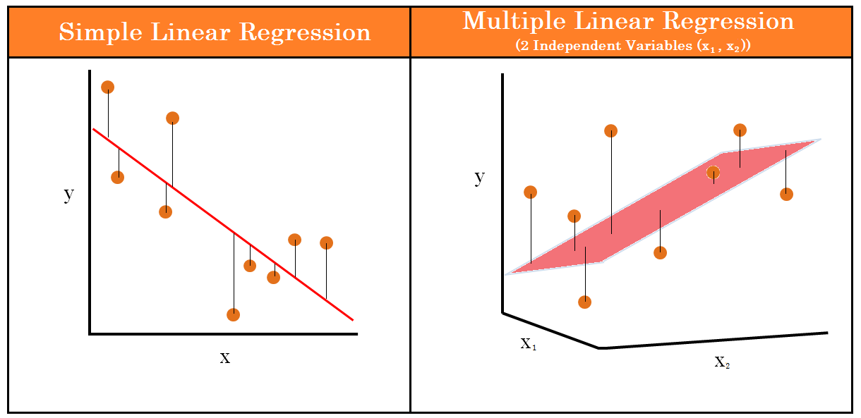
4.1Difference between Linear regression and Multiple linear regression
The major difference between linear regression and multiple linear regression is that in linear regression there is only one independent variable while when we check out, Multiple linear regression there is more than one independent variable.
Linear regression: When we want to predict the height of one particular person just from the weight of that person.
Multiple Linear regression: If we alter the above problem statement just a little bit like, if we have the features like height, age, and gender of the person and we have to predict the weight of the person then we have to use the concept of multiple linear regression.

Slide 10
5.Methodology
Multiple regression is a machine learning algorithm to predict a dependent variable with two or more predictors.
Multiple regression has numerous real-world applications in three problem domains: examining relationships between variables, making numerical predictions and time series forecasting.
If you have everything ready for model building, its implementation can be as simple as 4 easy steps as demonstrated in the “Fire Drill”. However, real hard work is wrangling with data and finding the right model through an iterative process.
Multiple regression is used to determine the relation between several random variables MLR tells how multiple independent variables are dependent on one single dependent variable.
Once we figure out the independent factors to predict the dependent variable, the information on the multiple variables can be used to create accurate prediction on the level of effect of they have on the outcome variable.

Slide 11
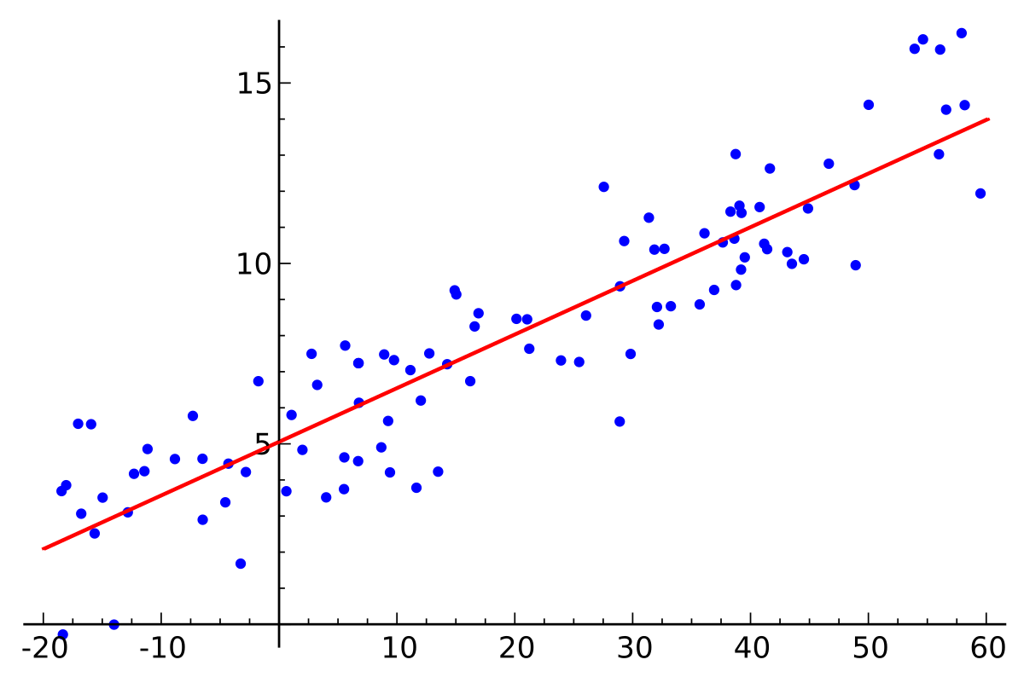
6.Implementation:
Multiple Linear Regression attempts to model the relationship between two or more features and a response by fitting a linear equation to observed data.
Y = b0 + b1 * x1 + b2 * x2 + b3 * x3 + …… bn * xn
Y = Dependent variable and x1, x2, x3, …… xn = multiple independent variables.

Slide 12
6.1Assumption of Regression model:
Linearity: The relationship between dependent and independent variables should be linear.
Homoscedasticity: Constant variance of the errors should be maintained.
Multivariate normality: Multiple Regression assumes that the residuals are normally distributed.
Lack of Multicollinearity: It is assumed that there is little or no multicollinearity in the data.

Slide 13
6.2 Dummy variable:
In Multiple Regression Model we use a lot of categorical data. Using Categorical Data is a good method to include non-numeric data into the respective Regression Model. Categorical Data refers to data values that represent categories-data values with the fixed and unordered number of values, for instance, gender. In the regression model, these values can be represented by Dummy Variables.
These variables consist of values such as 0 or 1 representing the presence and absence of categorical values.
Method of Building Model:
•All-in
•Backward-Elimination
•Forward Selection
•Bidirectional Elimination
•Score Comparison

Slide 14
6.3Steps Involved in Multiple Linear Regression Model
Step 1: Data Pre-Processing
Importing The Libraries.
Importing the Data Set.
Encoding the Categorical Data.
Avoiding the Dummy Variable Trap.
Splitting the Data set into Training Set and Test Set.
Step 2: Fitting Multiple Linear Regression to the Training set
Step 3: Predicting the Test set results.

Slide 15
7.Conclusion:
The best machine learning model for the given dataset is by using the multiple linear regression algorithm. Linear regression performs exceptionally well for linearly separable data it is easier to implement, interpret and efficient to train it handles overfitting pretty well using dimensionally reduction techniques, regularization, and cross-validation. Although using linear regression is not the best fitted model so we use multiple linear regression as Linear regression algorithm only has one independent variable impacting the slope of the relationship, multiple regression incorporates multiple independent variables. Each independent variable in multiple regression has its own coefficient to ensure each variable is weighted appropriately.
So, the mean absolute error is 3182.9153333333347 . Therefore our predicted value can be 3182.9153333333347 units more or less than the actual value.

