Slide 1
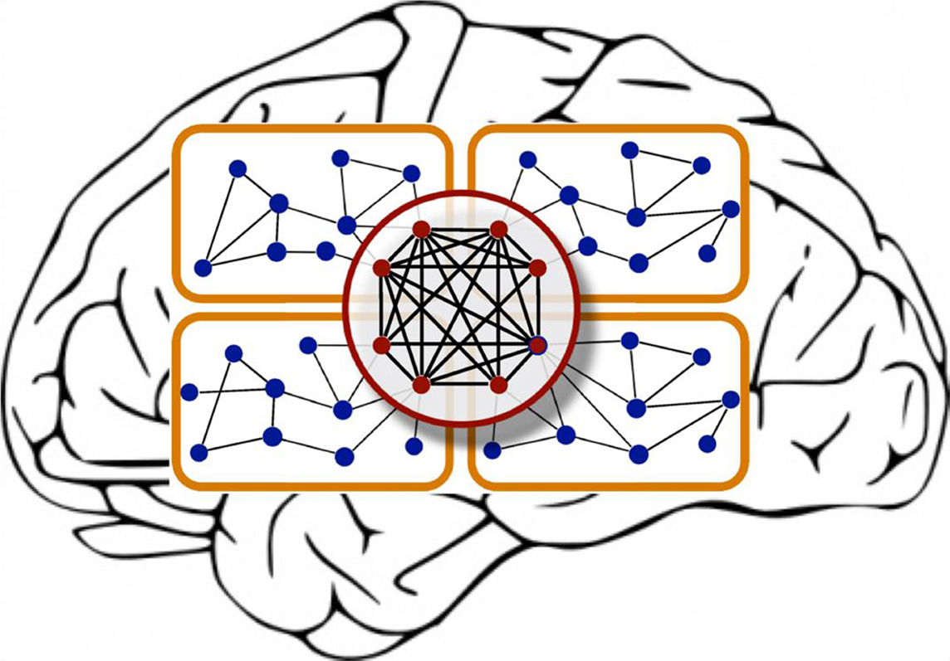
Computational Models of Cognition
Week 9: Neural Networks

Slide 2
Outline
Logistics
Problem Set 2 grades are out
Problem Set 4 due next Friday
Review
Hebbian Learning
Error-Driven learning
Recurrent networks

Slide 3
Questions/Concerns?

Slide 4
Spaces, Features, and Neural Nets
Neural nets compute distributed representations of inputs, providing an alternative to discrete symbolic approaches
y₂
y₁
y₂
Output space
y₁
W
x₂
x₁
x₂
x₁
Input space

Slide 5
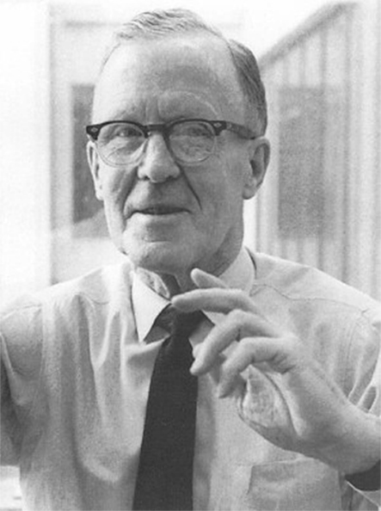
Hebbian Learning
“Neurons that Fire Together, Wire Together”
where w_{ij} is the weight from node i to node j
a_{i} is the activation of node i
Donald Hebb

Slide 6
Hebbian Learning
Hebb’s Rule in English:
We should adjust the weight between two neurons in proportion to the amount that their activations are correlated.
Captures the notion of associative learning
w ← w + y^{k}x^{k}

Slide 7
Limitations to Hebbian Learning
Hebbian learning is unsupervised:
Only learns about correlations between inputs and outputs
Learned weights correspond to principal components of the input data
What if instead we want to model a situation in which a learner produces a specific output in response to an input?

Slide 8
Error-Driven Learning
Big idea: We can “train” a network to learn specific mappings between inputs and outputs by adjusting its weights in proportion to their contribution to the error on the current trial
Two Approaches:
Delta Rule (no hidden layers)
Backpropagation (hidden layers!)

Slide 9
Error-Driven learning
Preliminaries
Training set
Input vector -> operations -> output vector
The key is finding the right set of weights
Cost function / Error function
Notes:
It’s often convenient to have some metric of how good or bad we’re doing

Slide 10
Error-Driven Learning: Delta Rule
Output
y
x₁
x₂
Input Features
output
error
influence
of input

Slide 11
Gradient descent
E (error)
(η is learning rate)
w_{ij}
Simple algorithm for finding a minimum:
Move in a direction where E decreases
Stop if no such direction exists
Notes:
Every time we want to update our weights, we subtract the derivative of the cost function w.r.t. the weight itself, scaled by a learning rate , and — that’s it! You’ll see that as it gets closer and closer to the center, the derivative term gets smaller and smaller, converging to zero as it approaches the solution.

Slide 12
Delta Rule & Linear Separability
The Delta Rule corresponds to finding a linear decision boundary between different classes in the input space.
?
AND
OR
XOR
x₂
x₂
x₂
x₁
x₁
x₁

Slide 13
Introducing Hidden Layers
y
Output
Output
y
z₁
z₂
Hidden Features
x₁
x₂
x₁
x₂
Input Features
Input Features
Learning Rule:
Delta Rule
Learning Rule:
Backprop

Slide 14
Nonlinear Separability Using Hidden Layers
Output Features
y
y
z₂
Hidden Features
z₁
z₂
z₁
x₂
Input Features
x₁
x₂
x₁

Slide 15
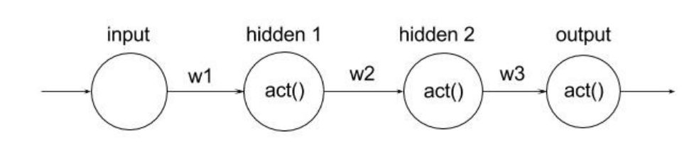
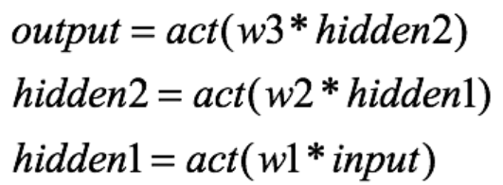
Backpropagation algorithm
Each neuron is a function of the previous one connected to it
Notes:
Consider a single layered shallow network which serves as a good toy example.
If one were to change the value of w1, both “hidden 1” and“hidden 2” (and ultimately the output) neurons would change

Slide 16
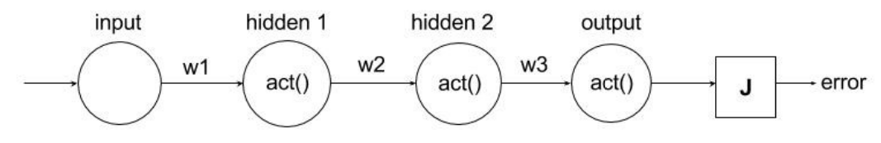
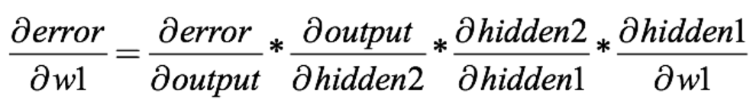
Backpropagation algorithm
Notes:
Now if we attach an error term to this network like before, and want to find the best weights w1 to miminize error, we simply do derivation as before and apply chain rule

Slide 17
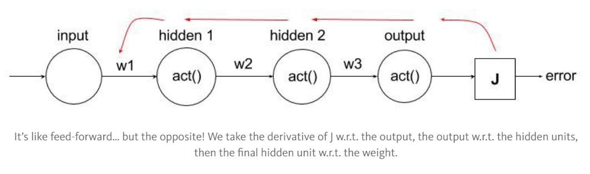
Backpropagation algorithm
Notes:
We call it “backpropagation” because it almost seems as if we are traversing from the output error to the weights, taking iterative steps using chain the rule until we “reach” our weight.

Slide 18
Learning In Multi-Layer Networks
For a two-layer net, we can describe the error associated with an input unit i as:
where
…and apply the chain rule to calculate the gradient with respect to w_{ij}

Slide 19
Error Driven Learning: Backpropagation
Corresponds to doing the Delta Rule with an error term:
Viewed this way, the backprop learning algorithm is simply

Slide 20
Advantages to Backpropagation
With backprop, we can now perform supervised learning in cases where the decision boundaries between classes are non-linear.
A candidate for a domain-general learning mechanism?

Slide 21
Sequence Learning in Neural Networks
Output Features
x₁
x₂
Corresponds to a Markov chain where we are predicting the next state given the current state.
Hidden Features
z₁
z₂
What if we want to model sequences with longer-term dependencies?
Input Features
x₁
x₂

Slide 22
Sequence learning
A glaring limitation of Vanilla Neural is that their API is too constrained: they accept a fixed-sized vector as input (e.g. an image) and produce a fixed-sized vector as output (e.g. probabilities of different classes). Not only that: These models perform this mapping using a fixed amount of computational steps (e.g. the number of layers in the model). The core reason that recurrent nets are more exciting is that they allow us to operate over sequences of vectors

Slide 23
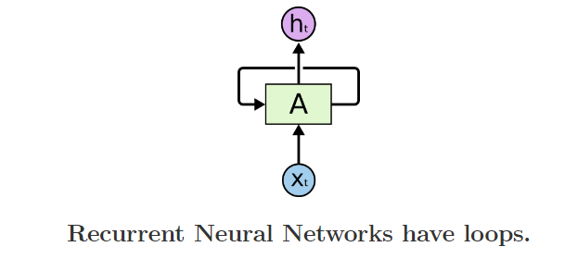
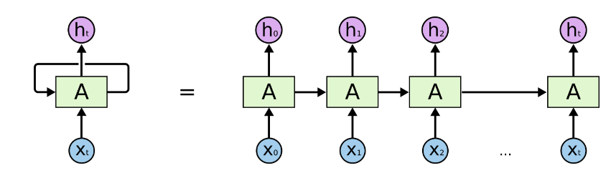
Recurrent Neural Networks

Slide 24
Recurrent Neural Networks
Output Features
x₁
x₂
copy
Hidden Features
z₁
z₂
context units
input
Input Features
x₁
x₂
(Elman, 1990)

Slide 25
Capturing Long-Range Dependencies with RNNs
Predict x_{n+1} from x₁ … x_{n}

Slide 26
PCA
PCA demo: http://setosa.io/ev/principal-component-analysis/

Slide 27
Next Week
I will be available to answer questions about ps4

