Slide 1
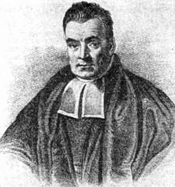
Computational Models of Cognition

Slide 2
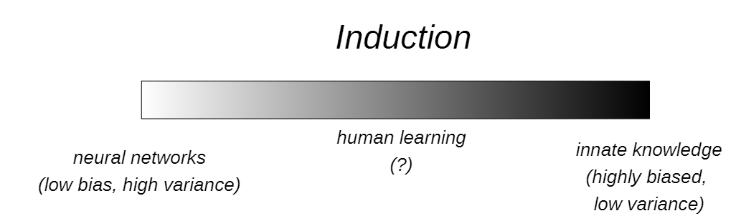
Notes:
Motivation+bias variance

Slide 3
Quick Reference
Sample Space – The set of all possible outcomes of an experiment
Random Variable – A function that maps points in our sample space to the real numbers
Event – A subset of the sample points in a sample space
Probability – We’ll get back to you on that…

Slide 4
C
A
B
D
E
The black rectangle is our sample space
Partitions A, B, C, D, and E are events
A random variable maps points in our sample space to real numbers

Slide 5
But what is probability?
Frequentist interpretation
Probabilities reflect the long-run relative frequencies of the outcomes of experiments
Single event probabilities are meaningless
Subjectivist interpretation
Probabilities reflect degrees of belief
Single event probabilities are okay
For further info, see: https://en.wikipedia.org/wiki/Probability_interpretations

Slide 6
Axioms of Probability Theory
All probability values are constrained to fall between 0 and 1

Slide 7
Axioms of Probability Theory
All probabilities fall between 0 and 1
The total probability of all atomic events in a sample space must sum to 1

Slide 8
Axioms of Probability Theory
All probabilities fall between 0 and 1
The probability of all atomic events in a sample space must be 1
If events A and B are mutually exclusive, the union of A and B has probability P(A) + P(B)
Two events are mutually exclusive if they have no atomic events in common
Notes:
Give analogy with atom in atomic events – single event

Slide 9
Mutually Exclusive Events
C
A
B
D
E
A, B, C, D = Mutually Exclusive Events
P(A v B v C v D) = 1
Sample Space

Slide 10
Non-Mutually Exclusive Events
A
A ∧ B
B
A and B are NOT mutually exclusive
P(A v B) ≠ P(A) + P(B)
Sample Space

Slide 11
Conditional Probability
The conditional probability of an event A given another event B is given by
P(A|B) = P(AB)/P(B)
Corrollaries:
Joint Probability: P(AB) = P(A|B)P(B)
Chain Rule: P(ABC) = P(A|BC)P(B|C)P(C)

Slide 12
(In)dependence
Two events, A and B are independent IFF their joint probability is given by
P(AB) = P(A)P(B)
Otherwise, the two events are said to be dependent. Their joint probability is then given by
P(AB) = P(A|B)P(B) = P(B|A)P(A)
** Why are these equivalent?

Slide 13
Deriving Bayes’ Rule
Write down the definition of joint probability
Isolate P(B|A)
Optional: Rewrite P(A) as marginalization over B’
1.
2.
3.

Slide 14
Bayes’ Rule
Bayes’ rule tells us how to combine our prior knowledge about a process with some new observations to determine how probable a particular hypothesis is.
Likelihood
Prior
probability
Posterior
probability
Sum over space
of hypotheses

Slide 15
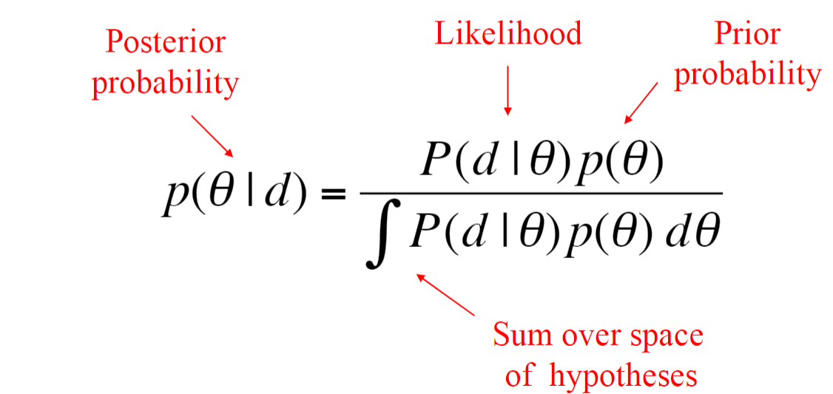
Continuous version of Bayes
Notes:
Give the rational behind need for it.
And explain via uniform distribution example.

Slide 16
Bayesian view of learning
Surprise candy comes in 2 flavors: cherry ☺ and lime ☹
h₁: 100% cherry
h₂ 75% cherry + 25% lime
h₃ 50% cherry+ 50% lime
h₄ 25% cherry + 75% lime
h₅ 100%lime
Prior prob over h1,..h5 <0.1, 0.2, 0.4, 0.2, 0.1>

Slide 17
Bayesian view of learning
Suppose bag is all lime bag (h₅) and the first 10 candies are all lime
P(d|h₃) = 0.5¹⁰

Slide 18
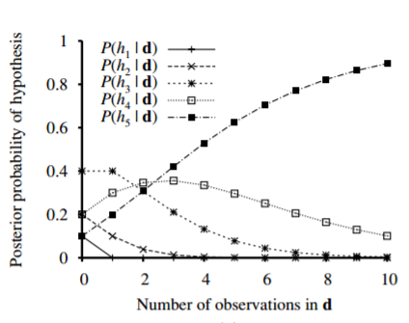
Bayesian view of learning

Slide 19
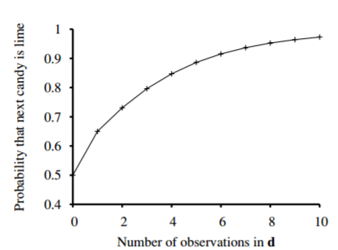
Bayesian prediction
Notes:
P(X|d) = sum(PX,h|d)

Slide 20
Bayesian view of learning
Bayesian prediction eventually agrees with the true hypothesis!
For any fixed prior that does not rule out the true hypothesis, the posterior probability of any false hypothesis will eventually vanish
This comes at a price however – for real problems, the hypothesis space is usually very large or infinite

Slide 21
Maximum a posteriori (MAP)
Make predictions based on a single most probable hypothesis
P(X|d) ≈ P(X|h_{MAP})
h_{Map} = h₅ after 3 candies in a row, so prob that fourth candy will be 1 (Bayesian prediction was 0.8 – less dangerous)
As more data arrive, MAP and Bayesian prediction becomes closer
Finding MAP is much easier than Bayesian learning

Slide 22
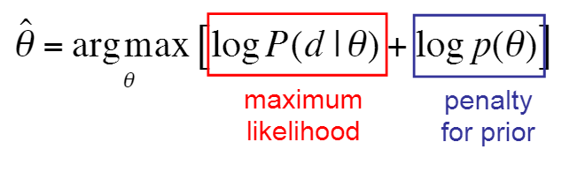
Overfitting
Many hypothesis can fit the data, Bayesian and MAP learning use the prior to penalize complexity
Notes:
More complex hypothesis can fit data better, but have lower prior

Slide 23
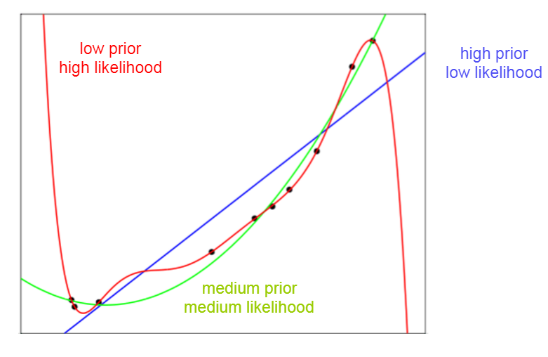
Complexity tradeoff
Notes:
Remember the analogy between prior/likelihood with bias/variance tradeoff

Slide 24
Maximum likelihood estimation
Simplifying MAP further – assume a uniform prior over the space of hypothesis
MAP is reduced to choosing an h_{i} that maximizes P(d|h_{i})
This is called MLE – more frequentist approach

Slide 25
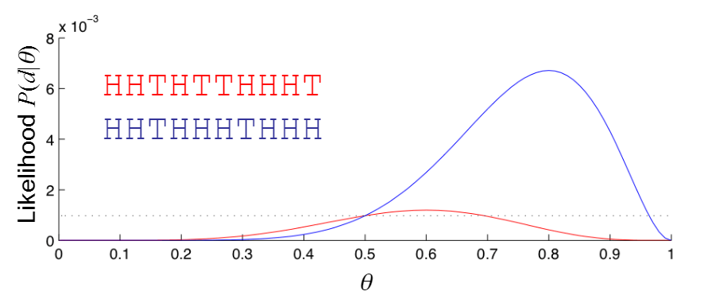
Maximum likelihood estimation
Notes:
Simply based on data, we infer the value of theta
Think about equivalence between MLE and MAP. When will they differ?

Slide 26
Adding prior information
Where do priors come from?

Slide 27
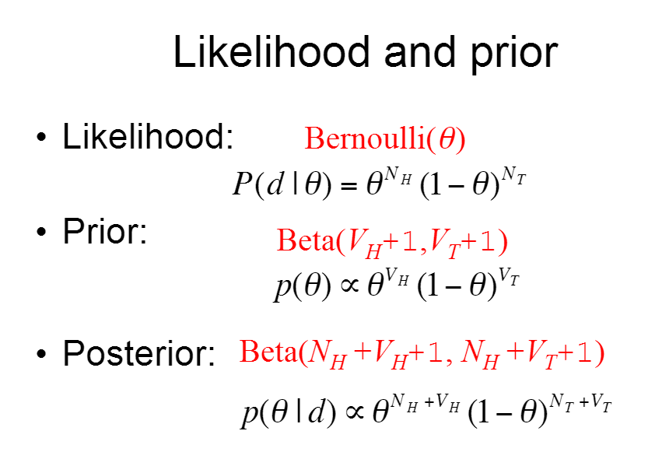
Conjugate priors
Notes:
Explain Bernoulli, binomial, and expectation

Slide 28
Summary
Probability theory provides the tools we need to reason about uncertainty
In this class we will be assuming the subjectivist definition of probability
Bayes’ rule provides the machinery for updating a set of beliefs given some new evidence
Bayesian inference underlies many of the statistical approaches to induction

