Slide 2

Notes:
Struggle is good.
Basics are very very very very very important.

Slide 3
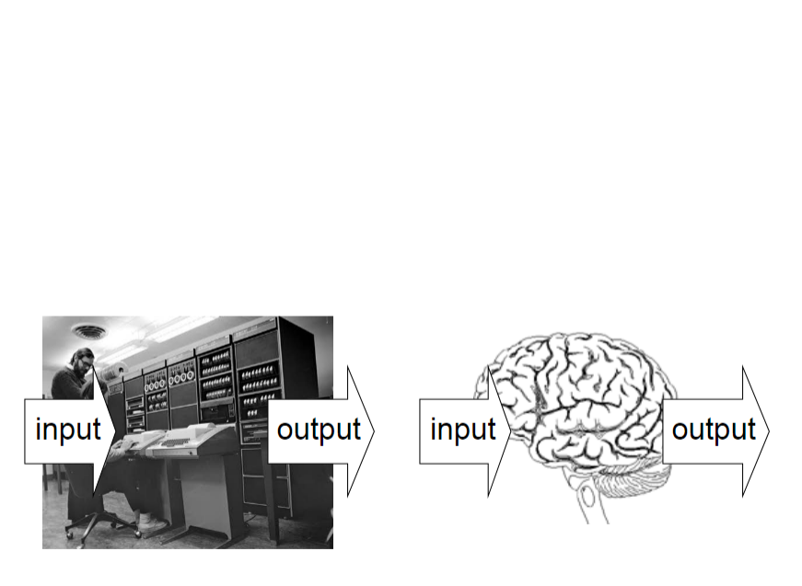

Slide 4
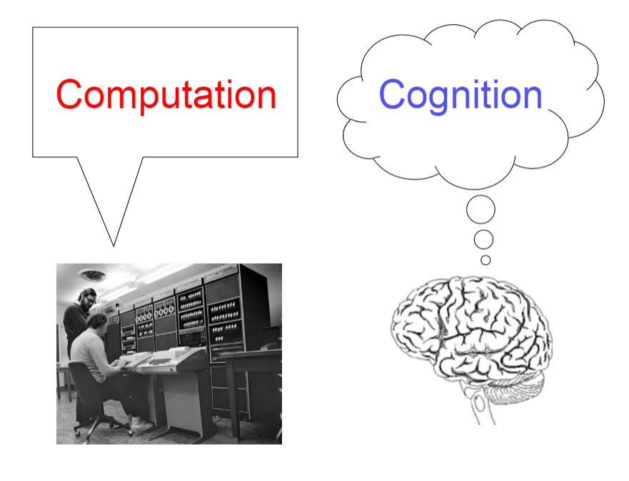

Slide 5
Two goals
Cognition:
Explain human cognition (and behavior) in terms of the underlying computation
Computation:
Gain insight as to how to solve some challenging computational problems

Slide 6
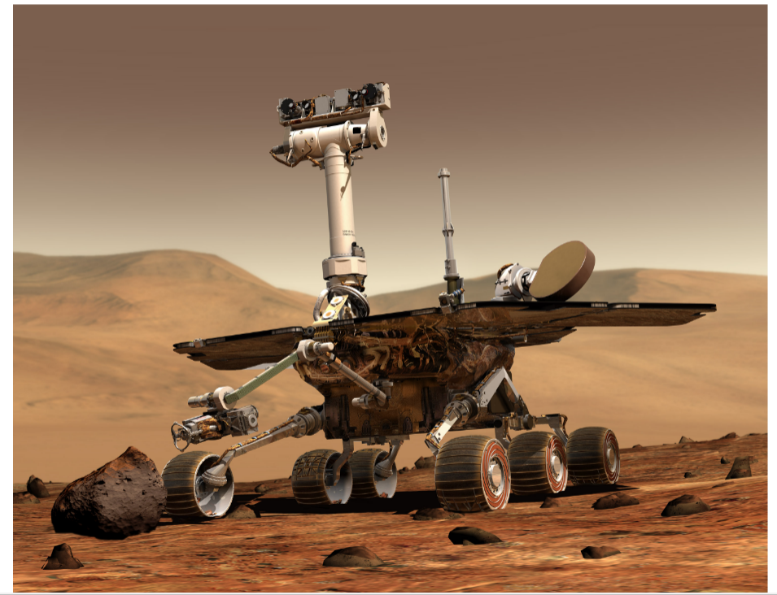

Slide 7

Notes:
Ask students question about how they would go about trying to understand an alien object. Then emphasize an understanding cannot be complete without understanding function (why) something works the way it does.

Slide 8
Marr’s 3 Levels of Analysis

Slide 9

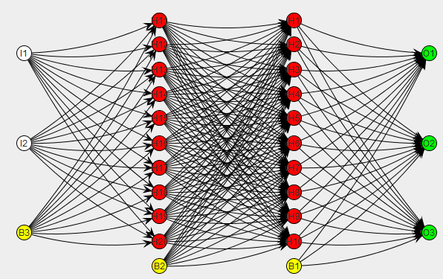
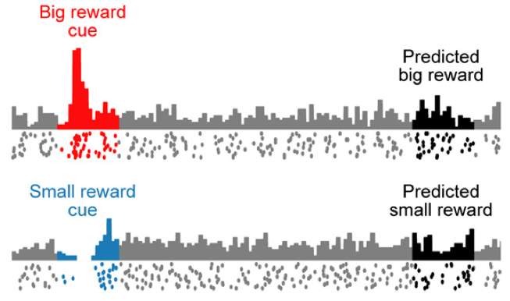
Three Levels of Description
Computational (WHY) Why do things work the way they do? What does the system compute/what is the optimal solution to this problem?
maximize:
Algorithmic (HOW) What representations can implement such computations? How does the choice of representations determine the algorithm?
Implementational (HOW) How can such a system be built in hardware? How can neurons carry out the computations?
Modified from slide by C. Rothkopf: http://fias.uni-frankfurt.de/~rothkopf/docs/david_marr_3_levels.jpg
Notes:
*How* does the system solve the problem? How does it represent its inputs, outputs, and intermediate results? Which process does it use to transform inputs into outputs?

Slide 10
Marr’s three levels
Computation
Computational Cognitive Science
Representation and algorithm
Cognitive psychology
Implementation
Neuroscience
Notes:
Curiosity, memory example. Make sure that students understand that this is almost challenging classical psychology here.

Slide 11
Understanding a cash register
Computational Level
Algorithmic Level
Implementation Level

Slide 12
Computation level
What is being computed?
Addition
Why is it being computed?
Addition is the formal system that satisfies functional constraints such as a) buying nothing costs nothing, b) order of purchase is irrelevant etc.

Slide 13
Algorithmic level
What representation?
Roman numeral, Arabic system
Different representations make certain operations easier or more difficult
What algorithm?
Abacus vs algorists

Slide 14
Implementation level
What is the physical implementation of the system?

Slide 15
Check Your Understanding
Which level(s) of analysis do the following questions address?
Can we build a logical AND gate using Legos?
How do people identify and retrieve information from long-term memory?
What is the optimal strategy for playing Rock-Paper-Scissors?
What techniques do firefighters use to predict where a fire will spread?
Notes:
Answers:
Implementational
Algorithmic/Implementational (ambiguous)
Computational
Algorithmic

Slide 16
A Loose Hierarchy
Marr’s levels of analysis are coupled, but only loosely: often an explanation at one level involves issues that are mostly independent of the other two!
Examples:
Does knowing why a cash register exists tell us anything about the how it performs its computations?
Will knowing the state of every neuron in the brain automatically tell us what the brain is computing?
Notes:
Do emphasize complete understanding comes from full levels

Slide 17
How Universal Are Marr’s Levels?
Question: Does every information processing task have an explanation at each of Marr’s 3 levels?
Answer: Not necessarily! Some phenomena may have explanations at only one or two levels of analysis.
Examples:
Afterimages
Auditory masking

Slide 18
An Approach to Computational Analysis
Map inputs to outputs
What regularities do you see?
Can they be characterized using mathematics?
Use knowledge of these regularities to develop a theory of the problem(s) the system is solving
Potential Pitfall: Phenomena that lack a function won't have a meaningful computational level description!
Work out an optimal solution to the problem you’ve identified
Perform experiments to see how well the system’s behavior corresponds to your solution

