Slide 1
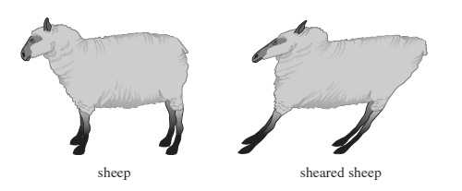
Computational Models of Cognition
Week 7: Linear Algebra
UC Berkeley, Spring 2015
3/11/15

Slide 2
Outline
Logistics
Problem Set 1 grades are out
Problem Set 3 due next Friday
Review
Linear algebra
Semantic networks

Slide 3
Questions/Concerns?

Slide 4
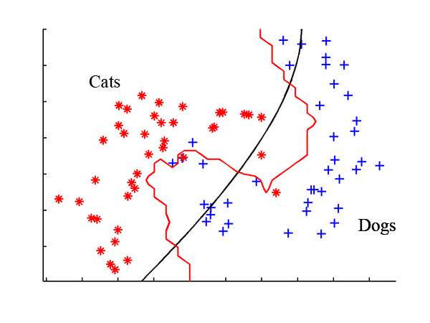
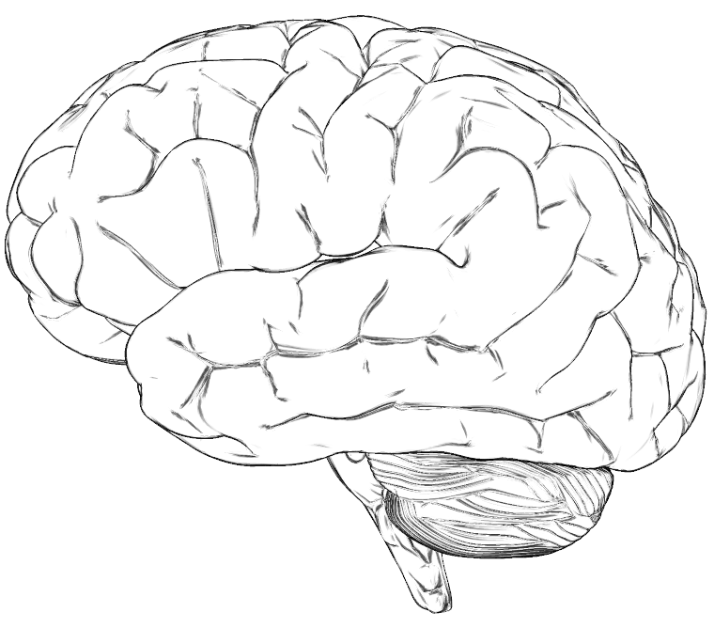
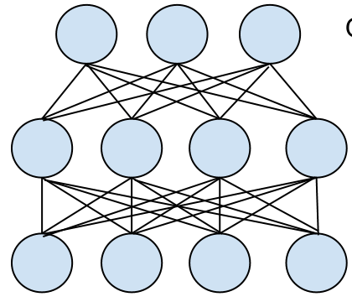
The Big Picture
Linear algebra is a tool for characterizing the behavior of systems where many values must be represented simultaneously

Slide 5
Linear Functions
A function y = f(x) is said to be linear IFF for any inputs x1 and x2 and any real number c the following equations hold:
In English:
If we multiply the input of a linear function by some constant, the output is multiplied by the same constant.
To predict the output of a linear system when the sum x1 + x2 is presented, all we need to know is the individual outputs of the system for x1 and x2.

Slide 6
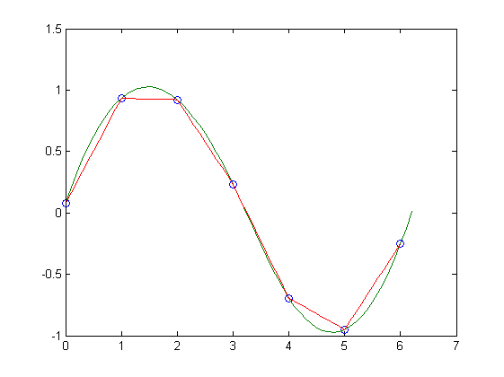
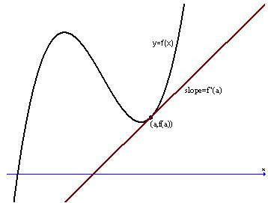
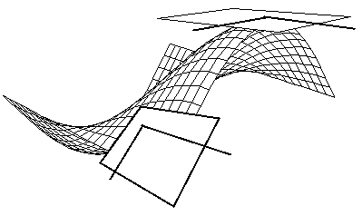
Why Linear?
Linear functions provide good local approximations to more complex functions.
Linear functions have mathematical properties that make them nice to work with (more on this later)

Slide 7
Standard Notation
Matrices and vectors are represented using bold letters (e.g., x, A, I, etc).
It is standard to represent vectors with lowercase letters and matrices with uppercase letters.
The dimensions of a matrix or vector are always listed as [number of rows] x [number of columns].
The transpose operation flips the rows and columns of a vector or matrix. It is is denoted with a superscript T.

Slide 8
Examples
n x 1
m x n
j x 1

Slide 9
Arithmetic
Addition:
Multiplication:
> a = np.array([1,2,3,4,5])
> b = np.array([5,4,3,2,1])
> a + b
array([6, 6, 6, 6, 6])
n x 1
n x 1
n x 1
> a = np.array([1,2,3,4,5])
> b = np.array([5,4,3,2,1])
> np.dot(a, b)
35
n x 1
n x 1
1 x n
n x 1

Slide 10
Addition:
Two vectors or matrices must have the same dimensions to be added; otherwise the operation is undefined.
Multiplication:
The multiplication operation (technically the dot product) requires that the inner dimensions of the two matrices/vectors match.
2 x n
n x 1
2 x 1
n x 2
n x 1

Slide 11
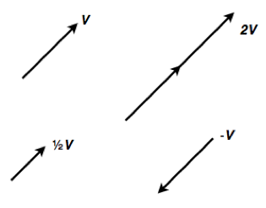
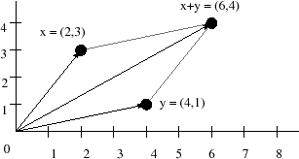
Geometric Interpretation
Scalar Multiplication
Vector Addition

Slide 12
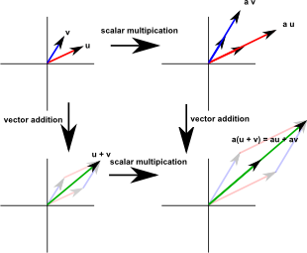
Spans and Basis Sets
Intuition:
Given a collection of vectors in R^{n}, the span of the set is the collection of all points which can be reached using only linear combinations of the vectors.
The basis set is the smallest collection of vectors in the vector space that are sufficient to produce all other points in the spanning set.

Slide 13
Examples
?

Slide 14
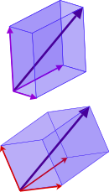
Change of Basis
For any spanning set, there exist an infinite number of basis sets.
While formally equivalent, some basis sets are more useful for particular problems.
A common technique in linear algebra is the change of basis operation, which translates the representation of a set of points in one basis to a representation in another basis.
Basis 1
Basis 2

Slide 15
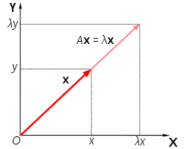
Eigenvalues and Eigenvectors
For a square matrix A, is an eigenvalue and x is an eigenvector IFF
In English:
An eigenvector is a vector x which, when multiplied by A, is mapped to a scalar multiple of itself.
The particular scalar value is the vector’s eigenvalue.

Slide 16
Eigen Decomposition
We can represent any square matrix A as a matrix product:
Where is an n x n diagonal matrix whose elements are the eigenvalues of A, and U is an n x n matrix whose columns are the eigenvectors of A.
The process of decomposing A into this product is sometimes called diagonalization.

Slide 17
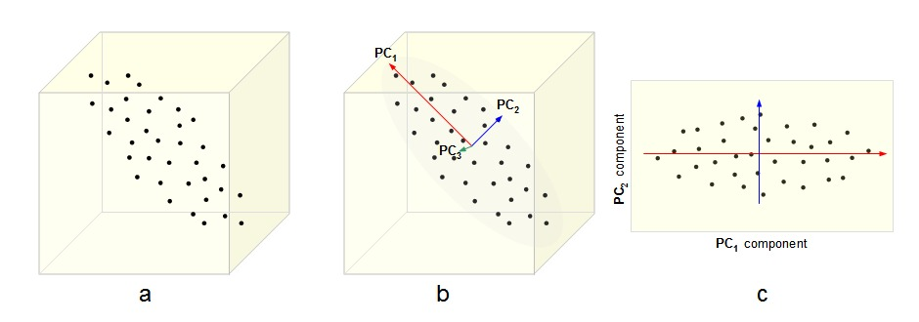
Eigen Decomposition and Change of Basis
Often, it is helpful to represent a collection of points in terms of their eigenvectors. This corresponds to a change of basis operation
These are the columns of the matrix U
This idea underlies dimensionality reduction techniques like PCA and SVD (stay tuned!)

Slide 18
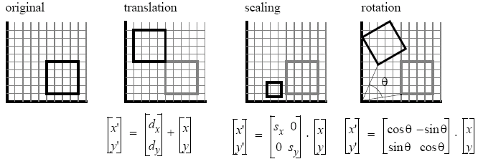
Linear Functions as Matrices
A matrix can be used to map a vector x into a new vector y via the relation y = Mx. The transformation is linear.
Big Idea: Any linear function can be expressed as a matrix.

Slide 19
Questions?

Slide 20
Semantic Networks
Inheritance hierarchies
Associative networks
“Real-world” semantic networks

Slide 21
Inheritance Hierarchies
Every node inherits properties on the path from the root
Notes:
Class system in object oriented programming languages
P and Q. P = x is a bird. Q – x has wings

Slide 22
Associative Networks
Notes:
Links represent associations between words or concepts

Slide 23
Spreading Activation
a_{i}
w_{ij}
a_{j}
Nodes become active as the result of activation of nodes they are connected to. Can use linear algebra to represent this!
The state of the system is summarized by a vector a, and evolves over time as characterized by matrix of weights W
Notes:
Links represent associations between words or concepts

Slide 24
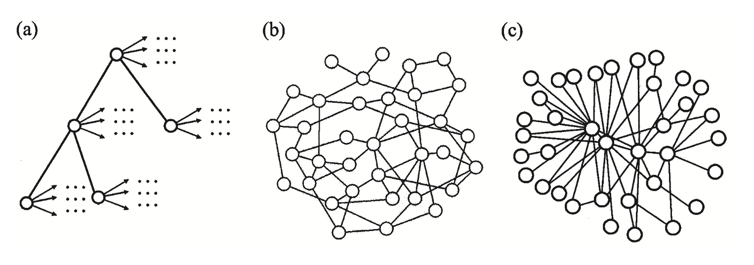
Real World Networks: What Structure?
Nelson et al. free association norms
WordNet
Roget’s Thesaurus
Notes:
“Real” semantic networks could have many different structures. They could represent a strict inheritance hierarchy like we talked about (a), they could have arbitrary structure (b), or they could be best characterized as a scale-free, small-world graph

Slide 25
Properties of Semantic Networks
“Small world”
Short paths between words/ concepts
“Scale free”
Power-law degree distribution
Most nodes have few links, some have lots and lots of links
“Small neighborhoods”
neighbors of a node are likely to be linked
The Internet exhibits these same properties!

Slide 26
Next Week
I will be available to answer questions about Problem Set 2

