Slide 1
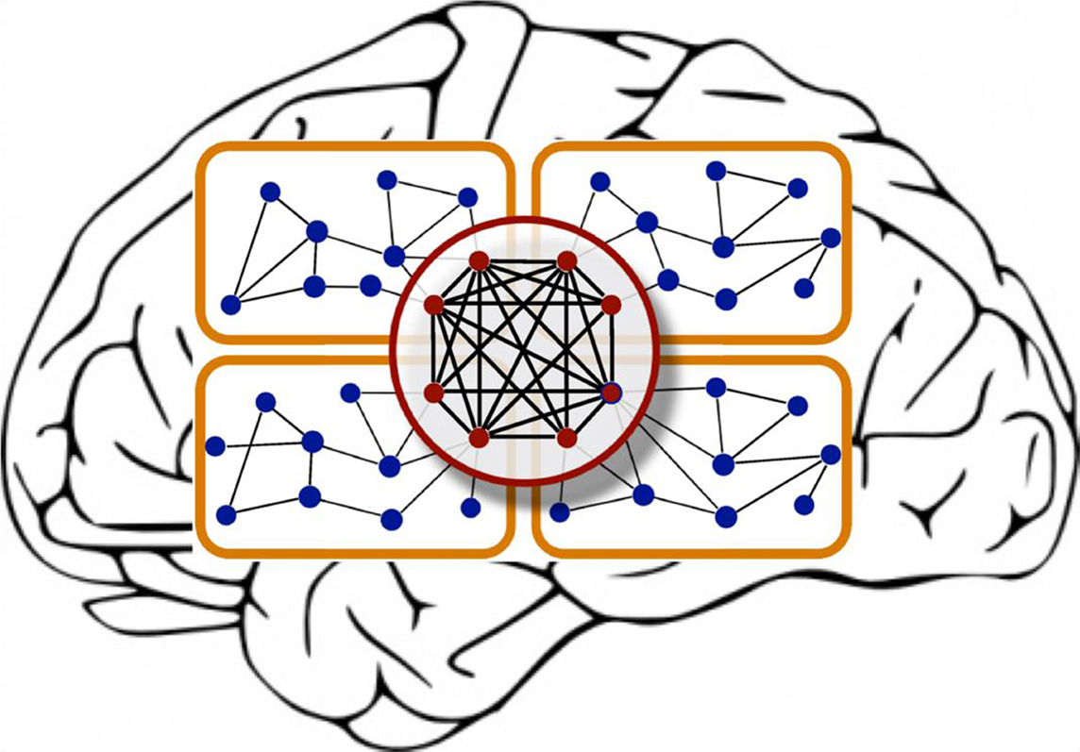
Computational Models of Cognition
Week 9: Neural Networks

Slide 2
Spaces, Features, and Neural Nets
Neural nets compute distributed representations of inputs, providing an alternative to discrete symbolic approaches
y₂
y₁
y₂
Output space
y₁
W
x₂
x₁
x₂
x₁
Input space
Notes:
First, talk about x, y, and w. and figuring out w is the main solution

Slide 3
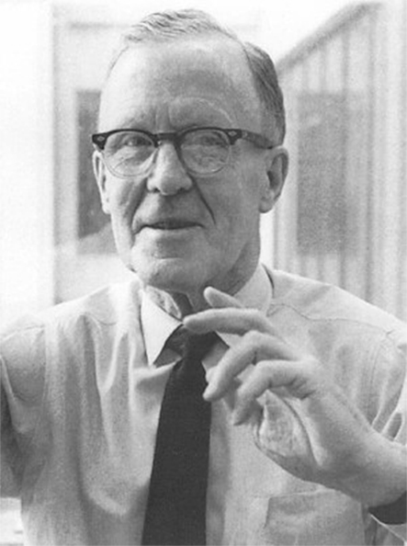
Hebbian Learning
“Neurons that Fire Together, Wire Together”
where w_{ij} is the weight from node i to node j
a_{i} is the activation of node i
Donald Hebb

Slide 4
Hebbian Learning
Hebb’s Rule in English:
We should adjust the weight between two neurons in proportion to the amount that their activations are correlated.
Captures the notion of associative learning
w ← w + y^{k}x^{k}

Slide 5
Limitations to Hebbian Learning
Hebbian learning is unsupervised:
Only learns about correlations between inputs and outputs
What if instead we want to model a situation in which a learner produces a specific output in response to an input?

Slide 6
Error-Driven Learning
Big idea: We can “train” a network to learn specific mappings between inputs and outputs by adjusting its weights in proportion to their contribution to the error on the current trial
Two Approaches:
Delta Rule (no hidden layers)
Backpropagation (hidden layers!)

Slide 7
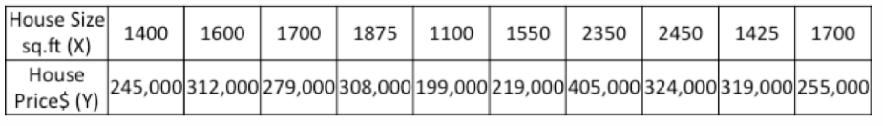
Digging deeper into gradient descent
For a new house, given the size (X), what will it’s price (Y) be?
Notes:
First make sure everyone understands gradient descent, concept of errors, and how to minimize errors.

Slide 8
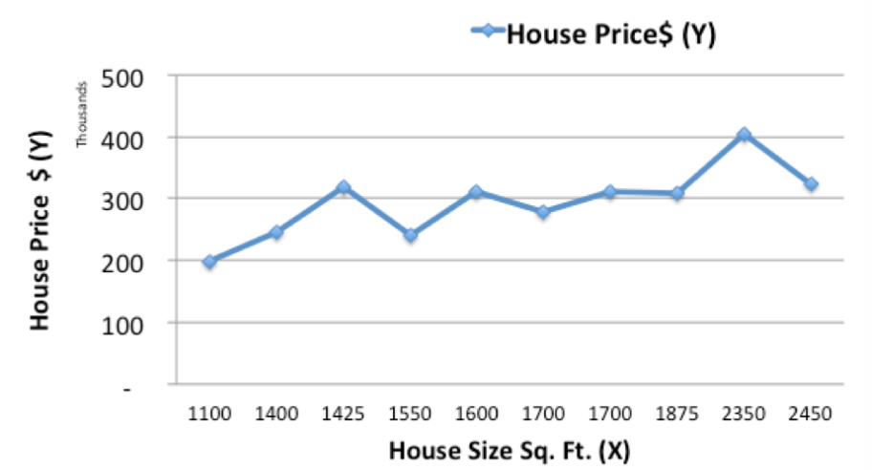

Slide 9
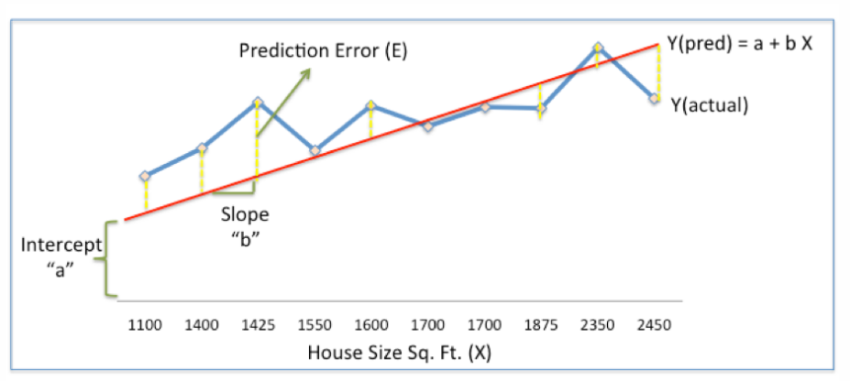
Our objective is to find optimal a, b that minimizes the error between actual and predicted values.

Slide 10
Error term
Sum of Squared Errors (SSE) = ½ Sum (Actual House Price – Predicted House Price)²
½ Sum(Y – Ypred)²

Slide 11
Gradient descent to the rescue
Step 1: Initialize the weights(a & b) with random values and calculate Error (SSE)
Step 2: Calculate the gradient i.e. change in SSE when the weights (a & b) are changed by a very small value from their original randomly initialized value. This helps us move the values of a & b in the direction in which SSE is minimized.
Step 3: Adjust the weights with the gradients to reach the optimal values where SSE is minimized
Step 4: Use the new weights for prediction and to calculate the new SSE
Step 5: Repeat steps 2 and 3 till further adjustments to weights doesn’t significantly reduce the Error

Slide 12
Gradient descent
E (error)
(η is learning rate)
w_{ij}
Simple algorithm for finding a minimum:
Move in a direction where E decreases
Stop if no such direction exists
Notes:
Every time we want to update our weights, we subtract the derivative of the cost function w.r.t. the weight itself, scaled by a learning rate , and — that’s it! You’ll see that as it gets closer and closer to the center, the derivative term gets smaller and smaller, converging to zero as it approaches the solution.

Slide 13
Back to neural networks
Preliminaries (Error-Driven learning)
Training set
Input vector -> operations -> output vector
The key is finding the right set of weights
Cost function / Error function
Notes:
It’s often convenient to have some metric of how good or bad we’re doing

Slide 14
Error-Driven Learning: Delta Rule
Output
y
x₁
x₂
Input Features
output
error
influence
of input
Notes:
Talk about error and activation functions here.

Slide 15
Delta Rule & Linear Separability
The Delta Rule corresponds to finding a linear decision boundary between different classes in the input space.
?
AND
OR
XOR
x₂
x₂
x₂
x₁
x₁
x₁

Slide 16
Introducing Hidden Layers
y
Output
Output
y
z₁
z₂
Hidden Features
x₁
x₂
x₁
x₂
Input Features
Input Features
Learning Rule:
Delta Rule
Learning Rule:
Backprop

Slide 17
Nonlinear Separability Using Hidden Layers
Output Features
y
y
z₂
Hidden Features
z₁
z₂
z₁
x₂
Input Features
x₁
x₂
x₁

Slide 18
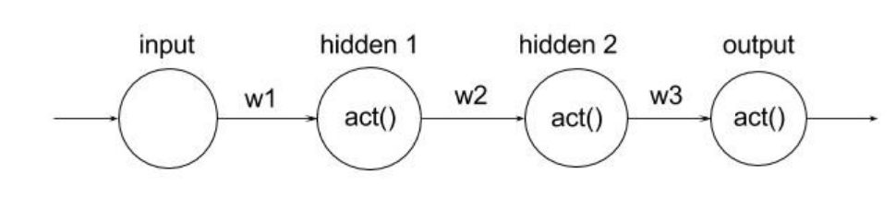
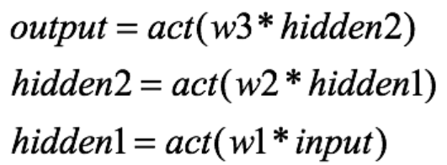
Backpropagation algorithm
Each neuron is a function of the previous one connected to it
Notes:
Consider a single layered shallow network which serves as a good toy example.
If one were to change the value of w1, both “hidden 1” and“hidden 2” (and ultimately the output) neurons would change

Slide 19
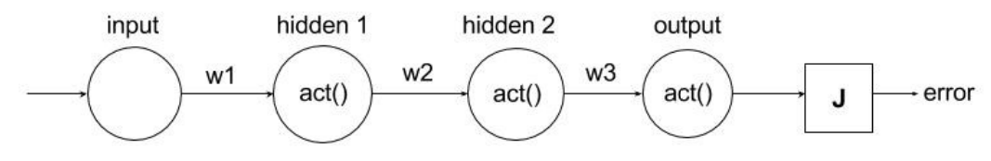
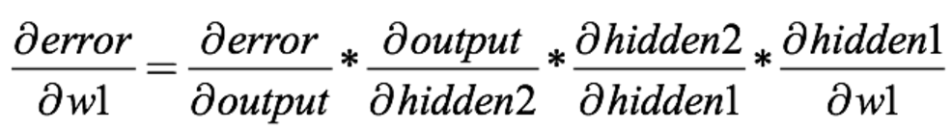
Backpropagation algorithm
Notes:
Now if we attach an error term to this network like before, and want to find the best weights w1 to miminize error, we simply do derivation as before and apply chain rule.
J is the cost function here that’s it.

Slide 20
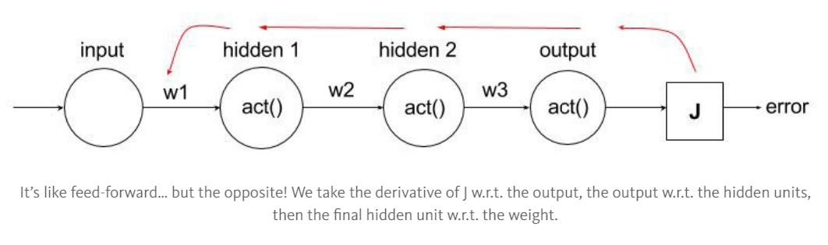
Backpropagation algorithm
Notes:
We call it “backpropagation” because it almost seems as if we are traversing from the output error to the weights, taking iterative steps using chain the rule until we “reach” our weight.
Since neural networks are convoluted multilayer machine learning model structures (at least relative to other ones), each weight “contributes” to the overall error in a more complex manner, and hence the actual derivatives require a lot of effort to produce. However, once we get past the calculus, backpropagation of neural nets is equivalent to typical gradient descent for logistic/linear regression.

Slide 21
Learning In Multi-Layer Networks
For a two-layer net, we can describe the error associated with an input unit i as:
where
…and apply the chain rule to calculate the gradient with respect to w_{ij}

Slide 22
Error Driven Learning: Backpropagation
Corresponds to doing the Delta Rule with an error term:
Viewed this way, the backprop learning algorithm is simply

Slide 23
Advantages to Backpropagation
With backprop, we can now perform supervised learning in cases where the decision boundaries between classes are non-linear.
A candidate for a domain-general learning mechanism?

Slide 24
Capturing Long-Range Dependencies with RNNs
Predict x_{n+1} from x₁ … x_{n}
Notes:
A glaring limitation of Vanilla Neural is that their API is too constrained: they accept a fixed-sized vector as input (e.g. an image) and produce a fixed-sized vector as output (e.g. probabilities of different classes). Not only that: These models perform this mapping using a fixed amount of computational steps (e.g. the number of layers in the model). The core reason that recurrent nets are more exciting is that they allow us to operate over sequences of vectors

Slide 25
Sequence Learning in Neural Networks
Output Features
x₁
x₂
Corresponds to a Markov chain where we are predicting the next state given the current state.
Hidden Features
z₁
z₂
What if we want to model sequences with longer-term dependencies?
Input Features
x₁
x₂
Notes:
A glaring limitation of Vanilla Neural is that their API is too constrained: they accept a fixed-sized vector as input (e.g. an image) and produce a fixed-sized vector as output (e.g. probabilities of different classes). Not only that: These models perform this mapping using a fixed amount of computational steps (e.g. the number of layers in the model). The core reason that recurrent nets are more exciting is that they allow us to operate over sequences of vectors

Slide 26
Sequence learning
A glaring limitation of Vanilla Neural is that their API is too constrained: they accept a fixed-sized vector as input (e.g. an image) and produce a fixed-sized vector as output (e.g. probabilities of different classes). Not only that: These models perform this mapping using a fixed amount of computational steps (e.g. the number of layers in the model). The core reason that recurrent nets are more exciting is that they allow us to operate over sequences of vectors

Slide 27
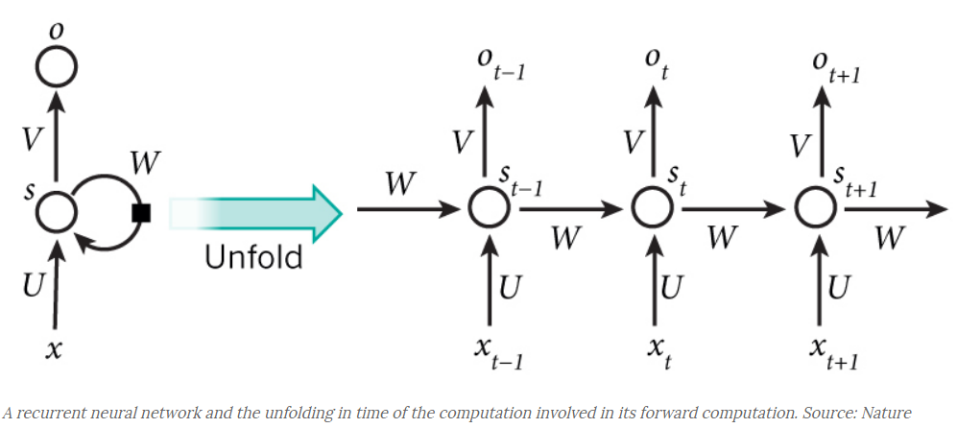
Recurrent Neural Networks
Notes:
RNNs have loops.
PCA if time

Slide 28
Recurrent Neural Networks
Output Features
x₁
x₂
copy
Hidden Features
z₁
z₂
context units
input
Input Features
x₁
x₂
(Elman, 1990)

Slide 29
PCA
PCA demo: http://setosa.io/ev/principal-component-analysis/

